Slide 1
DSP w1 noise

Slide 2
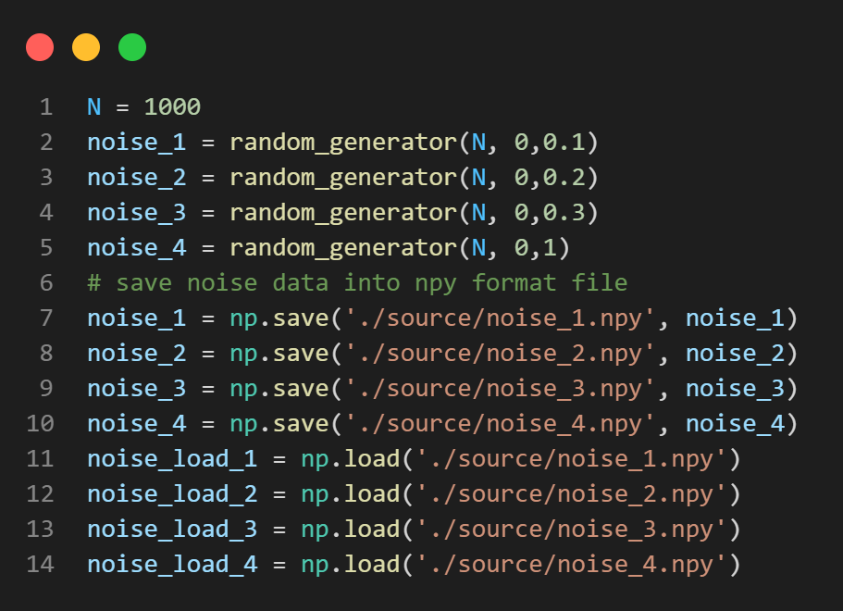
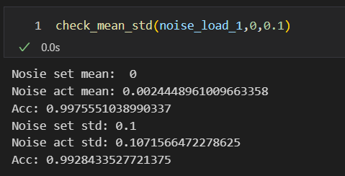
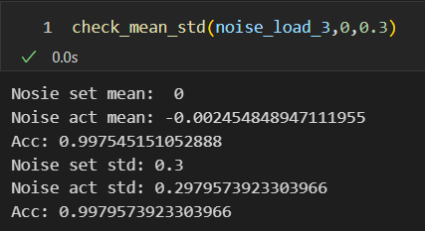
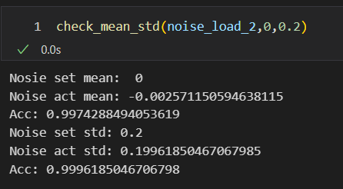
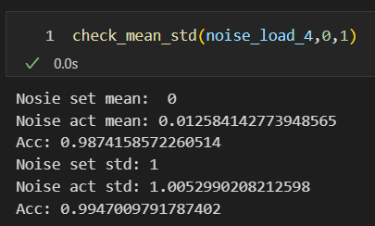
Check noise actual values

Slide 3

SNR

Slide 4


Signal A

Slide 5



Slide 6

MAE in signal A

Slide 7


Signal B

Slide 8



Slide 9



Slide 10



Slide 11



Slide 12



