Slide 1
DSP w1 noise

Slide 2
Display orignal signal

Slide 3
Total MAE
Sampling rate | 480 | 240 | 120 | 60 | 30 | 15
Signal
A | 1.23e-05 | 5.79e-05 | 2.4e-04 | 9.4e-04 | 0.00413 | 0.01833
B | 0.00327 | 0.01626 | 0.06290 | 0.20351 | 0.29909 | 0.35274
C | 4.30e-05 | 2.09e-04 | 8.70e-04 | 0.00337 | 0.01543 | 0.03342
D | 0 | 0 | 0.00147 | 0.00658 | 0.02024 | 0.04697

Slide 4
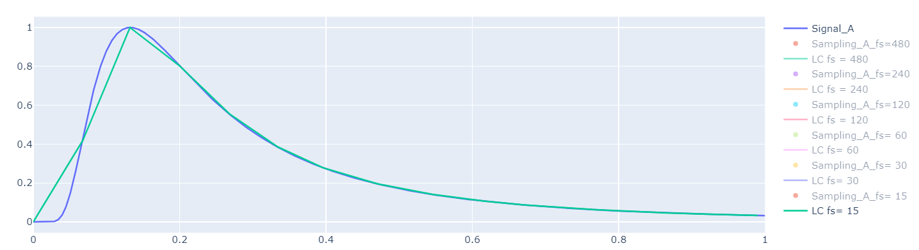
Interval MAE for signal A

Slide 5
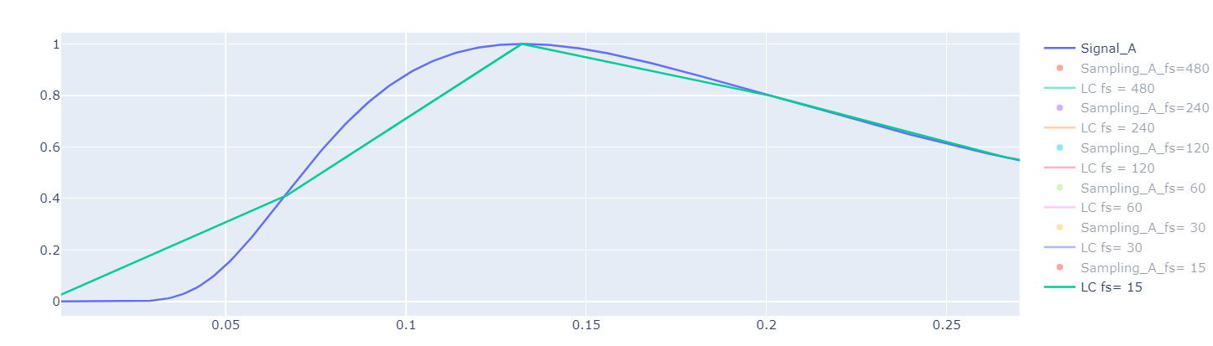

Slide 6
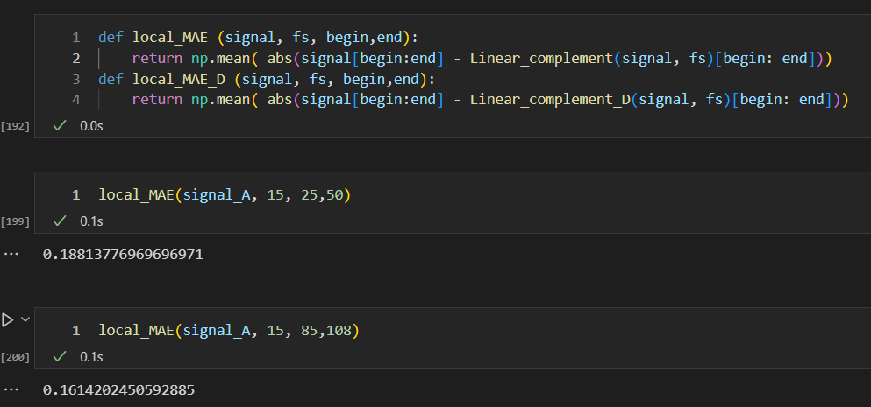

Slide 7
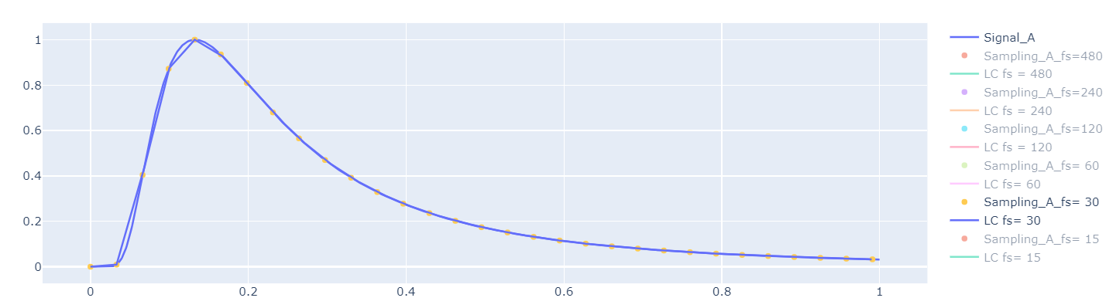
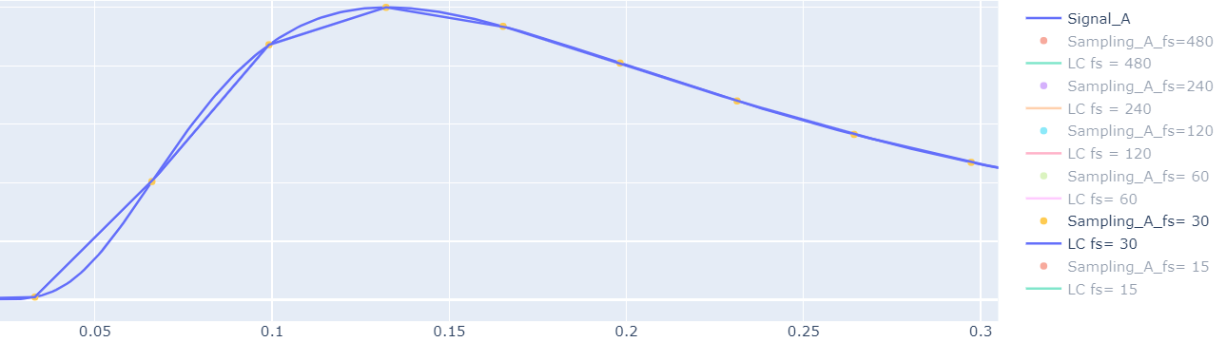

Slide 8
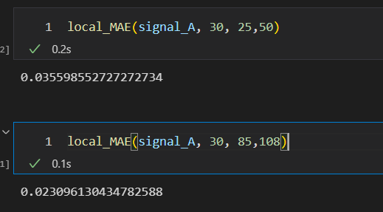

Slide 9
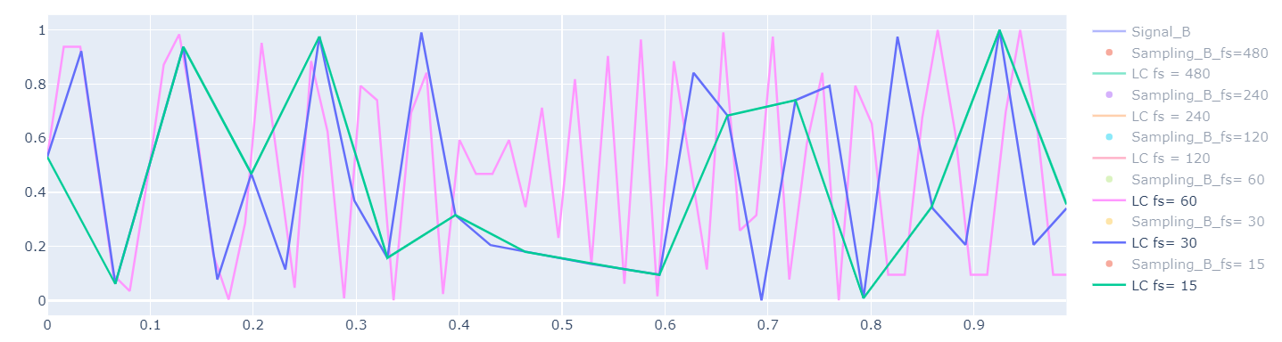
Interval MAE for signal B

Slide 10
Sampling rate | 480 | 240 | 120 | 60 | 30 | 15
Signal
A | 1.23e-05 | 5.79e-05 | 2.4e-04 | 9.4e-04 | 0.00413 | 0.01833
B | 0.00327 | 0.01626 | 0.06290 | 0.20351 | 0.29909 | 0.35274
C | 4.30e-05 | 2.09e-04 | 8.70e-04 | 0.00337 | 0.01543 | 0.03342
D | 0 | 0 | 0.00147 | 0.00658 | 0.02024 | 0.04697

Slide 11
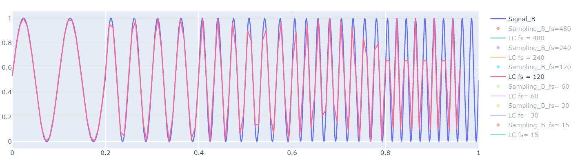
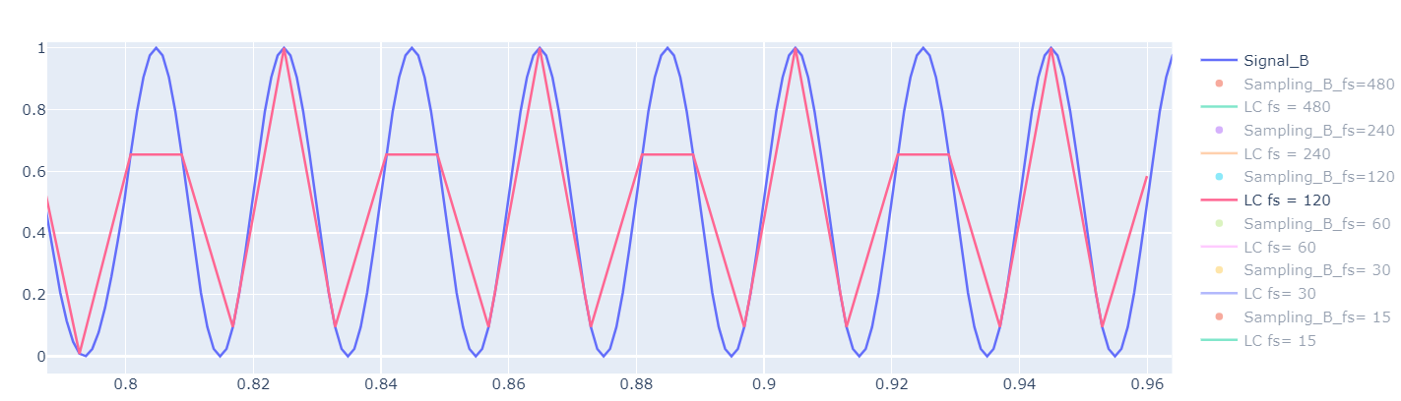

Slide 12
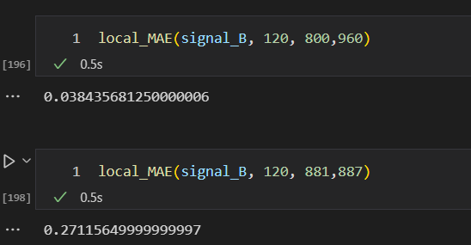

Slide 13
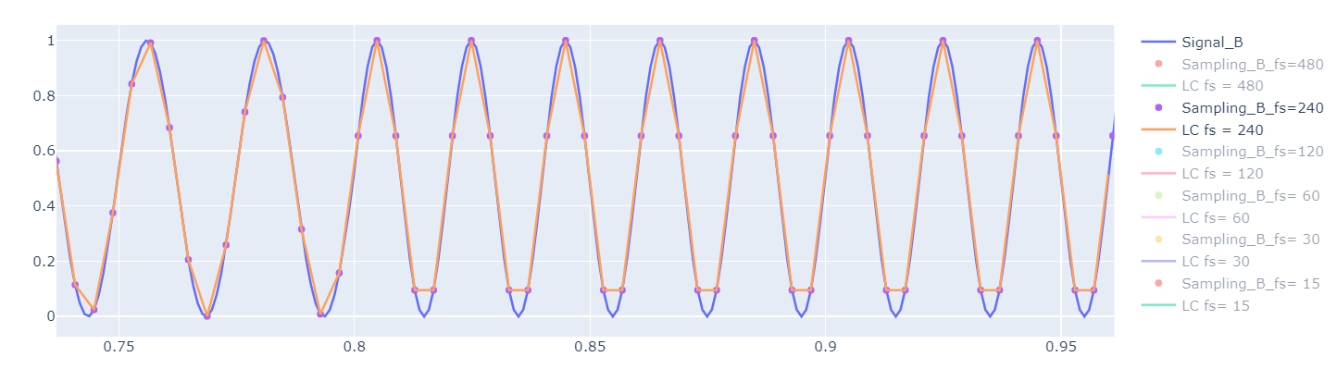
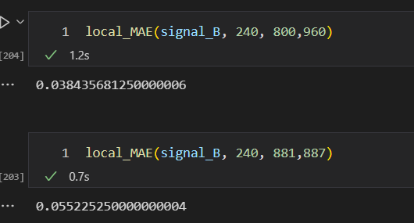
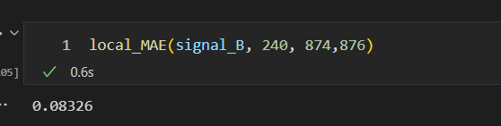

Slide 14
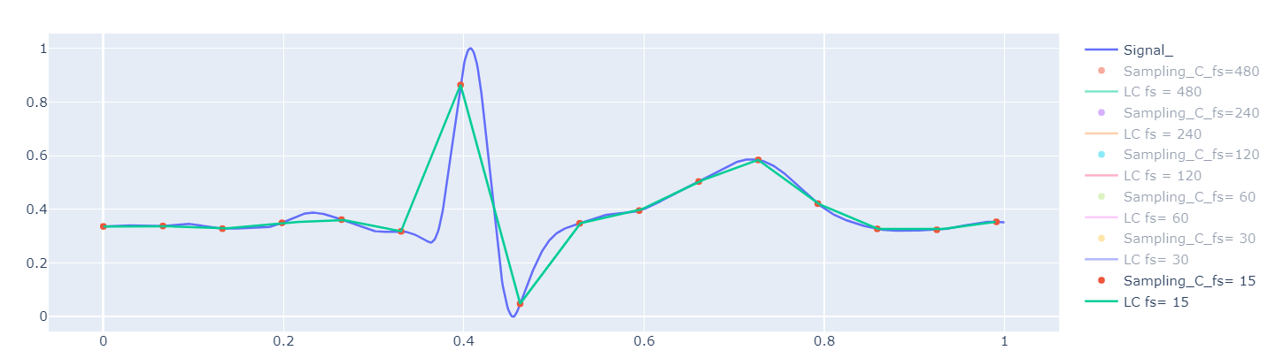
Interval MAE for signal C

Slide 15
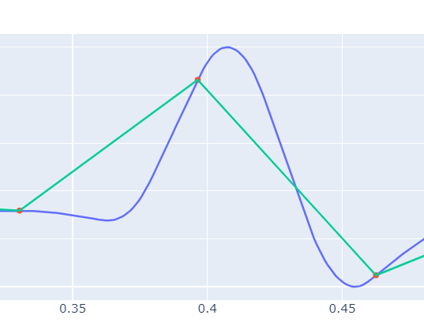
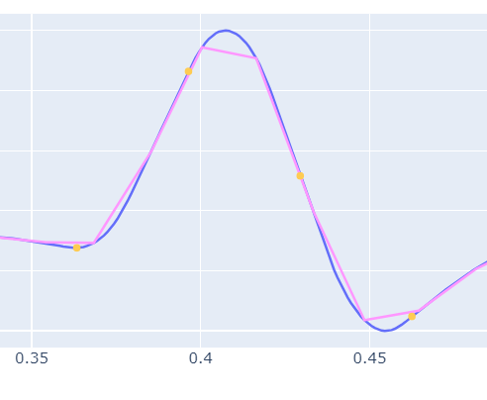
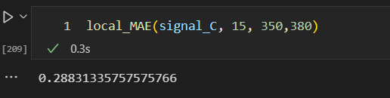
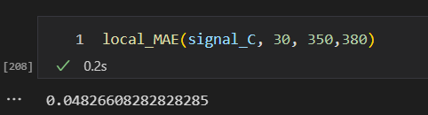
Interval MAE for signal C

Slide 16
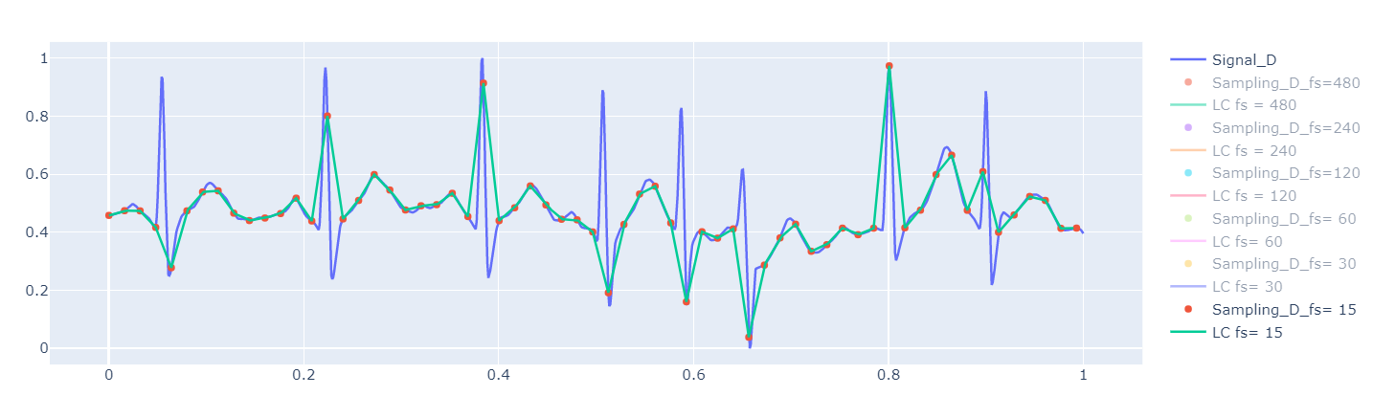
Interval MAE for signal D

Slide 17
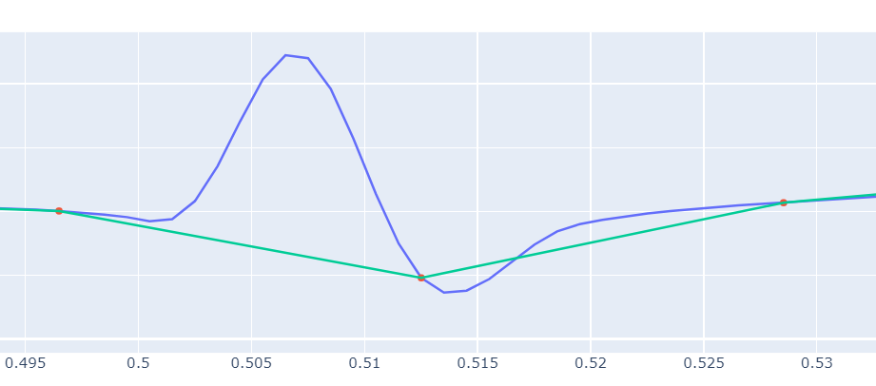
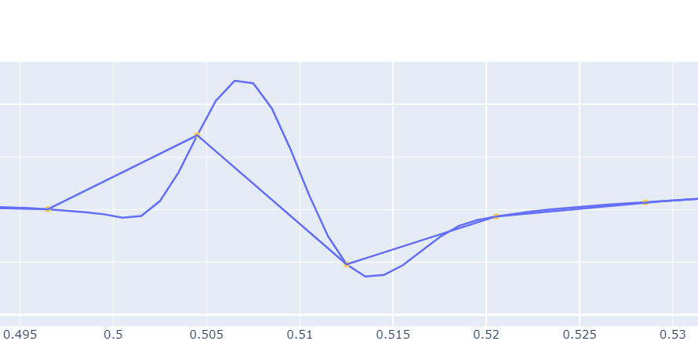
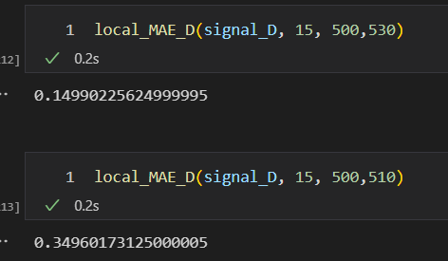
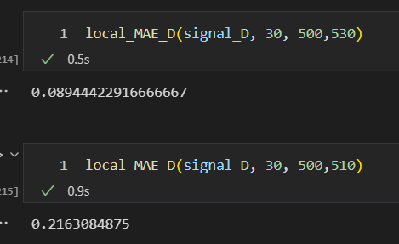

Slide 18
