Slide 1
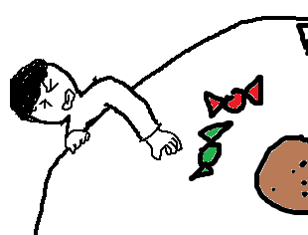
The Final Report of Machine Learning & Practice
presenter:
U0552020 何文傑
F107112107 黃柏儒
Date:
12.2018

Slide 2
Contents
Requirements
Analysis
Design
Coding & Refine
Verification
Work distribution chart

Slide 3
Requirements

Slide 4
Requirements
Program execution
Identification targets
Program execution
Recognition rates
Constraint systems
Others

Slide 5
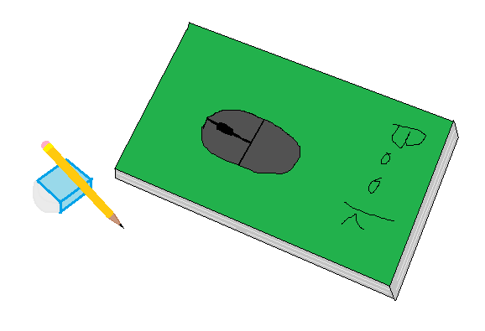
Identification targets
Eraser
Pen
Mouse
Book

Slide 6
Program execution
input
output
Programming language
Python
on Screen
discern rectangle
Object class
Confidence belonging class

Slide 7
Recognition rates
Inside testing：
Outside testing：
The recognition rates of the training samples : 100%
The recognition rates of the Non-training samples : 85%

Slide 8
Constraint systems
The targets area should be seen unless over 50%.
If the targets area are too small, ignore them.

Slide 9
Others
overlap
Bonus :
The input image should include these four targets, and each of two should be overlapped.
Covered by unknow object.
Program execution speed
Dataset quantity
Targets type

Slide 10
Analysis

Slide 11
主系統
主系統
Annotation
(標註)
class
Segmentation
Segment feature extraction
紋路
x, y, Δx, Δy
訓練
辨識
Segmentation
Superpixel
Segment feature extraction
LBP
紋路
MLP training
Superpixel
LBP
MLP prediction
Class
Part
Bounding Box

Slide 12
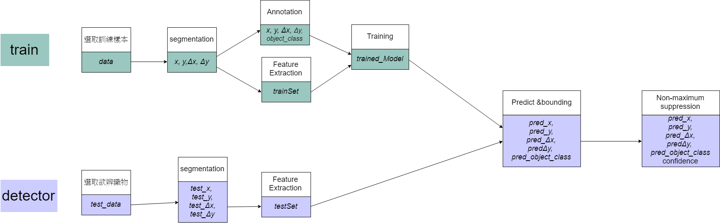

Slide 13
Design
- training

Slide 14
Superpixel
Input
data
Output
X
Y
Δx
Δy
Method
SLIC
Parameter
N-segment
Compactness ratio

Slide 15
Annotation
Input
data
Output
X
Y
Δx
Δy
object_class
Method
grid_step = 1
Parameter
grid size

Slide 16
Feature Extraction
Input
X、Y、Δx、Δy
Output
trainSet
Method
LBP

Slide 17
Training
Input
trainSet
X、Y、Δx、Δy 、object_class
Output
trained_Model
Method
MLP
Parameter
MLP : hidden node

Slide 18
Design
- detector

Slide 19
Superpixel
Input
test_data
Output
test_X
test_Y
test_Δx
test_Δy
Method
SLIC
Parameter
N-segment
Compactness ratio

Slide 20
Feature Extraction
Input
test_X、test_Y、test_Δx、test_Δy
Output
testSet
Method
LBP

Slide 21
Predict&bounding
Input
trained_Model
testSet
X、Y、Δx、Δy
Output
pred_x
pred_y
pred_Δx
pred_Δy
pred_ object_class
Method
找出較高IoU的Anchor box內的 x , y , Δx , Δy 形成 bounding box

Slide 22
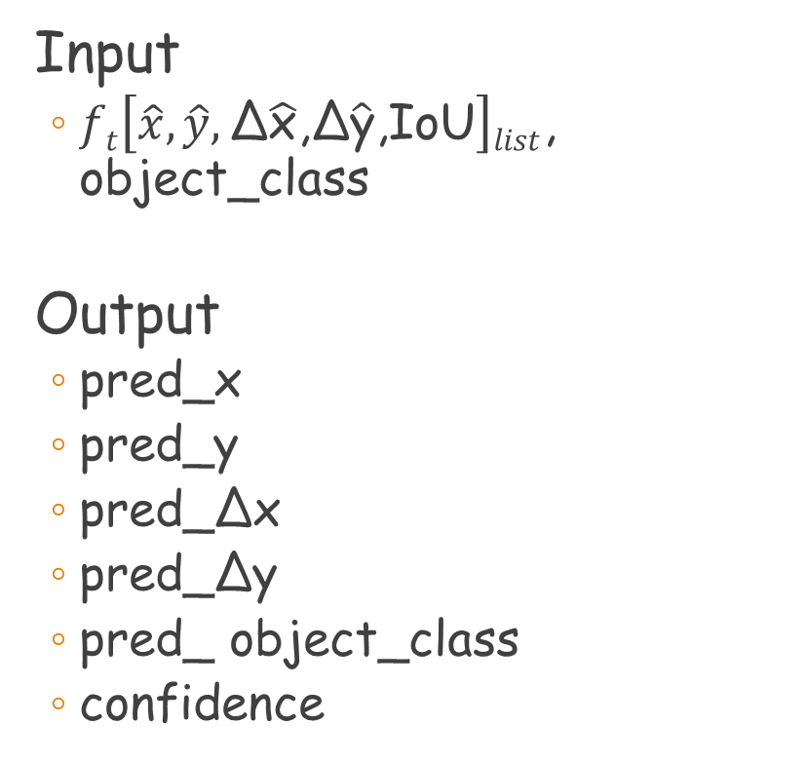
Non-maximum suppression
Input
$ft\left[\hat{x},\hat{y},\text{Δ}\hat{\text{x}}\text{,}\text{Δ}\hat{\text{y}}\text{,}\text{IoU}\right]list$, object_class
Output
pred_x
pred_y
pred_Δx
pred_Δy
pred_ object_class
confidence
Method
將大於重疊率的bounding box 做非極大值抑制
Parameter
Rate of overlap

Slide 23
Experiment result

Slide 24
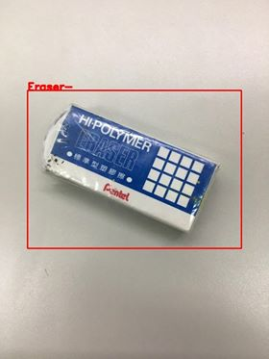
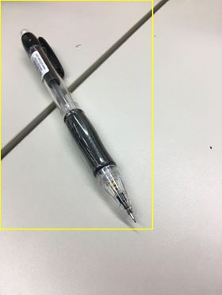
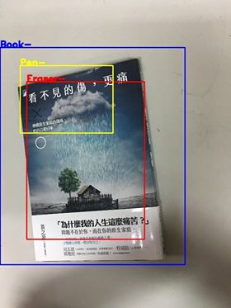
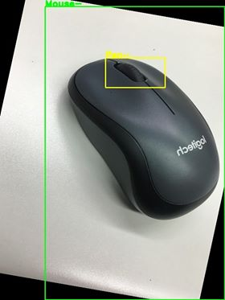
Outside test
ok
ok
Probably will be ok…

Slide 25
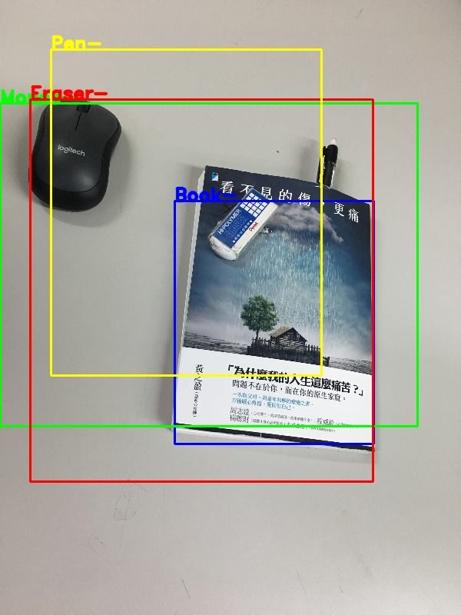
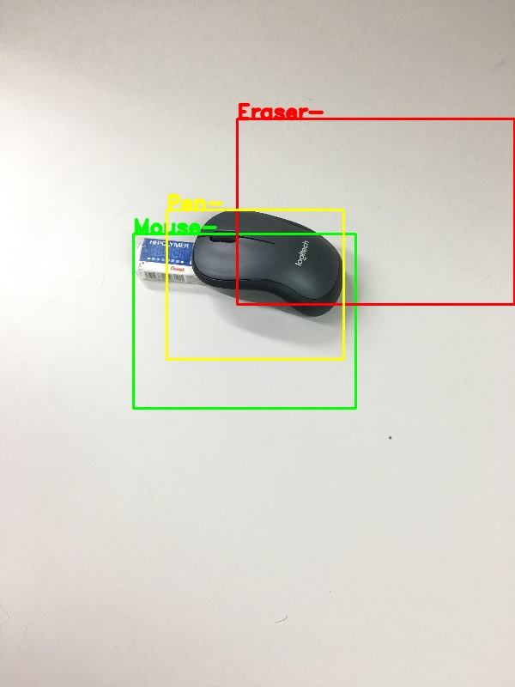
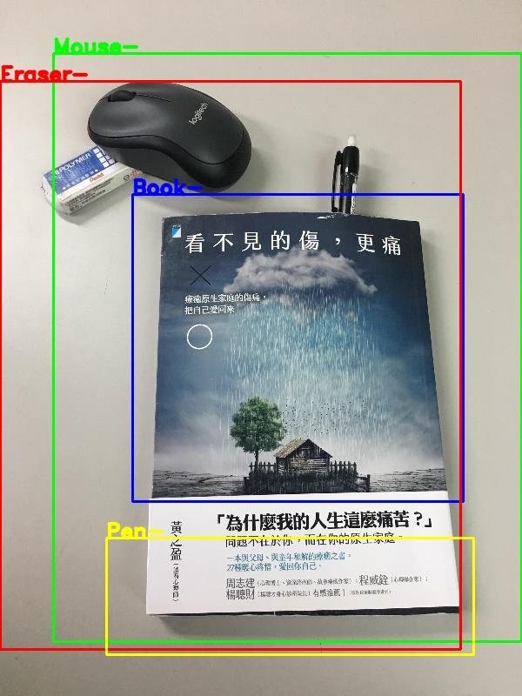
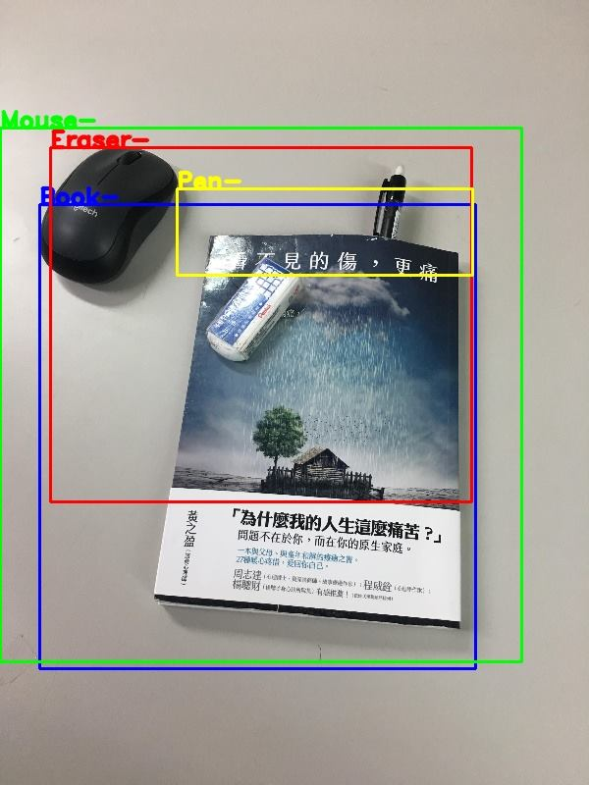
Bad result

Slide 26
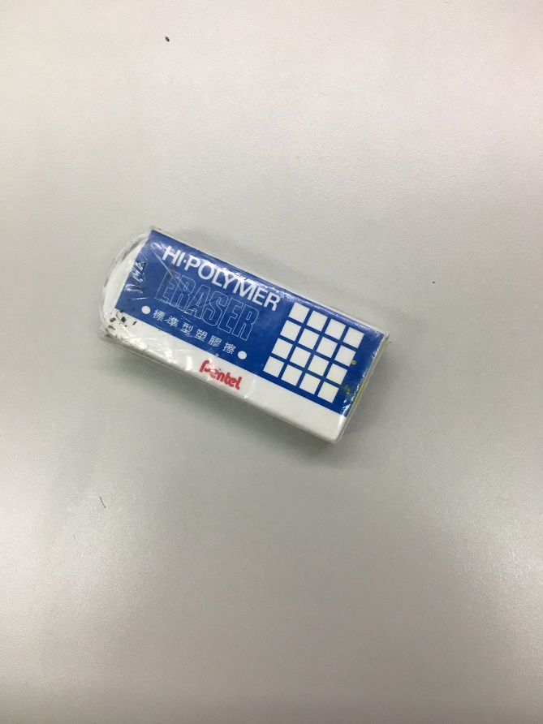

Problem
Training_image
Training_image
Testing_image

Slide 27
Thanks Your Listening

