Slide 1
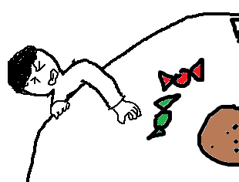
The Final Report of Machine Learning & Practice
presenter:
U0552020 何文傑
F107112107 黃柏儒
Date:
12.2018

Slide 2
Contents
Requirements
Analysis
Design
Coding & Refine
Verification
Work distribution chart

Slide 3
Requirements

Slide 4
Requirements
Program execution
Identification targets
Program execution
Recognition rates
Constraint systems
Others

Slide 5
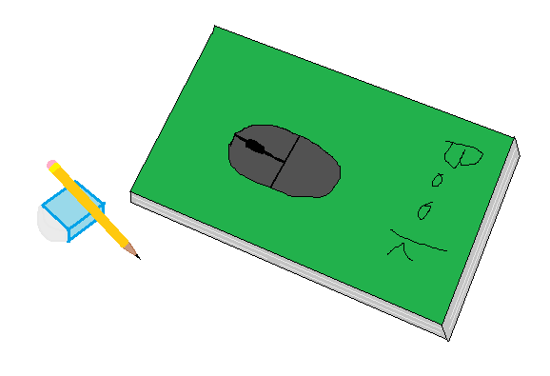
Identification targets
Eraser
Pen
Mouse
Book

Slide 6
Program execution
input
output
Programming language
Python
on Screen
discern rectangle
Object class
Confidence belonging class

Slide 7
Recognition rates
Inside testing：
Outside testing：
The recognition rates of the training samples : 100%
The recognition rates of the Non-training samples : 85%

Slide 8
Constraint systems
The targets area should be seen unless over 50%.
If the targets area are too small, ignore them.

Slide 9
Others
overlap
Bonus :
The input image should include these four targets, and each of two should be overlapped.
Covered by unknow object.
Program execution speed
Dataset quantity
Targets type

Slide 10
Analysis

Slide 11
主系統
白平衡
Image pre-processing
主系統
Annotation
(標註)
class
銳利化
Segmentation
Segment feature extraction
形狀、外觀
x, y, Δx, Δy
訓練
辨識
Segmentation
Superpixel
Segment feature extraction
HoG
形狀、外觀
SVM、MLP training
Superpixel
HoG
SVM、MLP prediction
Class
Part
Bounding Box

Slide 12
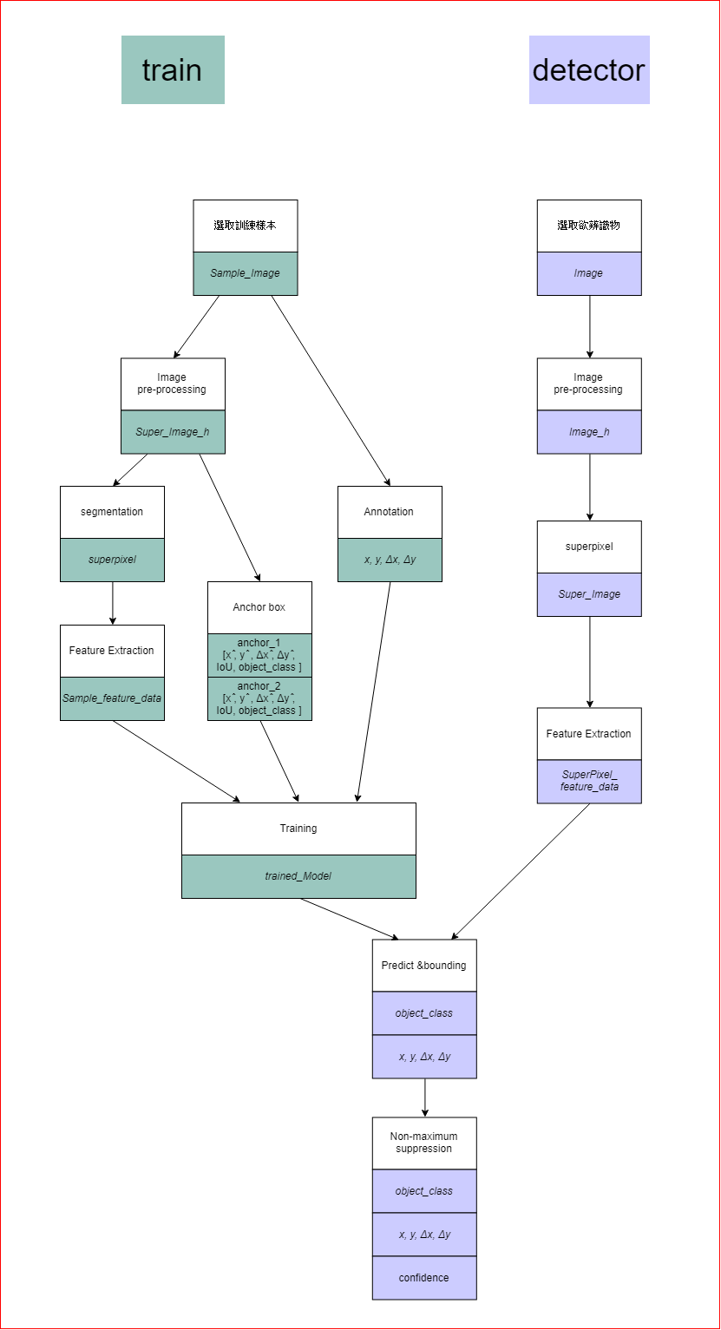

Slide 13
Design
- training

Slide 14
Annotation
Input
Sample_Image
Output
x
y
Δx
Δy
Method
grid_step = 1
Parameter
grid size

Slide 15
Image Pre-processing
Input
Sample_Image
Output
Super_Image_h
Method
Blur
Color balance
Deblur
Sharp

Slide 16
Feature Extraction
Input
Super_Image_h
Output
Sample_feature_data
Method
HoG

Slide 17
Training
Input
Sample_feature_data
Output
trained_Model
Method
SVM
MLP
Parameter
SVM : Support vector
MLP : hidden node

Slide 18
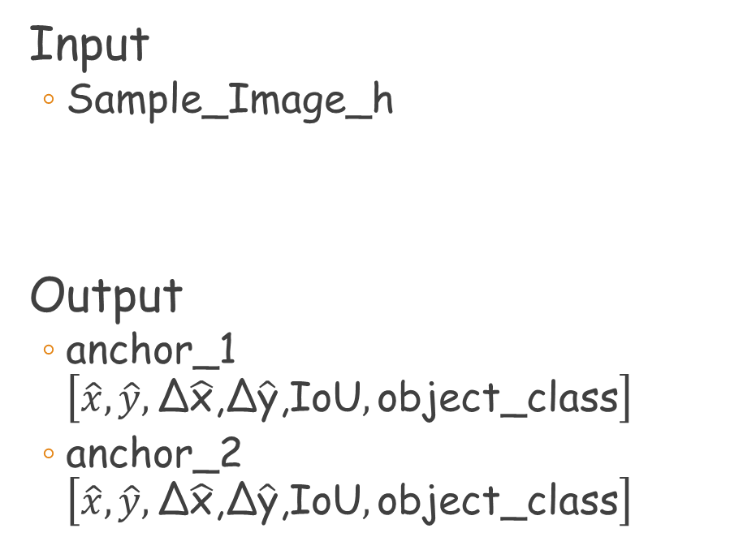
Anchor box
Input
Sample_Image_h
Output
anchor_1$\left[\hat{x},\hat{y},\text{Δ}\hat{\text{x}}\text{,}\text{Δ}\hat{\text{y}}\text{,}\text{IoU},\text{object}\text{_}\text{class}\right]$
anchor_2$\left[\hat{x},\hat{y},\text{Δ}\hat{\text{x}}\text{,}\text{Δ}\hat{\text{y}}\text{,}\text{IoU},\text{object}\text{_}\text{class}\right]$
Method
Use the SLIC to find out the prospect, then enclose the objects which might be the targets with anchor box.

Slide 19
Design
- detector

Slide 20
Superpixel
Input
Image
Output
Super_Image
Method
SLIC
Parameter
N-segment
Compactness ratio

Slide 21
Image Pre-processing
Input
Image
Output
Image_h
Method
Blur
Color balance
Deblur
Sharp

Slide 22
Feature Extraction
Input
Surper_Image_h
Output
SurperPixel_feature_data
Method
HoG

Slide 23
Predict&bounding
Input
trained_Model
SurperPixel_feature_data
Output
object_class
x
y
Δx
Δy
Method
找出較高IoU的Anchor box內的 x , y , Δx , Δy 形成 bounding box

Slide 24
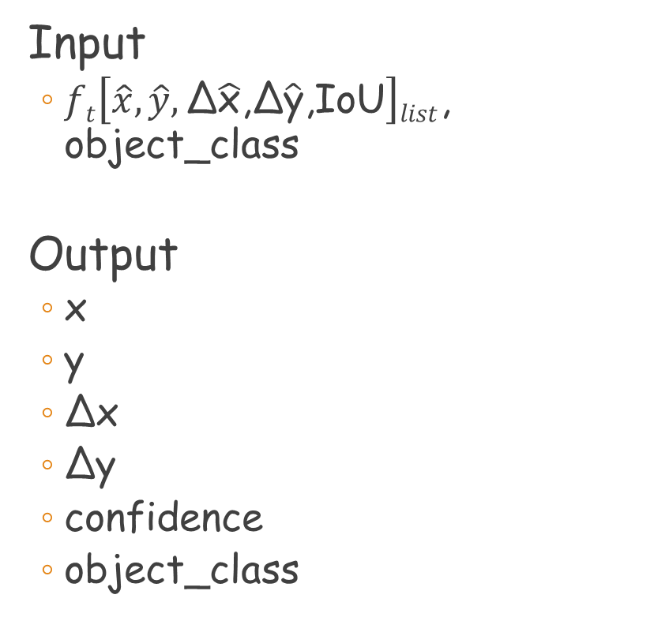
Non-maximum suppression
Input
$ft\left[\hat{x},\hat{y},\text{Δ}\hat{\text{x}}\text{,}\text{Δ}\hat{\text{y}}\text{,}\text{IoU}\right]list$, object_class
Output
x
y
Δx
Δy
confidence
object_class
Method
將大於重疊率的bounding box 做非極大值抑制
Parameter
Rate of overlap

Slide 25
Coding & Refine

Slide 27
Verification

Slide 29
Work distribution chart

Slide 31
Thanks Your Listening

