Slide 1
The Battle of Neighborhoods
K-means clustering is an iterative clustering algorithm where the number of clusters K is predetermined and the algorithm iteratively assigns each data point to one of the K clusters based on the feature similarity

Slide 2
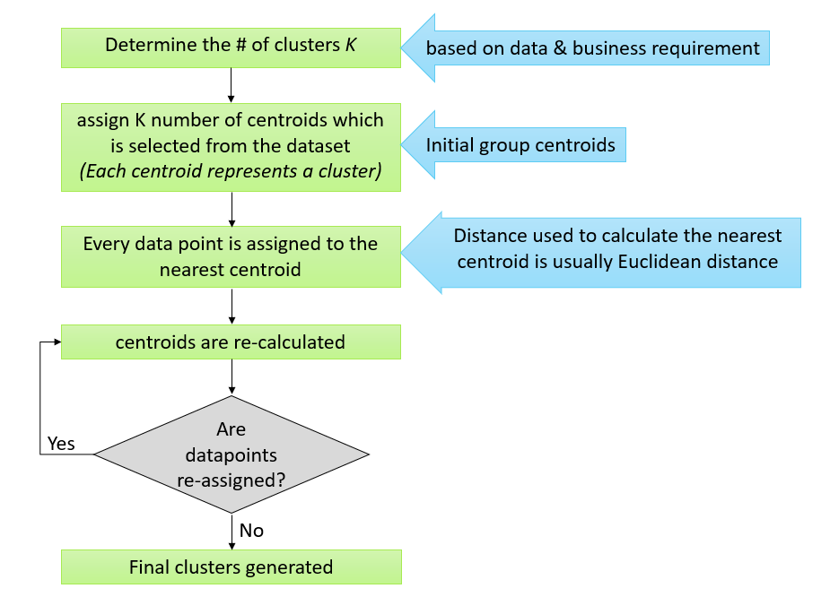
K-Means

Slide 3
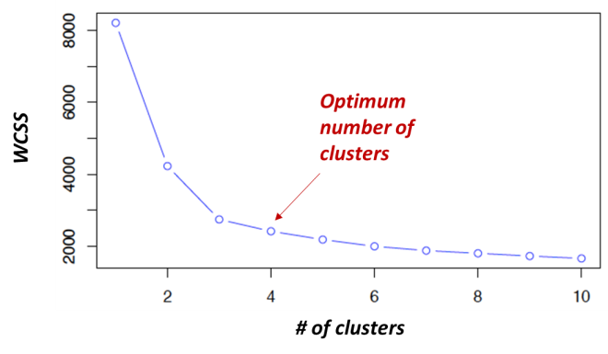

Slide 4
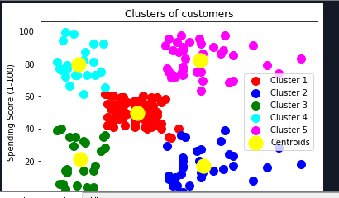
Result obtained

