Slide 1
APPROACH
Collect the new york city data from https://cocl.us/new_york_dataset
Using FourSquare API we will find all venues for each neighborhood.
Filter out all venues that are Indian Resturants.
Find rating , tips and like count for each Indian Resturants using FourSquare API.
Using rating for each resturant , we will sort that data.
Visualize the Ranking of neighborhoods using folium library(python)

Slide 2
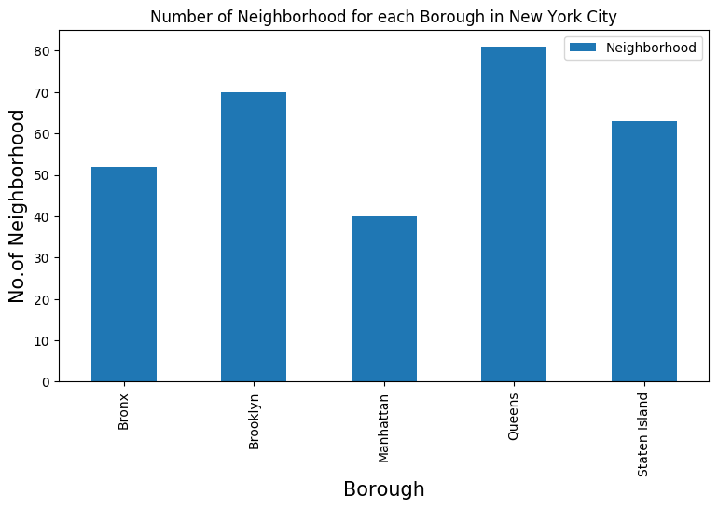
Highest number of neighbour

Slide 3
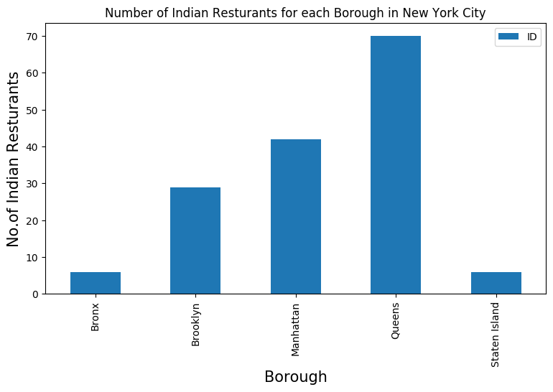
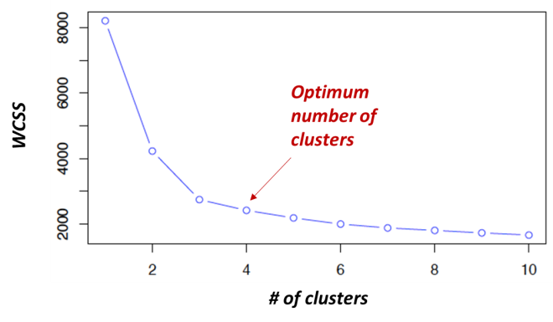
Number of resturants

Slide 4
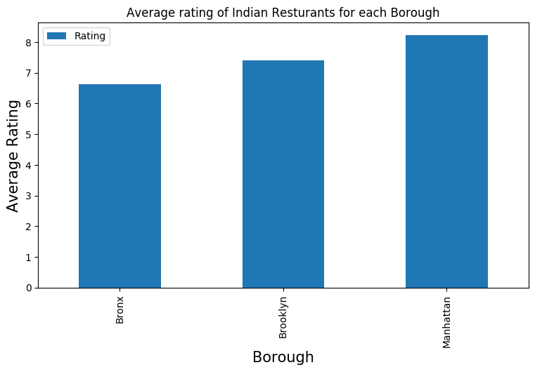
Ratings

