Slide 1
Prediction of Accident Severity
Created By-
Aakrit Bhargava (209303131)

Slide 2
Introduction
Motivation
Traffic accidents are severe concern for most of the countries
Approx. 1.25 million people deaths caused because of road accident injuries in a year [1]
Complexity of dataset
Objective
To help traffic control authorities predict the accident severity
Effectively able to predict “Serious” accidents

Slide 3
Dataset
Size of Dataset: ~730 MB
Number of records: ~250k Rows
Number of columns: 70 Columns
Source: https://www.kaggle.com/datasets/akshay4/road-accidents-incidence

Slide 4
Data Pre-processing
Data missing values are imputed by the most frequent value of the column
Categorical data labelled with numerical values
Merged similar categorical values
Physically removed some Columns
Merged Serious and Fatal classes as Serious class

Slide 5
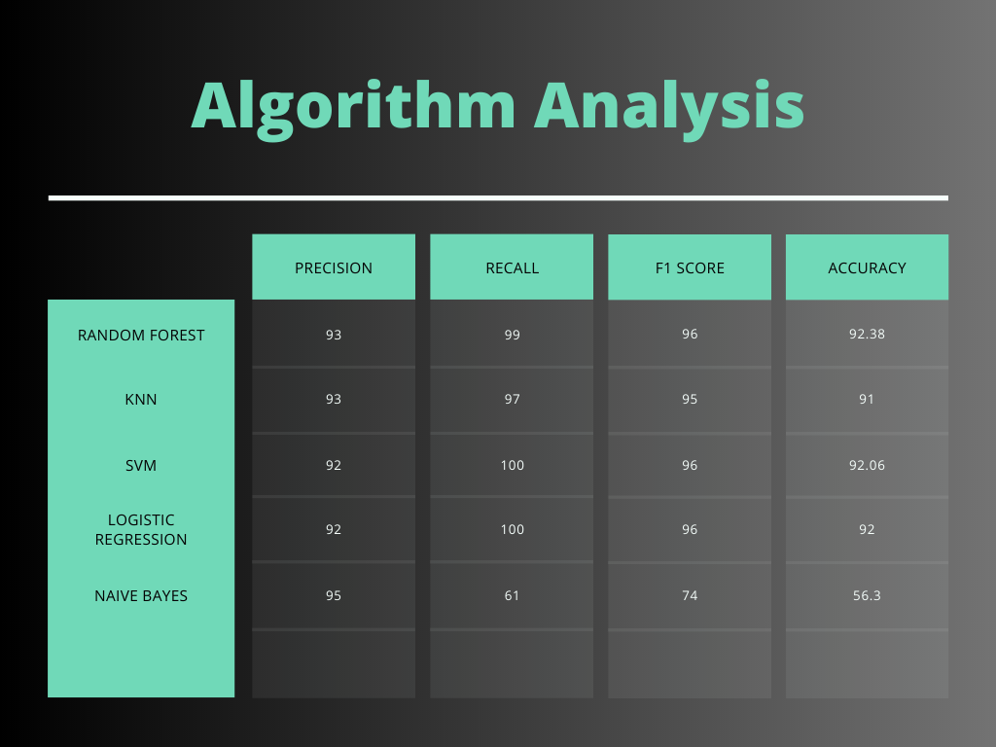
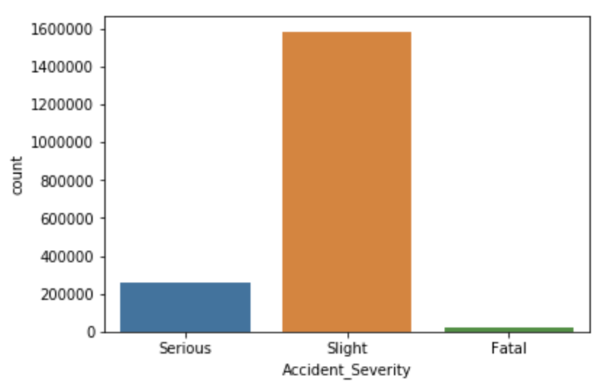
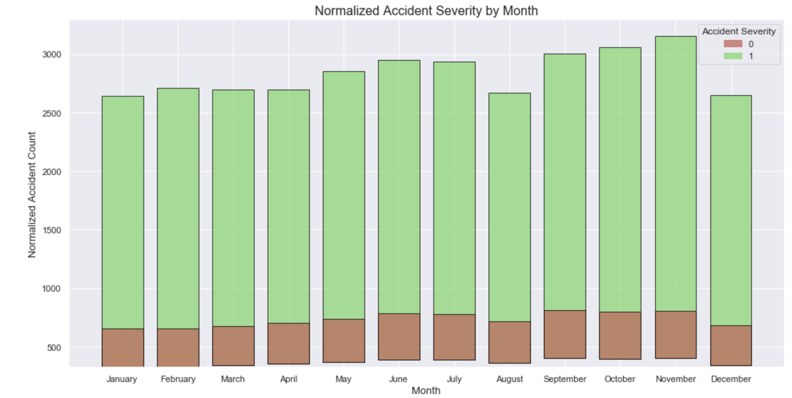
Data Visualization

Slide 6
Algorithms Used
K- Nearest Neighbor
Naïve Bayes
Random Forest
SVM
Logistic Regression

Slide 7
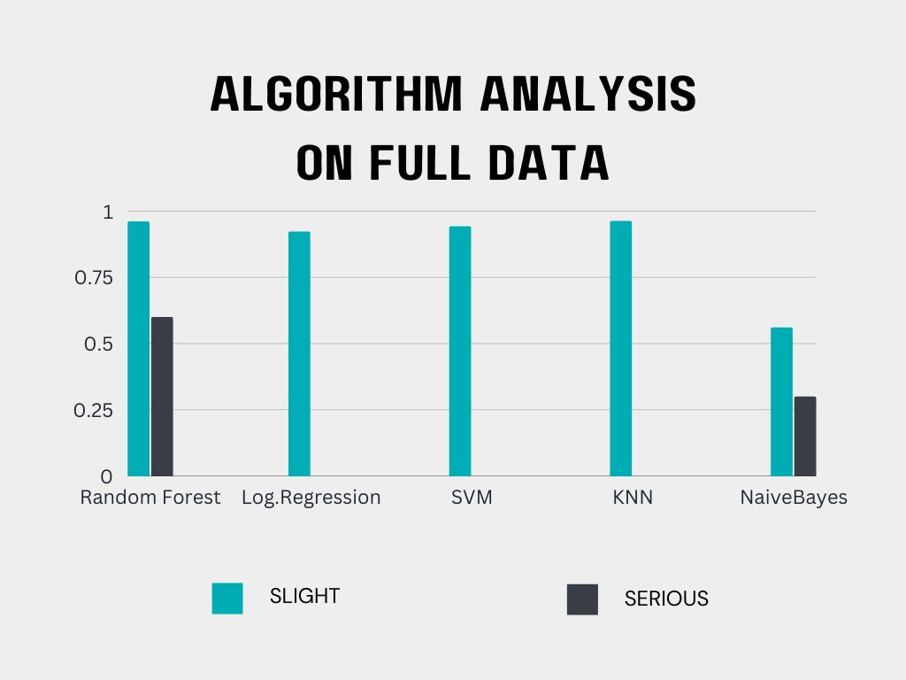
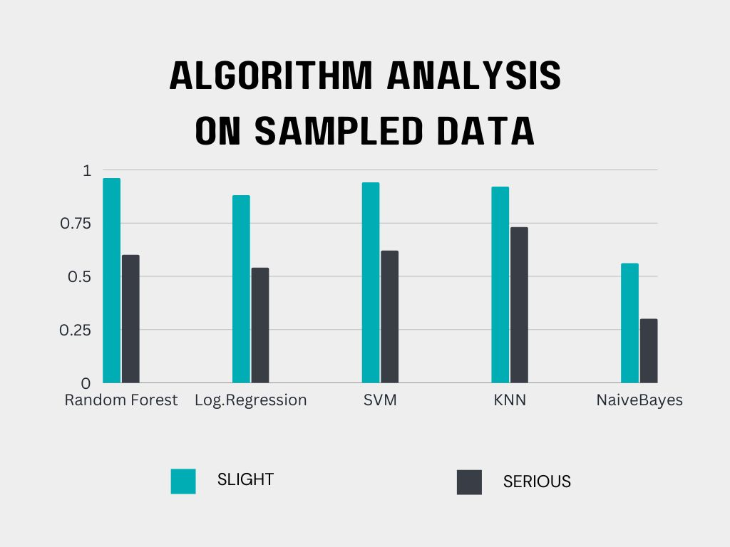
Comparative Analysis

Slide 8
Handling Imbalanced Data
Over Sampling
Under Sampling
Mis-classification penalty
Ensemble methods

Slide 9
Challenges
Cannot run most of the algorithms on local machines
Not able to test over sampling
Highly imbalanced classes
NaN and 0 Value data

Slide 10
What worked What not worked
Under Sampling
Fine tuning the parameters
Data Preprocessing
Over Sampling
Keeping data with 0 values

Slide 11
Conclusion
In conclusion, most of the algorithms are biased towards most frequent class. However, efficient pre-processing and corresponding imbalanced data techniques should give optimal results.

Slide 12
References
[1] Global Status Report on Road Safety 2019
http://www.who.int/violence_injury_prevention/road_safety_status/2019/en/

