Slide 1
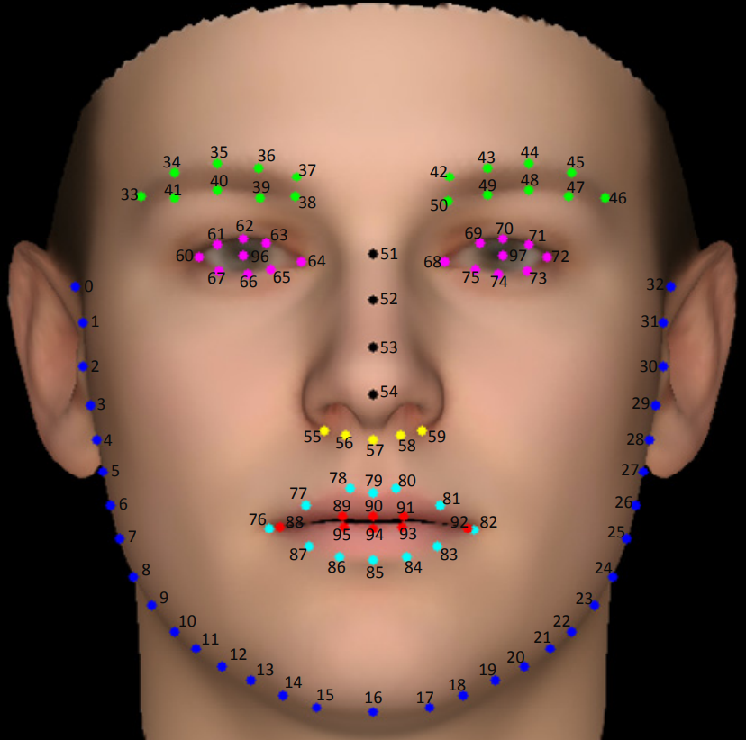
Face landmark is mainly used for image or video processing and also analysis including object detection, face detection, etc. Facial landmarks are used to localize and represent important regions of the face, such as: · Mouth. · Eyes. · Eyebrows. · Nose.

