Slide 1
BD-FPP
A Multi-Region Bangladeshi Food-Price Dataset with Engineered Lag Features
for Time-Series Commodity Price Forecasting
23 September 2026 | Group B2, Batch 2K21
Khulna University of Engineering & Technology — Dept. of Computer Science & Engineering
CSE 4112: Machine Learning Laboratory
Md. Sabith · Abu Hasanat Soykot · Newaz Mohammad Hamim · Tajnoor Sultana · Ahsanul Islam Emon

Slide 2
Dataset Overview
Regionally disaggregated panel of daily retail commodity prices
Coverage | 8 divisions, 18 commodities, 295 distinct calendar dates (16 Jun 2025 - 20 Aug 2026)
Pre-lag records | 32,647 rows (raw division-level panel)
Model-ready table | 25,207 rows x 15 columns, zero missing values
Exchange rate | Daily USD/BDT reference rate joined by date; range 121.00-123.785, mean 122.42
BD-FPP: Multi-Region Bangladeshi Food-Price Dataset | KUET CSE 4112
2

Slide 3
Data Processing Pipeline
From raw panel to model-ready multi-horizon table
Raw division-level
panel
(32,647 rows)
→
Duplicate check +
chronological sort
per series
→
Lag features
T-1 / T-7 / T-30 /
30d-MA
→
Forward targets
target_7d/14d/30d
(drop incomplete rows)
→
Model-ready table
25,207 rows
15 columns
→
Chrono & Random
80/20 splits
-> Weka ARFF
Two evaluation protocols run on the same 25,207-row table:
Chronological Split
Earliest 80% (20,165 rows) trains,
latest 20% (5,042 rows) tests.
Mirrors genuine forecasting — no future
information reaches training.
Random (Shuffled) Split
Seed 42, i.i.d. 80/20 shuffle, same sizes.
Past/future rows interleaved — a direct
stress test of the leakage risk flagged
in the group's earlier report.
BD-FPP: Multi-Region Bangladeshi Food-Price Dataset | KUET CSE 4112
3

Slide 4
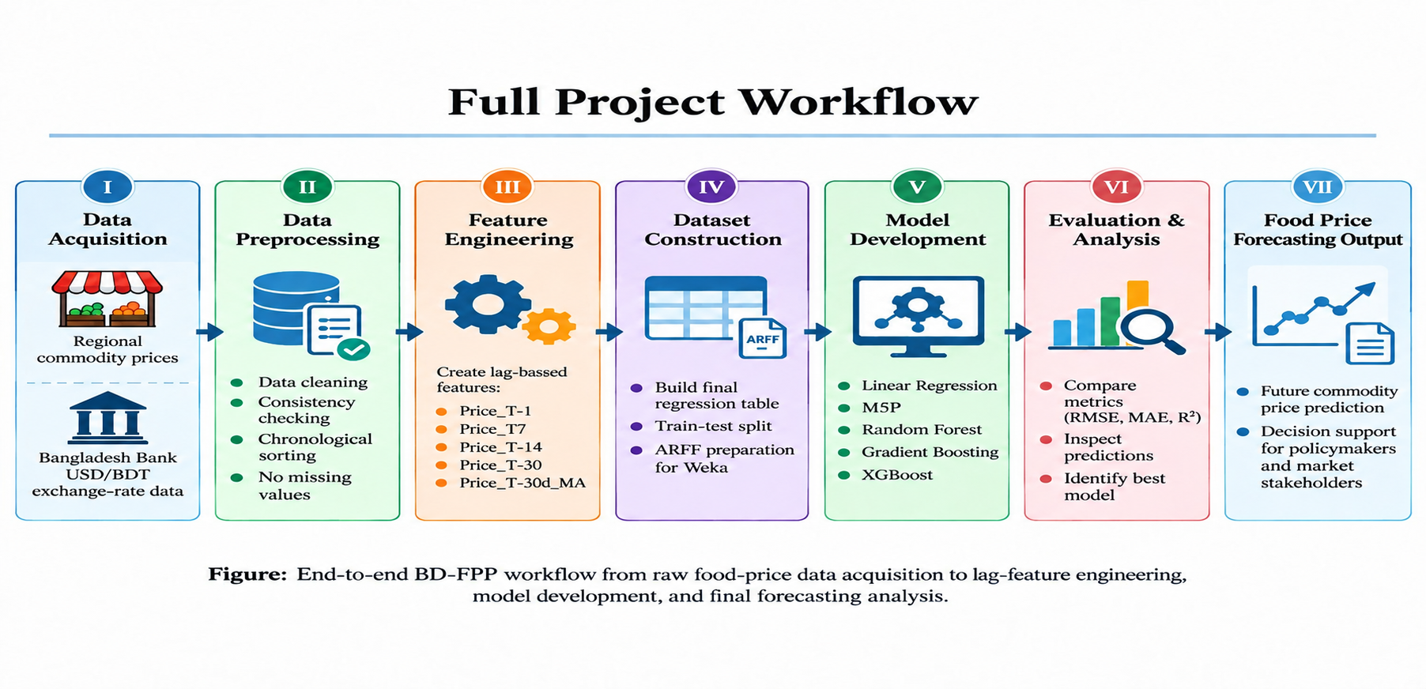
Full Project Workflow
End-to-end path from raw price collection to forecasting output
BD-FPP: Multi-Region Bangladeshi Food-Price Dataset | KUET CSE 4112
4

Slide 5
Dataset Schema — 15 Columns
Field | Type | Role
division, commodity_name, retail_unit | Nominal | Categorical predictors (8 / 18 / 3 values)
year, month, day, usd_bdt_rate | Numeric | Calendar + exchange-rate predictors
average_price | Numeric | Observed current retail price (predictor)
Price_T-1, Price_T-7, Price_T-30 | Numeric | Engineered lag predictors (own series history)
Price_30d_MA | Numeric | Engineered trailing 30-obs. rolling-average predictor
target_7d / target_14d / target_30d | Numeric | Forecast targets — price N days ahead (class per run)
BD-FPP: Multi-Region Bangladeshi Food-Price Dataset | KUET CSE 4112
6

Slide 6
Dataset Schema — 15 Columns
Commodity No. | Commodity Name | Retail Unit
1 | Ata (loose) – White | Kilogram
2 | Palm Oil | Liter
3 | Soybean Oil (loose) | Liter
4 | Egg Farm-Red | 4 Pieces
5 | Green Chili (Local) | Kilogram
6 | Garlic (Imported) | Kilogram
7 | Broiler chicken | Kilogram
8 | Beef | Kilogram
9 | Ginger (Imported) | Kilogram
10 | Pangash (big) | Kilogram
11 | Garlic (local) – Big Size | Kilogram
12 | Ata (Packet) | Kilogram
13 | Onion (local) | Kilogram
14 | Rice – Medium | Kilogram
15 | Rice – Fine | Kilogram
16 | Lentils – Desi-Whole | Kilogram
17 | Potato (Holland) – Red | Kilogram
18 | Milk | Liter
BD-FPP: Multi-Region Bangladeshi Food-Price Dataset | KUET CSE 4112
6

Slide 7
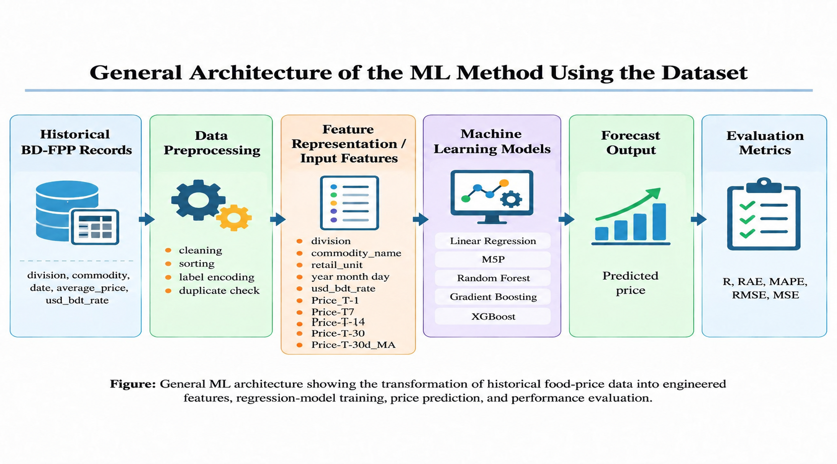
General ML Architecture
How historical BD-FPP records become a predicted price
BD-FPP: Multi-Region Bangladeshi Food-Price Dataset | KUET CSE 4112
7

Slide 8
Five Regression Models
Same 12 predictors; class = one of target_7d / target_14d / target_30d
Model | Train time
Linear Regression | 0.19 s
M5P (model tree) | 1 s
Random Forest | 1.8 s
Gradient Boosting | 3.1 s
XGBoost | 3.65 s
What the models do
Input: division, commodity, date, USD/BDT rate, current price + 4 lag features
Output: predicted retail price 7 / 14 / 30 days ahead (BDT per unit)
Use: decision-support for short-horizon price monitoring, not autonomous pricing
Dispatch: all via Weka's Classifiers; GB/XGBoost via the ScikitLearnClassifier wrapper
BD-FPP: Multi-Region Bangladeshi Food-Price Dataset | KUET CSE 4112
8

Slide 9
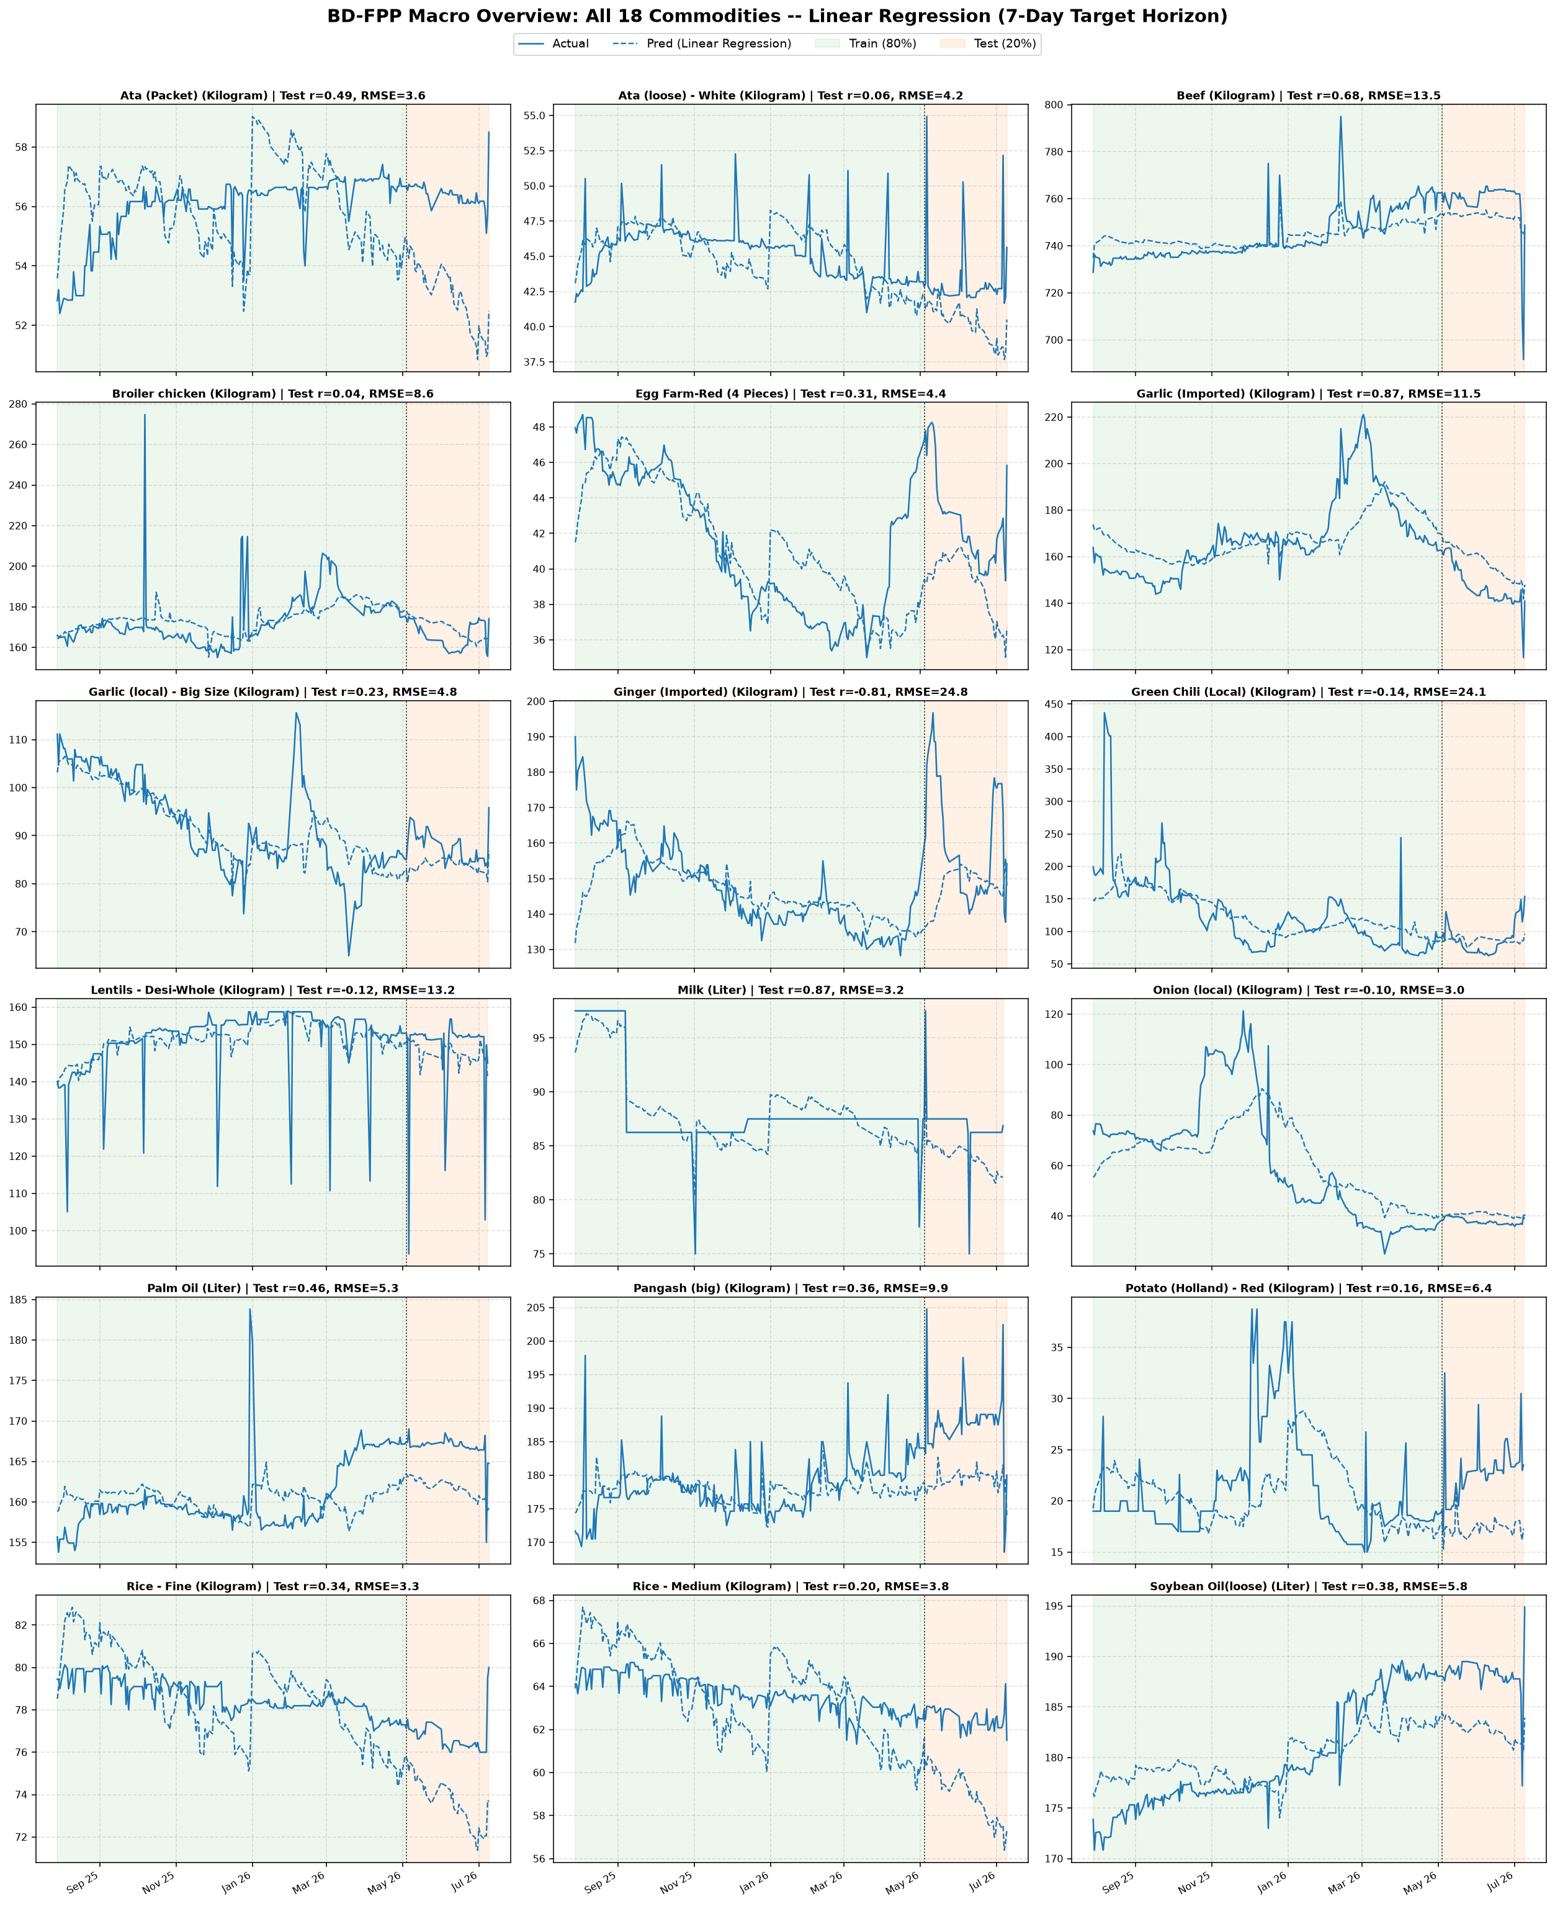
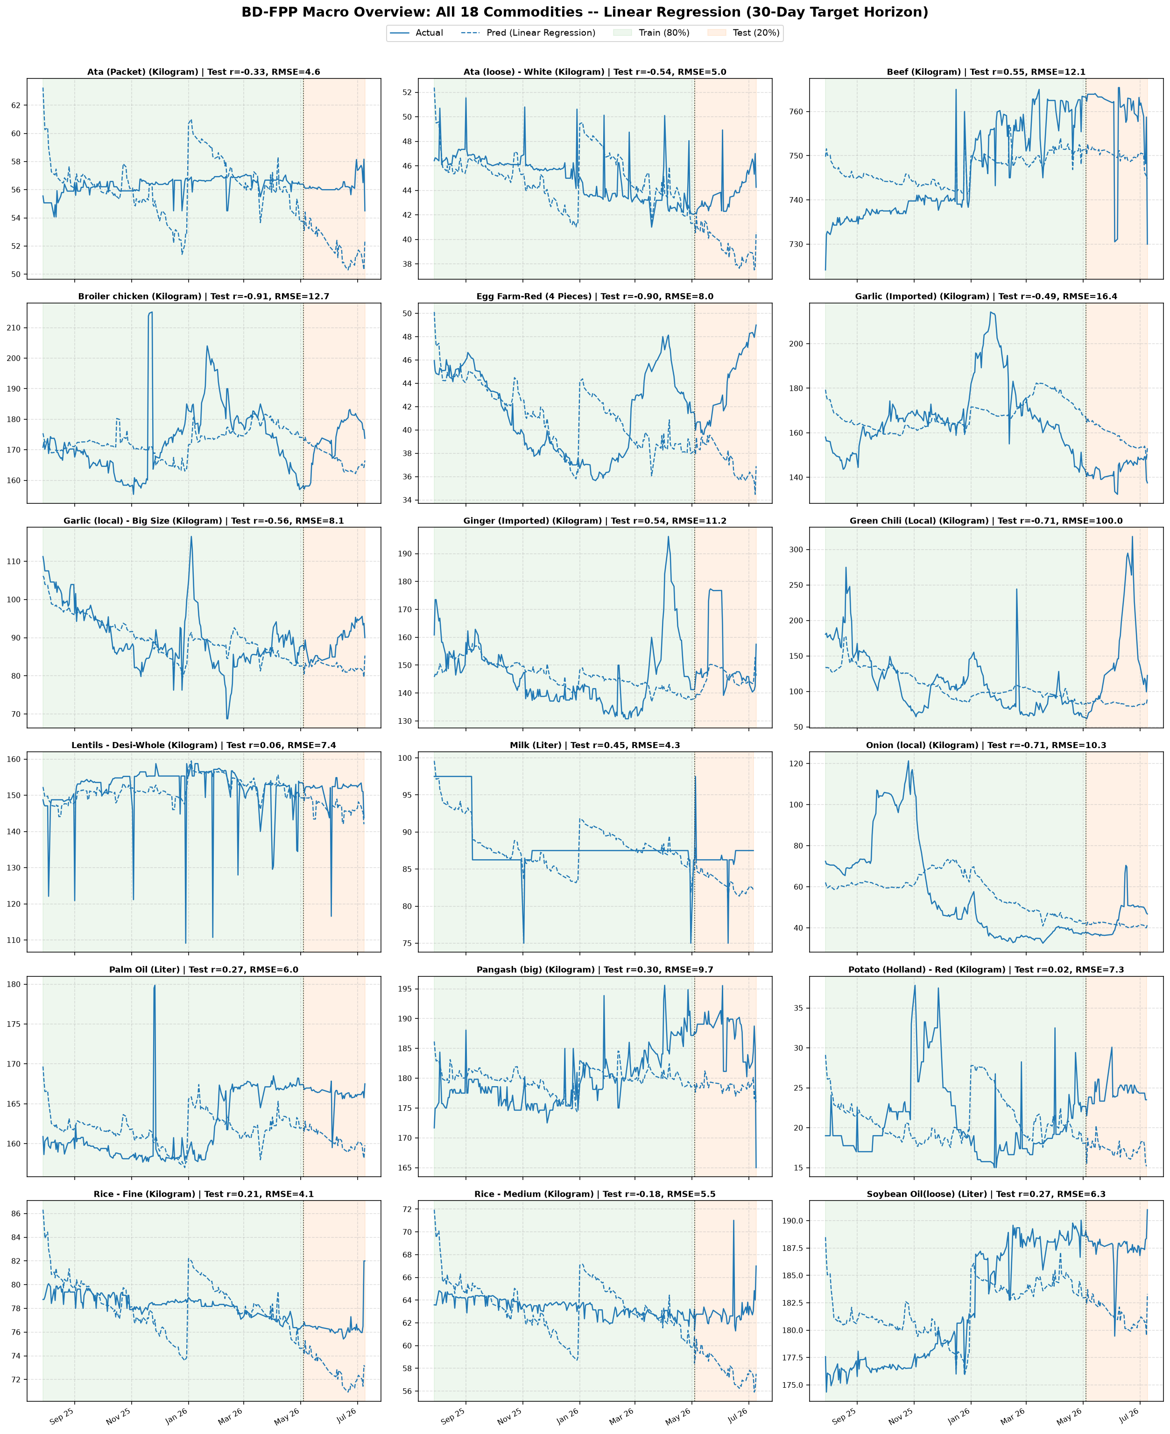
Time-series Graph Analysis
Linear Regression for 18 commodities
BD-FPP: Multi-Region Bangladeshi Food-Price Dataset | KUET CSE 4112
9

Slide 10
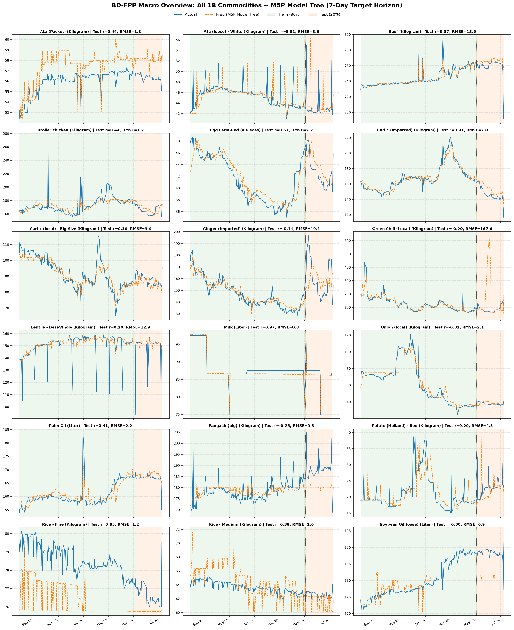
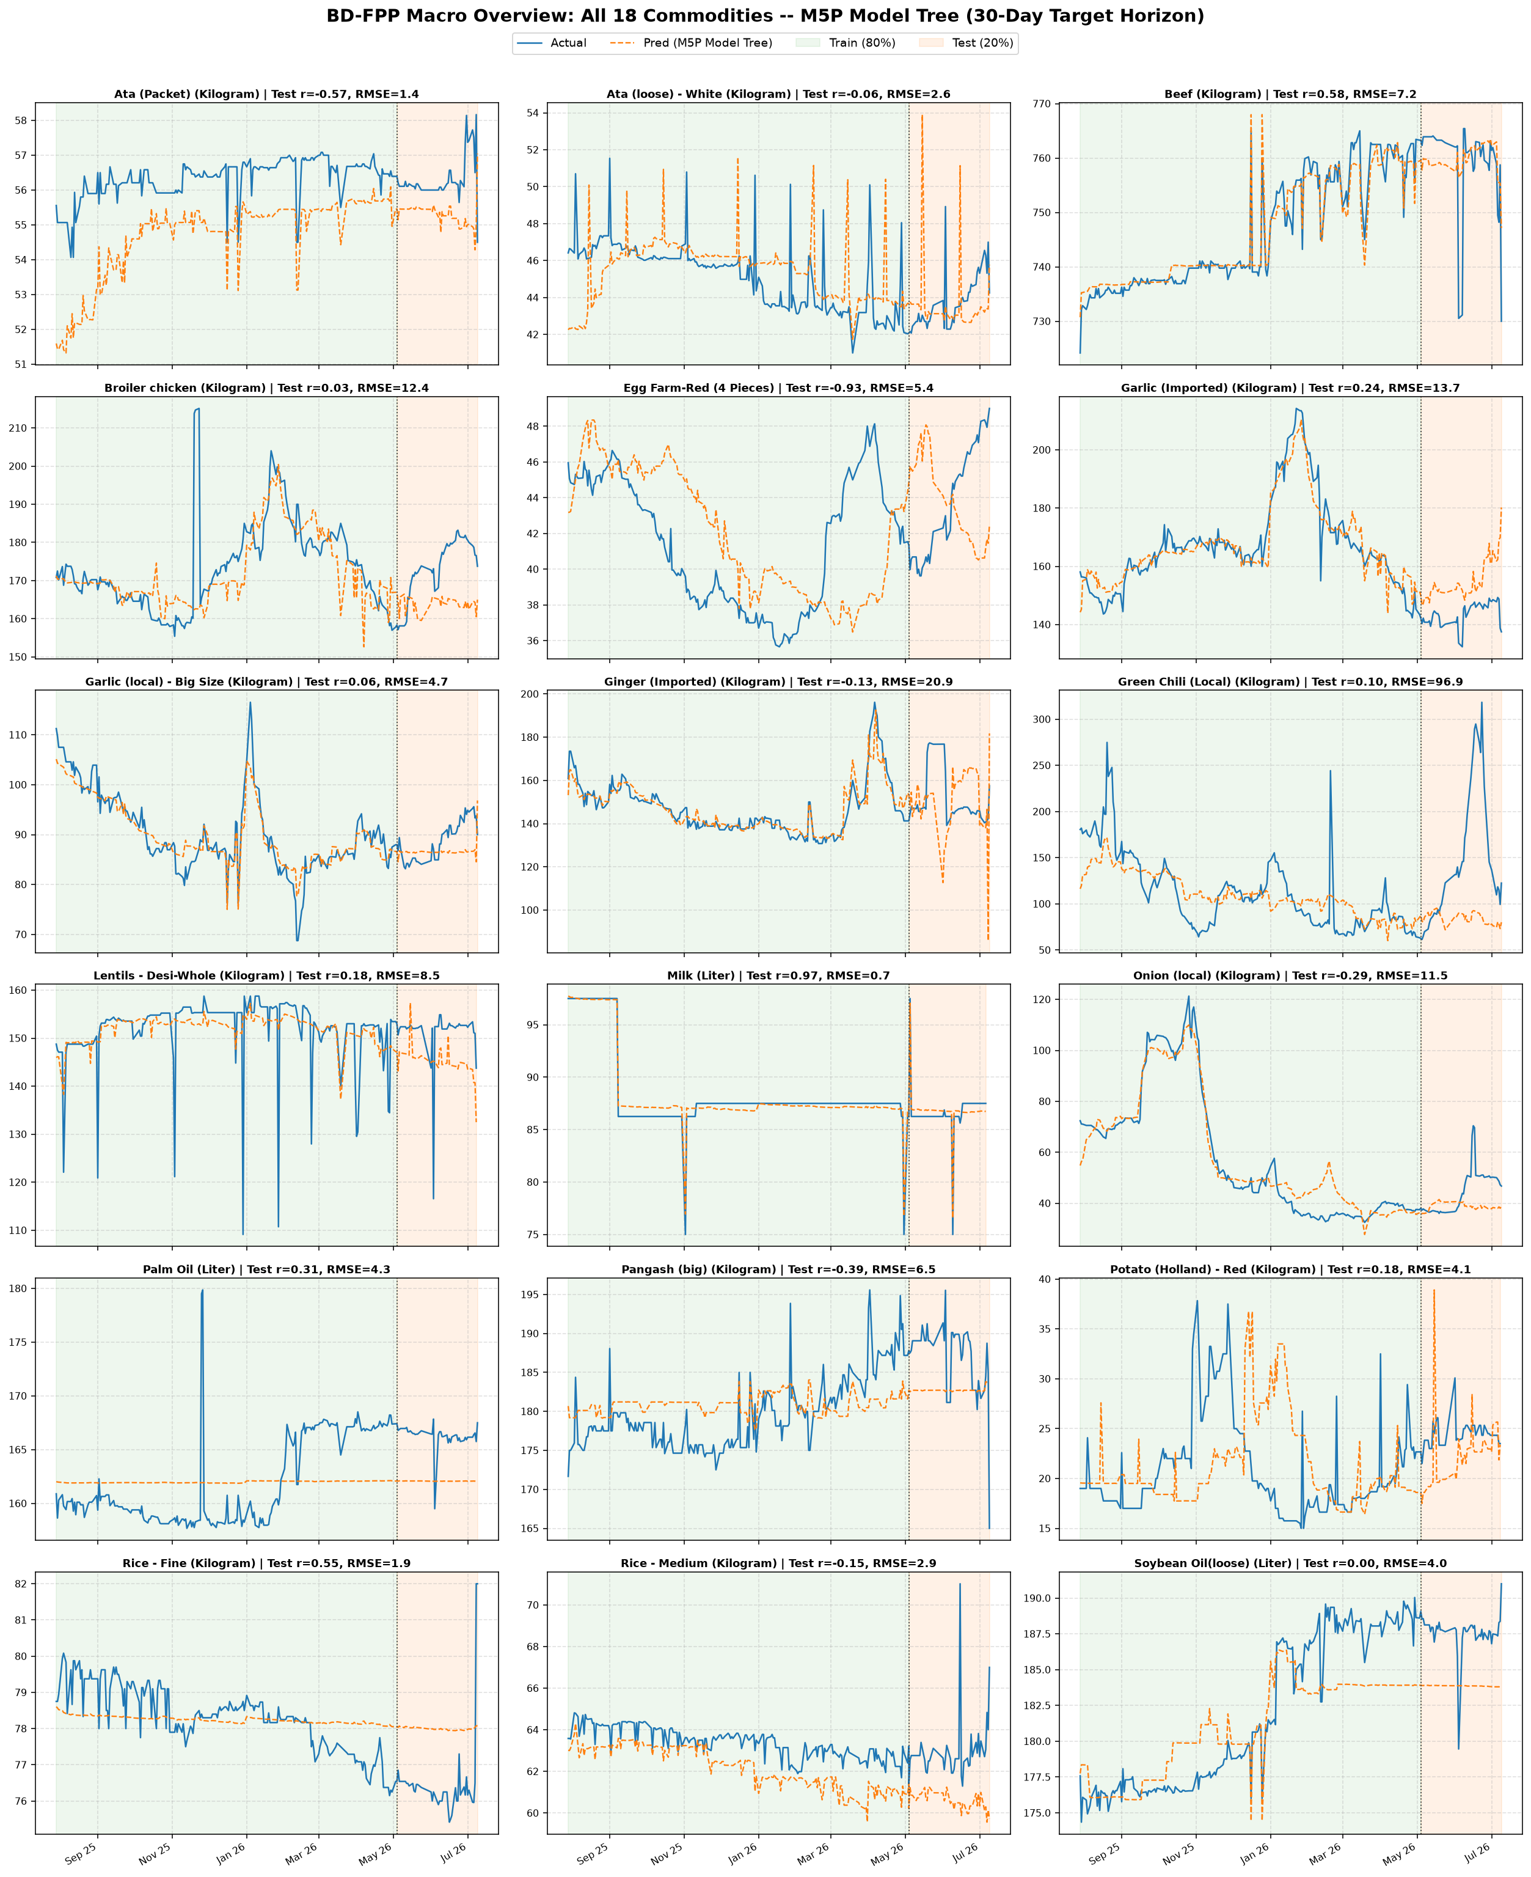
Time-series Graph Analysis
M5P for 18 commodities
BD-FPP: Multi-Region Bangladeshi Food-Price Dataset | KUET CSE 4112
10

Slide 11
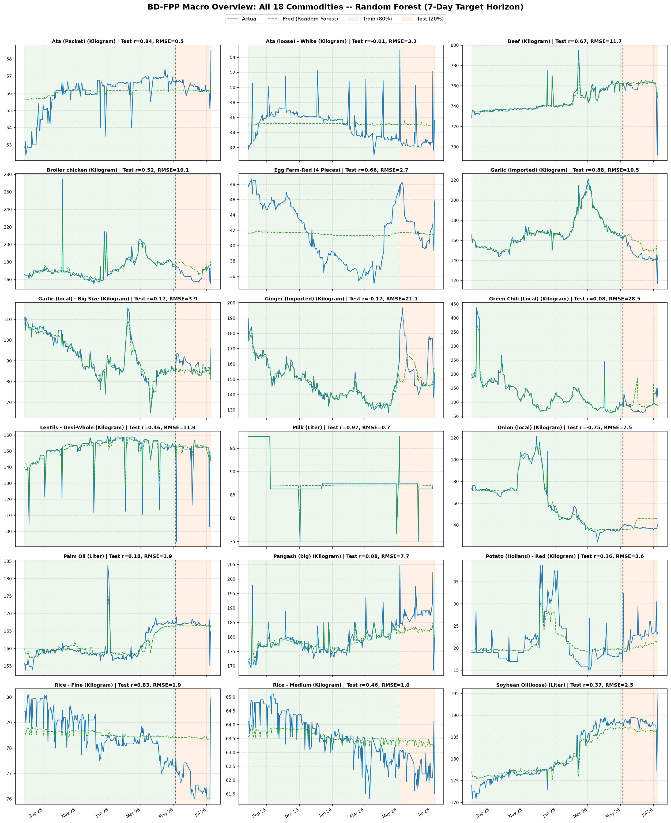
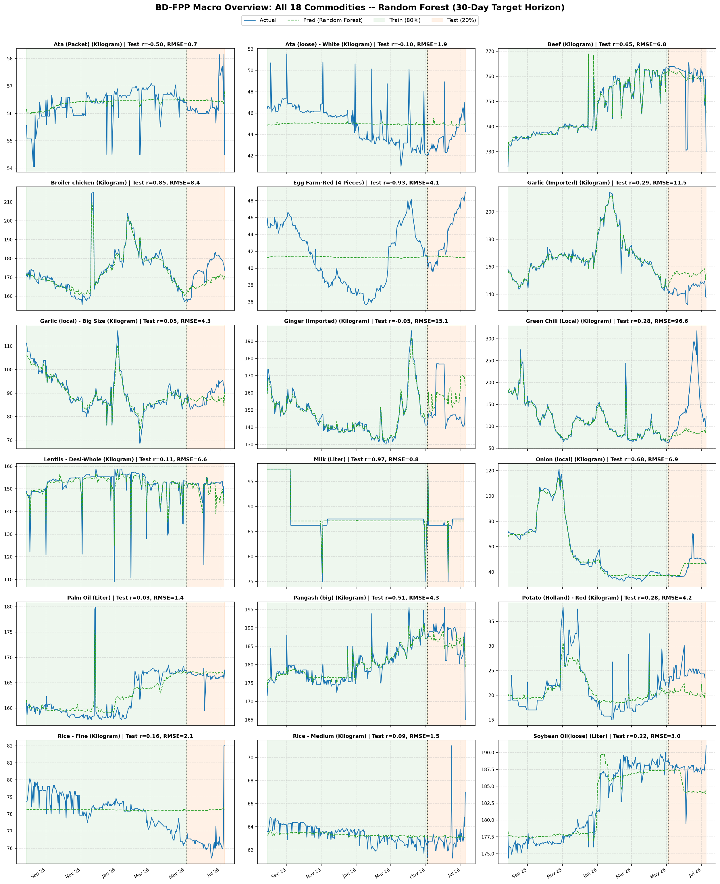
Time-series Graph Analysis
Random Forest for 18 commodities
BD-FPP: Multi-Region Bangladeshi Food-Price Dataset | KUET CSE 4112
11

Slide 12
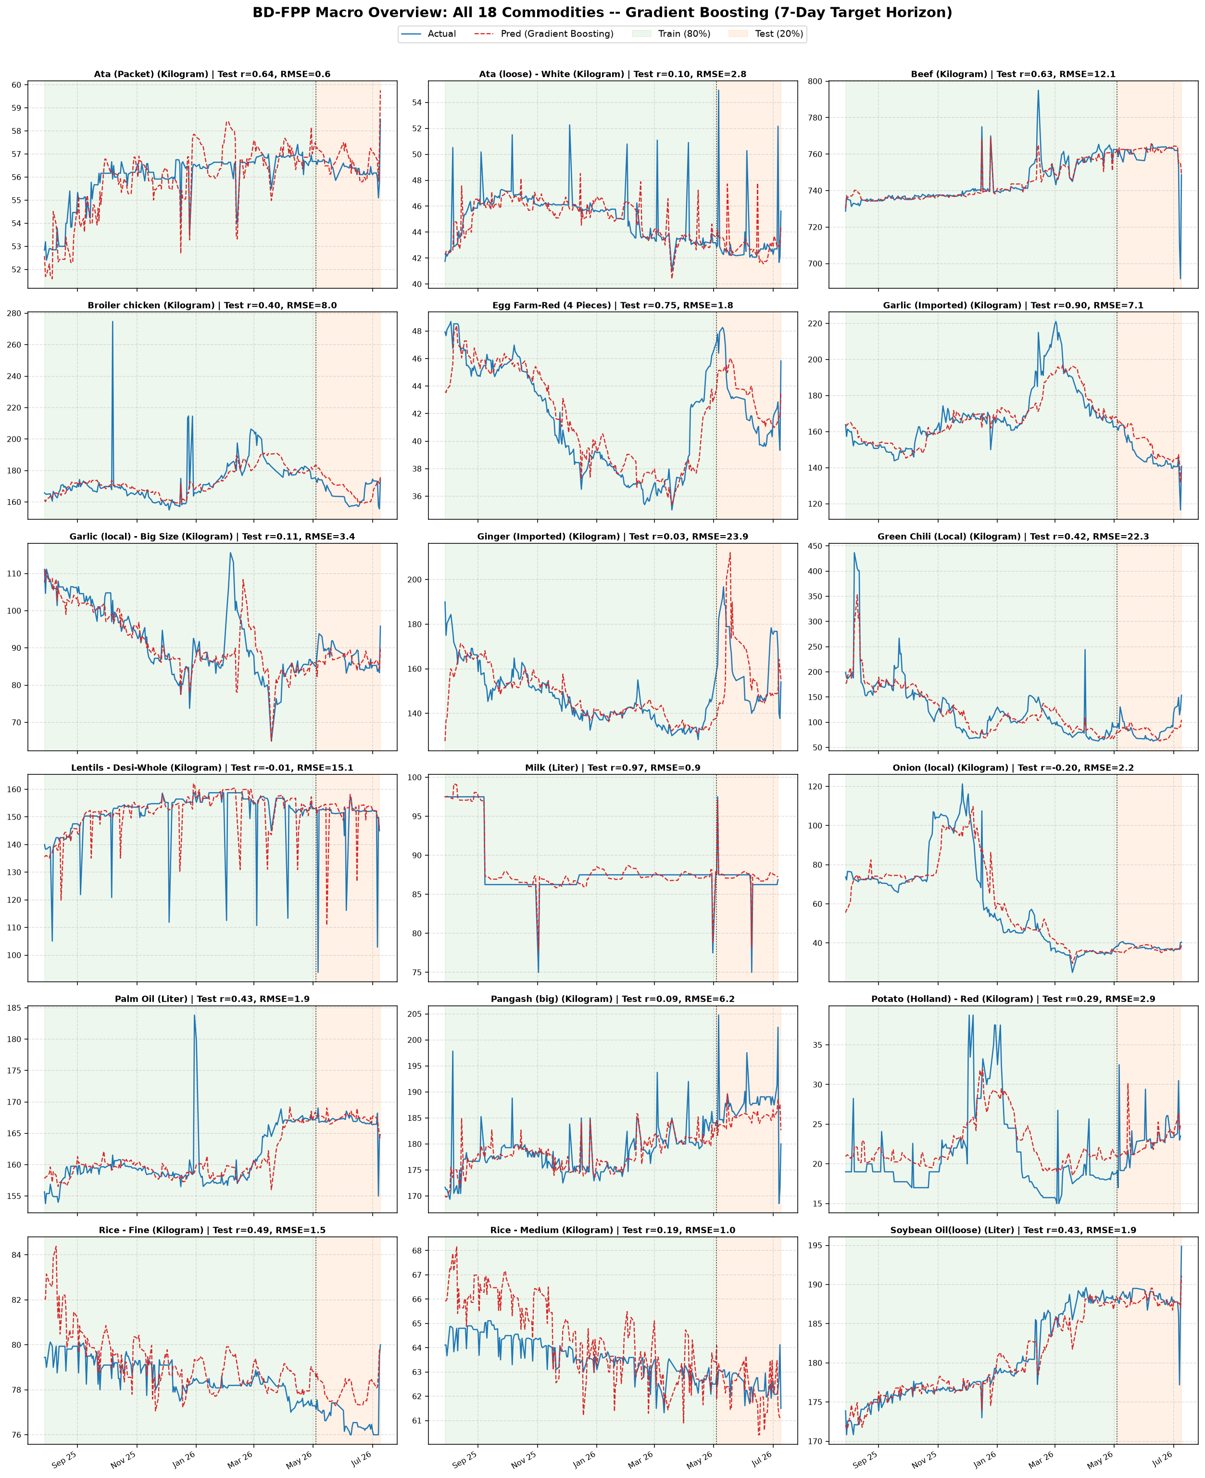
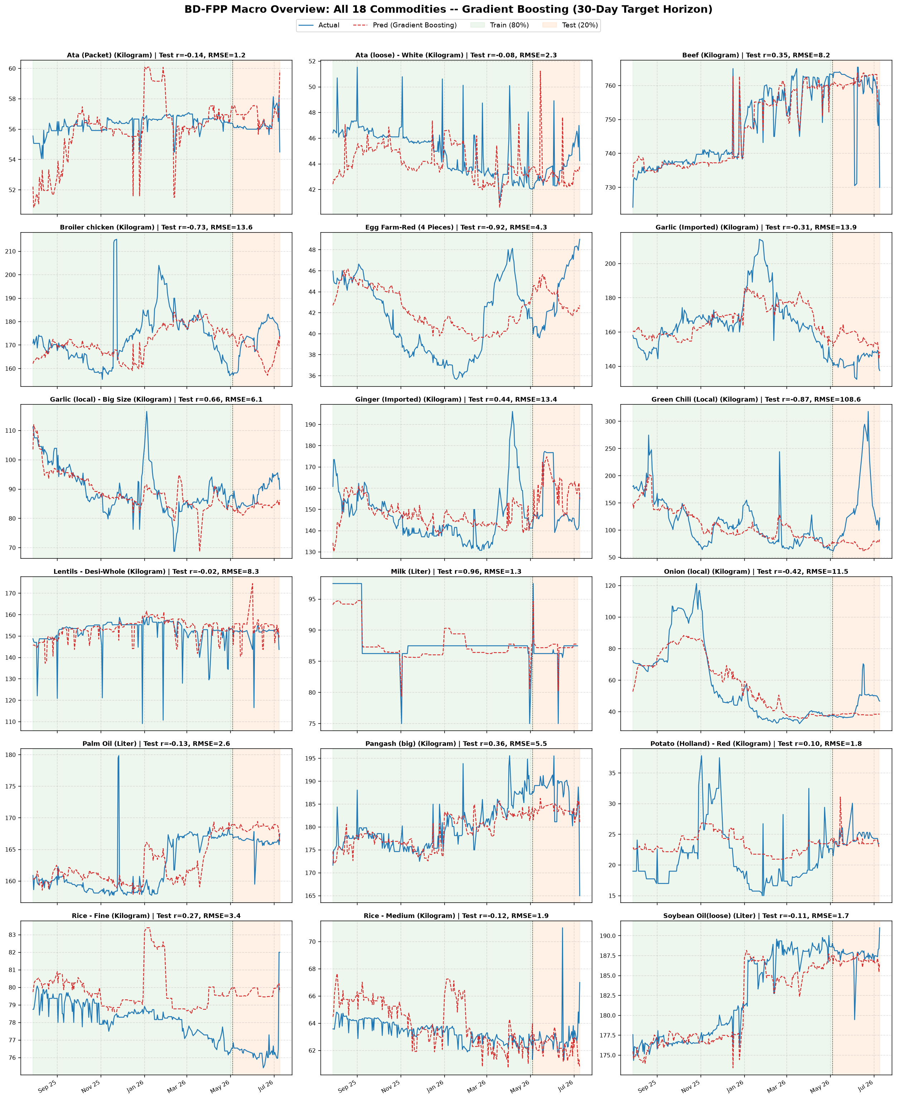
Time-series Graph Analysis
Gradient Boosting for 18 commodities
BD-FPP: Multi-Region Bangladeshi Food-Price Dataset | KUET CSE 4112
12

Slide 13
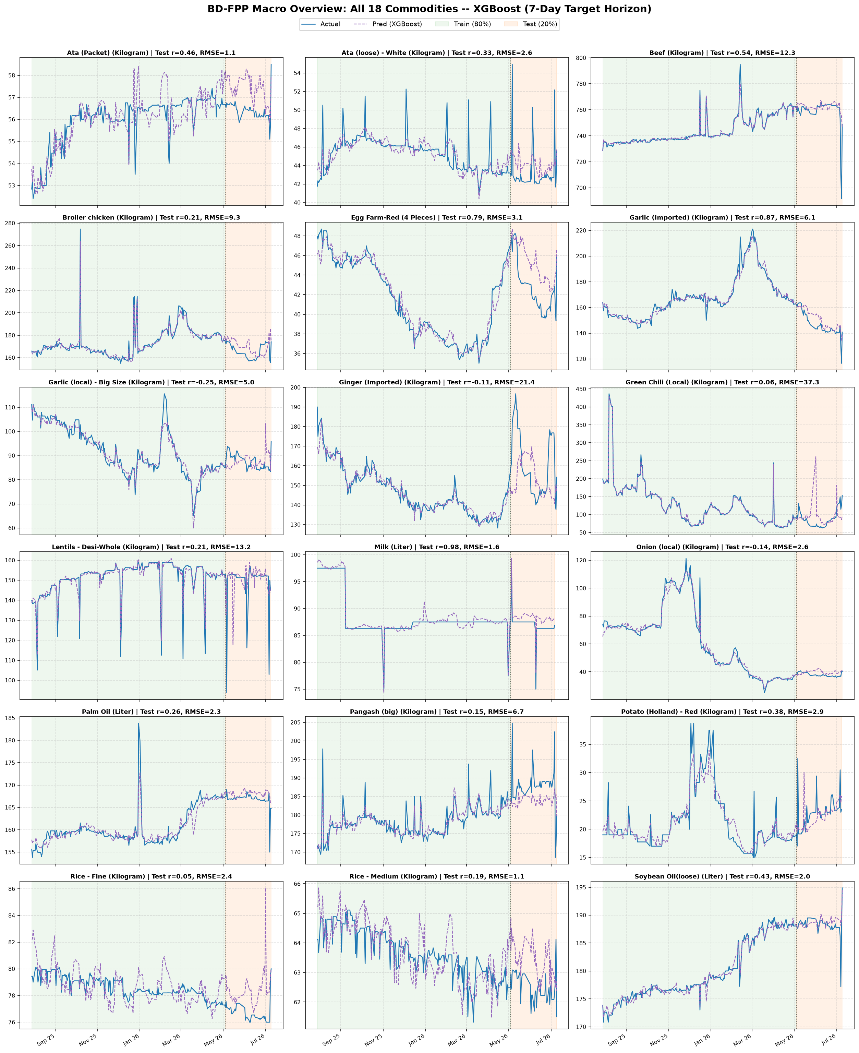
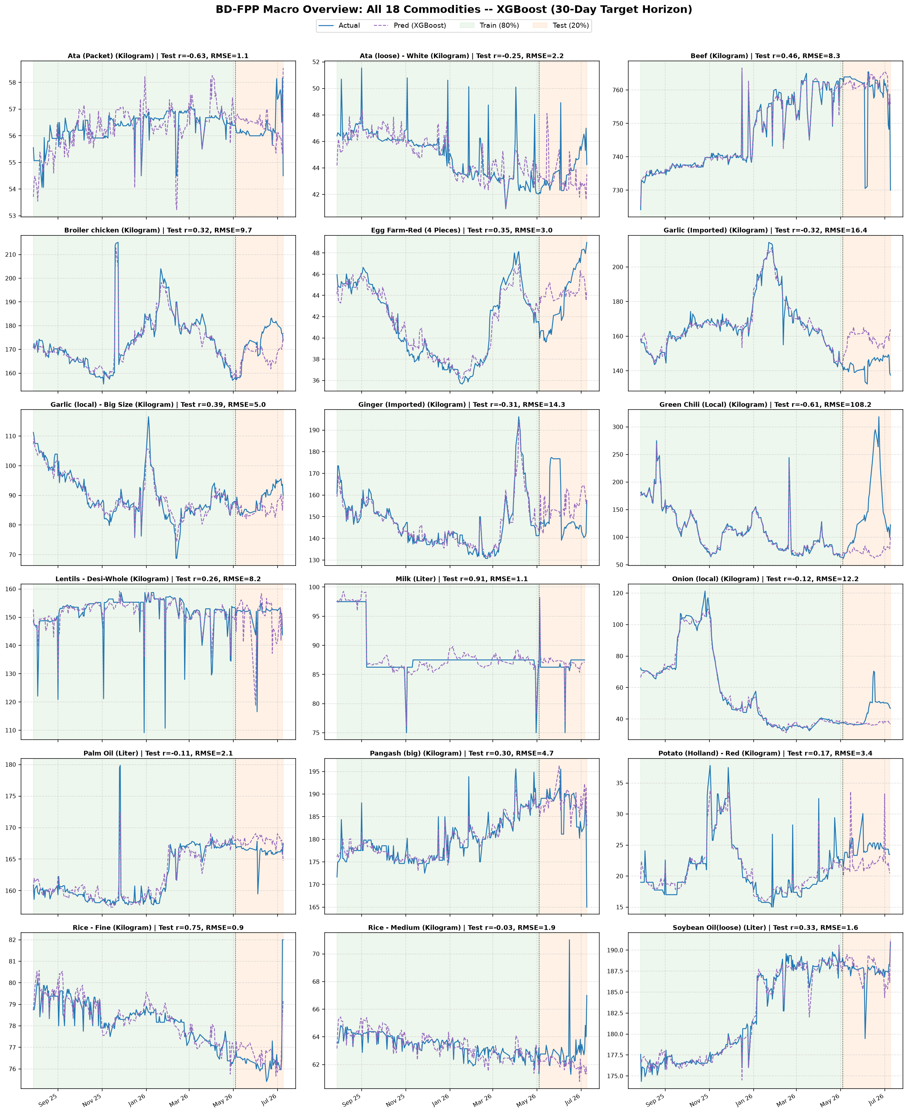
Time-series Graph Analysis
XGBoost for 18 commodities
BD-FPP: Multi-Region Bangladeshi Food-Price Dataset | KUET CSE 4112
13

Slide 14
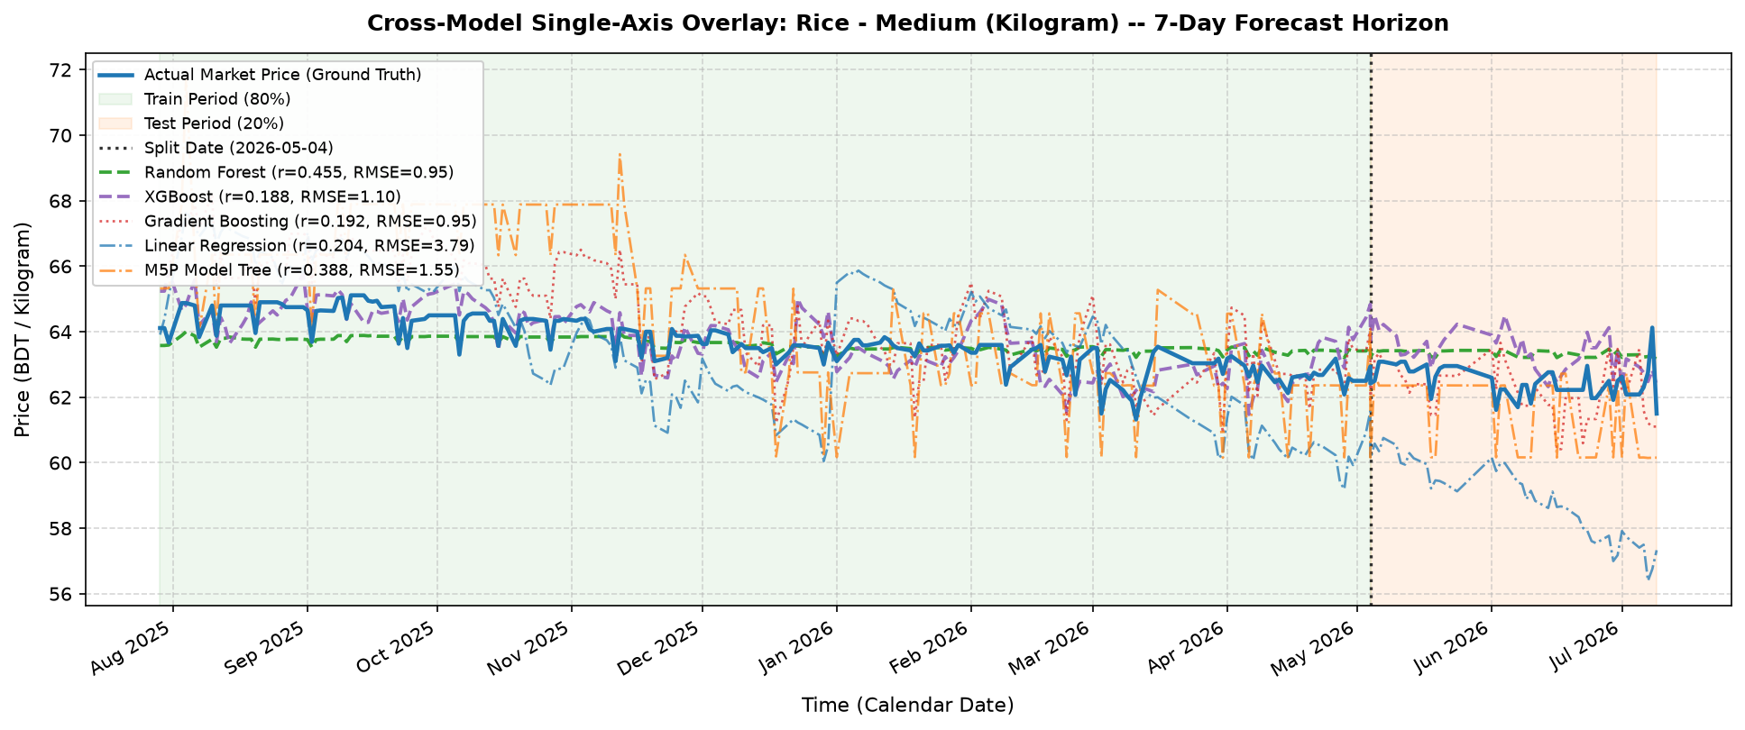
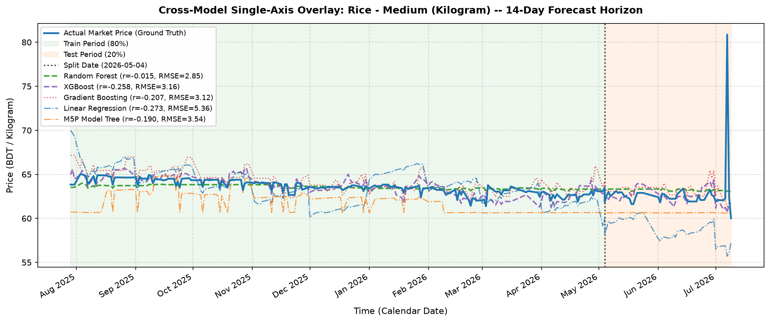
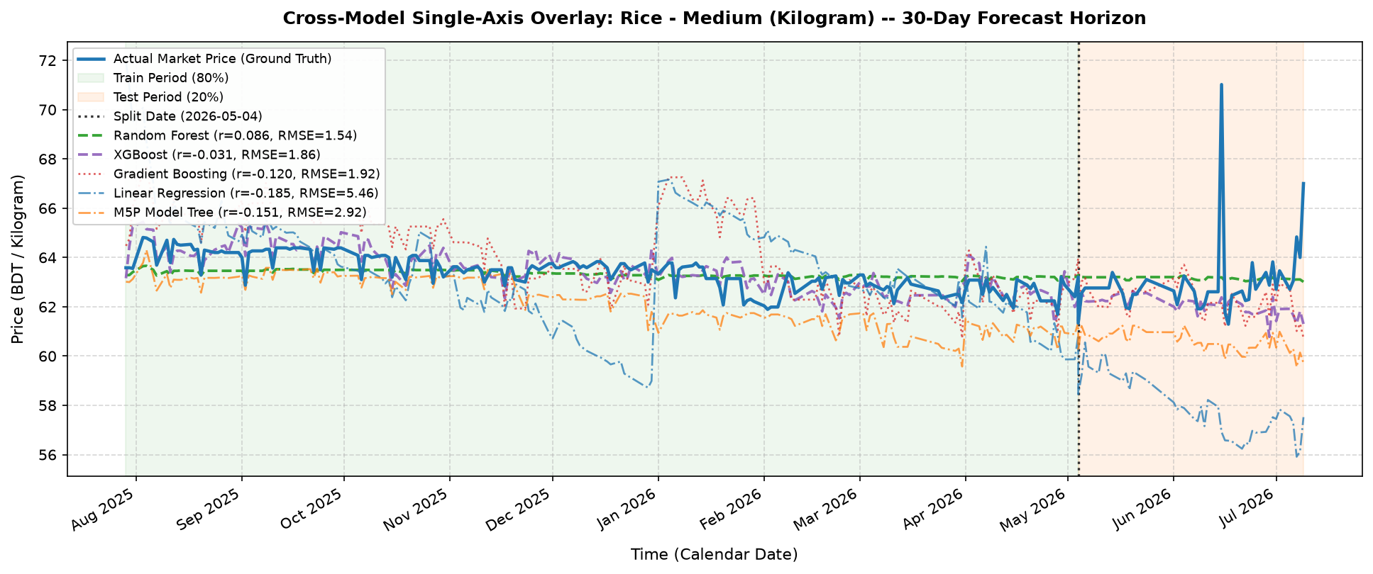
Cross-Model Analysis (Rice - Medium)
BD-FPP: Multi-Region Bangladeshi Food-Price Dataset | KUET CSE 4112
14

Slide 15
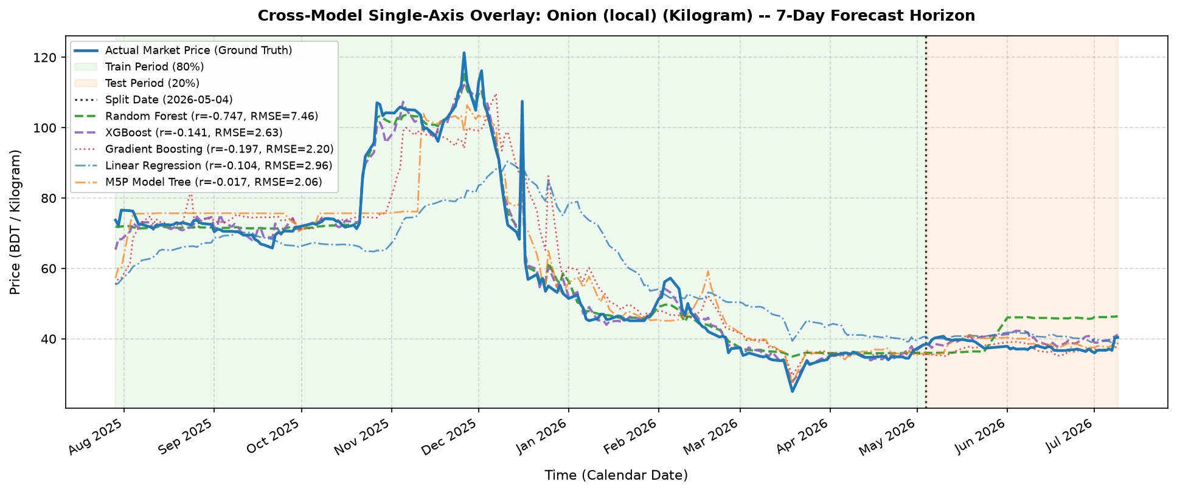
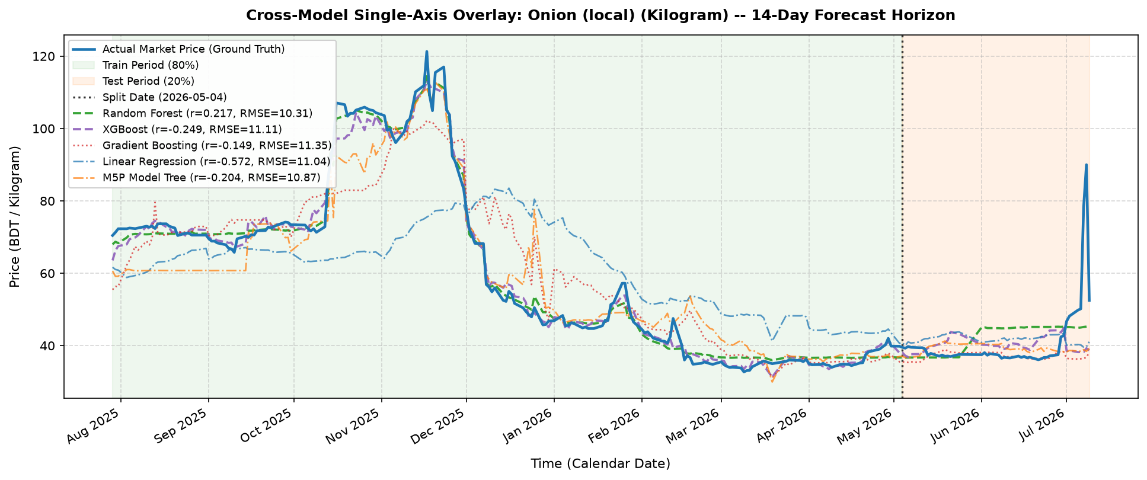
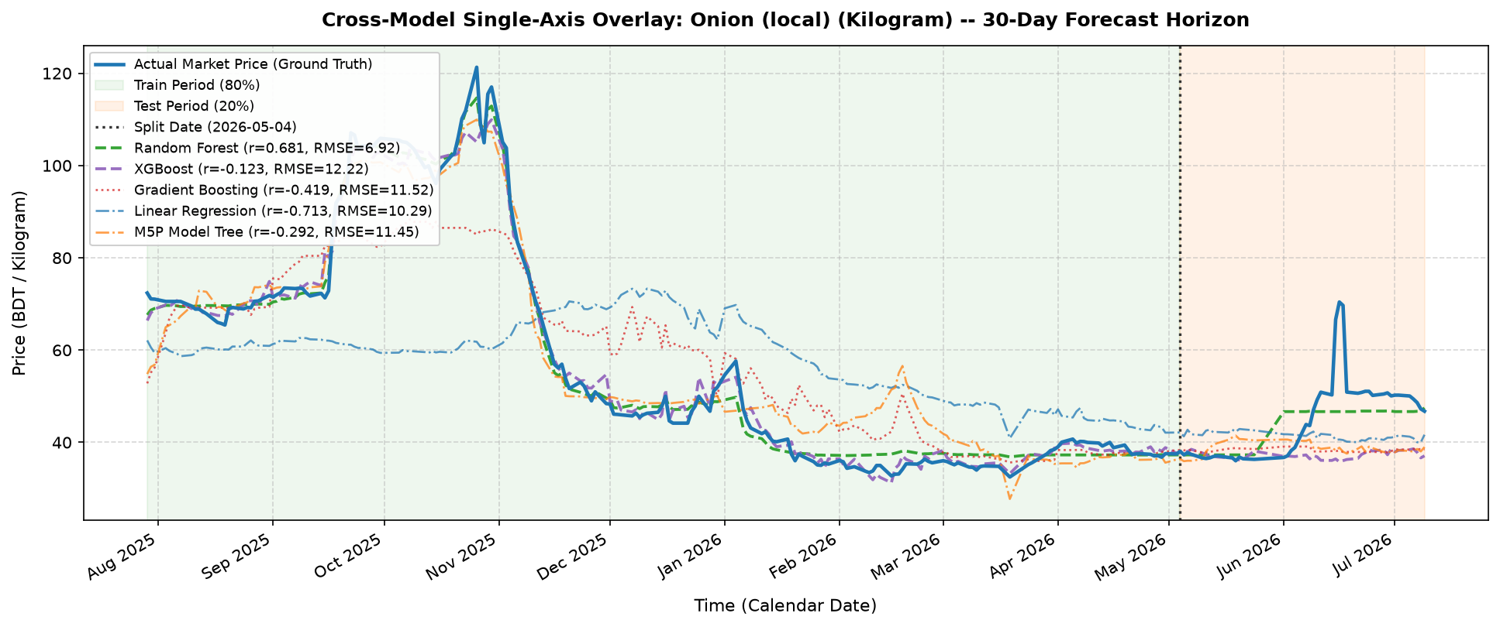
Cross-Model Analysis (Onion - Local)
BD-FPP: Multi-Region Bangladeshi Food-Price Dataset | KUET CSE 4112
15

Slide 16
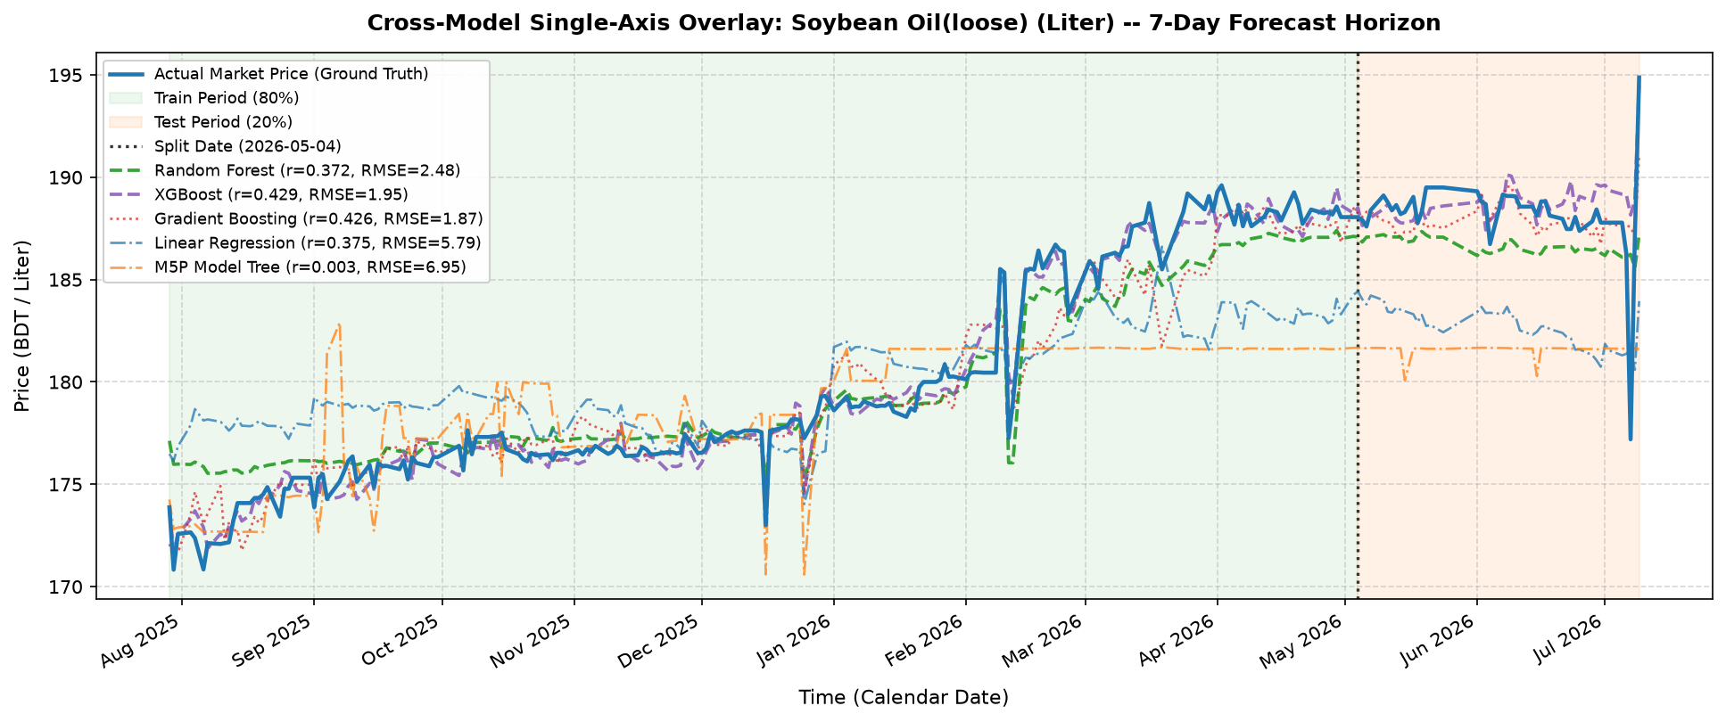
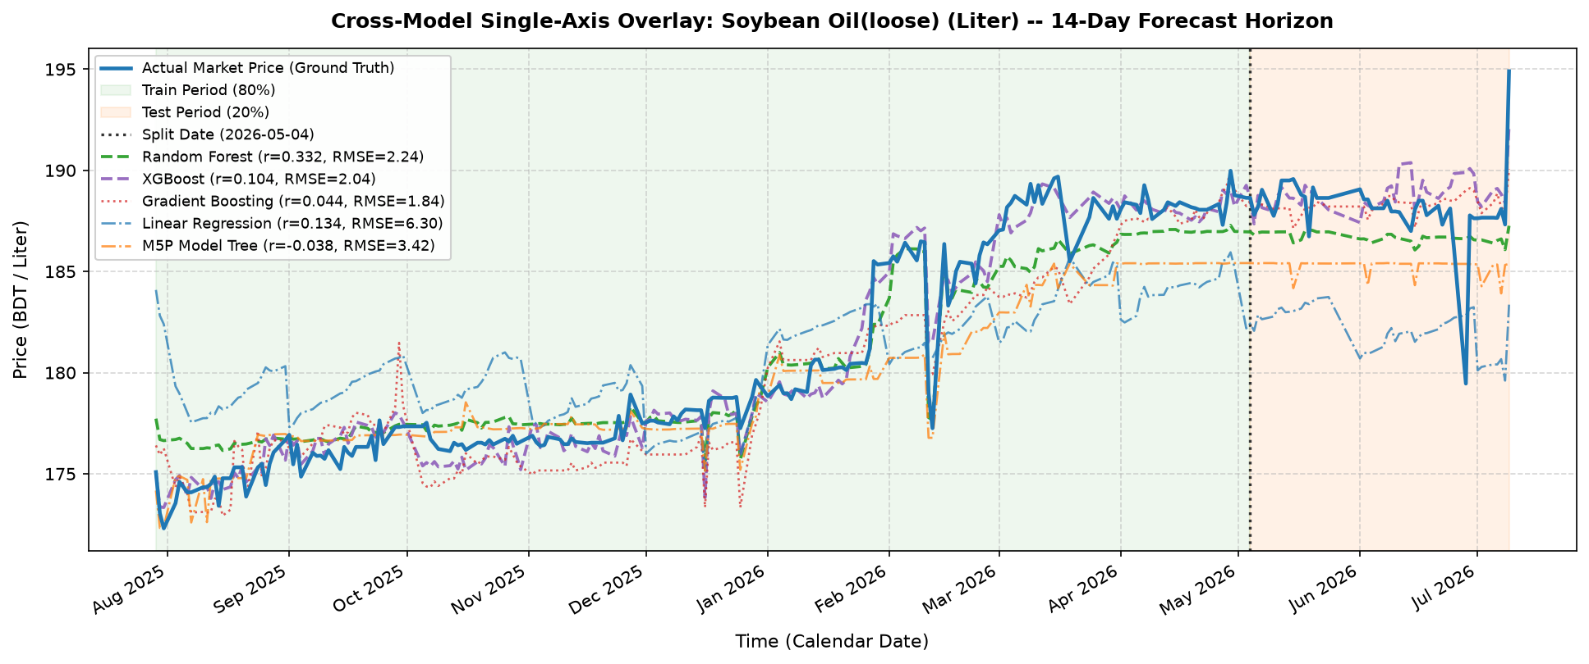
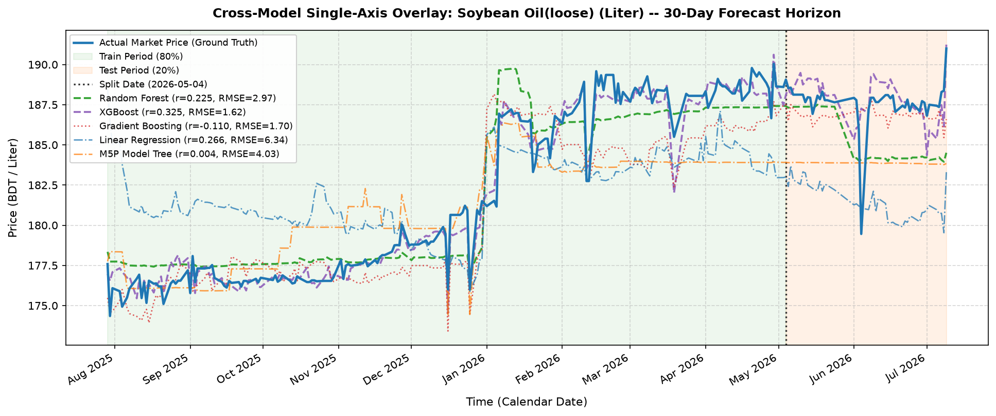
Cross-Model Analysis (Soybean Oil - Loose)
BD-FPP: Multi-Region Bangladeshi Food-Price Dataset | KUET CSE 4112
16

Slide 17
Results — Chronological Split
Best correlation: Random Forest (R=0.4515, RMSE 13.05) | Lowest error: Gradient Boosting (RAE=91.57%, MAPE=6.95%) | Weakest: M5P (MSE 1,685)
BD-FPP: Multi-Region Bangladeshi Food-Price Dataset | KUET CSE 4112
17

Slide 18
Results — Random (Shuffled) Split
Every model scores far higher than under the chronological split (best R rises 0.45 -> 0.79) — the interpolation/leakage signal the report quantifies next.
BD-FPP: Multi-Region Bangladeshi Food-Price Dataset | KUET CSE 4112
18

Slide 19
Chronological vs. Random — Generalization Gap
Every model degrades under the honest, chronological protocol (Table 13)
Degradation ratio
(chrono / random)
XGBoost: 2.23x
R falls 0.79 -> 0.44
Linear Regr.: 1.97x
R falls 0.55 -> 0.41
Random Forest: 1.88x
M5P: 1.84x
Gradient Boosting: 1.38x
(most protocol-stable)
BD-FPP: Multi-Region Bangladeshi Food-Price Dataset | KUET CSE 4112
19

Slide 20
Accuracy vs. Forecast Horizon (Pooled)
Whole-test-set correlation and MAE, chronological split (Table 14)
BD-FPP: Multi-Region Bangladeshi Food-Price Dataset | KUET CSE 4112
20

Slide 21
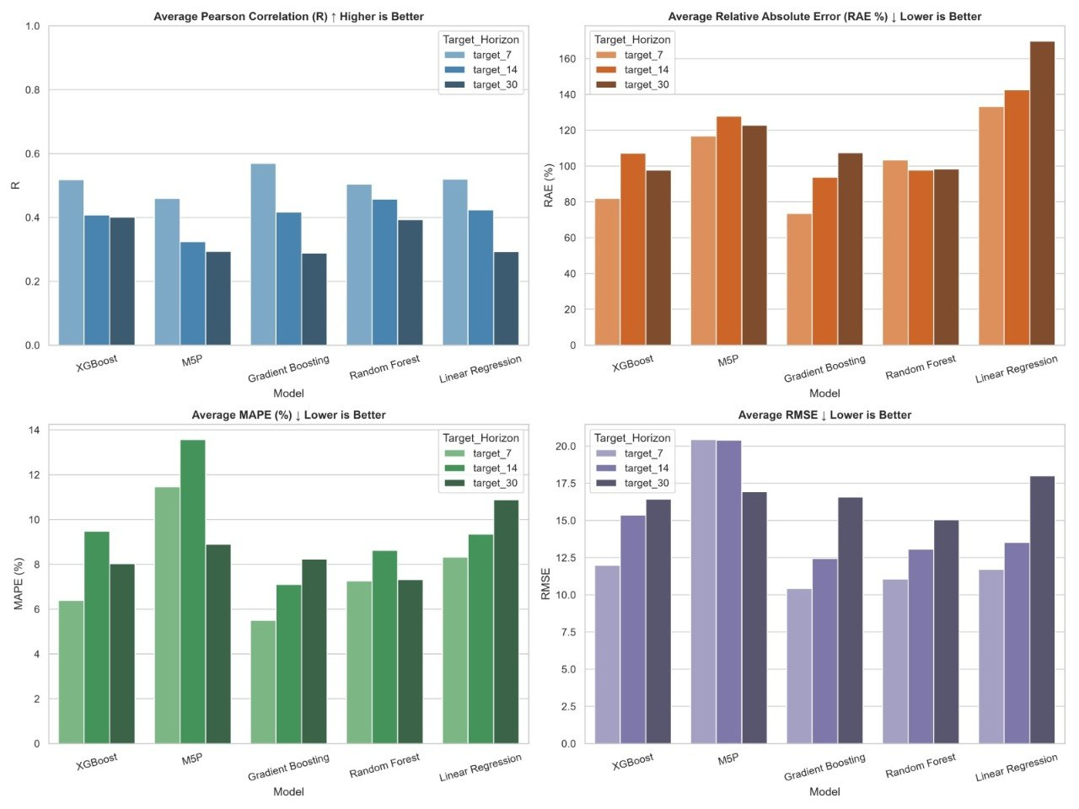
Per-Horizon Macro-Averaged Comparison
R, RAE, MAPE and RMSE by model and horizon — random-split view (Sec. 10.11)
BD-FPP: Multi-Region Bangladeshi Food-Price Dataset | KUET CSE 4112
21

Slide 22
Which Model Wins — and Why
Combining both protocols and all three horizons
Criterion | Winner | Evidence
Best chronological correlation | Random Forest | R = 0.4515, RMSE 13.05 (Table 11)
Lowest chronological error | Gradient Boosting | RAE 91.57%, MAPE 6.95%
Best random-split accuracy | XGBoost | R = 0.7887, RAE 42.96%
Most protocol-stable | Gradient Boosting | Only 1.38x degradation (Table 13)
Least stable overall | M5P | Best-at-30-days but worst-at-7-days — reverses under both axes
Overall recommendation: XGBoost is the best choice for real forecasting because it performed very well in both testing methods. Gradient Boosting gave the most consistent results and worked best for predicting the near future (short-term forecasts).
BD-FPP: Multi-Region Bangladeshi Food-Price Dataset | KUET CSE 4112
22

Slide 23
Inference Workflow — gui.py
User selects
protocol, model,
division, commodity,
target date
Plan greedy jumps
(e.g. 45 days =
30 + 14 + 7)
→
Rebuild lag row ->
predict -> append
as synthetic obs.
→
Repeat until
target date
(every step logged)
→
Final predicted
price (BDT) +
Jump Log
Model files: Weka-native models (Linear Regression, M5P, Random Forest) run through python-weka-wrapper3 + a local JVM; Gradient Boosting and XGBoost are unwrapped from Weka's ScikitLearnClassifier objects with javaobj and executed as native scikit-learn pickles.
Each prediction is used to make the next one, so errors can grow over time. Therefore, long-term predictions are less accurate and should be treated as estimates rather than exact prices.
BD-FPP: Multi-Region Bangladeshi Food-Price Dataset | KUET CSE 4112
23

Slide 24
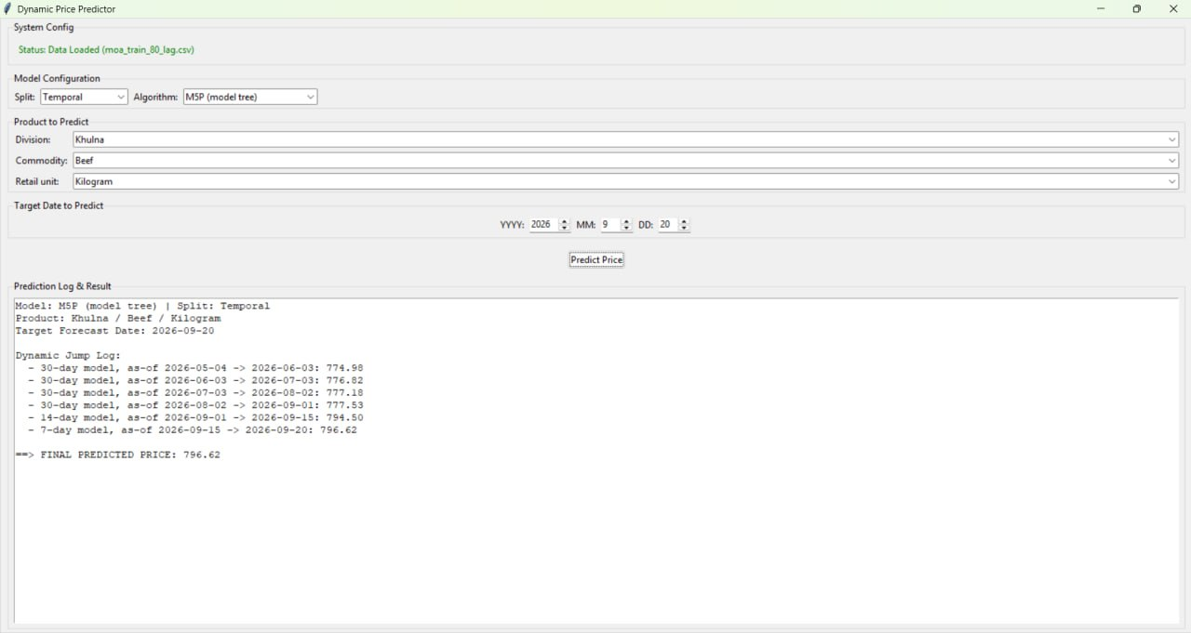
Inference Workflow — gui.py
BD-FPP: Multi-Region Bangladeshi Food-Price Dataset | KUET CSE 4112
24

Slide 25
Thank You
BD-FPP — Bangladeshi Food-Price Panel | Group B2, Batch 2K21
Md. Sabith · Abu Hasanat Soykot · Newaz Mohammad Hamim · Tajnoor Sultana · Ahsanul Islam Emon
Khulna University of Engineering & Technology — Dept. of Computer Science & Engineering

