Slide 1

Finding the Global Minimum of the
2D Ackley Function
MACHINE LEARNING · GA-ASSIGNMENT
with Genetic Algorithm
Presented by
Course Instructor
2107067
2107078
Dr. Al Mahmud
2107091
2107100
Professor, Department of CSE, KUET
2107108
2107115
Notes:
Our project uses a Genetic Algorithm to minimize the two-dimensional Ackley function. Today's talk walks through what we built, the problem, the inputs, how the algorithm works, the code behind it, the results, and what those results mean.
1

Slide 2
A Genetic Algorithm that hunts for a single point in a 2D landscape
WHAT WE'RE DOING
01
02
03
04
Goal
Approach
Benchmark
Deliverable
Find the (x1, x2) point that drives the 2D Ackley function as close as possible to its known global minimum f(0,0) = 0.
Evolve a population of 50 candidate points over up to 100 generations using selection, crossover, mutation and elitism — no gradients required.
Compare the GA's global search against SciPy's Nelder-Mead, a classical local, derivative-free optimizer, from a fixed starting point.
A tested Python codebase (NumPy/Matplotlib/SciPy/pytest) that prints progress, saves plots, and writes a JSON results summary.
GA · 2D Ackley Function
2 / 13
Notes:
In one line: we're evolving a population of candidate (x1,x2) points to minimize the Ackley function, and checking that approach against a classical local optimizer.
2

Slide 3
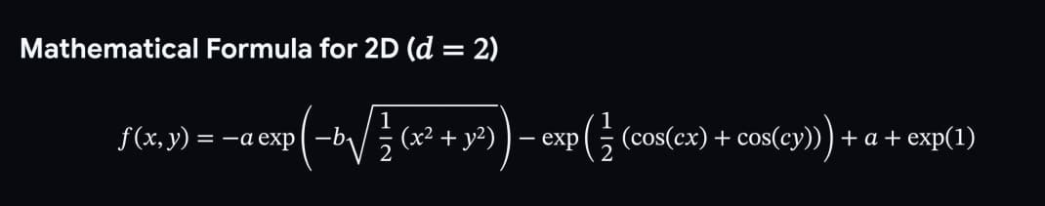
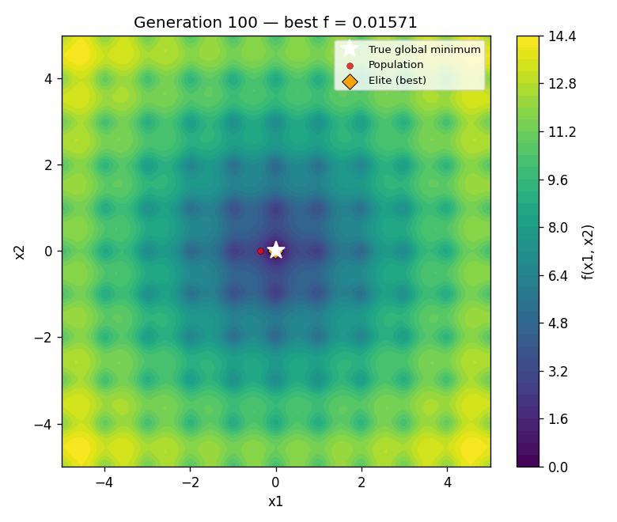
THE PROBLEM WE'RE SOLVING
Minimizing a deceptive, multimodal landscape
Domain: -5 ≤ x1, x2 ≤ 5, searched with no derivative information
Known global minimum: f(0, 0) = 0 — the target we're trying to reach
The Ackley function itself is used directly as the fitness/objective value
Why it's hard
▸
Flat outer plateau — Slopes barely change far from the center — little guidance toward (0,0).
▸
Dense local ripples — Cosine terms create many recurring local minima that trap local-search methods.
▸
Narrow central funnel — A steep, tight pit near the origin needs fine-grained tuning to reach zero.
The Ackley surface: a bullseye of ripples around a deep central well at (0,0).
GA · 2D Ackley Function
3 / 13
Notes:
The Ackley function is multimodal: it looks flat far out, is covered in small ripples, and has one very narrow true minimum at the origin. Local, gradient-based search tends to get stuck in the ripples.
3

Slide 4
INPUT
What goes into the system
Objective function
GA hyperparameters
f(x1,x2) = -a·exp(-b√0.5(x1²+x2²)) - exp(0.5(cos(cx1)+cos(cx2))) + a + e
50
100
Population size
Max generations
Param | Value | Meaning
a | 20.0 | Scaling constant
b | 0.2 | Exponential decay
c | 2π | Cosine frequency
Domain | [-5, 5] | For both x1 and x2
0.80
0.05
Crossover prob. (Pc)
Mutation prob. (Pm)
1 kept
0.5
Elitism
Mutation σ (Gaussian)
Fitness = Ackley value itself • lower is better • target = 0 at (0,0)
1e-6
42 (reproducible)
Chromosome: [x1, x2] ∈ ℝ², each gene initialized uniformly at random inside [-5, 5].
Early-stop tolerance
Random seed
GA · 2D Ackley Function
4 / 13
Notes:
Two kinds of input: the mathematical definition of the Ackley function with its constants and domain, and the GA's own configuration — population size, generation budget, crossover and mutation rates, elitism, and the random seed that makes a run reproducible.
4

Slide 5
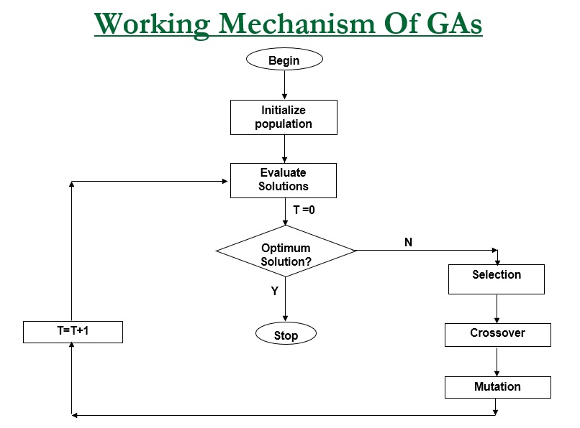
HOW IT WORKS
The standard GA flowchart
Reading the loop
Initialize population
_init_population() draws 50 chromosomes [x1,x2] uniformly from [-5,5].
Evaluate solutions
ackley_vec() scores the whole population in one vectorized call.
Optimum solution? (Y/N)
Checks best_fitness ≤ 1e-6 (Y → stop) or generations = 100 (Y → stop).
Selection → Crossover → Mutation
Inverted roulette wheel, one-point crossover (Pc=0.8), Gaussian mutation (Pm=0.05).
T = T + 1, loop back
Elite carried forward, new population re-evaluated, and the cycle repeats.
GA · 2D Ackley Function
5 / 13
Notes:
This is the textbook GA flowchart: initialize, evaluate, test for the optimum, and if not found, cycle through selection, crossover and mutation before incrementing the generation counter and looping back. Our implementation follows this exactly — the next two slides map each box to real code and formulas.
5

Slide 6
HOW IT WORKS — IN OUR CODE
One generation of the algorithm, step by step
1
2
3
4
5
Sort & preserve
Select parents
Crossover
Mutate
Re-assemble
→
→
→
→
Rank the population by fitness; copy the best (elite) chromosome unchanged.
Inverted roulette wheel: weight = worst − fitness + ε, so lower Ackley values get bigger odds.
One-point crossover swaps x1/x2 between two parents with probability 0.8.
One randomly chosen gene gets a Gaussian nudge (σ = 0.5) with probability 0.05, then is clipped to [-5,5].
Elite + offspring form the next 50-member population; re-evaluate fitness and check for convergence.
Loop repeats for up to 100 generations, or stops early once best fitness ≤ 1e-6.
GA · 2D Ackley Function
6 / 13
Notes:
Each generation follows the same five-step loop. The elite chromosome bypasses crossover and mutation entirely, which guarantees the best-so-far fitness never gets worse.
6

Slide 7
METHODOLOGY — DEEP DIVE I
What actually happens inside each operator
1 · Selection
2 · Crossover
3 · Mutation
Inverted roulette wheel
One-point, applied with Pc = 0.8
One-gene Gaussian, applied with Pm = 0.05
w_i = (f_worst − f_i) + 1e-8
p_i = w_i / Σ w_k
A 2-gene chromosome has exactly one interior cut point — between x1 and x2 — so the children simply trade genes:
1
Copy the chromosome (never mutate the parent array in place).
2
Pick one of the 2 gene indexes at random.
P1 = [ 2.10, -3.40 ]
P2 = [-1.05, 0.90 ]
→ C1 = [ 2.10, 0.90 ]
→ C2 = [-1.05, -3.40 ]
3
Draw Δ ~ N(0, σ²) with σ = 0.5.
Worked example (3 chromosomes):
A: f=0.4 → w=2.6 → p=0.65
4
Add Δ to the chosen gene only.
B: f=1.5 → w=1.5 → p=0.375
5
Clip the result back into [-5, 5] with np.clip.
C: f=3.0 (worst) → w=0.0 → p≈0
Roll < 0.8 → crossover fires and children replace the parents; roll ≥ 0.8 → parents pass through unchanged (copied as-is).
A is closest to zero, so it dominates the wheel; C (the worst) gets almost no chance. Parents are drawn with replacement from this distribution.
gene x2 = 4.85
Δ = +0.9 → 5.75 → clip → 5.0
This mixes x1 from one parent with x2 from another — the only recombination possible with a 2-gene, real-valued chromosome.
Small, localized nudges maintain diversity and let the population fine-tune around a promising basin without wild jumps.
GA · 2D Ackley Function
7 / 13
Notes:
Concretely: selection converts fitness into odds so low-Ackley chromosomes dominate the draw; crossover trades x1/x2 between two parents since there's only one possible cut point; mutation nudges a single gene with a small Gaussian step and clips it back into bounds.
7

Slide 8
METHODOLOGY — DEEP DIVE II
Inside run(): the full generation loop, in order
np.argsort(fitness) ranks the 50×2 population array ascending.
ackley_vec(next_population) re-evaluates all 50 fitness values at once.
1
6
population[:elitism] is copied verbatim into next_population.
best_fitness / best_chromosome update only if the new best is lower.
2
7
Repeat: draw a parent pair via roulette → crossover (Pc) → mutate each child (Pm).
history_best and history_mean each get one new value appended.
3
8
Keep appending children until next_population reaches size 50.
If verbose, print progress at generation 1 and every 10th generation.
4
9
next_population = elite + offspring, replacing the current population.
Stop if best_fitness ≤ convergence_tol (1e-6) or generations = 100.
5
10
Elitism means step 7's best-so-far value is mathematically non-increasing generation over generation — the recorded curve can only flatten or drop.
GA · 2D Ackley Function
8 / 13
Notes:
This is literally the body of GeneticAlgorithm.run(): sort and preserve the elite, fill the rest of the population through selection/crossover/mutation, re-evaluate the whole array in one vectorized call, update the best-so-far bookkeeping, log history, and check the two stopping conditions.
8

Slide 9
CORE TOOLS & CODE
Four Python modules, four libraries
ackley.py
genetic_algorithm.py
main.py
test_ga.py
Defines scalar ackley() and vectorized ackley_vec() — the objective function and its constants.
GAConfig / GAResult dataclasses plus the GeneticAlgorithm engine: selection, crossover, mutation, run loop.
Runs experiments, saves the two plots, runs the Nelder-Mead comparison, writes run_summary.json.
Six pytest checks covering correctness, monotonic improvement, convergence, and bounds.
→
→
→
Libraries
NumPy SciPy OpenPyXL PyTest
Pandas MatPlotLib ImageIO
Run it: cd src → pip install -r requirements.txt → python main.py | Test it: python -m pytest test_ga.py -v
GA · 2D Ackley Function
9 / 13
Notes:
The code is split into an objective-function module, a reusable GA engine, an entry point for experiments and plots, and a focused test suite, built on NumPy, Matplotlib, SciPy and pytest.
9

Slide 10
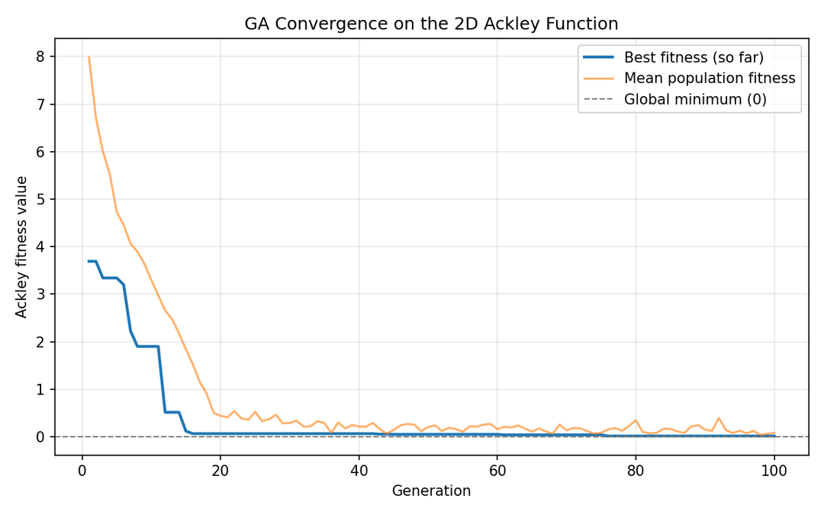
OUTPUT
What the program produced (seed 42)
[-0.00185, 0.00496]
0.015713
100
No
Best chromosome
Best fitness
Generations run
Converged (≤ 1e-6)
Convergence over 100 generations
Also produced by the run
convergence_curve.png
Best-so-far & mean fitness vs. generation, with a zero reference line.
ackley_surface_solution.png
Filled contour of the landscape with the true minimum and GA solution marked.
run_summary.json
Machine-readable record of settings, GA result, classical comparison, and reduced-generation runs.
GA · 2D Ackley Function
10 / 13
Notes:
The seed-42 run landed on [-0.00185, 0.00496] with fitness 0.0157 after the full 100 generations — close to zero but short of the strict 1e-6 tolerance. The program also writes plots and a JSON summary to src/output.
10

Slide 11

The GA solution on the Ackley surface
OUTPUT
GA · 2D Ackley Function
11 / 13
Notes:
The contour plot gives a geometric view: the GA's red-dot solution sits essentially on top of the true minimum, having crossed several rings of local minima to get there.
11

Slide 12
DISCUSSION OF OUTPUTS
What the results tell us
Automated verification
6 / 6 tests passed · 1.09s · Python 3.14.3
GA vs. classical Nelder-Mead
✓
f(0,0) ≈ 0 within 1e-9
Metric | Genetic Algorithm | Nelder-Mead
Start | Random population (N=50) | [4.0, -4.0]
Result | [-0.00185, 0.00496] | [3.983, -3.983]
Fitness | 0.015713 | 10.998262
Outcome | Reached the global basin | Trapped in a local ripple
✓
Fitness is positive away from the origin
✓
Scalar and vectorized evaluations agree
✓
Best-so-far fitness never increases
✓
100-gen run reaches fitness below 1.0
✓
Final chromosome stays within [-5, 5]
Why: Nelder-Mead only follows local slope from one starting point, so it settles in the nearest ripple. The GA keeps 50 points spread across the whole domain, so some always land near the true basin.
Interpretation: the run is close to the mathematical optimum but not exact — typical for a stochastic search. A different seed or a longer budget could close the remaining gap.
12 / 13
Notes:
Nelder-Mead gets trapped locally while the GA reaches the global basin; more generations sharpen precision but even 20 generations already find the right basin. All six tests pass, confirming the implementation behaves as specified.
12

Slide 13
The GA reached the basin the local optimizer couldn't
SUMMARY & CONCLUSIONS
1
2
3
Optimization success
Global beats local, here
Verified & reproducible
Navigated the multimodal Ackley landscape to f ≈ 0.0157, right beside the true minimum.
Outperformed Nelder-Mead, which stayed trapped in a local ripple from its starting point.
Six pytest checks pass; a fixed seed makes the run repeatable end to end.
GA · 2D Ackley Function
13 / 13
Notes:
To close: the GA maintains a population, improves it through selection and variation, and protects the best candidate with elitism — and that's what let it beat a local optimizer on this landscape.
13

Slide 14
Thank you for your attention!

