Slide 1

Recurrent Neural Networks
aCubeIT
L02 - Deep Learning for Life Sciences Course

Slide 2
Recurrent Neural Networks (RNNs)
Predict Sequences

Slide 3
Recurrent Neural Networks (RNNs)
Machine Translation
Speech Recognition
Sentiment Classification
DNA Sequence Analysis
Predict Sequences

Slide 4
Can you predict the direction of mouvement ?

Slide 5
Can you predict the direction of mouvement ?

Slide 6
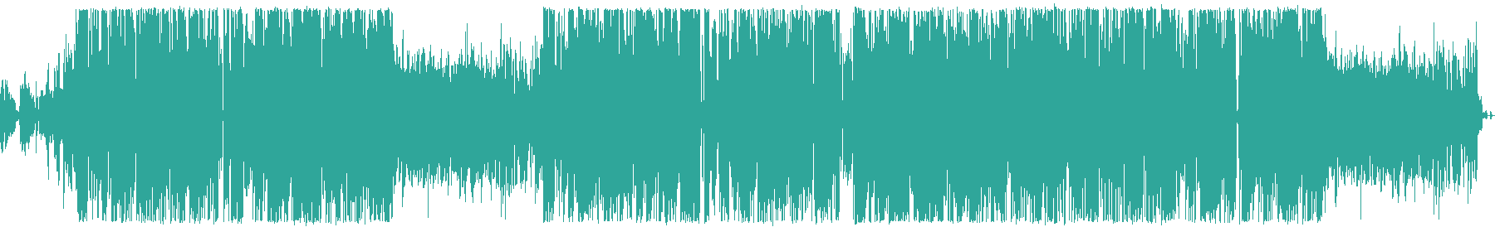
Sequences in the Wild
Audio waves
Eminem, 2020. Music to Be Murdered By: Those Kinda Nights (ft. Ed Sheeran).

Slide 7
Sequences in the Wild
“This morning I took my dog
out for a walk.”
Text

Slide 8
Sequences in the Wild
Bases in a DNA molecule

Slide 9
Recurrent Neural Networks (RNNs)
Pros:
Works well with sequential data
Multiple architectures
Cons:
Doesn’t work well with image data

Slide 10
RNN Architectures
One to one
One to multiple
Multiple to one
Multiple to multiple

Slide 11
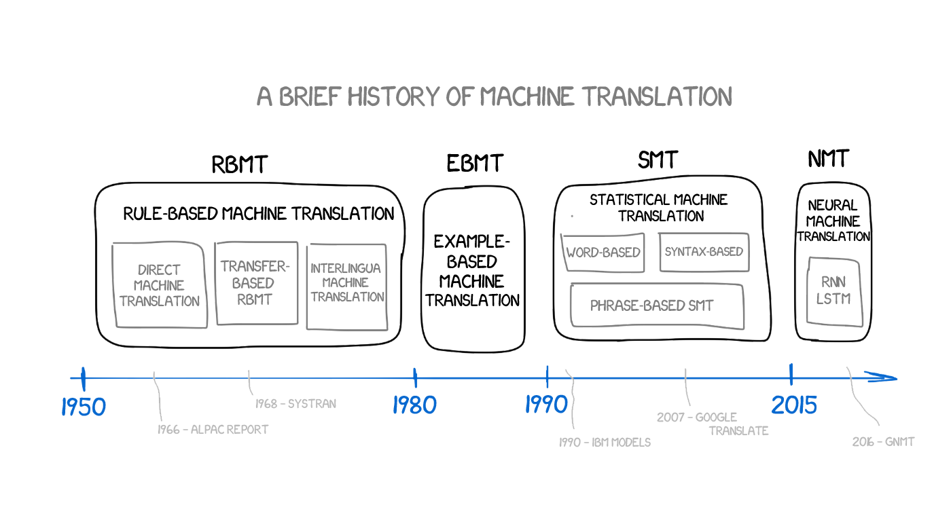
RNNs: Machine Translation
Vasily Zubarev. 2018, Machine Translation, https://vas3k.com/blog/machine_translation (accessed February 2020).

Slide 12
Hybrid Networks
Automatic Image Captioning
CNN-RNNs

Slide 13
Thank you !
Ackruti Trade Center, MIDC, Mumbai, IND
www.acubeit.com
+91 9892512129
prakash@acubeit.com
aCubeIT

