Slide 1
Analysis of Endangered Species in National Parks
Adrien Cortesi, 08/21/2024

Slide 2
Introduction
Project Goal: Analyze conservation statuses of species and their distribution across U.S. National Parks.
Key Areas:
Distribution of conservation statuses.
Significance of differences across species categories.
Most observed species in each park.

Slide 3
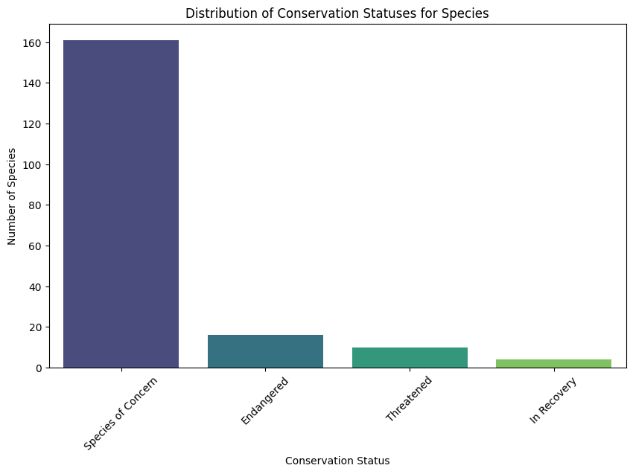
Data Overview: species_info.csv
Columns:
category: Class of species (e.g., Mammal, Bird).
scientific_name: Scientific name of species.
common_name: Common names.
conservation_status: Current conservation status.
Observations:
Most species are categorized under "Species of Concern."
Fewer species fall under "Endangered," "Threatened," or "In Recovery."

Slide 4
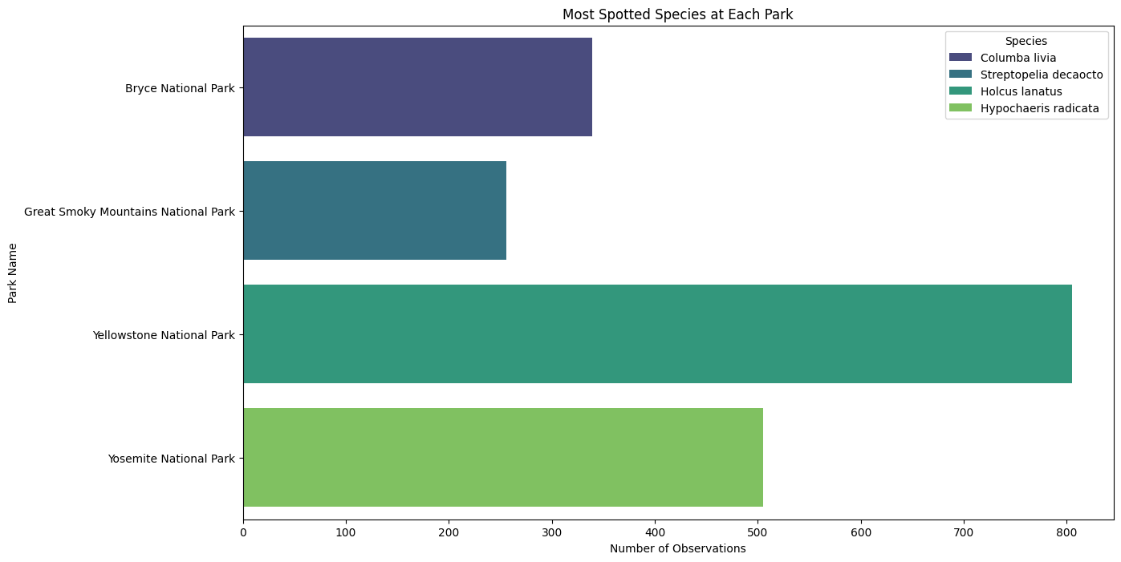
Data Overview: observations.csv
Columns:
scientific_name: Scientific name of species.
park_name: Park where species were observed.
observations: Number of times each species was observed.
Purpose:
Used to determine the most observed species at each park.

Slide 5
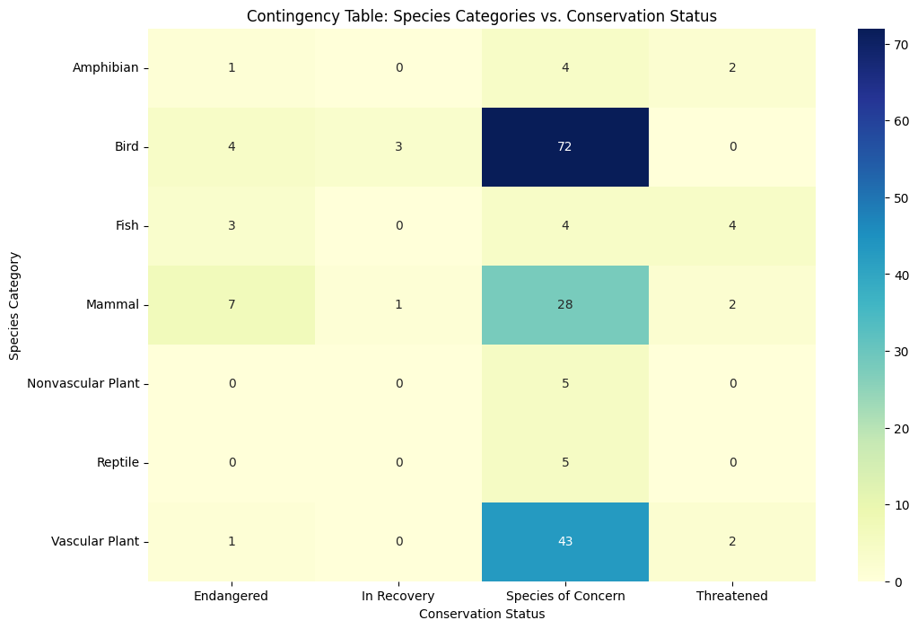
Significance of Conservation Status Across Species Categories
Chi-Square Test:
Purpose: Test if the differences in conservation statuses across species categories are significant.
Result: Significant differences found (p-value < 0.05).
Interpretation:
Some species categories are more prone to being endangered.

Slide 6
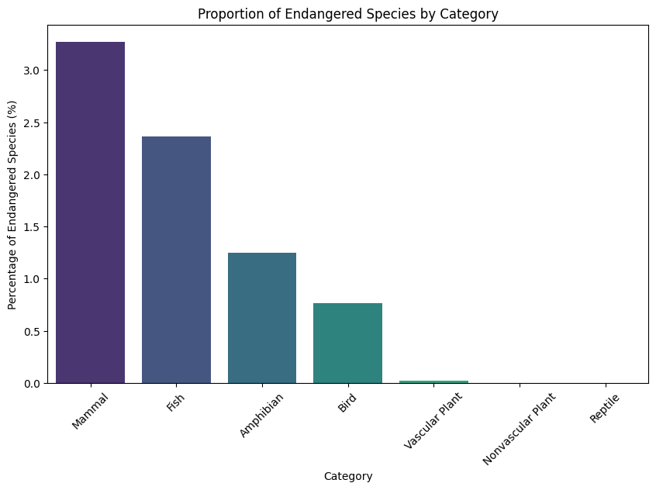
Conservation Recommendations
Focus Areas:
Mammals, Fish, and Amphibians: High proportions of endangered species.
Species of Concern: Need monitoring to prevent further decline.
Actions:
Prioritize conservation resources for at-risk categories.
Continue monitoring species in less critical categories.

Slide 7
Conclusion
Recap:
Distribution of Conservation Statuses:
Majority of species are classified as "Species of Concern."
Smaller numbers fall under "Endangered," "Threatened," or "In Recovery."
Significance of Differences:
Chi-Square test indicates significant differences in conservation statuses across species categories.
Some categories (e.g., Mammals, Fish) are more prone to endangerment.
Most Observed Species by Park:
Each park has a distinct species that is most frequently observed.
Highlights biodiversity and species prevalence in different parks.
Final Thoughts:
Data-Driven Insights:
Crucial for prioritizing conservation efforts.
Focus on species categories with higher endangerment risks.
Continued monitoring of "Species of Concern" is essential.

