Slide 1

FaasCache: Keeping Serverless Computing Alive With Greedy-Dual Caching
Alex Fuerst, Prateek Sharma

Slide 2




How the time flies by
FaaS
System
Container
Layer
ML Function
Docker, VM,
Firecracker, etc
~1s
~1s
Azure Functions,
AWS Lambda,
OpenWhisk, etc
~.5s
Cold start
~2s
def lambda_handler(event, context): picture = event[’data’] prediction_output = infer_image(picture) return prediction_output
import tensorflow as tf m = download_model(’http://model/img_classify.pb’) session = create_tensorflow_graph(m)
Execution

Slide 3
Can we avoid Cold starts?
Init
User Code
Keep-Alive
User Code
Keep-Alive
Cold start​
Warm start​
Providers keep code resident in memory for a short time
New invocations can skip initialization
Tradeoff between higher warm starts and memory use
How long to keep alive?
Fixed interval ignores fact that not all functions are created equally
Resources, frequency, initialization time

Slide 4
Keep-alive akin to caching!
Events in FaaS map to caching space
Warm start => cache hit
Cold start => cache miss
Keep functions warm indefinitely to increase hit rate
What to keep => eviction
Greedy-Dual policy accounts for varied characteristics
$$KeepAlivePriority=Recency+ \frac{Frequency ∗InitTime}{Memory}$$

Slide 5

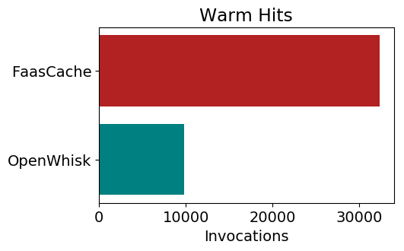
FaasCache Effectiveness
Caching analogy allows experimentation with other keep-alive policies
LRU, LFU, etc.
Use ideas like hit-ratios to optimize resource allocation
Real experiments via implementation in OpenWhisk
Increase warm hits by up to 3x!

Slide 6
Cold Starts in the wild
Provider / Runtime | Cold Start (s)*
AWS / JavaScript | 0.25
AWS / Python | 0.23
GCP / JavaScript | 0.65
GCP / Python | 1.0
Azure / JavaScript | ~ 5
Azure / Python | ~ 1.2
https://mikhail.io/serverless/coldstarts/big3/
* Medians of ranges

Slide 7
Can we avoid this?
Providers keep code resident in memory for a short and fixed time
This simple TTL ignores the fact that not all functions are created equally
Application | Mem size | Run Time | Initialization Time
ML Inference (TF CNN) | 512 MB | 6.5 s | 4.5 s
Video Encoding | 500 MB | 56 s | 3 s
Matrix Multiply | 256 MB | 2.5 s | 2.2 s
Disk-bench (dd) | 256 MB | 2.2 s | 1.8 s
Web-serving | 64 MB | 2.4 s | 2 s
Floating Point | 128 MB | 2 s | 1.7 s

Slide 8
How bad are cold starts?
Application | Mem size | Run Time | Initialization Time
ML Inference (TF CNN) | 512 MB | 6.5 s | 4.5 s
Video Encoding | 500 MB | 56 s | 3 s
Matrix Multiply | 256 MB | 2.5 s | 2.2 s
Disk-bench (dd) | 256 MB | 2.2 s | 1.8 s
Web-serving | 64 MB | 2.4 s | 2 s
Floating Point | 128 MB | 2 s | 1.7 s
Provider Init
User Init
User Code Run
Keep-Alive
Provider Init
User Init
Cold start​
Keep-Alive Ends
Cold start​

Slide 9


Caching with Greedy-Dual
$$Priority=Clock+ \frac{Frequency ∗Cost}{Size}$$
$$Priority=Recency+ \frac{Frequency ∗Startup}{Memory}$$
Capture recency, update with each eviction
Number of invocations while alive
Initialization time
Resource allocation (memory)

