Slide 1



Cloud-scale VM Deflation for Running Interactive Applications On Transient Servers
Alexander Fuerst, Ahmed Ali-Eldin, Prashant Shenoy, and Prateek Sharma
¹

Slide 2
Transient Computing
Surplus cloud resources are sold at discounted rates as low-priority Virtual Machines (VMs)
AWS Spot Instances , Azure Batch VMs, Google Preemptible VMs
Current transient cloud VMs are subject to unexpected revocation (preemption)
Preemption leads to application failure and downtime
Not ideal for interactive and long running applications
How can we provide such low cost and low priority VMs without preemption?

Slide 3
Deflatable Virtual Machines
Fractionally reclaim resources from low-priority VMs, avoiding preemption
CPU, Memory, Network, Disk bandwidth
Allow to make forward progress, albiet with some performance degradation
Arrival of new VMs causes deflation of low-priority VMs
Classic, high-priority, On-Demand VMs unaffected
Physical Server
On-Demand VM
Deflatable VM
Deflatable VM
On-Demand VM
Incoming VM

Slide 4
Deflation Benefits & Tradeoff
For applications: Black-box solution that supports all application classes No need for fault tolerance handling or downtime Better availability | For cloud providers: Increase cluster utilization Utilize surplus resources
Tradeoff: Possible performance degradation because of reduced resources
How feasible is deflation on typical cloud VMs?
How can we incorporate deflation in clouds?

Slide 5
Agenda
Transient computing
Deflatable Virtual Machines
Trace-based Deflatability Analysis
Server-Level Deflation
Cluster Deflation Management
Application Deflation Experiments
Related & Future work

Slide 6
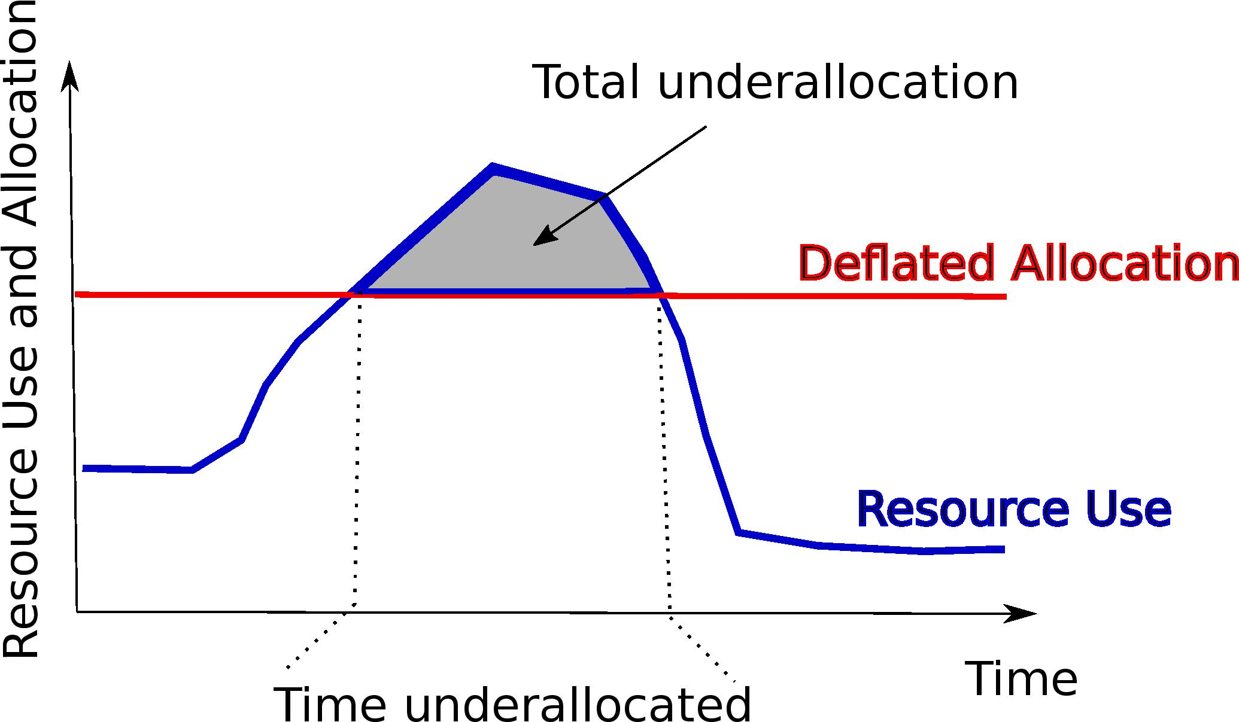
Performance impact of deflation on typical Cloud VMs
Deflation causes underallocation
What fraction of time VM utilization is above deflation levels (performance degradation)?
If deflated allocation is above the VMs utilization, there is no performance degradation (slack)
Analyze traces from Azure and Alibaba
Slack
Slack

Slide 7
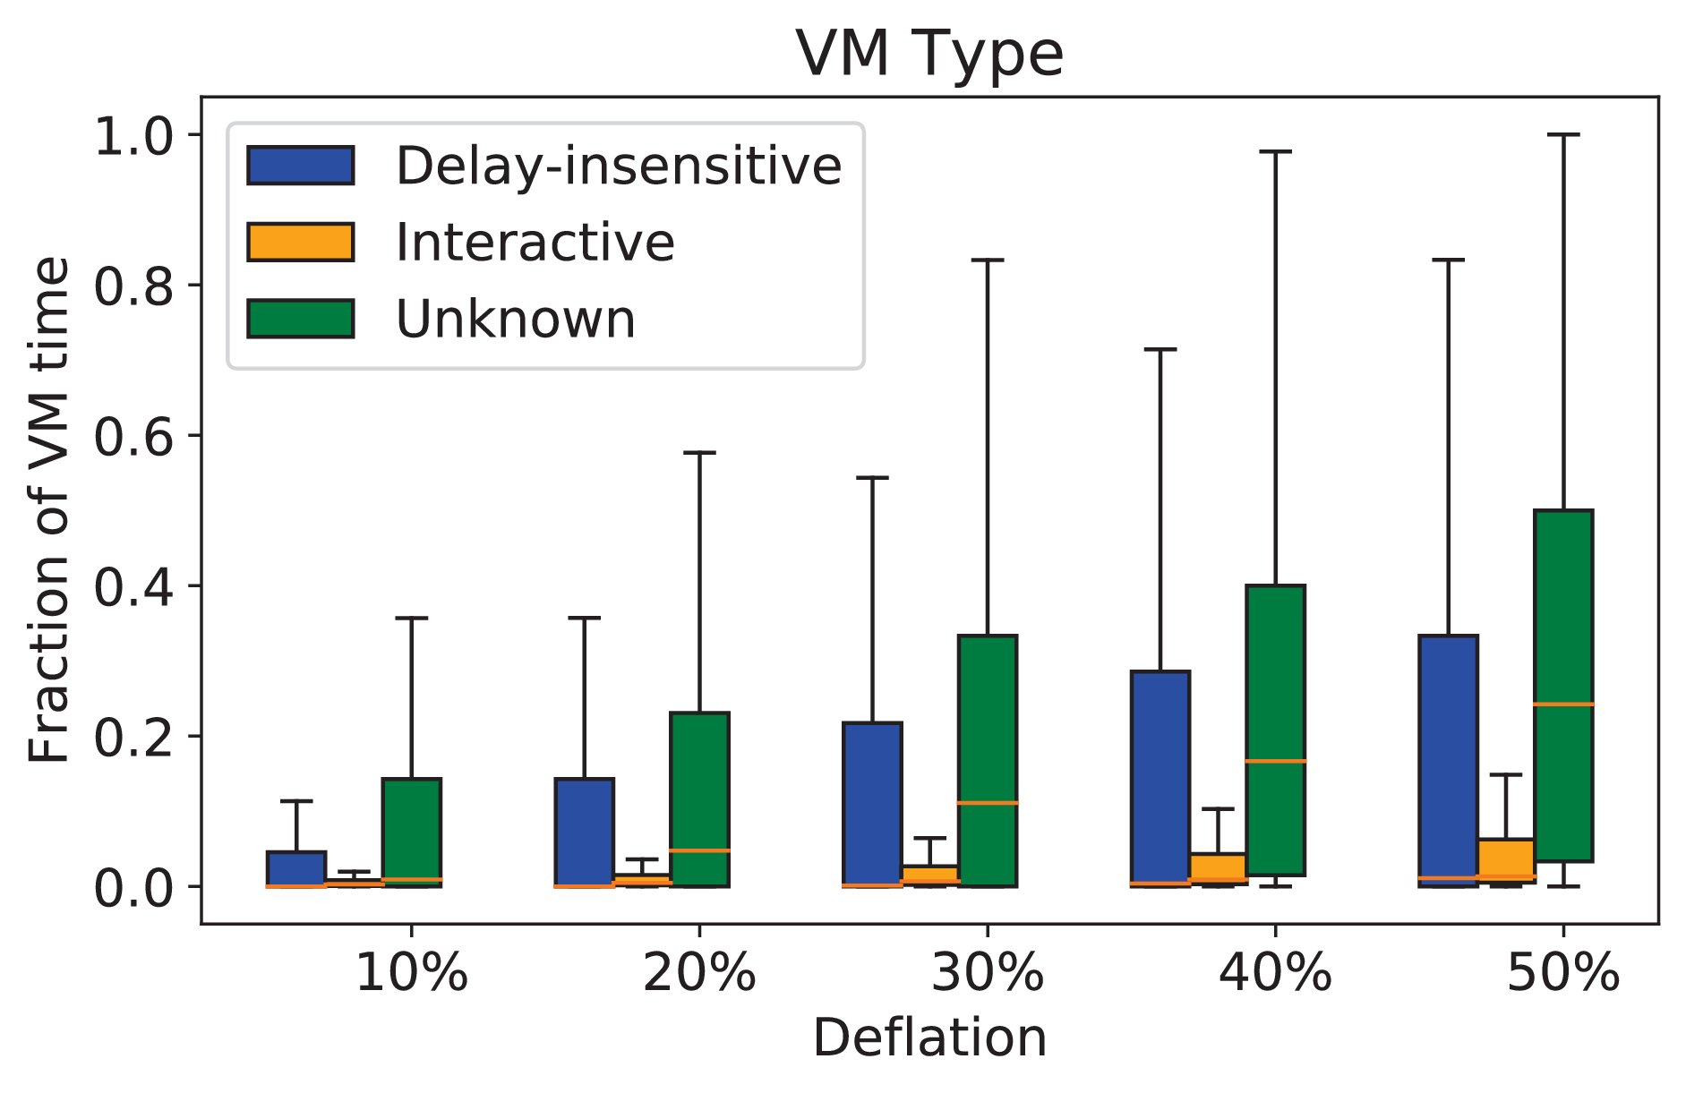
How much can CPU resources be deflated by?
Use timeseries of resource (CPU) utilization of Azure VMs
Fraction of time that the CPU usage is higher than different deflation targets
Interactive VMs will be impacted less than 20% of the time at 50% deflation
Most batch VMs impacted under 30% of the time
Interactive applications are over-provisioned to handle peak load
Fraction of time different VM types face underallocation, for different deflation levels

Slide 8
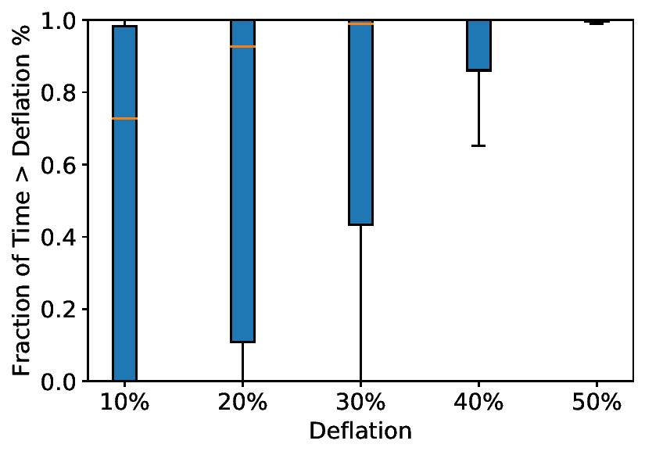
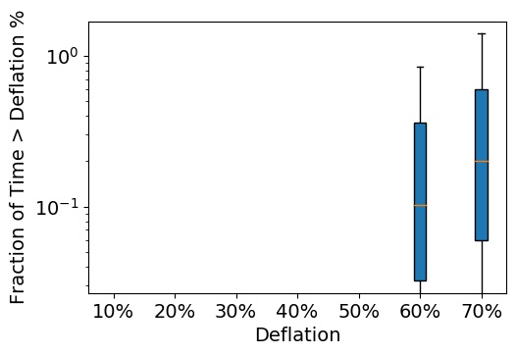
Memory and I/O Deflatability
Alibaba dataset has memory and I/O data from containers
Containers have high memory utilization, but
Primarily JVM apps
Large heap but small working set
Low memory bandwidth usage (avg ~1%)
Very little disk and network usage (avg < 1%)
Cloud applications have significant deflatable slack

Slide 9
Deflation Mechanisms
How is deflation achieved?

Slide 10
Explicit Guest-OS Deflation
Deflation Mechanisms
VM Allocation
OS hot-unplugs memory and CPU, returning to the hypervisor
Explicit to OS and application
Done in course-grained units (whole vCPUs)
Hotplug has a safety threshold that limits effectiveness
NICs and disk are unsafe to hotplug
Hypervisor must handle
CPUs
Mem
NIC BW
Hot unplug
Disk BW
CPUs
Mem
VM sees 2 vCPUs, 3 Mem, full bandwidth after unplug
NIC BW
Disk BW

Slide 11
Transparent Deflation via Hypervisor
Deflation Mechanisms
Use traditional VM overcommitment mechanisms
CPU: Multiplex vCPUs to fewer physical CPUs
Memory: Swap VM pages
Transparent deflation adds overhead
Combine mechanisms into hybrid deflation:
Reclaim via hotplug up to safety limit
Reclaim remaining via hypervisor
VM Allocation
CPUs
Mem
Transparently deflate
NIC BW
CPUs
Disk BW
Mem
NIC BW
VM still sees 2 vCPUs, 3 Mem, full bandwidth
Disks BW

Slide 12
Cluster Deflation Policies
How much to deflate?

Slide 13
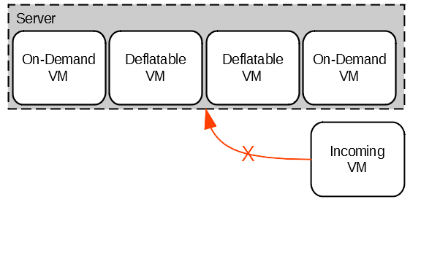
Server Deflation Policies
All server resources are allocated
VM needs to be created on server
Can’t preempt to reclaim resources
No room
By how much do we deflate each VM?

Slide 14
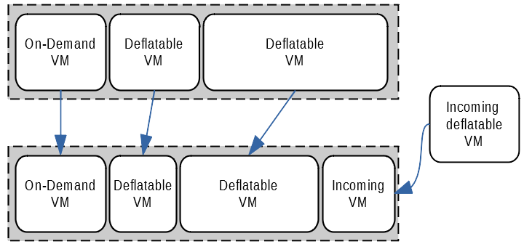

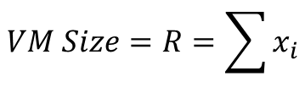
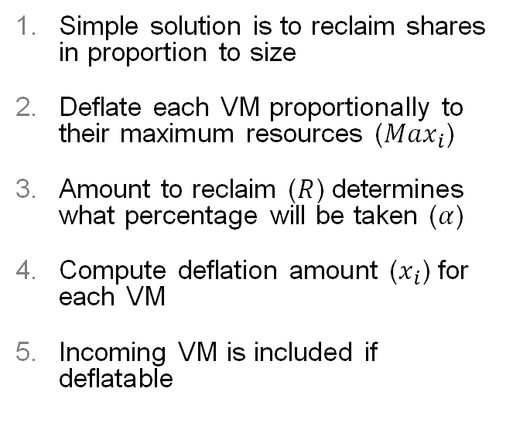



Proportional Deflation
Server Deflation Policies
Simple solution is to reclaim shares in proportion to size
Deflate each VM proportionally to their maximum resources (${Max}_{i}$)
Amount to reclaim ($R$) determines what percentage will be taken ($α$)
Compute deflation amount ($x_{i}$) for each VM
Incoming VM is included if deflatable
Incoming Size:
R = 1
$$x_{i}=.25$$
$$x_{i}=.5$$
$$x_{i}=.25$$
$$x_{i}={Max}_{i}−α∗{Max}_{i}$$
$$α =1−\frac{R}{\sum_{i}^{n}{{Max}_{i}}}$$
$$VM Size=R=\sum{x_{i}}$$

Slide 15


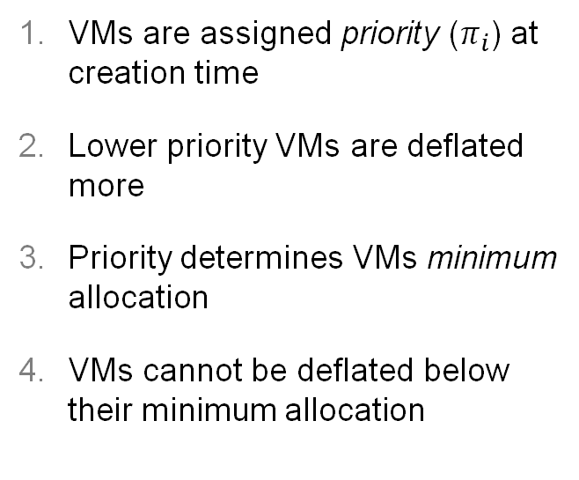
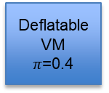
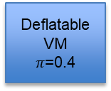
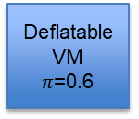

Priority Deflation
Server Deflation Policies
VMs are assigned priority ($π_{i}$) at creation time
Lower priority VMs are deflated more
Priority determines VMs minimum allocation
VMs cannot be deflated below their minimum allocation
Physical Server
Deflatable VM
$π$=0.8
Deflatable VM
$π$=0.6
Deflatable VM
$π$=0.4
Deflatable VM
$π$=0.4
Incoming VM
$$x_{i}={(Max}_{i}−π_{i}∗{Max}_{i})−α∗π_{i}∗{(Max}_{i}−π_{i}∗{Max}_{i})$$
$$α =1−\frac{R}{\sum_{i}^{n}{{Max}_{i}}}$$
$$R=\sum{x_{i}}$$

Slide 16
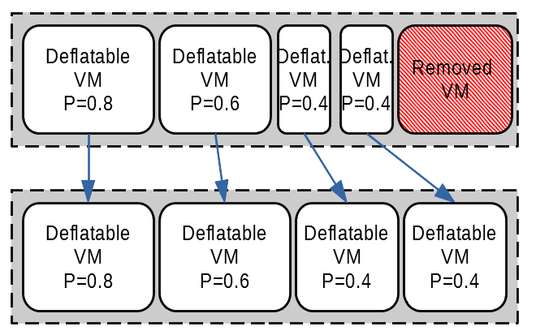
Reinflation
Server Deflation Policies
As VMs exit or are removed, their resources are reclaimed
These can then be returned to deflated VMs
Easily computed as inverse of deflation calculation
R = -R_{free}
How do we decide where to place VMs?

Slide 17
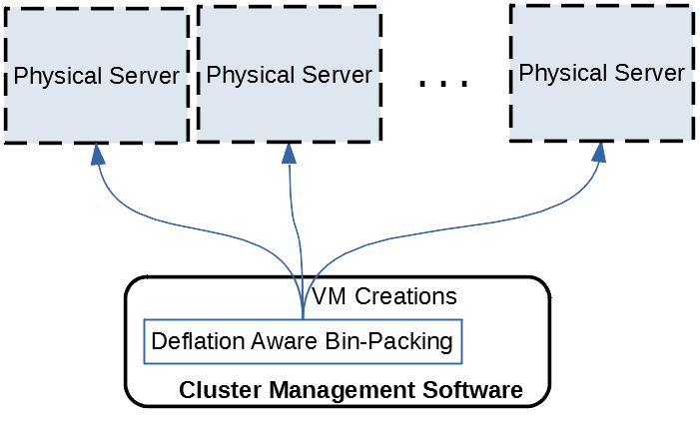
Cluster-Wide Deflation Policies
VM placement naturally affects deflation
Track overcommitment of all VMs in cluster
Deflation-aware bin-packing intelligently chooses host
Can partition physical servers and assign deflatable VMs to them by priority

Slide 18
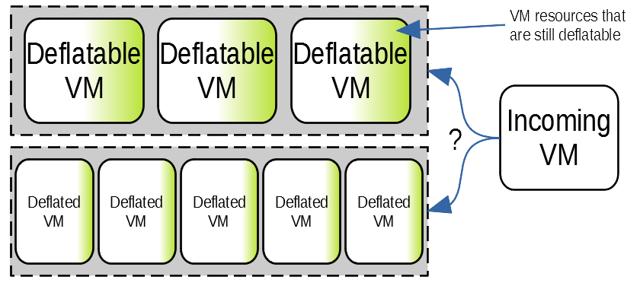
Deflation-Aware Bin Packing
Cluster-Wide Deflation Policies
No server has free resources for incoming VM
Quantify low-priority VMs’ deflatable resources
Must account for existing server overcommitment
What server should we choose?

Slide 19
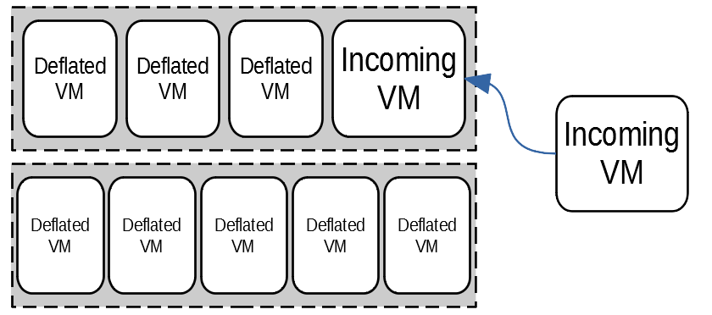
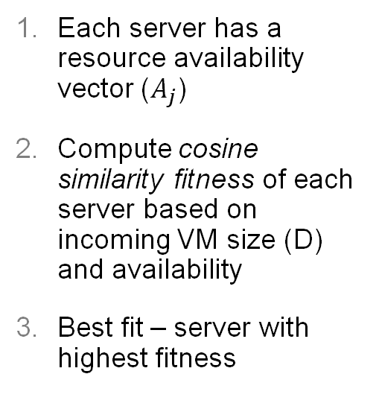


Deflation-Aware Bin Packing
Cluster-Wide Deflation Policies
Each server has a resource availability vector ($A_{j}$)
Compute cosine similarity fitness of each server based on incoming VM size (D) and availability
Best fit – server with highest fitness
$$A_{j}={Total}_{j}−{Used}_{j}+(\frac{{deflatable}_{j}}{{overcommited}_{j}})$$
$$fitness\left(D,A_{j}\right)= \frac{A_{j}∗D}{\left|A_{j}\right|∗|D|}$$

Slide 20
Experimental Evaluation
Let’s do some science

Slide 21

Evaluation Questions
How does deflation affect interactive application throughput?
Deflate highly interactive web app and services
Wikipedia, MySQL, Memcached, Apache HTTP
Does deflation reduce chance of preemptions in overcommitted clusters?
Cluster simulator (~2000 Python LOC)
Real VM utilization data from Azure
https://en.wikipedia.org/wiki/Wikipedia_logo

Slide 22
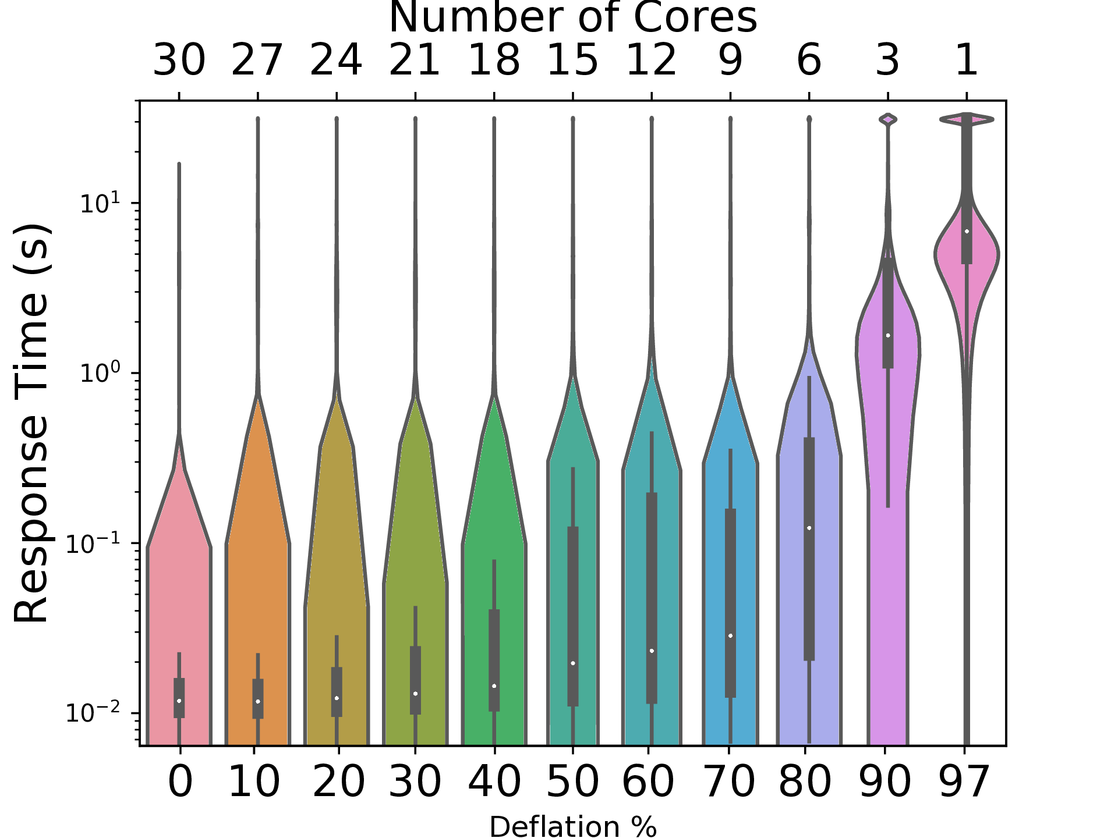
Wikipedia CPU Deflation
Mean response time is still less than 0.1 sec at 70% deflation
No requests dropped till 80% CPU deflation

Slide 23
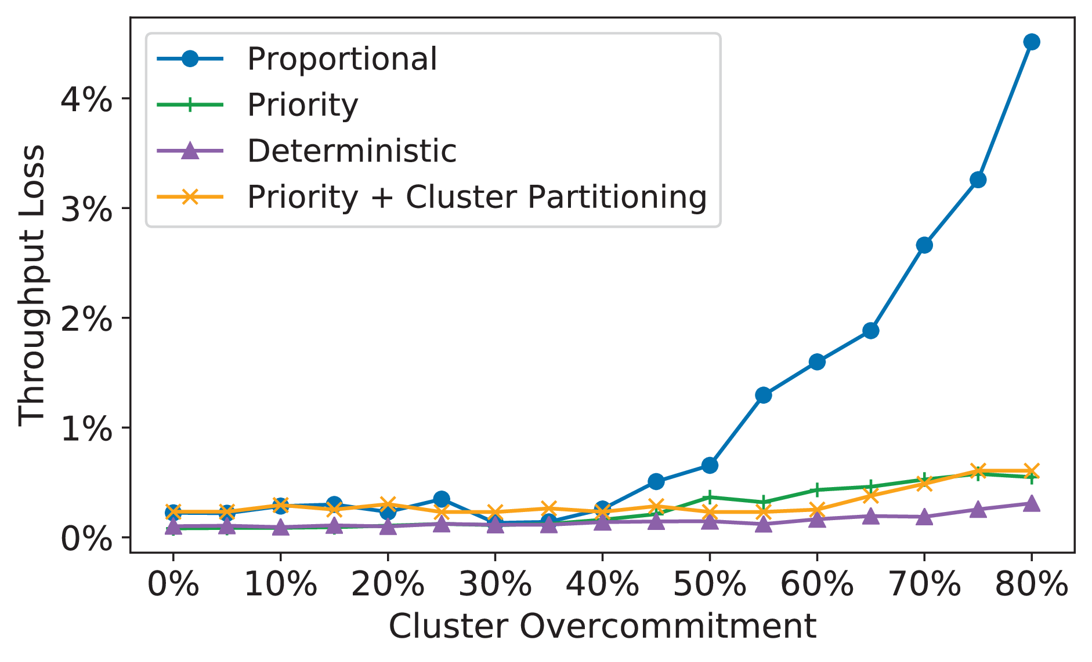
Azure Simulation Throughput Loss
Use Azure traces to estimate throughput loss
Throughput reduced by only 4% even at extreme 80% cluster overcommittment
Priority deflation keeps loss under 1%
Priority assigned based on p95 CPU
Loss is lower than overcommitment due to unused VM resources (slack)
Shows effectiveness of bin-packing and proportional deflation policies

Slide 24
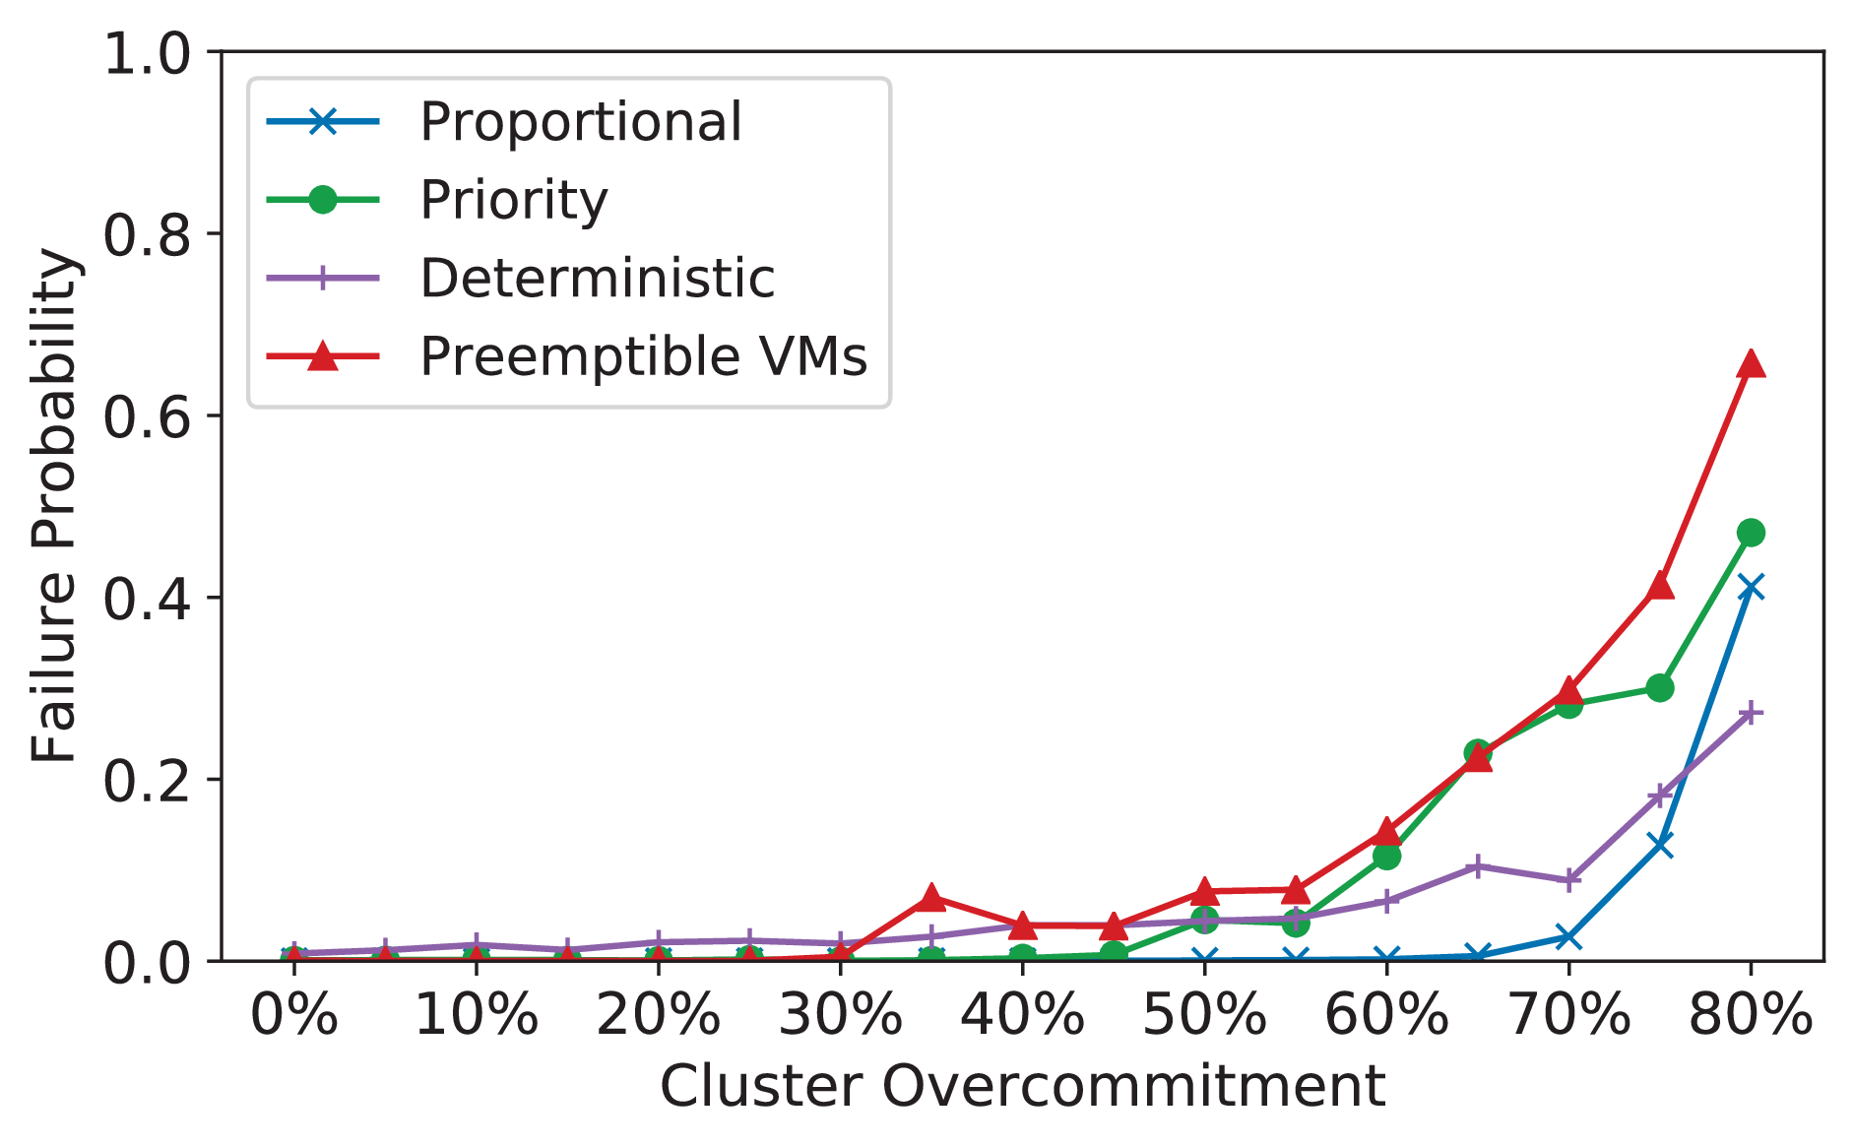
Preemption Reduction
VMs preempted if they are deflated below their minimum threshold
Negligible preemptions even at extreme cluster overcommittment (50%)
Interactive applications can thus be safely deflated without risk of downtime

Slide 25

Future
GPU deflation
Increase in performance interference due to deflation?
Impact of deflatable VMs on end-users

Slide 26
Related Work
Resource Deflation: [EuroSys ‘19]
VM overcommitment: [Ballooning]
Burstable VMs: Inverse of deflatable VMs.
Transient computing & fault tolerance [SpotWeb, SpotCheck]
Virtualized cluster management [VMWare DRS]

Slide 27
Conclusions
Deflatable VMs: An alternative to preemptible VMs for transient computing
Main idea: Fractionally reclaim resources instead of outright preemption
Real-world resource utilization (Azure and Alibaba traces) indicates most applications amenable to deflation
Hybrid deflation using hypervisor and OS level overcommittment
Proportional deflation and bin-packing policies can increase cluster overcommittment by 50%, resulting in < 5% decrease in application throughput

Slide 28
Thanks! Questions? alfuerst@iu.edu

Slide 29
Backup Slides

