Slide 1


Memory-Harvesting VMs in Cloud Platforms
Alexander Fuerst, Stanko Novaković, Íñigo Goiri, Gohar Irfan Chaudhry, Prateek Sharma, Kapil Arya, Kevin Broas, Eugene Bak, Mehmet Iyigun, Ricardo Bianchini
ASPLOS; March 3rd, 2022; Lausanne, Switzerland
Notes:
Conference name & date

Slide 2
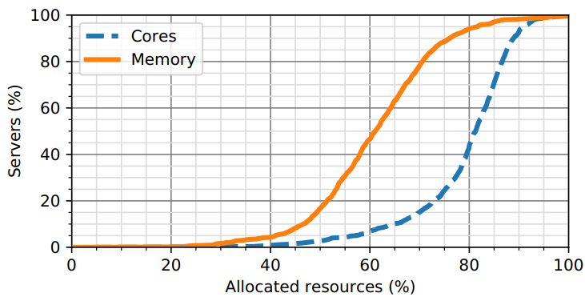
Motivation
Server memory is expensive
Cloud providers have lots of unallocated resources
3 weeks in June 2021
Half of servers have >40% of memory unused
Notes:
Memory is roughly half of server costs
40% of servers have 20% cores free
Fully half of servers have greater that 40% of memory unused

Slide 3

Motivation
Enable provider to turn these resources into cheap offerings
Platform-as-a-Service, Software-as-a-Service, Function-as-a-Service
CPU Harvest VMs: big step in dynamic resources [1]
Adjusting to resource demands leads to lower eviction rate
Host
VM
VM
Harvest VM
Harvest VM
[1] Ambati, Pradeep, et al. "Providing SLOs for Resource-Harvesting VMs in Cloud Platforms." 14th USENIX Symposium on Operating Systems Design and Implementation (OSDI'20). 2020.
Notes:
Mention evictability and building on Spot VMs
Remove deflation & disaggregation – be prepared for questions

Slide 4
Proposal: Memory-Harvesting VMs (MHVMs)
Build on existing CPU Harvest VMs
Maximize DRAM utilization without impacting regular (high SLA) guests
Assign unallocated memory to MHVMs for temporary use
Reclaim extra memory on demand
Enhance and build on existing dynamic VM memory techniques
Identify and mitigate challenges in production deployments
Ensure MHVMs do not interfere with co-located guests

Slide 5
Platform challenges: VM Creation Time
As VMs arrive and depart hosts, we may need to adjust MHVM memory
Memory reclamation is slow (unlike CPUs)
End-to-end VM creation time critical for provider
Host memory
VM 1
VM 2
MHVM
Time
VM 1
VM 2
VM 3
MHVM
MVHMs must not impact creation time
Notes:
Reclamation tput is < 10 GB/s
Even 1 sec added time is too much
Providers care about this metric, esp with comparisons

Slide 6
Platform challenges: NUMA Locality
VMs may span NUMA domains
Such spanning not surfaced to the guest
Loss of memory access locality
Host memory
VM 1
VM 2
MHVM
Time
VM 1
VM 2
VM 3
MHVM
NUMA 0
NUMA 1
MVHMs have the potential to make NUMA spanning worse
Notes:
Servers typically come with 2 sockets
Hypervisor tries to keep VMs memory located on same NUMA domain as assigned cores

Slide 7
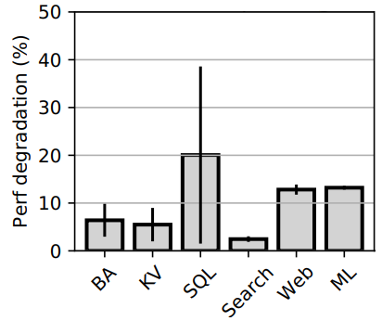
Platform challenges: NUMA Locality
Performance degradation to common Cloud applications
under NUMA spanning
SQL
Search
Web
ML
Analytics
Key-value
MHVMs must not lead to more NUMA spanning
Notes:
Mention how applications suffer unexpected latency when access off-NUMA memory, causing degredation

Slide 8
Platform challenges: Fragmentation
Reclamation done at 4KB granularity
MHVM may return unaligned and non-contiguous pages
Guest fragmentation → host fragmentation
Host memory
VM 1
VM 2
MHVM
Time
VM 1
VM 2
MHVM
VM3
VM3
VM3
VM3
VM3
VM3
MVHMs have the potential to fragment host memory

Slide 9
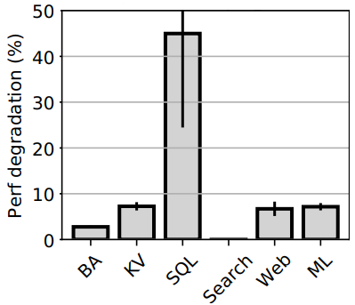
Platform challenges: Fragmentation
Performance degradation to common Cloud applications
under 4 KB host fragmentation
SQL
Web
ML
Key-value
Search
Analytics
MHVMs must not fragment host memory
Notes:
Mention how

Slide 10
Tackling Platform Challenges
Challenge | Mitigations
VM Creation Time | Reserve a memory buffer to accommodate incoming VMs Resize MHVMs off the critical path to refill buffer
NUMA Locality | Balance NUMA nodes Memory buffer reserved across nodes NUMA-aware resizing
Fragmentation | Reclaim large pages
We can ensure NO impact by MHVMs on co-located guests

Slide 11
Optimizing Memory Resizing
Pre-reclamation
Guest prepares memory chunks in the background after a resize starts
Batch size
Host asks guest synchronously for larger chunks of memory
Application notification
Notify MHVM and guest applications of the resize target
Applications can free up memory in advance
Multiple MHVMs
Memory can be reclaimed in parallel
30% higher reclamation throughput

Slide 12
MHVM Resizing Example
VM 1
VM 2
Buffer
MHVM
VM 1
Buffer
MHVM
Time
VM 1
VM 3
Buffer
MHVM
VM 1
VM 3
VM 4
Buffer
MHVM
VM 1
VM 3
VM 4
VM 5
Memory

Slide 13
Applications on MHVMs
What applications can run on MVHMs?
It’s hard to be a Memory-Harvesting VM
Need to handle evictions and variable resources
Suitable applications
Batch workloads (analytics,…)
Capable of using extra memory (serverless, databases,...)
Focus on frameworks
Modifying each individual application requires engineering overhead
FaaS, Hadoop, Kubernetes,…
Notes:
Evictions still a concern

Slide 14


Our MHVM Applications
MH-Hadoop: Data analytics
Running batch workloads
Spin up new workers on growing VMs
Better job throughput
Easily adjust work if VM is evicted
MH-FaaS: Function as a Service/Serverless
Running latency-sensitive user functions
Use extra memory to keep functions ‘warm’
Better end-user latency
Mix of regular and MHVMs to handle evictions
https://xuri.me/wp-content/uploads/2015/03/hadoop-logo.png
https://seeklogo.com/vector-logo/339662/azure-functions

Slide 15
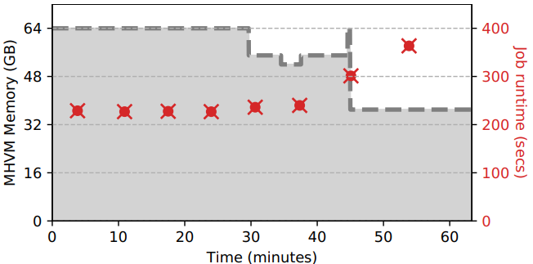
MH-Hadoop
Replay individual server VM arrivals and run MHVMs when possible
MHVM grows and shrinks with arrivals/departures of regular VMs
MH-Hadoop uses extra memory to run more workers
Extra memory improves the workload runtime

Slide 16
Cloud Platform Feasibility
MHVMs are provided at reduced cost, akin to Spot
MHVMs are 91% cheaper than Regular VMs
Harvested resources are significantly discounted
Memory bound applications see better cost benefit (e.g., MH-FaaS)
Notes:
Decreasing order on graph
Make all text black

Slide 17
Cloud Platform Impact
Replay VM arrivals/departures across thousands of servers
No impact of MHVMs on regular VM creation time or NUMA spanning
We can harvest 20% of free Azure memory
Tradeoff between VM creation impact and harvested memory
Notes:
Decreasing order on graph
Make all text black

Slide 18
Conclusion
Addresses challenges of running MHVMs in production
We can harvest 20% of free Azure memory
Extend several frameworks to transparently run on MHVMs
Enable providers to cheaply utilize spare resources
Thank you for listening!
Please see our paper for more details, experiments, and results

Slide 19
Tackling Platform Challenges
Reserving a memory buffer
Accommodate incoming VMs immediately
Resize MHVMs off critical path to refill buffer
Balancing NUMA nodes
Expose virtual NUMA topology inside MHVMs
Enable NUMA-aware assignment and memory reclamation
Have memory buffer reserve memory across NUMA nodes evenly
Reclaiming large pages
Require MHVM to return contiguous large pages
We can ensure NO impact by MHVMs on co-located guests

Slide 20
Optimizing Resizing Throughput
Custom guest resize driver to improve reclamation throughput
Batching and pre-reclamation
Proactive reclamation maintains throughput for busy guests
30% higher reclamation throughput
Notes:
Remove captions from figs

Slide 21
Work on Variable-Resource VMs
Most focus on unallocated or idle CPU
Deflatable VMs is the closest to our proposal
Harvesting both unallocated and idle memory
Does not consider platform challenges
Notes:
Mention how deflatable not suitable for production
All together they have not utilized the empty resource providers have
Remove disaggregation – be prepared for questions

Slide 22
MHVM Resizing Example
Host memory
VM 1
Buffer
MHVM
Buffer
MHVM
Buffer
MHVM
Buffer
MHVM
VM 2
Buffer
MHVM
VM 2
Buffer
MHVM
Time
VM 3
MHVM
VM 2
Buffer
VM 2
MHVM
MHVM
VM 2
VM 3
VM 2
VM 5
NUMA 0
NUMA 1

Slide 23
Platform issues: VM Creation Time
New VM
VMs arrive and depart hosts
We may need to adjust MHVM memory
Reclamation slow (unlike CPUs)
End-to-end VM creation time critical for provider
Host
VM
MHVM
VM
MVHMs must not impact creation time
Notes:
30% of arrivals are 16 GB or less
Another 30% are ~32 GB

Slide 24
Platform issues: NUMA Locality
Host
VMs may span NUMA domains
Such spanning not surfaced to the guest
Loss of memory access locality
NUMA 0
NUMA 1
MHVM
MHVM
New VM
Notes:
Servers typically come with 2 sockets
Hypervisor tries to keep VMs memory located on same NUMA domain as assigned cores

Slide 25
Platform issues: Fragmentation
VMs are assigned 2 MB pages by the hypervisor
Exchange is done at 4k page granularity
Guest may return unaligned and non-contiguous
Guest fragmentation → host fragmentation
Guest memory allocation

