Slide 1
Locality-Aware Load-Balancing For Serverless Clusters
Alex Fuerst, Prateek Sharma
HPDC; June 29th, 2022; Minneapolis, Minnesota

Slide 2




Serverless Computing
Function as a Service
Provider
#Initialization code
import numpy as np
import tensorflow as tf
m = download_model(’http://model_serve/img_classify.pb’)
session = create_tensorflow graph(m)
def lambda_handler(event):
#This is called on every function invocation
picture = event[’data’]
prediction_output = run_inference_on_image(picture)
return prediction_output
1) User uploads their source
code to the provider
2) On-demand invocation
of code with inputs
PUT https://faas.com/img_recogn?input=face.png
3) Provider returns code results

Slide 3
Function as a Service Clusters
λ₁
λ₂
λ₁
Unique resource management challenge
Wide diversity in applications
Lot of servers to choose between quickly
Many considerations for provider
Maximizing resource utilization
Minimize user latency
λ₁
λ₂
λ₁
λ₃
Load Balancer
Server 1
Server 2
Server 3

Slide 4
Where to run a function?
λ₁
Conventional load balancing: least loaded
Functions all require CPU resources
And they occupy space in server memory
Both are highly applicable load metrics
Load Balancer
Server 1
Server 2
Server 3
λ₃
λ₂
λ₂
λ₁
λ₁
λ₁

Slide 5
Criticality of Locality
Functions see lower latency when run repeatedly on same server
Provider keeps functions alive in memory to achieve this
Both users and providers want such ‘warm hits’
Policies like least-loaded increase ‘cold starts’
Function | Warm Runtime | Cold Runtime
CNN Inference | 2.5 s | 6.5
Web Serving | 0.4 s | 2.4 s
Scientific Computing | 0.5 s | 2.5 s

Slide 6
Outline & Significance
Possible impact of load balancing
Background: Why load balancing in FaaS is hard?
Our solution: Consistent Hashing with Random Load Update
Experimental Analysis

Slide 7
Domain Challenges
FaaS Load balancing state of the art:
Most work has focused on single-server optimizations
OpenWhisk: "sticky" memory cap
Competing priorities
Preserve locality
Avoid server overloading
Complex nature of the workload
Heterogenous function characteristics
Skewed nature of requests: frequent, burst, or rare
Inconsistent cluster information

Slide 8
Locality via Consistent Hashing
Want a policy that encourages warm hits
Locality seems like a good way to get this
Functions map somewhere on a ‘ring’
Local server is next on the ring
Repeated functions run on the same server
0
3
Server
1
2

Slide 9
Locality via Consistent Hashing
Want a policy that encourages warm hits
Locality seems like a good way to get this
Functions map somewhere on a ‘ring’
Local server is next on the ring
Repeated functions run on the same server
Amenable to server changes
Low-impact addition and removal
0
3
Server
2

Slide 10
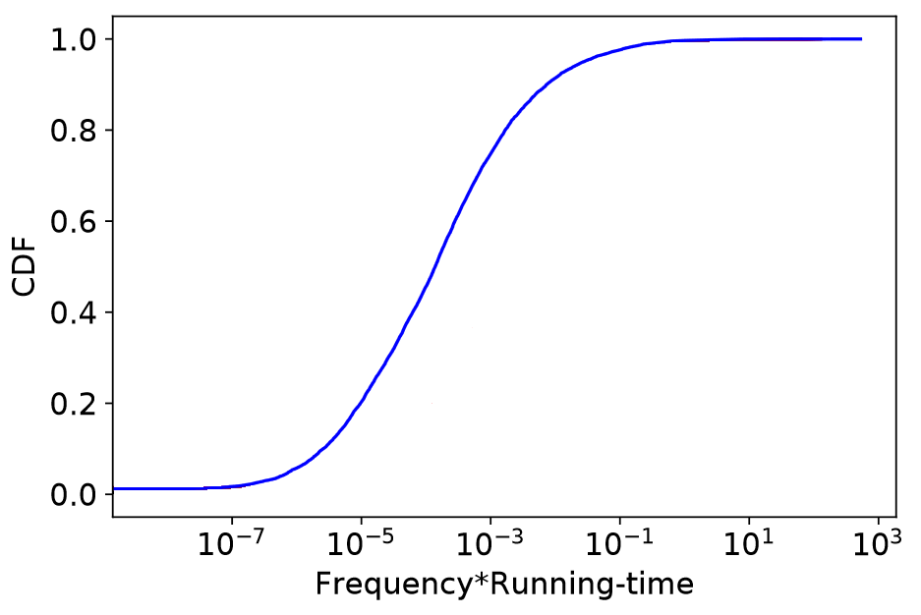
Overloading Concern
Functions are invoked at different frequencies
Creates high variance on used resources
20% of functions use 100x resources
3
0
2

Slide 11
CH with Bounded Loads
Assumes each item creates equal load
LB tracks outstanding work to get ‘load’
If server is “full” we forward to the next server
When under the load bound: pure locality
Forwarding has a high but decaying probability of warm hit
3
0
Domain characteristics make this not suitable for FaaS
2
[*] Mirrokni, V., Thorup, M., and Zadimoghaddam, M.Consistent hashing with bounded loads.
InProceedings of the Twenty-Ninth Annual ACM-SIAM Symposiumon Discrete Algorithms(2018), SIAM, pp. 587–604.

Slide 12
Challenge 1: Stale loads
Functions do not contribute to load equally or consistently
Any load metric will be stale at load balancer
We use Linux’s load average metric to capture all work on the server
Policies assuming perfect load information can lead to violating load bound
Load
Bound
Load
Load
Actual
Load
Actual load exceeds bound
Est.
Load
Assign work here thinking estimated load will not exceed bound

Slide 13
Challenge 2: Outsized Impact Functions
20% of functions account for most invocations
Invoked with high frequency, e.g. less than every second
‘Bursts’ of high frequency with periods of inactivity
These functions create violations of the load bound
We modify SHARDS reuse distance to find such functions online
Tracking the inter-arrival-time quickly detects popular functions or bursts

Slide 14
Solution: Aggressive Forwarding
Popular and bursts are marked for more aggressive forwarding
Even if the server is under the load bound, forwarding can happen
Model anticipated load using Gaussian noise
Reduces overload risk for individual servers
Popular functions maintain warm hits across several servers

Slide 15
CH with Random Load Update
RLU-Forward(function, server)
L = Load(server)
if Popular(function)
L = Load(server) + N (𝜇=1/avg_IAT, 𝜎=0.1)
if L < load_bound
Run(function, server)
else
RLU-Forward(function, next(server))
Popular functions have increased chance of being forwarded
3
0
Server
1
2
Follow the hash ring for locality

Slide 16
Evaluation
Implemented our algorithm inside OpenWhisk
Workers’ load is propagated to load balancer via Redis cache
Workload
Functions created with code from FunctionBench ported to OpenWhisk
Function inter-arrival-time mimics Azure trace data
Our primary goal is to minimize global latency
The “optimal” case is everything running warm
And ensure no server is overloaded causing interference

Slide 17
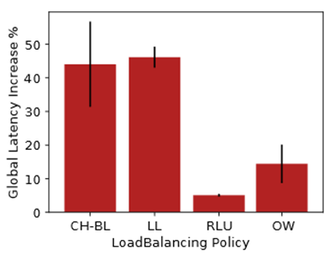
Global Latency Evaluation
Place systems under heavy load
Enough to have ~1 outstanding request per CPU in the cluster
Least-loaded eschews locality entirely
CH - Bounded loads forwards poorly
RLU outperforms all by at least 2x

Slide 18
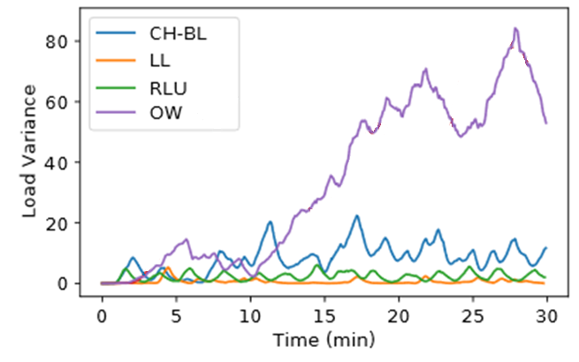
Load balancing
Variance between loads on workers
OpenWhisk prioritizes locality
This causes excessive load on workers
Creates additional latency for functions
RLU is on-par with least-loaded
Server load is kept low while preserving locality for low latency

Slide 19
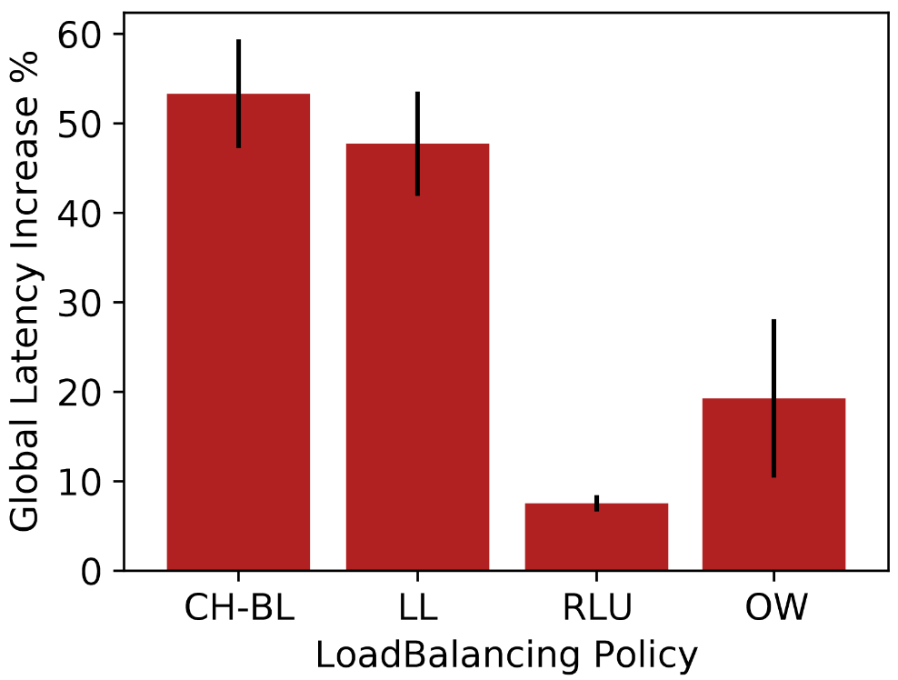
Bursty Workload Evaluation
Change the frequency of functions routinely
Exercising the ability to detect changing popularities

Slide 20
Related Work
Single server optimizations
Keep-alive: FaasCache; ASPLOS 2021, Serverless in the Wild; ATC 2020
Startup: Catalyzer; ASPLOS 2020, Firecracker; NSDI 2020
Cluster Level
Package-Aware Scheduling; CCGRID 2019
IceBreaker; ASPLOS 2022

Slide 21
Our simple and practical load balancing policy can substantially improve FaaS latency over current load balancing policies.
Please check out our paper, Locality-aware Load-Balancing For Serverless Clusters, for more.
https://aFuerst.github.io/

Slide 22
Where to run a function?
Least loaded seems to make sense
Functions take up both memory and CPU while running
We don’t want to overcommit either
Providers want good usage of FaaS resources
Simple policies ignore key factors that make FaaS effective

Slide 23
Locality with Bounded Loads
When under the load bound: pure locality
Gives us a high warm hit probability
Even if we must forward, we have a high but decaying chance
Better than random

Slide 24




Cold Start
Initialization can be skipped after first invocation
Things like snapshots still have startup time
We can re-use our execution environments
This is a ‘warm start’
Container
Layer
~1s
~1s
ML Function
Docker, VM,
Firecracker, etc
~2s
def lambda_handler(event, context): picture = event[’data’] prediction_output = infer_image(picture) return prediction_output
import tensorflow as tf m = download_model(’http://model/img_classify.pb’) session = create_tensorflow_graph(m)
Execution

Slide 25
Keep-Alive Choice
λ₇
Workers cannot fit everything in memory
They will remove functions to make room for others
Keep-alive managed at the worker level
Can we impact keep-alive at the cluster level?
Worker 0
λ₅
λ₆
λ₃
λ₄
λ₁
λ₂

Slide 26
Load Balancing
Load balancers tackle two main scenarios
Compute-bound load: queries, web servers, etc.
Data-oriented load: CDNs, K/V stores, etc.
FaaS must consider both
Functions are not uniform
Varied memory footprints and compute times

Slide 27
Function Skew
Pure-locality doesn’t work
Variable runtimes from 100 ms. to minutes
Invocation frequency also varies by several orders of magnitude
A few outlier functions create much of the load on systems
How to balance this varied this workload?

Slide 28
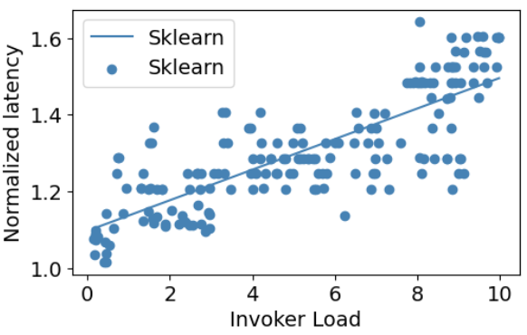
Does load matter?
Hard limit on memory subscription
Simply cannot run
Functions see latency increases with server load
Our goal is to minimize global latency
Cold start vs degraded performance?

Slide 29
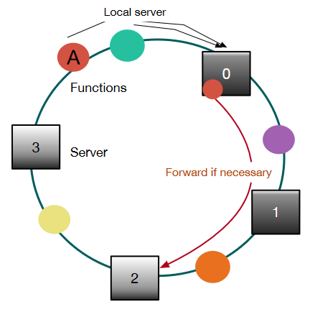
Combining load and locality
Bounded-loads_{[1]} took a stab at this
Servers can become “full” with load
We can then forward work to another worker
The hash ring lets us have a consistent forwarding location
This overflow mechanic keeps locality
Better chance of a warm start
[1] Mirrokni, V., Thorup, M., and Zadimoghaddam, M.Consistent hashing withbounded loads.
InProceedings of the Twenty-Ninth Annual ACM-SIAM Symposiumon Discrete Algorithms(2018), SIAM, pp. 587–604.

Slide 30
Bounded-loads insufficiency
A variety of assumptions are made that FaaS breaks:
Homogenous work runtimes and sizes
Running times are constant while under the load-bound
CPU usage of work is consistent during execution
Predictability of an item’s average arrival time
Up-to-date information on system load is always available

Slide 31
Detecting heavy hitters
We must handle both bursts and popular functions
And these will change over time too – must be dynamic detection
Functions invoked closer together will be easy to pick out
Use inter-arrival-time as a metric

