Slide 1
Ilúvatar: A Fast Control Plane for Serverless Computing
Alex Fuerst, Abdul Rehman, Prateek Sharma
HPDC; June 22nd, 2023; Orlando, Florida

Slide 2
Serverless Computing is growing
Web
Science
...
ML
FaaS (Serverless)
OpenWhisk
Azure Functions
...
AWS λ
Notes:
Science workflwos

Slide 3

FaaS Control Plane Flow
(1)
FaaS Control Plane
Load Balancer
#Initialization code
import numpy as np
import tensorflow as tf
m = download_model(’http://model_serve/img_classify.pb’)
session = create_tensorflow graph(m)
def lambda_handler(event):
#This is called on every function invocation
picture = event[’data’]
prediction_output = run_inference_on_image(picture)
return prediction_output
Store
(3)
Worker
Worker
Worker
(2)
(4)
HTTP-based invocation, with inputs
PUT https://faas.com/img_recogn?input=face.png
λ_{img_recogn}

Slide 4
FaaS Resource Management Challenges
Managing Sandboxing
OS Virtualization & isolation
Request Orchestration
Load-balancing, container cache lookup, passing arguments, keeping track of function results/state
Highly concurrent and complex workloads
Extremely Heterogeneous: IAT .1s - 1 day; exec time 100 ms - 100 s
Bursty: Long periods of stable activity and sudden high usage
Request Handling
Container Init
λ Exec
Control Plane, our focus
Cold start​
Notes:
Res mgmt . Bursty figure from QoS paper . Sandboxing and resource management latency. Figure of timeline

Slide 5
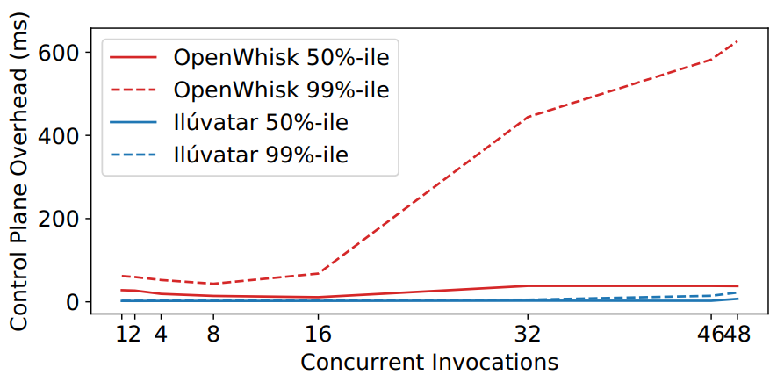
Why make Ilúvatar?
AWS, GCP, Azure not open-source any time soon
OpenWhisk a popular control plane for researchers
Open source, general purpose, maintained
Performance problems stemming from design choices
Major providers see noticeable overhead variance too
Notes:
FaaS control planes
Comment that AWS/GCP/Azure see overheads of 40-50 ms too

Slide 6
Outline
How our design achieved this performance
How Ilúvatar enables research
Ilúvatar in action

Slide 7
Ilúvatar's Worker-Centric Design
Design
Built from the ground-up with simplicity and latency in mind
Optimizing the common-case warm starts was high priority
Per-worker queue provides overload & overcommitment control
Bypass
?
Run in Container
λ_{i}
λ_{i}
λ_{i}
λ_{i}
Concurrency Control
Container
Function
code
Agent
Load
Balancer
Worker
Container Pool:
In-use & Available
Run Function
Notes:
3. Handling overcommittment and overload via per-worker queue . Replace regulator by concurrency control

Slide 8
Container Mechanisms
Design
FaaS requires isolating functions from one another
Tradeoff between performance and security
Docker feature-full but slow, custom library would give most optimization
Don’t want system build around a new FaaS container
Abstract container details away from invocation and resource functionality
Allows us to support multiple mechanisms dynamically
Default to using containerd for performance & simplicity
Notes:
PS: Too abstract. Containerd also for performance. Some high vs. Low level containerization tradeoffs here (Docker has most functionality but slow, rolling our own container library would provide most optimization opportunities but time consuming, etc)

Slide 9
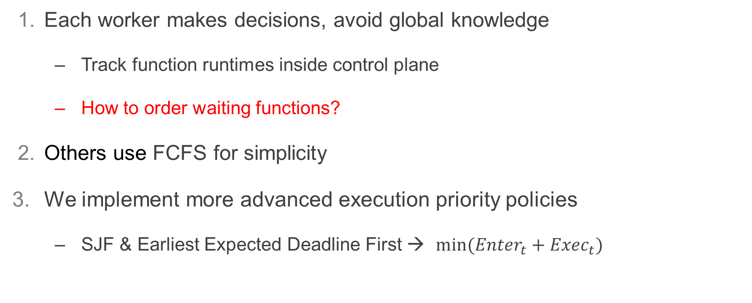
Queueing Ability
Design
Each worker makes decisions, avoid global knowledge
Track function runtimes inside control plane
How to order waiting functions?
Others use FCFS for simplicity
We implement more advanced execution priority policies
SJF & Earliest Expected Deadline First → $min⁡({Enter}_{t}+{Exec}_{t})$
Run in Container
λ_{i}
λ_{i}
λ_{i}
λ_{i}
Notes:
Put queue section of worker diagram here
PS: Emphasizing per-worker instead of shared queue here is important.
Discussing the concurrency regulation mechanism is also crucial.
EEDF equation.

Slide 10
Queueing Ability, Contd.
Design
Ability to dynamically overcommit CPU resources
Allow short functions to bypass queue
Increased throughput + Decreased wait time
Overcommitment vs waiting: why not both?
Run in Container
λ_{i}
Bypass
?
λ_{i}
λ_{i}
λ_{i}
Concurrency Control
Notes:
Put queue section of worker diagram here
PS: Emphasizing per-worker instead of shared queue here is important.
Discussing the concurrency regulation mechanism is also crucial.

Slide 11
Implementation
Design
13k lines of Rust
No GC, fast compiler, small footprint
Maximize work done asynchronously (off invocation hot-path)
Lazy container pool for keep-alive eviction
Network namespace caching
Concurrent data structures for nearly all shared data

Slide 12
So how fast is it?
Most executions incur ~2 ms overhead from the platform
Most comes from communicating with the container
End-to-End latency
Ingestion & Queueing
Container Operations
Agent Communication
λ Execution
Returning
.076 ms
.159 ms
1.55 ms
.245 ms
Platform Overhead
~2 ms
Notes:
E2E latency

Slide 13
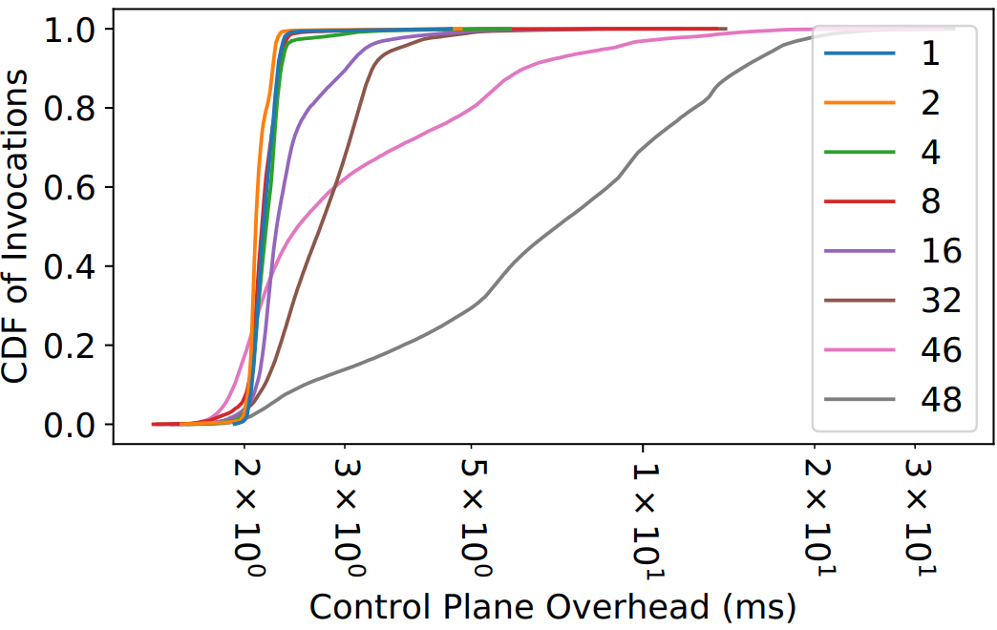
So how fast is it?
Design
Run an increasing number of short functions (>300 ms) in a closed loop
Short time for most invocations, so a larger % of time spent in control plane
48 CPU machine.
Scales well until all CPUs are spent running short invocations
Even at full system saturation (48 threads), p99 overhead is less than 20ms

Slide 14
Research Prioritized
Research
Built-in declarative load generation framework
Generate realistic traces with different # functions, IATs, from the full Azure trace
Run the entire system as a simulation
Real-world representative results because it’s all the same code
“null” container backend turns invocation into sleeps
Logs, logs, and (guess what) more logs
Events inside the worker, invocation latency breakdowns
Rust function-level tracing, system metrics (CPU, memory, etc.)
Easy, repeatable, and comparable results

Slide 15
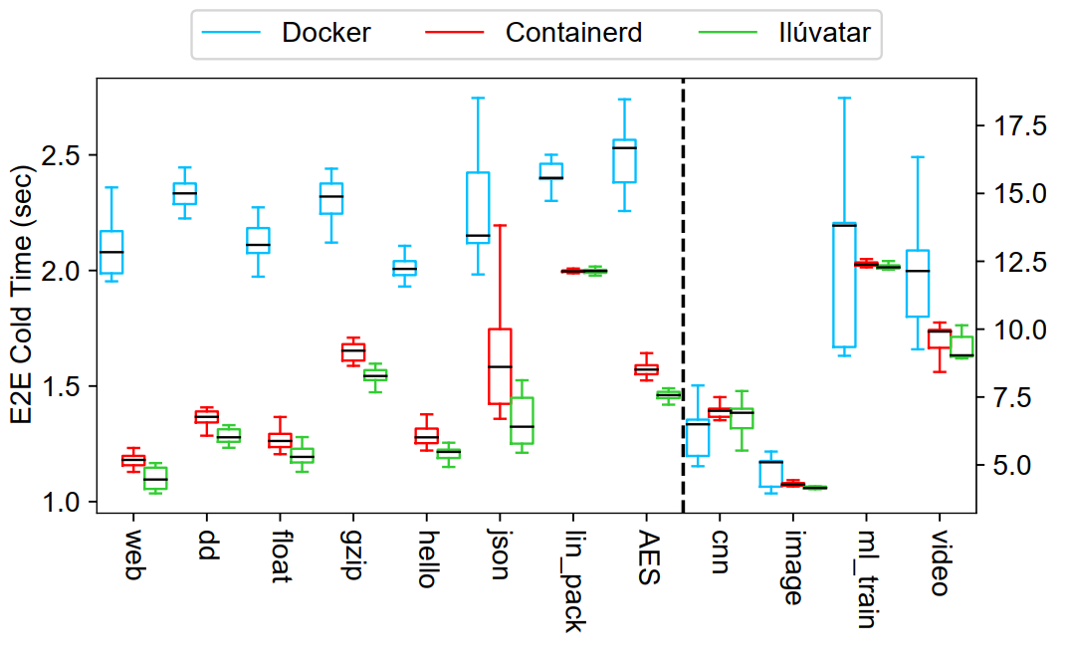
Containerization Impact
Ilúvatar in Action
Ilúvatar here uses Containerd and network namespace cache
Lower-level Containerd is faster than Docker
Simplified implementation and comparison

Slide 16
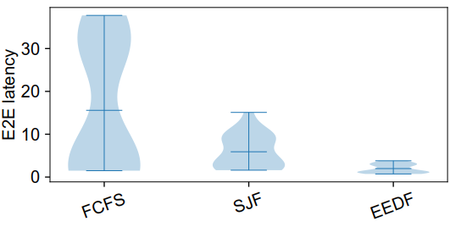
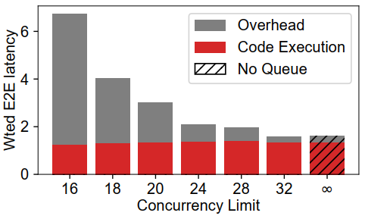
Queueing is important
Ilúvatar in Action
Long jobs can penalize short functions
Overcommitment can improve throughput

Slide 17
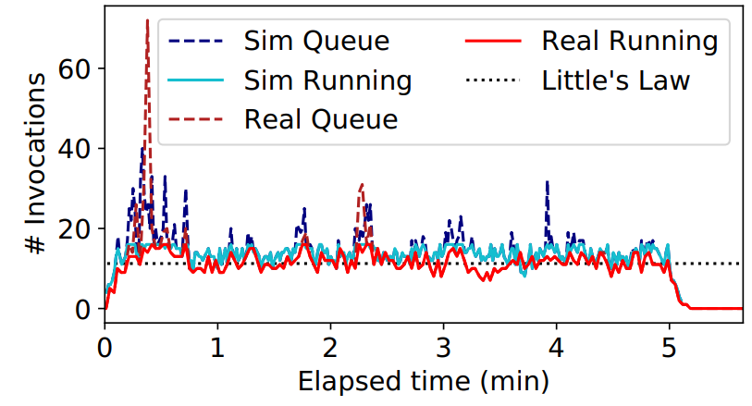
Representative simulations
Ilúvatar in Action
Run a trace on hardware and on identically configured simulation

Slide 19
Related work
FaaS control planes
SOCK, Nightcore, OpenLambda, OpenFaaS, OpenWhisk
Work “below” the control plane
Sandboxes (Catalyzer), cold-start optimizations (SAND, Icebreaker)
Work “above” the control plane
Predictive and DAG scheduling (Aquatope)
Faasrank, Atoll, WISEFUSE, Load-balancing

Slide 20
Try it out now!
https://github.com/COS-IN/iluvatar-faas
Check out paper for more details

Slide 21
How easy is it?
Ilúvatar in Action
TODO: video
Set up a collection of machines with ansible
Generate & run realistic or scenario traces
Analyze results from captured data

Slide 22
Is OpenWhisk Suitable?
+ Open Source
+ General Purpose
- Performance
- Application Complexity

Slide 23
Design Requirements
Fast, low-jitter performance
Worker-centric architecture
Queue center point
Caching layers
Rust
Enable FaaS Research
Extensibility
Configurable
Experimentation platform
You can eat your cake and have it too

Slide 24
Why Worker-Centric?
All the action is happening on the worker
Warm-starts are the bulk of invocations
Optimizing the common case was high priority

Slide 25
Caching
Network namespaces cached
Expensive objects like container connections are cached
Container keep-alive & management gets first-class consideration
These actions can be done in the background
Only service the invocation on the critical path

Slide 26
Caching
Network namespaces cached
Expensive objects like container connections are cached
Container keep-alive & management gets first-class consideration
These actions can be done in the background
Only service the invocation on the critical path

