Slide 1
Biopython: Introduction
Colby Witherup Wood
Northwestern IT Research Computing Services
Request a consultation: http://bit.ly/rcs_consult
You should have the following programs and packages installed:
Python and Jupyter (both included in Anaconda)
Biopython - on the command line, use one of the following commands:
conda install -c conda-forge biopython
OR pip install biopython
Workshop materials:
https://github.com/aGitHasNoName/Biopython

Slide 2

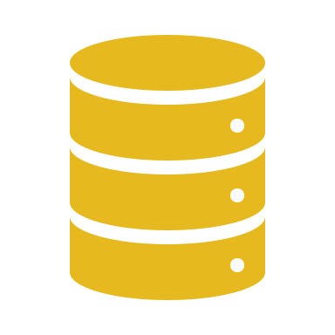
Biopython is used for working with sequence data in Python
DNA
RNA
Protein
”working with” can mean:
Renaming sequences
Filtering and removing certain sequences from a group of sequences
Combining sequences
Transforming sequences: reverse complement/transcription/translation
Plotting sequence lengths
Plotting GC content
Converting between file formats
BLASTing sequences and parsing the results

Slide 3
Most Biopython tools are available in other GUIs
Why should you use Biopython instead?
Have total customization
Save a record of what you did in a script
Automate your analyses – let the computer do the work
Parallelization – run the same script on multiple genes or files
Combine your scripts into pipelines

Slide 4
Sample pipeline to build a phylogenetic tree
Sort sequences into gene families (Orthofinder or BLAST with Biopython)
Create fasta file for each gene family (Biopython)
Rename sequences with sample id (Biopython)
Remove short sequences (Biopython)
Align genes (Mafft)
Trim sequences (TrimAl)
Convert file to phyllip format (Biopython)
Make gene trees (RaxML)
Build phylogenetic tree (Astral)

