Slide 1
Biopython: Introduction
Colby Witherup Wood
Northwestern IT Research Computing Services
Request a consultation: bit.ly/rcs_consult
You should have the following programs and packages installed:
Python and Jupyter (both included in Anaconda)
Biopython - on the command line, use one of the following commands:
conda install -c conda-forge biopython
OR pip install biopython

Slide 2
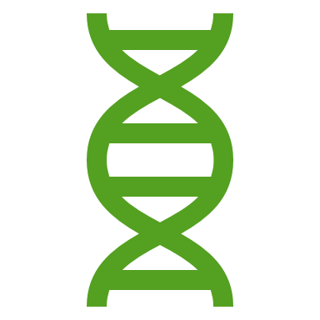
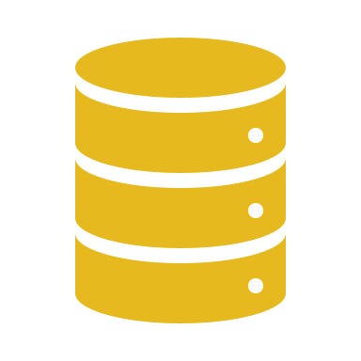
Biopython is used for working with sequence data in Python
“sequence data” can mean:
DNA
RNA
Protein
Multiple Sequence Alignments
”working with” can mean:
Renaming sequences
Filtering and removing certain sequences from a group of sequences
Combining sequences
Transforming sequences: reverse complement/transcription/translation
Plotting sequence lengths
Plotting GC content
Converting between file formats
BLASTing sequences and parsing the results

Slide 3
Most Biopython tools are available in GUIs
Why should you use Biopython instead?
Have total customization
Save a record of what you did in a script
Automate your analyses – let the computer do the work
Parallelization – run the same script on multiple genes or files
Combine your scripts into pipelines

Slide 4
Sample pipeline to build a phylogenetic tree
Sort sequences into gene families (Orthofinder or BLAST with Biopython)
Create fasta file for each gene family (Biopython)
Rename sequences with sample id (Biopython)
Remove short sequences (Biopython)
Align genes (Mafft)
Trim sequences (TrimAl)
Convert file to phylip format (Biopython)
Make gene trees (RaxML)
Build phylogenetic tree (Astral)

Slide 5
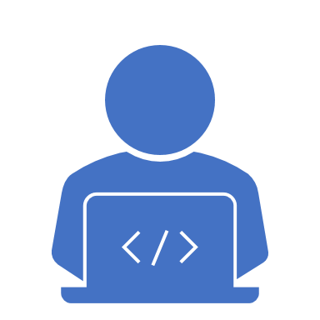
Biopython is suitable for beginning Python programmers

Slide 6
Workshop Materials
Go to github.com/aGitHasNoName/Biopython
Click the green button that says Clone or download
Select Download ZIP
Unzip the folder (Macs will usually unzip the folder automatically) and move the folder someplace easy to find in your Documents or Desktop
Open up Jupyter Lab (or Jupyter Notebook) from Anaconda (or from the command line)
Navigate to the Biopython folder
Open up Biopython.ipynb
This workshop was inspired by the Biopython Tutorial and Cookbook: biopython.org/DIST/docs/tutorial/Tutorial

