Slide 1
Biopython: Introduction
Colby Witherup Wood
Northwestern IT Research Computing Services
Request a consultation: bit.ly/rcs_consult
This workshop will begin at
1:02 pm Central

Slide 2
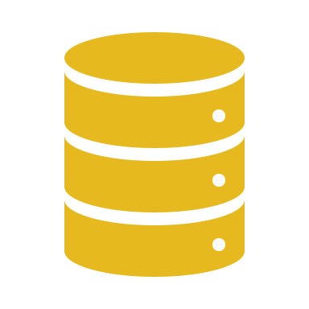

Biopython is used for working with sequence data in Python
”working with” can mean:
Renaming sequences
Filtering and removing certain sequences from a group of sequences
Combining sequences
Transforming sequences: reverse complement/transcription/translation
Plotting sequence lengths
Plotting GC content
Converting between file formats
BLASTing sequences and parsing the results
“sequence data” can mean:
DNA
RNA
Protein
Multiple Sequence Alignments

Slide 3
Most Biopython tools are available in GUIs
Why should you use Biopython instead?
Have total customization
Save a record of what you did in a script
Automate your analyses – let the computer do the work
Parallelization – run the same script on multiple genes or files
Combine your scripts into pipelines

Slide 4
Sample pipeline to build a phylogenetic tree
Sort sequences into gene families (Orthofinder or BLAST with Biopython)
Create fasta file for each gene family (Biopython)
Rename sequences with sample id (Biopython)
Remove short sequences (Biopython)
Align genes (Mafft)
Trim sequences (TrimAl)
Convert file to phylip format (Biopython)
Make gene trees (RaxML)
Build phylogenetic tree (Astral)

Slide 5

Biopython is suitable for beginning Python programmers

Slide 6
Workshop Materials
Two options for this workshop:
On your own computer (must have Biopython installed): Go to github.com/aGitHasNoName/Biopython. Click the green button that says Code. Select Download ZIP. Unzip the folder and move the folder someplace easy to find in your Documents or Desktop. Open up Jupyter Lab (or Jupyter Notebook) from Anaconda (or from the command line). Navigate to the Biopython folder. Open up Biopython.ipynb.
To access the notebook online: Go to colab.research.google.com, select GitHub, search for agithasnoname/Biopython. Select Biopython.ipynb.
If option 1 is giving you trouble, please use option 2.
This workshop was inspired by the Biopython Tutorial and Cookbook: biopython.org/DIST/docs/tutorial/Tutorial

Slide 7
Workshop plan
Please ask questions in the Zoom chat and I will answer during exercises or breaks
If my internet goes out at any point, that means everyone gets a 10-minute break
Installation instructions and links to materials are in the email that went out
If you have any trouble on your own computer, please switch to Google Colab

