Slide 1
Simulation
With a joystick (keyboard) the user simulates the robot motion
Obtain information about velocities
Compute the input ensuring the velocity
Compute and update the generalized coordinates with the function PerformMotion
Compute the odometry
Prepare all the topic to be published and publish them

Slide 2
Feature and characteristic
Versatility:
All the characteristics of the robot, of the sensors, of the world are passed as parameters so they can be changed:
  Robot: max value of omega, wheel radius, front axle, joint offset (a in table), castor arm length (d in table), initial position
  World: Xspacing, Yspacing, Linetickness
  Sensor: position (x, y) in robot frame, world
Robot model built with URDF using xacro

Slide 3
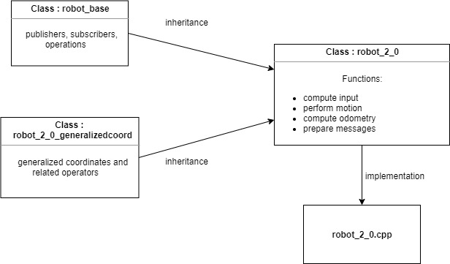
Robot Component

Slide 4
Library
Eigen has everything we need:
Easy intuitive initialization
All the operations
Intuitive and semantic

Slide 5
Testing
  Alpha testing: ok
  Beta testing: if you want
  Acceptance testing: if you think we should (UNIGE, CORO)

Slide 6
Sensor
  Check the lines around it
  Check different instances for the world (abort)
  Different lines? No problem

Slide 7
Ground Generator
  Different lines? No problem.
  Further application: always generate ground under the robot

Slide 8
File Handler
  Use rosbag and rosparam (safety)
  Only one run
  Check existence (add suffix)
  Folder not found (create it)
  Wrong path (abort)

Slide 9
Further Applications
  New sensor: just define it
  New world: just define it (modify generator accordingly)
  New robot type? Why not?!

