Slide 1
VLSI Final Project: CORDIC Algorithm
Allison Harry

Slide 2
Introduction
CORDIC algorithm computes trigonometric functions using only add & bitshift operations
Can also compute square root, exponentials, logarithms
Doesn’t require multiplications or a large lookup table
Hardware efficient when compared with other methods
Polynomial expansions (Taylor series, etc) require a hardware multiplier
Lookup tables can get very large, especially for higher accuracy

Slide 3
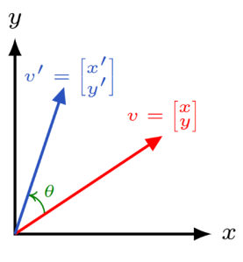
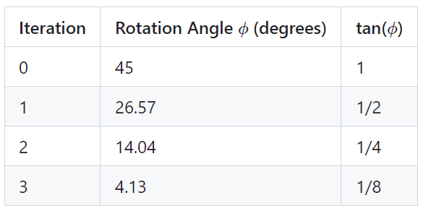
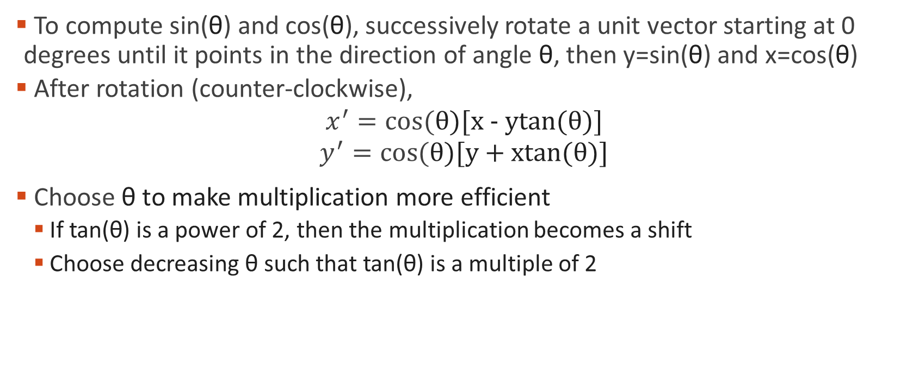
CORDIC Algorithm
To compute sin(θ) and cos(θ), successively rotate a unit vector starting at 0 degrees until it points in the direction of angle θ, then y=sin(θ) and x=cos(θ)
After rotation (counter-clockwise),
$$x^{′}=cos⁡(\text{θ})\text{[}\text{x}\text{ − }\text{ytan}\text{(}\text{θ}\text{)]}$$
$$y^{′}=cos⁡(\text{θ}\text{)[}\text{y}\text{ + }\text{xtan}\text{(}\text{θ}\text{)]}$$
Choose θ to make multiplication more efficient
If tan(θ) is a power of 2, then the multiplication becomes a shift
Choose decreasing θ such that tan(θ) is a multiple of 2
Notes:
Image source: https://math.libretexts.org/Bookshelves/Applied_Mathematics/Mathematics_for_Game_Developers_(Burzynski)/04%3A_Matrices/4.04%3A_Rotation_Matrices_in_2-Dimensions

Slide 4
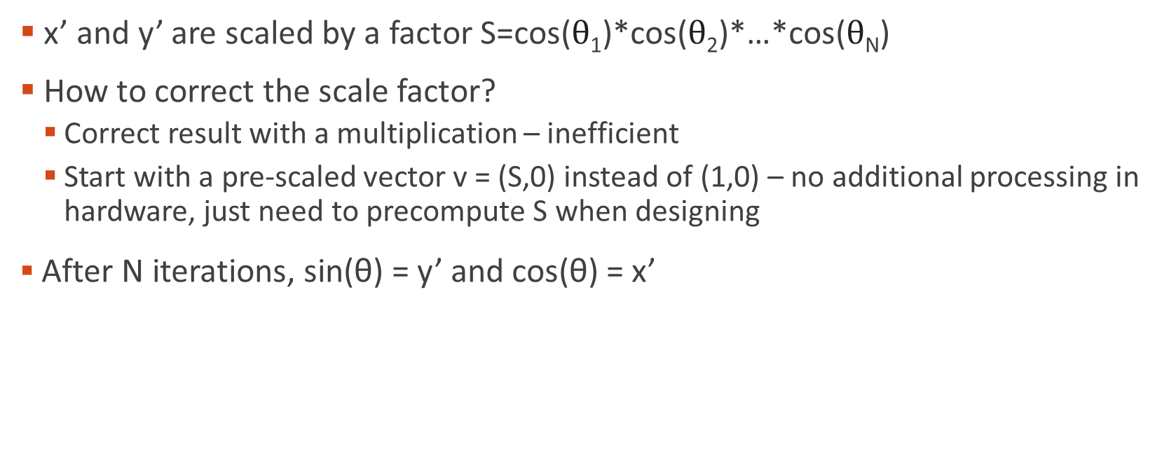
CORDIC Algorithm
x’ and y’ are scaled by a factor S=cos($\text{θ}$₁)*cos($\text{θ}$₂)*…*cos($\text{θ}$_{N})
How to correct the scale factor?
Correct result with a multiplication – inefficient
Start with a pre-scaled vector v = (S,0) instead of (1,0) – no additional processing in hardware, just need to precompute S when designing
After N iterations, sin(θ) = y’ and cos(θ) = x’
Notes:
Image source: https://math.libretexts.org/Bookshelves/Applied_Mathematics/Mathematics_for_Game_Developers_(Burzynski)/04%3A_Matrices/4.04%3A_Rotation_Matrices_in_2-Dimensions

Slide 5
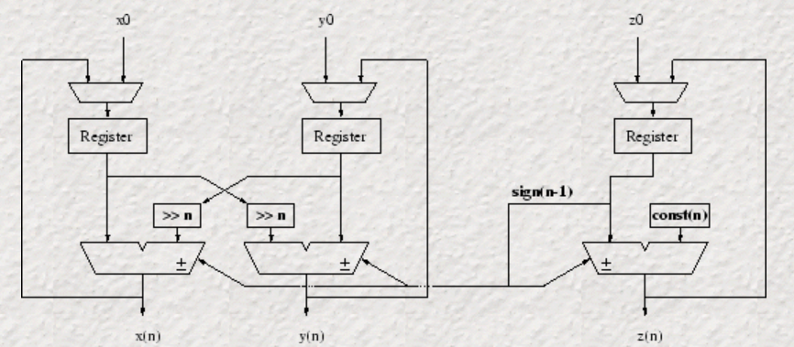
Implementations
Iterative
Computes 1 iteration of the algorithm each clock cycle
Can only compute one every N cycles
Low hardware requirement
Some overhead to keep track of which iteration it’s on
Notes:
Image source: https://cnmat.org/~norbert/cordic/node6.html

Slide 6
Implementations
Loop Unrolled / Pipelined
Duplicate the iterative hardware N times
Requires much more area
Faster, can output 1 result every clock cycle
Compute more than 1 iteration per pipeline stage
Computation depends on the previous iteration, so computing more than 1 iteration in a clock cycle will increase the critical path

Slide 7
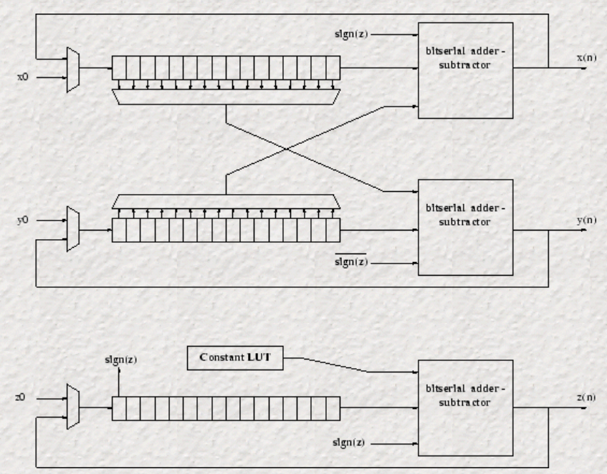
Implementations
Bit serial
Execute the additions/subtractions with a bit-serial adder
Decreases critical path because additions are done 1 bit at a time

Slide 8
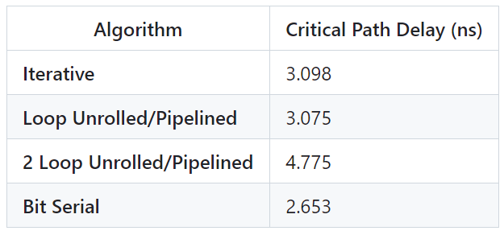
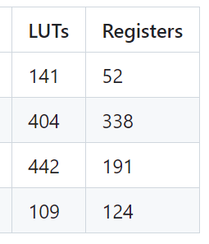
Results
Simulated in Modelsim to ensure designs would output correct results
Synthesis/implementation in Xilinx Vivado for FPGA

Slide 9
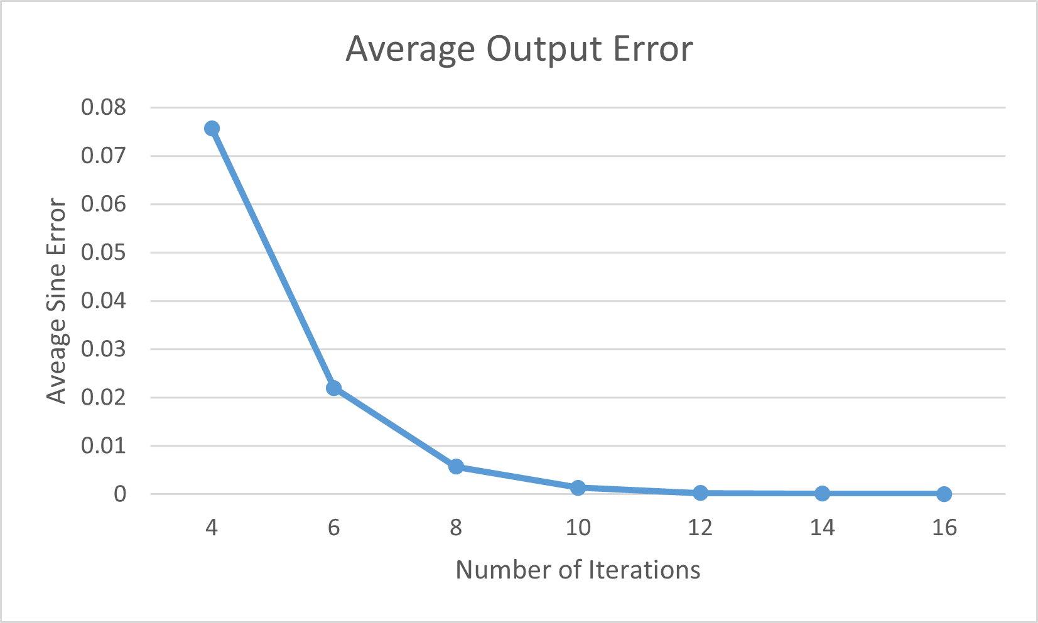
Results
Error decreases with more iterations N
Area can be saved by decreasing N but it will also decrease the accuracy

Slide 10
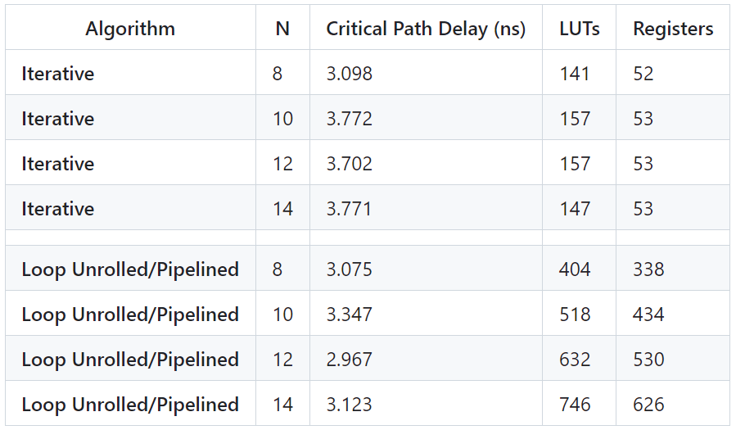
Results
Iterative implementation device utilization doesn’t increase much with N
Will require N clock cycles to compute though
Good for high accuracy, low speed
Pipelined device utilization increases with N
Need to add hardware for each new pipeline stage
Good for high speed, high accuracy

Slide 11
Conclusion
Iterative implementation – low throughput, low area, constant with N
Pipelined implementation – high throughput, high area, more costly with N
Bit serial implementation
Faster critical path doesn’t compensate for using more clock cycles to compute the additions one bit at a time
Requires additional control logic
Widely used, so could probably be optimized to be competitive with the other implementations

