Slide 1

An introduction to Nordic Semiconductor
Ultra Low Power Wireless Solutions
Andreas Haugland
BLE Course NTNU
Trondheim 2024
Notes:
Slides based on «Nordic Company Deliveries today and Future v1.5.3»

Slide 2
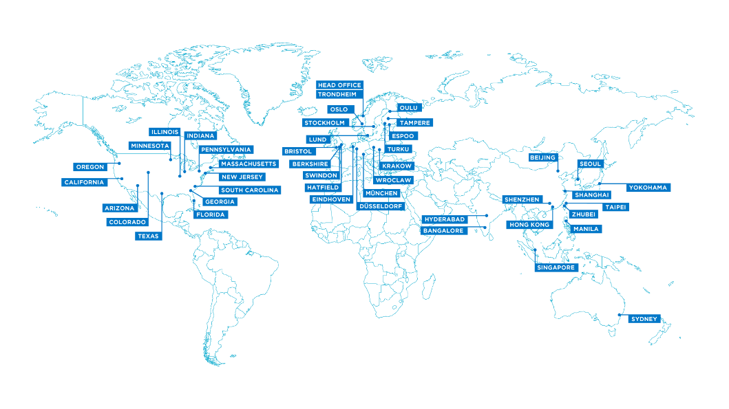
A brief overview of Nordic Semiconductor
Fabless semiconductor company - specialized in ULP wireless connectivity and embedded processing for IoT
Leading short range connectivity market with Bluetooth LE and Thread/Zigbee
Low power cellular IoT with LTE-M and NB-IoT technologies
Expanding into Wi-Fi 6 IoT market with new device family
Founded in 1982, Headquartered in Norway
~1000 employees
R&D in Norway, Finland, Poland, Sweden, UK, India and the US
Publicly listed in Norway under the ticker OBX:NOD
Key partners: TSMC, AMKOR, ASE
Notes:
Market leader in BLE - Expanded into 802.15.4/Thread and Zigbee

Slide 3
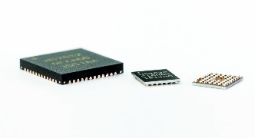

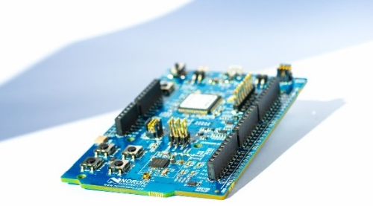
What do we make?
Embedded software
Integrated circuits
Development tools
System-on-Chips (SoCs)
System-in-Package(SiPs)
Wireless connectivity ICs (Radios)
Wireless protocol stacks
Software Development Kits(SDKs)
Development kits
Software tools Mobile Applications

Slide 4


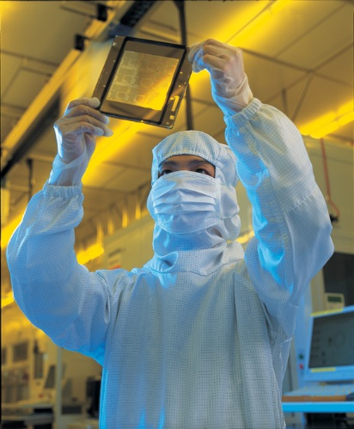
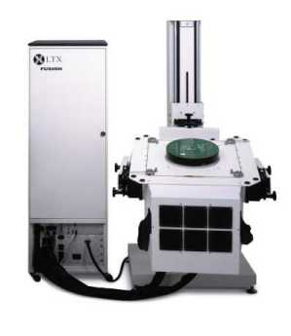

A «fabless» semiconductor company
Nordic Semiconductor outsources the IC manufacturing to a Semiconductor foundry
Taiwan Semiconductor Manufacturing Company (TSMC)
Testing and packaging of integrated circuits
Amkor Technology (Philippines)
ASE Group (Taiwan)
Sales and distribution
Nordic only sells ICs through distributors.
Logistic handled by stocking distributors

Slide 5
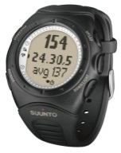
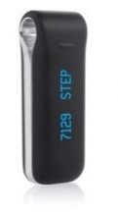
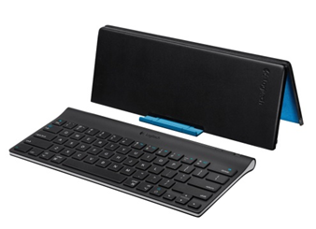
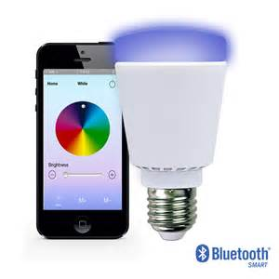

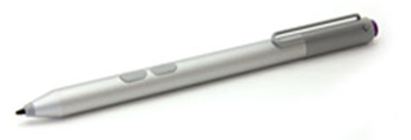
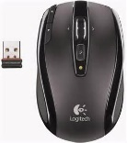
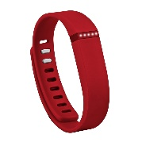
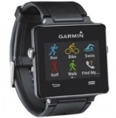
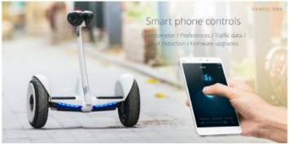
Nordic began the trend, and still the leader
Since early 2000s
Nordic #1 Since Day One From Proprietary and ANT Captured BLE Explosion
Solutions
From the Very Basic To the Most Advanced Leading in Software
Huge Customer Base
Massive Success with nRF51 and nRF52 Upping the Game with nRF53 and nRF54 Working with all Major Players
Notes:
Give them the story that we have been in ULP for a long time – actually we were FIRST!

Slide 6




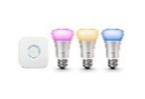











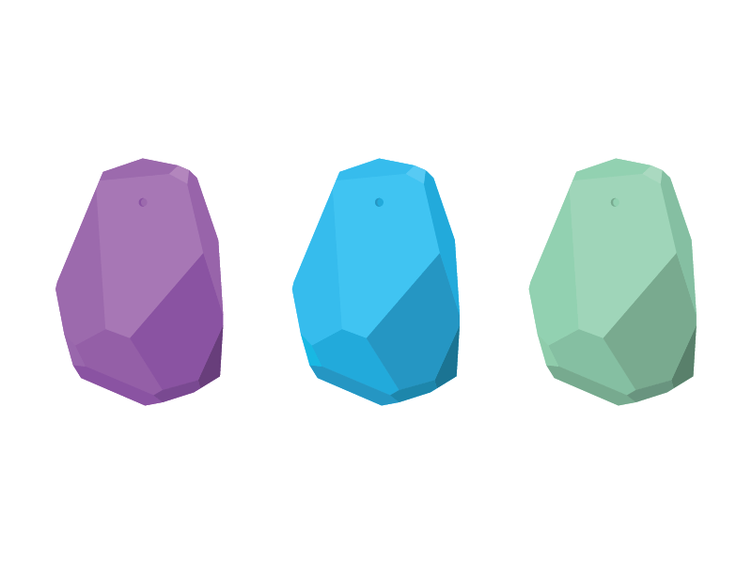







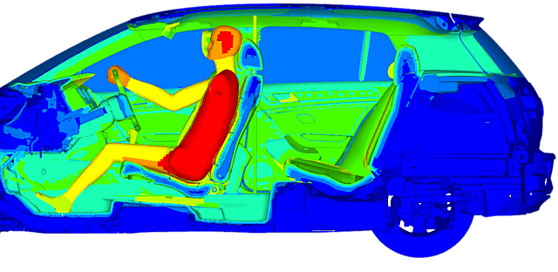





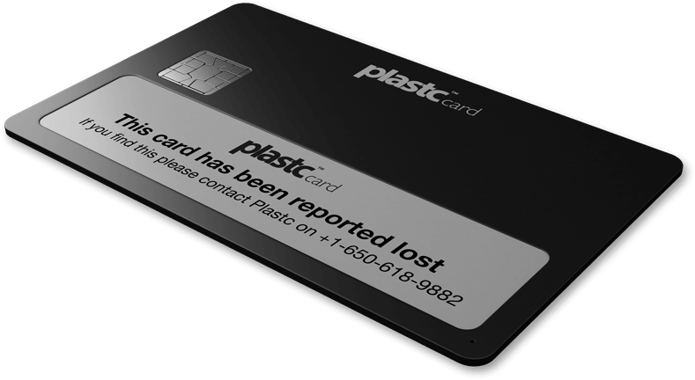








Powering an incredible range of products
Wearables
Enterprise
Automation
PC/Phone/Tablet HID
Smart Home
Healthcare/Medical
Gaming
Beacons
Remote Controls
Automotive
Toys
Payment/ID
Proximity Tags
Logistics/Transport
Industrial
Automation

Slide 7
Nordic gaining design win market share
Nordic no. of designs +8% in 2023, vs -10% for all others combined
Bluetooth Low Energy end-product certifications, last 12 months
Nordic end-product certifications
Q4’23 153 designs 45% mkt share
FY2023 483 designs 43% mkt share
*Source: DNB Markets/FCC

Slide 8



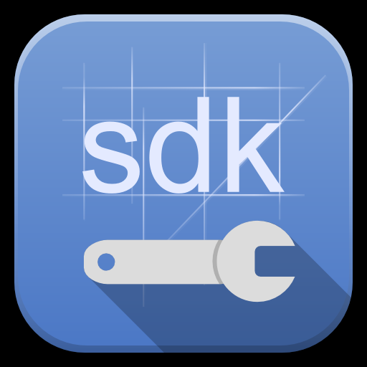


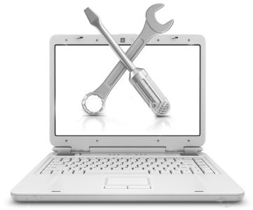

The Complete Bluetooth® low energy solution
Best in class, broad selection Bluetooth SoCs
Unique high performance Bluetooth stacks
World class specialist support teams
Comprehensive SDKs
End Product
Vibrant developer community
Extensive SW/HW development tools
Notes:
Developing and bringing products to market is the whole effort. Chip specs alone don’t get you there, the whole supporting structure around any SoC is equally important as the device capabilities. The device is best in class. There is an existing comprehensive array of software for the nRF51 series – protocol stacks, SDK, application-specific SDKs such as A4WP and IoT (IPv6). The SW architecture is common to the nRF51 series and with a small porting effort this existing wealth of SW is available to the nRF52.
Flexible single board development kits that easily interface with other vendors kits (Arduino Rev 3 standard) allow cost-effective development. Direct Nordic personal support service for all to get help with any sticking points, free evaluation of layouts by RF experts. Developer Zone a vibrant community and source of support from other developers in conjunction with open source GitHub allowing collaborative efforts on SW

Slide 9

The nRF5x Series – Short range
nRF52840
1024kB/256kB
Cost/Value
nRF52832
512kB/64kB
aQFN
4.2
nRF52832
256kB/32kB
QFN
CSP
nRF51822
256kB/32kB
QFN
QFN
CSP
TCSP
nRF52810
192kB/24kB
nRF51822
256kB/16kB
nRF51824
256kB/16kB
QFN
CSP
QFN
CSP
TCSP
QFN
nRF51822
128kB/16kB
QFN
CSP
nRF51® Series
nRF52® Series
Performance / Features

Slide 10





Nordic Semiconductor products
Short Range
Wi-Fi
Cellular
PMIC
nRF Cloud
Bluetooth Low Energy
Matter
Thread/Zigbee
Proprietary
Wi-Fi 6
2.4GHz +5GHz
LTE-M
NB-IoT
GPS
Li-Ion charger
LDO
DC/DC buck converter
Cloud connectivity
Location support
SCELL/MCELL
AGPS/PGPS
Device management

Slide 11
An introduction to Nordic Semiconductor
Ultra Low Power Wireless Solutions
Andreas Haugland
NTNU BLE Course
Trondheim 2024
Notes:
Slides based on «Nordic Company Deliveries today and Future v1.5.3»

Slide 12
Course Agenda
Monday, February 12th
 |  | Topic | Description | Duration(mins)
17:00 | 17:30 | Registration and Pizza | Course participants register, get the nRF52 DK+ servo + sensor + jumper cables and we eat pizza. | 30
17:30 | 18:00 | Introduction to Nordic Semiconductor, course agenda and nRF52 intro | A short presentation of Nordic Semiconductor ASA as a company and a quick walkthrough of the course agenda. | 30
18:00 | 18:30 | Introduction to the nRF52840 DK | Introduction to the nRF52840 DK and it’s features | 30
18:30 | 18:45 | Break | - | 15
18:45 | 19:15 | Walk through the Hands-on | What will we do in this course | 30
19:15 | 19:30 | Introduction to VS Code | Quick intro to VSC: Building projects, flashing the nRF52, modifying build parameters, debugging | 15
19:30 | 20:00 | Start working with the Hands-on | Start creating our project for the nRF52840 | 90
20:00 | 20:30
20:30 | 21:00

Slide 13
Course Agenda
Tuesday, February 13th
 |  | Topic | Description | Duration(mins)
17:00 | 17:30 | Pizza | Eating Pizza | 30
17:30 | 18:00 | SoftDevice Controller Introduction | Short introduction to the Bluetooth Low Energy stack | 30
18:00 | 19:00 | Bluetooth Low Energy(BLE) Hands-on with the nRF52840 | Start working on the Bluetooth Low Energy part of the Hands-on | 60
18:30 | 19:00
19:00 | 19:15 | Nordic Tools | Introduction to Nordic Development tools | 15
19:15 | 19:30 | Break | - | 15
19:30 | 20:00 | Bluetooth Low Energy(BLE) Hands-on with the nRF52840 | Implement event handling for Bluetooth Low Energy Events | 90
20:00 | 20:30
20:30 | 21:00

Slide 14
Course Agenda
Thursday, February 15th
 |  | Topic | Description | Duration(mins)
17:00 | 17:30 | Pizza | Eating Pizza | 30
17:30 | 18:00 | Bluetooth Low Energy(BLE) Hands-on with the nRF52840 | Roundup: Work on whatever you have left of the Hands-on (Take breaks as you need) | 180
18:00 | 18:30
18:30 | 19:00
19:00 | 19:30
19:30 | 20:00
20:00 | 20:30
20:30 | 21:00 | Kahoot Quiz | Kahoot Quiz to check see if you have learned anything during the course. Prize for the winner. | 30
Notes:
Kahoot kan flyttes frem hvis mange ser ut til å bli ferdige før

Slide 15
Agenda
Wednesday, December 8th
 |  | Topic | Description | Duration(mins)
09:00 | 09:15 | Introduction and Agenda | We go through the plan of this two-day session. Expectations vs reality. | 15
09:15 | 09:45 | nRF52840 Intro | A walkthrough of the nRF52840 | 30
09:45 | 10:45 | Bluetooth Low Energy(BLE) | Crash-course in the Bluetooth Low Energy protocol | 60
10:45 | 11:15 | Hands-on intro | Intro to github repo and nRF Connect for VS Code | 30
11:15 | 12:20 | Break/Lunch | - | 60
12:15 | 13:30 | Hands-on | Continue working on the hands-on | 75
13:30 | 14:00 | Softdevice Controller introduction | Let us look into the Nordic Softdevice Controller and compare it to the “old” Softdevice. | 90
14:00 | 15:30 | Hands-on | Continue working on the hands-on | 90
15:30 | - | Wrap up | Feedback and plan for tomorrow | -
Notes:
This plan is flexible. If we need more time of something, or less of something else that is fine. Try to get the feel of what gives the best learning outcome. Stress that feedback is welcome.
Discuss how we can do hands-on assistance. Mute this call and do individual teams calls?

Slide 16
Agenda
Thursday, December 9th
 |  | Topic | Description | Duration(mins)
09:00 | 09:15 | Introduction and Agenda | We go through the plan for today. Do we do any changes? | 15
09:15 | 10:15 | Nordic Tools | A walkthrough of some of Nordic’s Development tools | 60
10:15 | 11:15 | BLE Hands-on | Let us continue with the hands-on. Need more time? | 60
11:15 | 12:20 | Break/Lunch | - | 60
12:15 | 13:30 | Peripheral Hands-on ? | Should we look into some nRF Specific peripherals? PPI, registers in general? | 15
13:30 | 14:00 | Any requests? | If there is anything in particular you would like to go through, we can do so here. If not -> Hands-on | 90
14:00 | 15:30 | Hands-on | Finish our hand-on assignments. | 30
15:30 | - | Wrap up | Feedback. What worked well, and what didn’t? (the one who finishes the hands-on in second place has to do this training next year) | -
Notes:
This plan is flexible. If we need more time of something, or less of something else that is fine. Try to get the feel of what gives the best learning outcome. Stress that feedback is welcome.

Slide 17
Course Agenda
Tuesday, November 12th
 |  | Topic | Description | Duration(mins)
17:00 | 17:15 | Pizza | Eating Pizza | 30
17:15 | 17:30
17:30 | 17:45 | SoftDevice Introduction | Short introduction to the SoftDevice | 30
17:45 | 18:00
18:00 | 18:15 | Bluetooth Low Energy(BLE) Hands-on with the nRF52832 | Finish creating the custom service and the characteristic | 90
18:15 | 18:30
18:30 | 18:45
18:45 | 19:00
19:00 | 19:15
19:15 | 19:30 | Break | - | 15
19:30 | 19:45 | Bluetooth Low Energy(BLE) Hands-on with the nRF52832 | Implement event handling for SoftDevice Events | 60
19:45 | 20:00
20:00 | 20:15
20:15 | 20:30
20:30 | 20:45
20:45 | 21:00

