Slide 1

Segger Embedded Studio
Introduction to the nRF52 Development Kit and Segger Embedded Studio
Edvin Holmseth
Uni. Of Strathclyde
January 2020

Slide 2
Segger Embedded Studio (SES)
Professional IDE solution
Feature-packed debugger with seamless J-Link integration
Powerful Project Manager
Multi-Threaded build minimizes build times
Notes:
IDE: Integrated Development Environment

Slide 3
SES Project in SDK
From SDK 14.1, SES Project files have been added
Until SDK 14, Keil Project can be imported in SES
Not recommend
Not easy to configure build environments

Slide 4
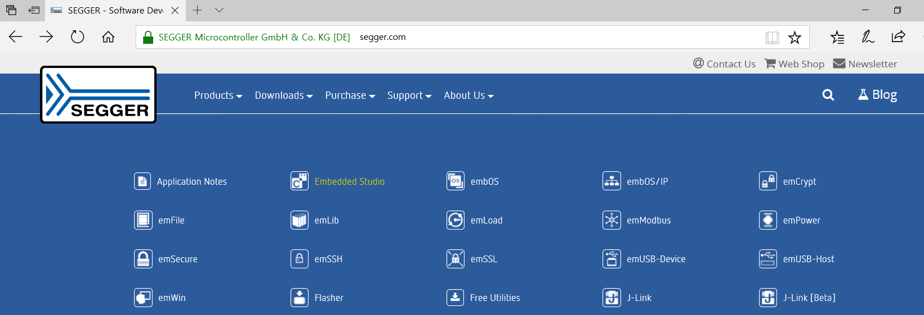
Install Segger Embedded Studio

Slide 5
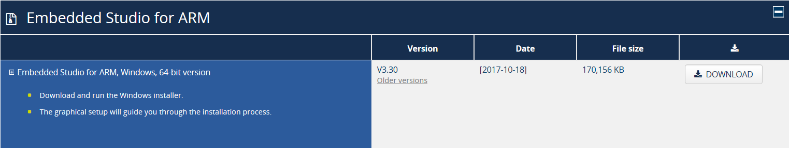
Install Segger Embedded Studio

Slide 6
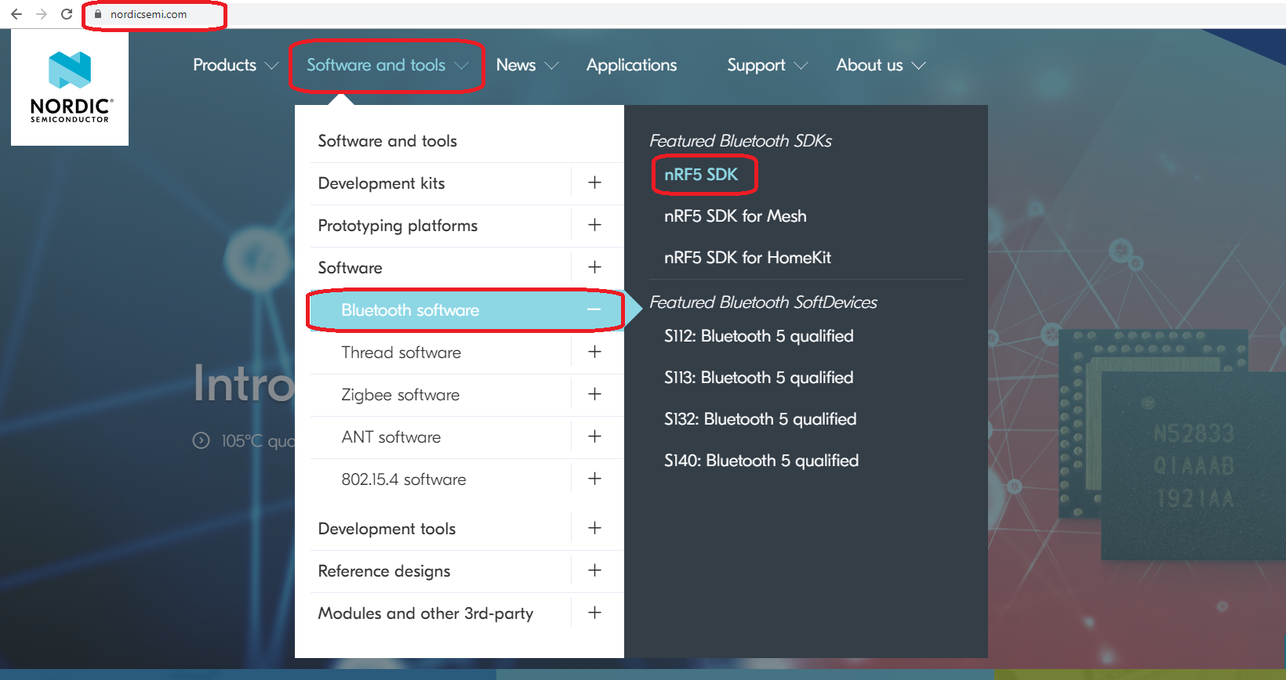
Download Nordic SDK

Slide 7
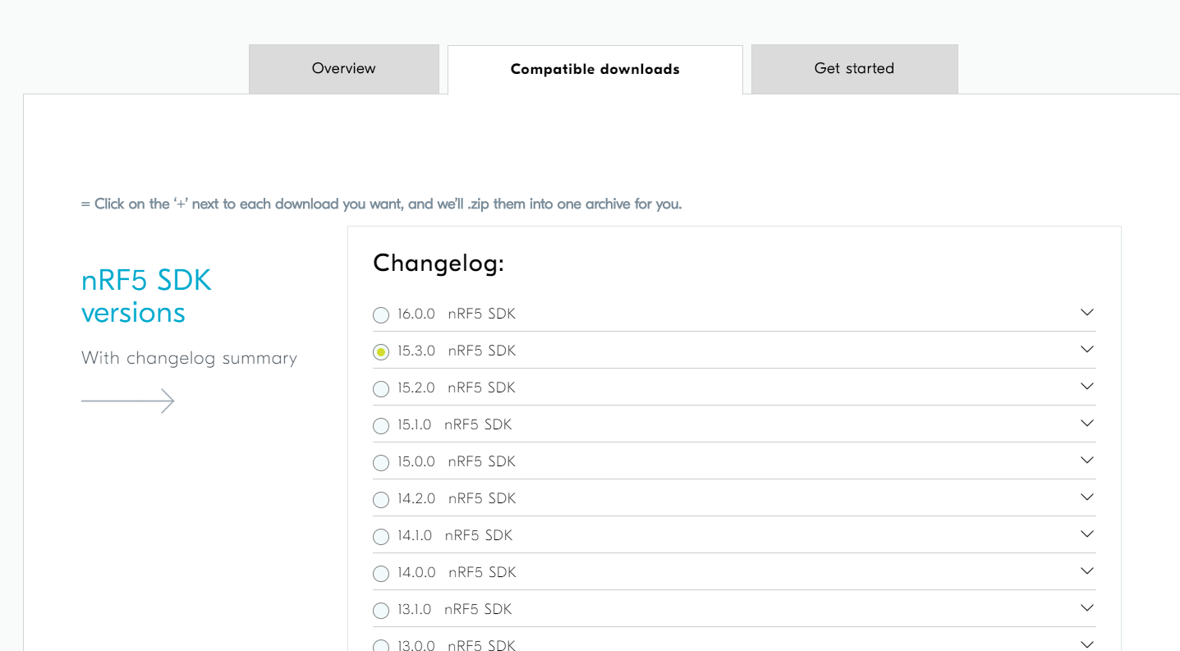
Download Nordic SDK

Slide 8
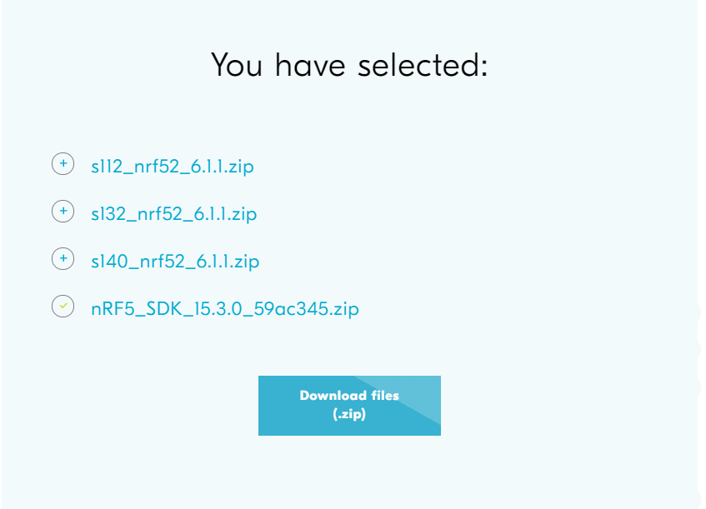
Download Nordic SDK

Slide 9
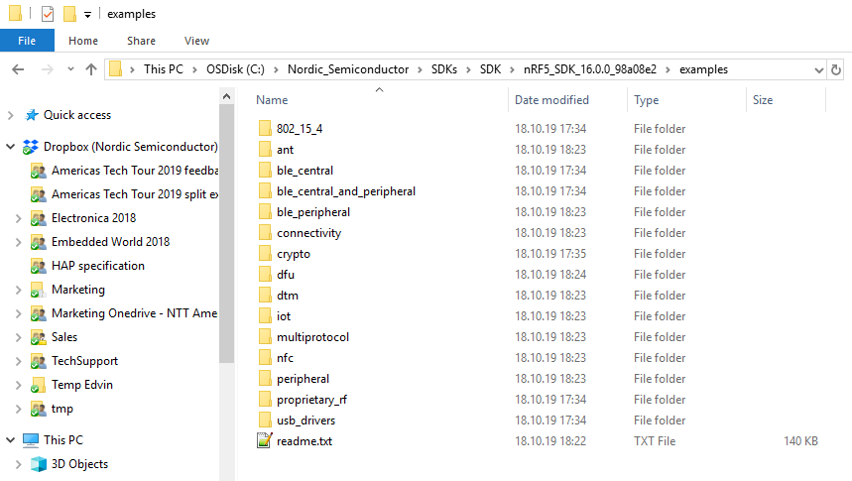
SDK Layout

Slide 10
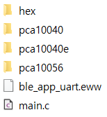
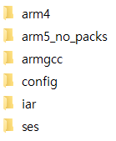

SES Project in SDK
S140(52840)
S112(52810)

Slide 11
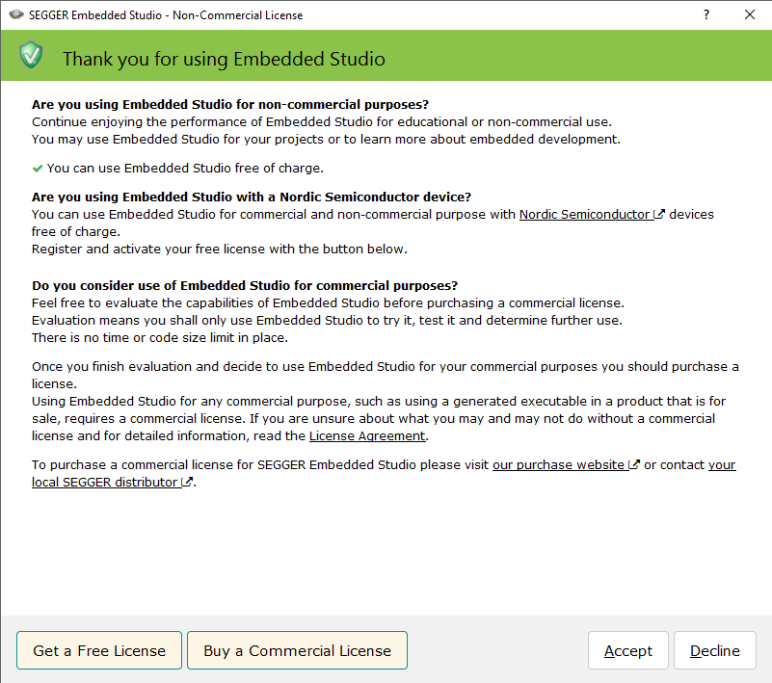
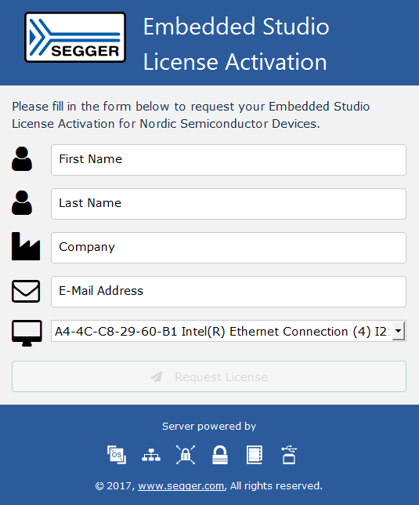
How to get the license

Slide 12
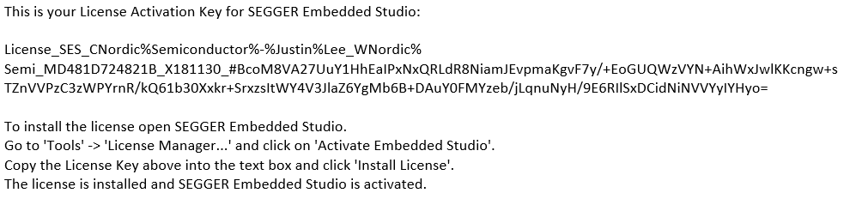
How to get the license
COPY

Slide 13
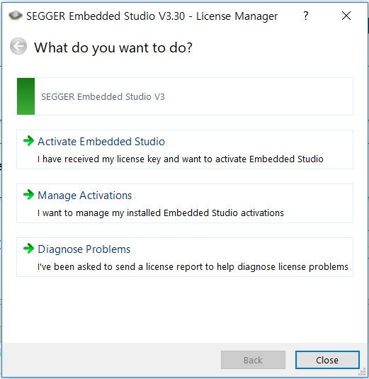
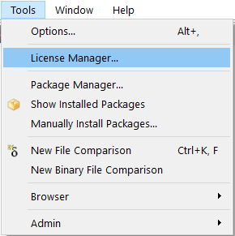
How to get the license

Slide 14
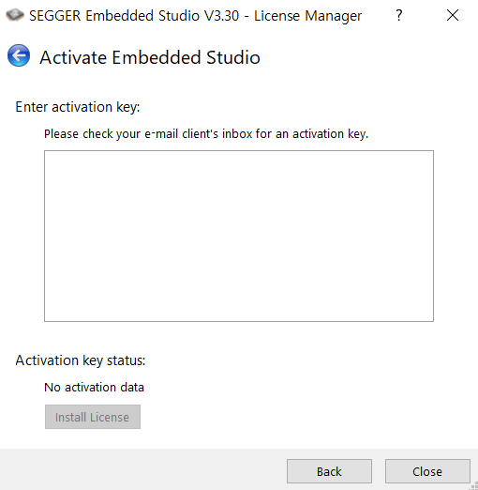
How to get the license
Paste an activation Key

Slide 15
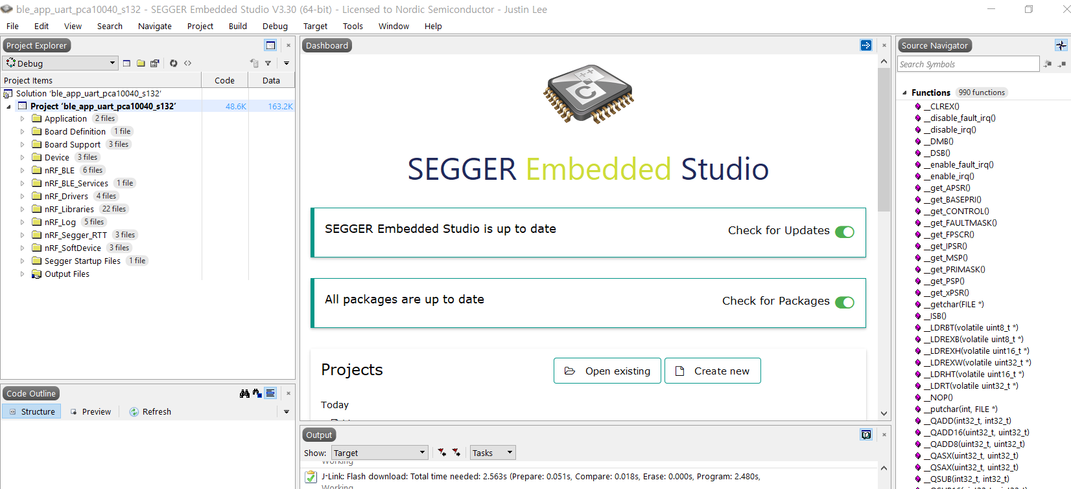
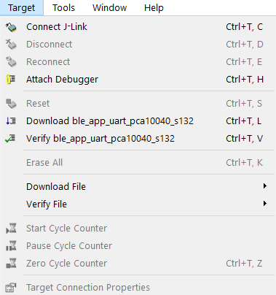
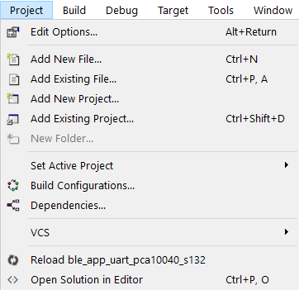
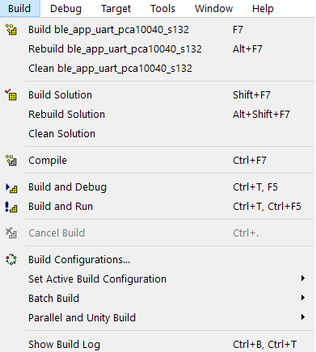
Configuration
Target Menu
Project Menu
Build Menu
Select Build Mode

Slide 16
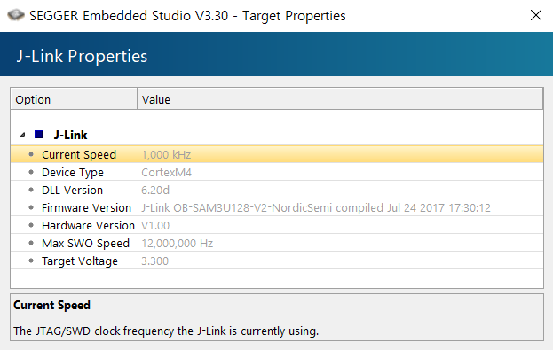
Configuration – Target Menu
Connect J-Link : to flash
Disconnect : to stop Debugger
Reconnect : to connect again (when J-Link error)
Attach Debugger : to run Debugger
Reset : Reset J-Link
Download ~~ : flash built file
Verify ~~ : verify flashing
Erase All : including SoftDevice
Download File : download manually
Verify File : Verify manually
Target Connection Properties :

Slide 17
Modify Project
Definition
Directory
RAM (Start Address, Size)
SDK Configuration
Etc

Slide 18
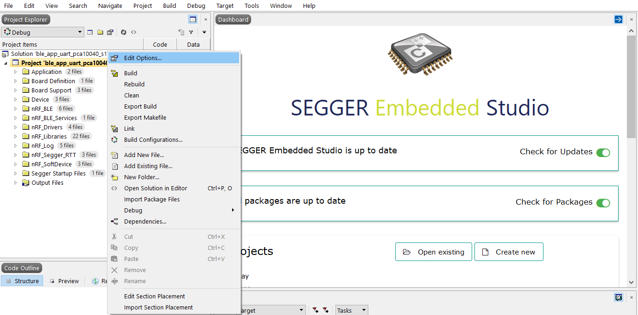
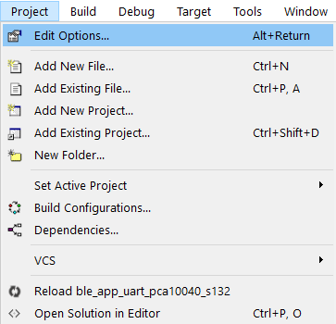
Edit Option
Notes:
HOW TO CHANGE PREPROCESSOR DEFINES

Slide 19
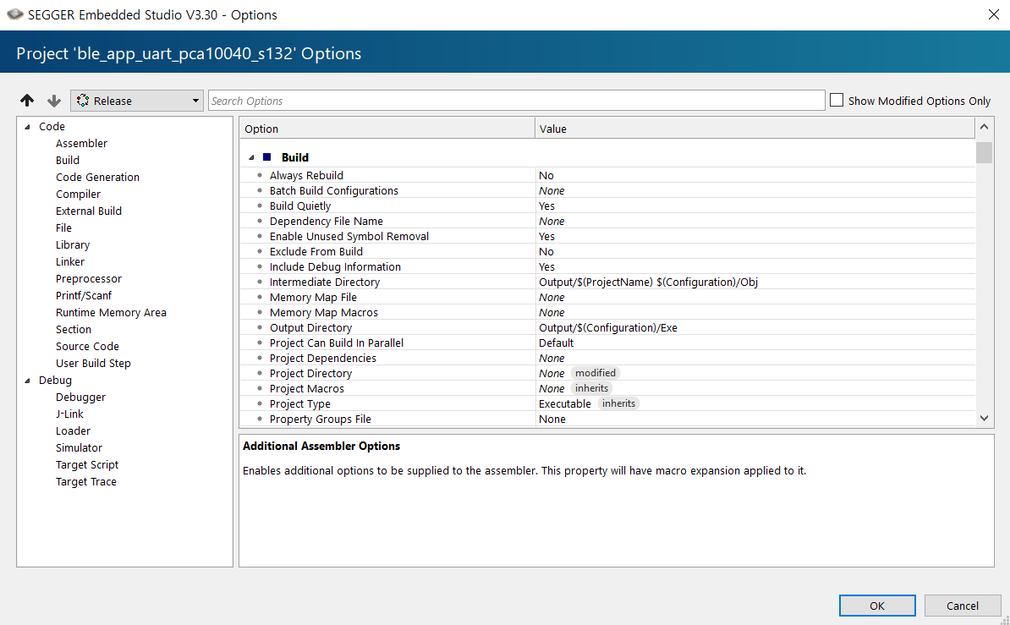
Edit Option

Slide 20
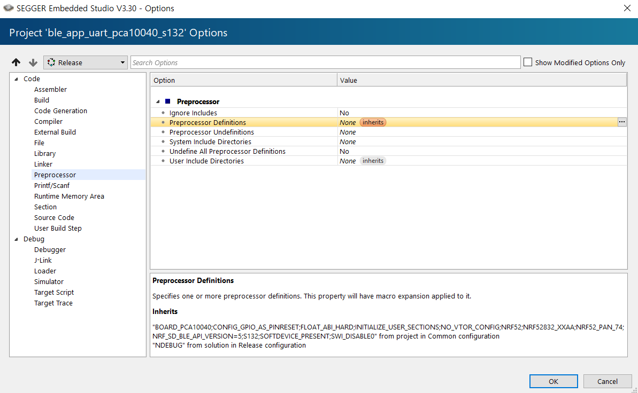
Edit Option - Definition
…. from project in Common configuration
…. from solution in Release configuration

Slide 21
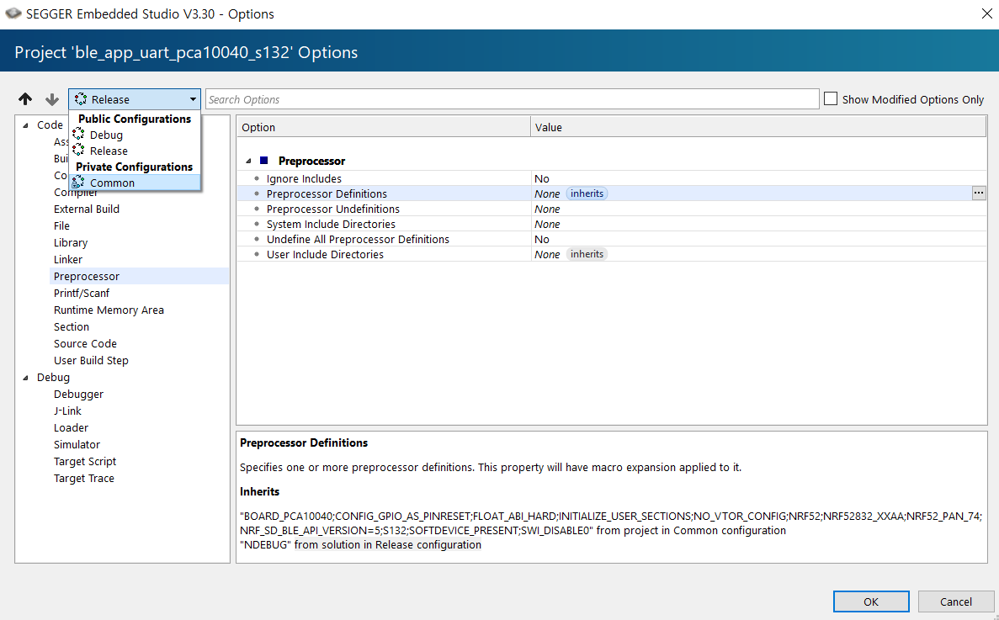
Edit Option - Definition

Slide 22
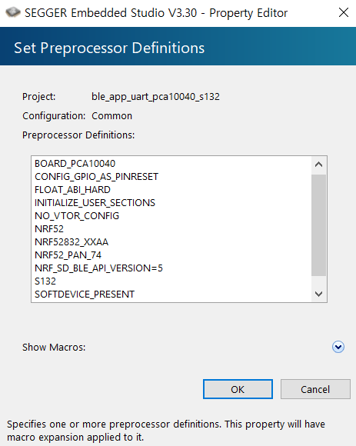
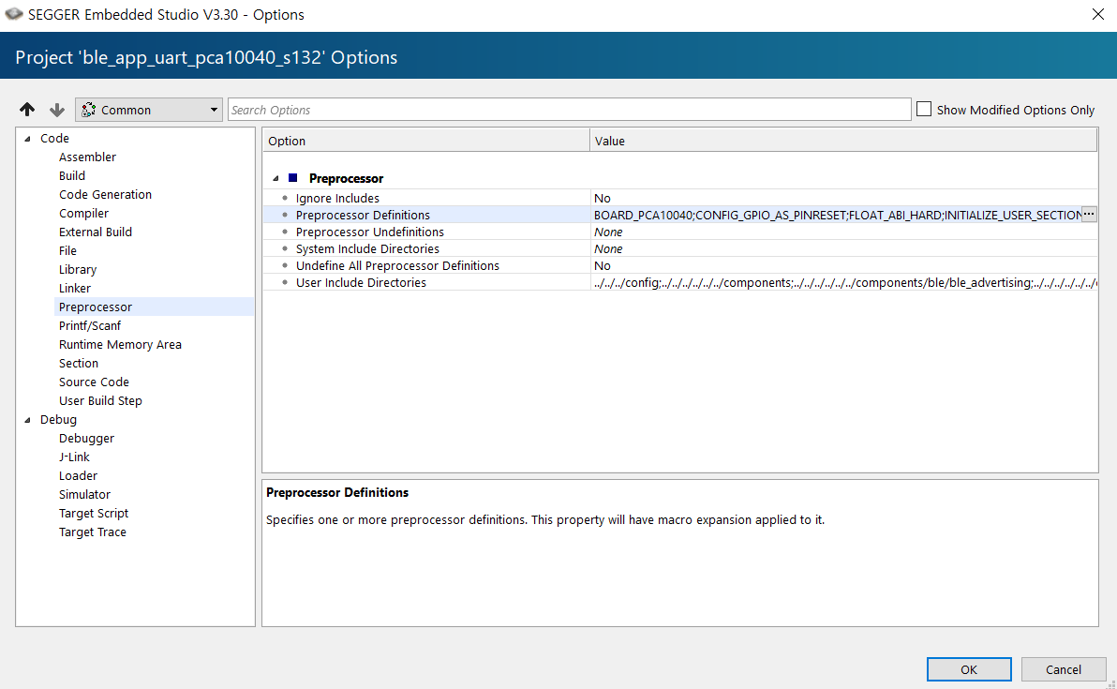
Edit Option - Definition

Slide 23
Edit Option - Definition
Release Def in Project
Common Def in Project
Common Def in Solution
Release Def in Solution

Slide 24
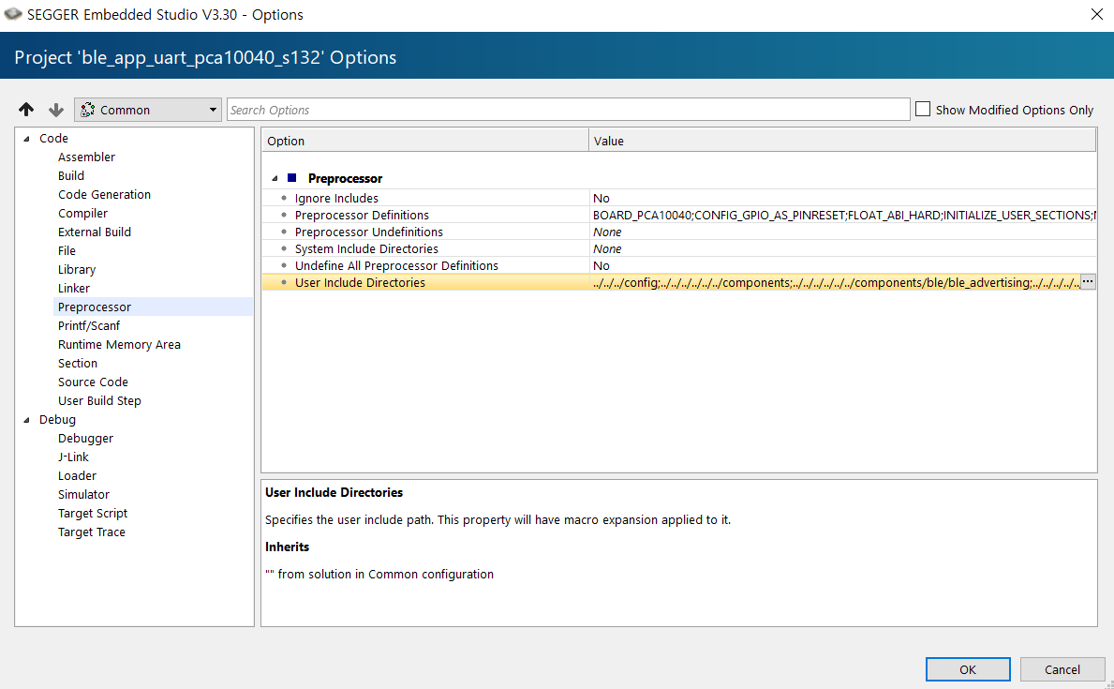
Edit Option – User Directories

Slide 25
Edit Option – User Directories
Release Dir in Project
Common Dir in Project
Common Dir in Solution
Release Dir in Solution

Slide 26
Edit Option – RAM adjustment
Modify in Project File
Modify in Editor from Project Menu
Modify in Linker of Edit Option

Slide 27
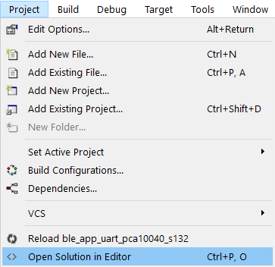
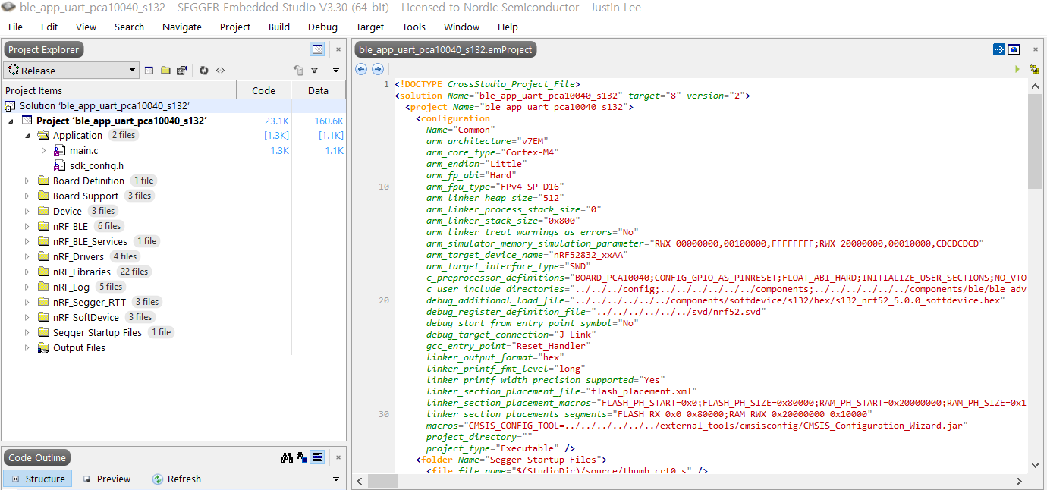
Edit Option – RAM adjustment

Slide 28
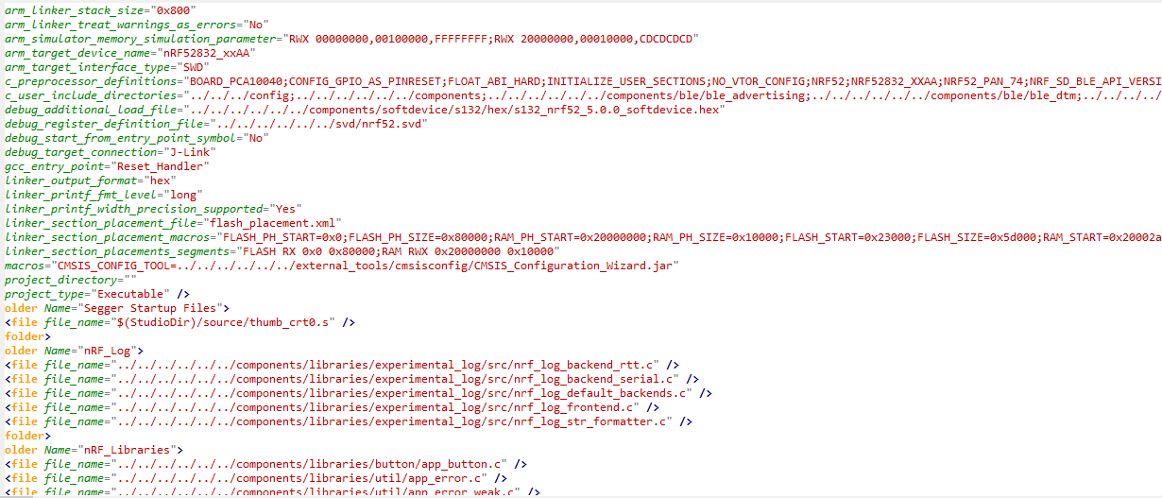
Edit Option – RAM adjustment
Linker_section_placement_macro
"FLASH_PH_START=0x0;FLASH_PH_SIZE=0x80000;
RAM_PH_START=0x20000000;RAM_PH_SIZE=0x10000;
FLASH_START=0x23000;FLASH_SIZE=0x5d000;
RAM_START=0x20002a68;RAM_SIZE=0xd598"

Slide 29
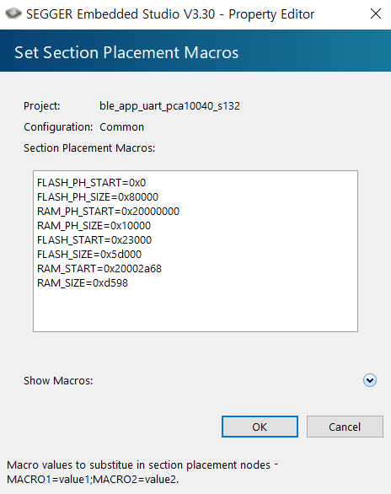
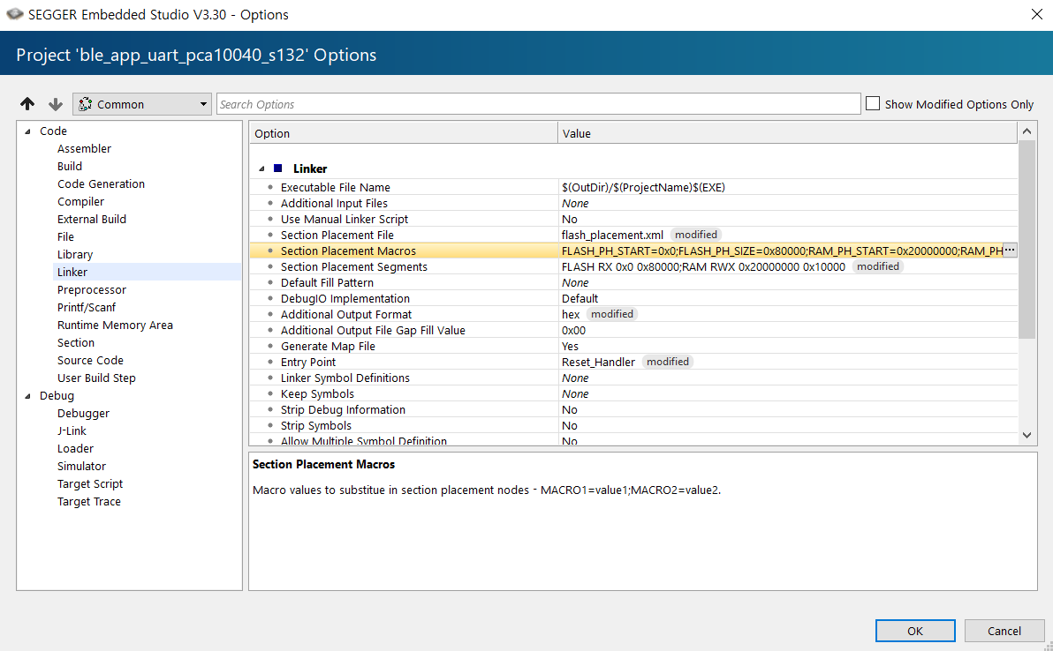
Edit Option – RAM adjustment

Slide 30
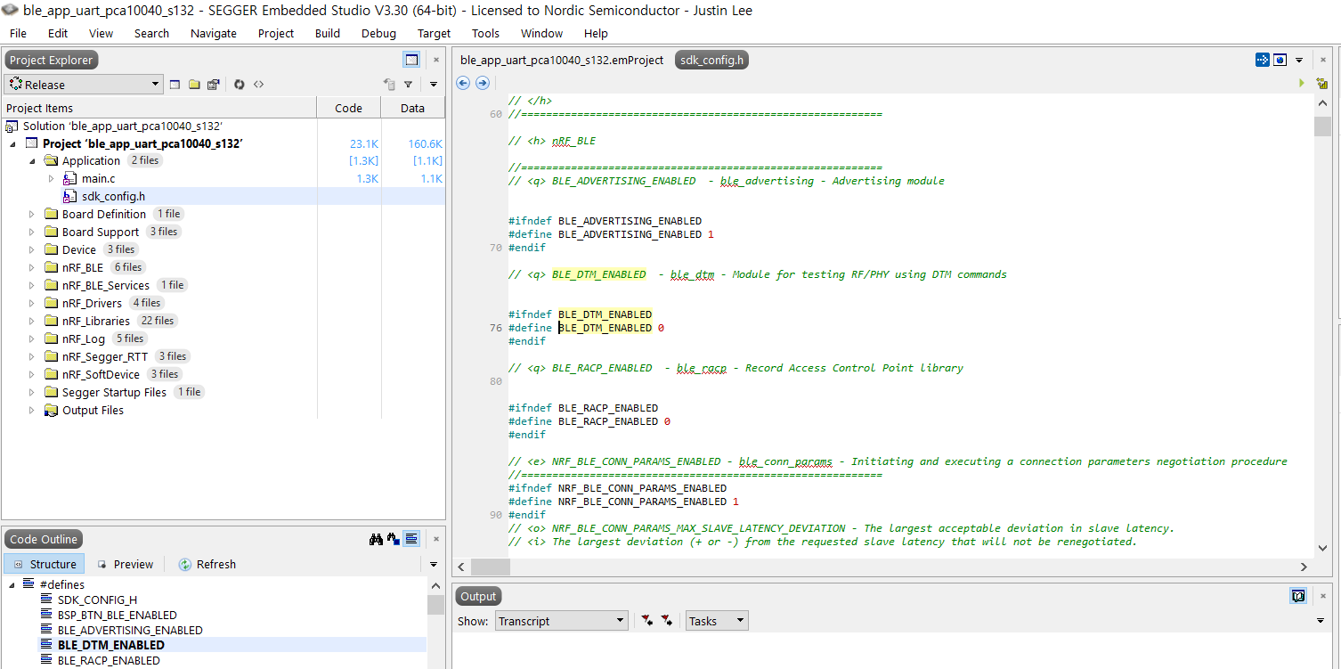
SDK Configuration

Slide 31
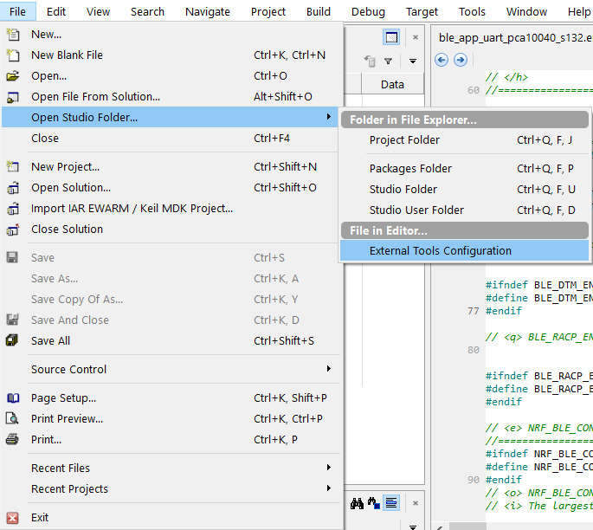
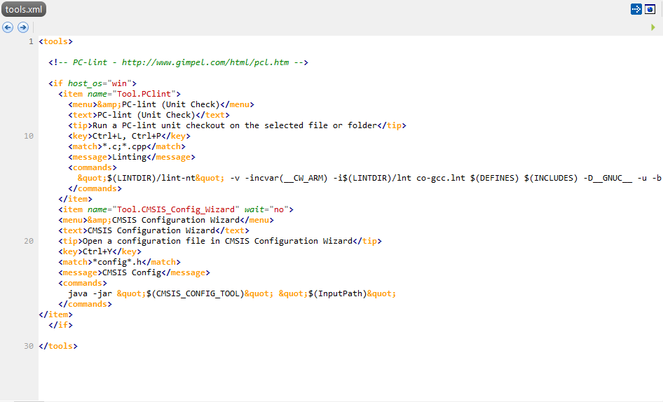
SDK Configuration – CMSIS Configuration Wizard
Insert Here
Refer : https://infocenter.nordicsemi.com/index.jsp?topic=%2Fcom.nordic.infocenter.sdk5.v15.3.0%2Fsdk_config.html&cp=5_5_0_1_6_5_1&anchor=sdk_config_ide_ses

Slide 32
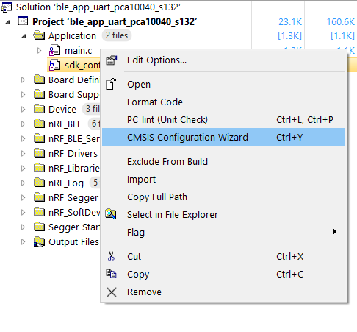
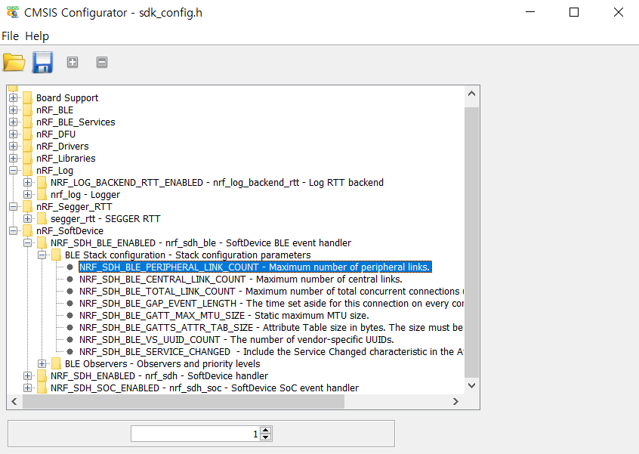
SDK Configuration – CMSIS Configuration Wizard

Slide 33
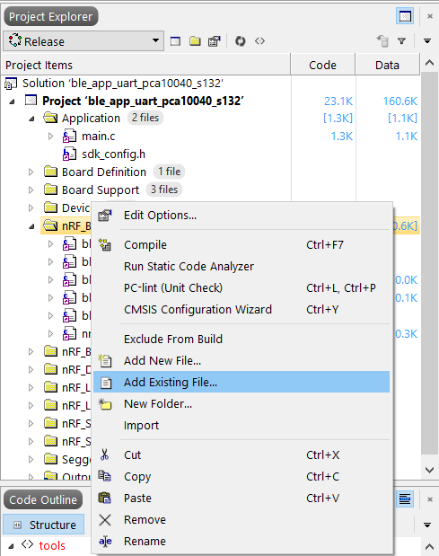
Adding Files & Libs

Slide 34
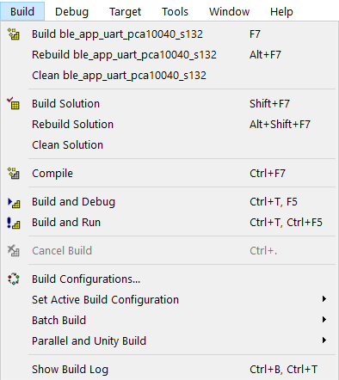
Build
Project Build
Build and run immediately

Slide 35
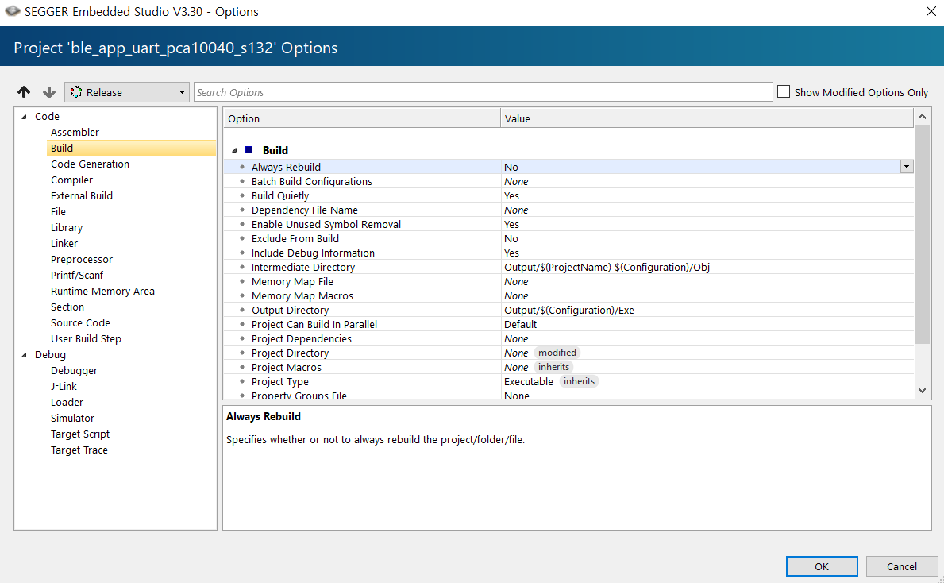
Build
Directory for obj files
Directory for exe file

Slide 36
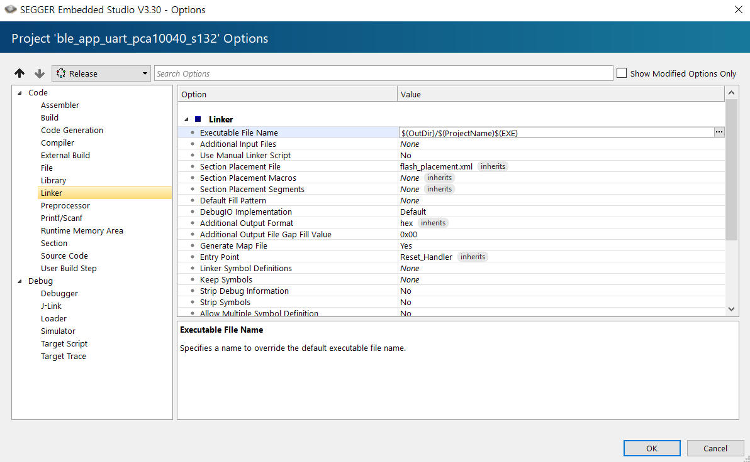
Build
Exe file type

Slide 37
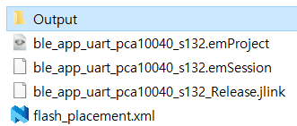
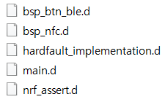


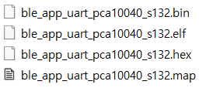

Build

Slide 38
How to flash
Similar with Keil, but different a little bit
Differences
Keil : only can flash an Application
Possible with customize tools (nrfjprog)
SES : can flash an Application with SoftDevice
Keil : can flash without J-Link connection
SES : need J-Link connection

Slide 39
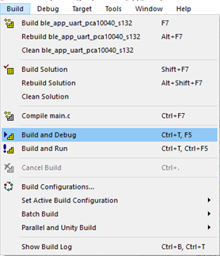
How to flash How to debug
Build (F7)
Connect J-Link in Target Menu
Erase All in Target Menu
Download in Target Menu
Verify (if you want) in Target Menu

Slide 40
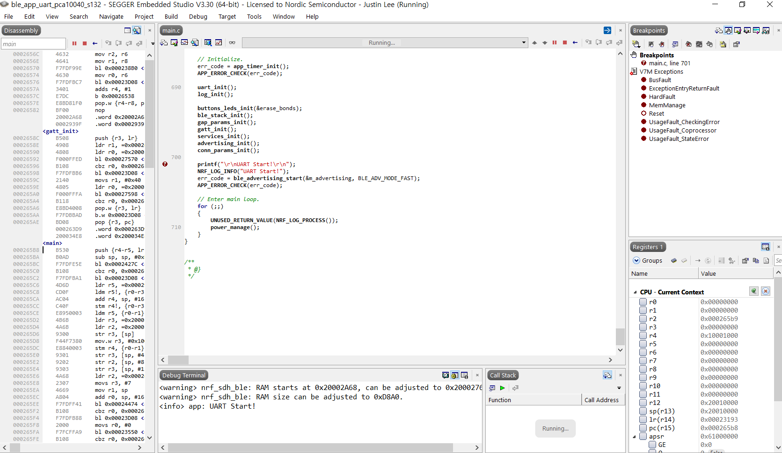
Debugging Mode
Go/Stop
Breakpoint
Line
Register
RTT Terminal
Call Stack

Slide 41
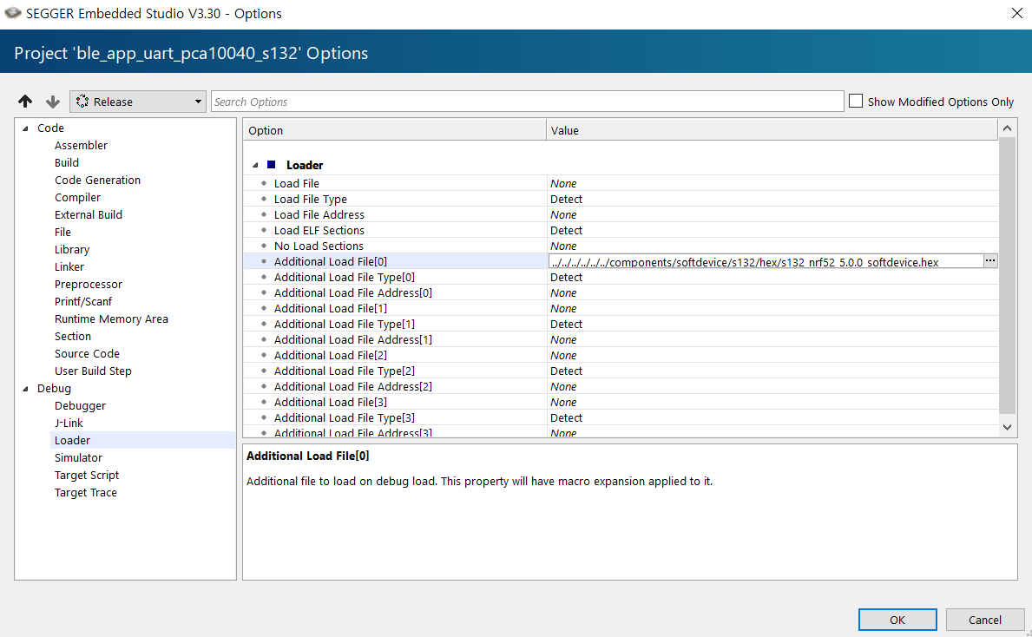
How to flash with SD, without SD
Indicate SoftDevice

Slide 42
Segger Embedded Studio
Introduction to the nRF52 Development Kit and Segger Embedded Studio
Edvin Holmseth
Uni. Of Strathclyde
January 2020

