Slide 1

nRF Connect for Visual Studio Code
Introduction to the nRF52 Development Kit and Visual Studio Code
Edvin Holmseth
Norwegian University of Science and Technology
March 2022

Slide 2
Visual Studio Code
Professional IDE solution
Free to use
Large User Controlled Extension Library
Notes:
IDE: Integrated Development Environment

Slide 3
Todo:
Download Visual Studio Code
Code.visualstudio.com/download
(Google “visual studio code download”)
Open it and check for updates to see that it is the latest version.
Download nRF Command Line Tools
Google will lead you to: https://www.nordicsemi.com/Products/Development-tools/nrf-command-line-tools/download
Download nRF Connect for Desktop
Update and open “Toolchain Manager”
Install nRF Connect SDK v1.9.1
Open VS Code

Slide 4
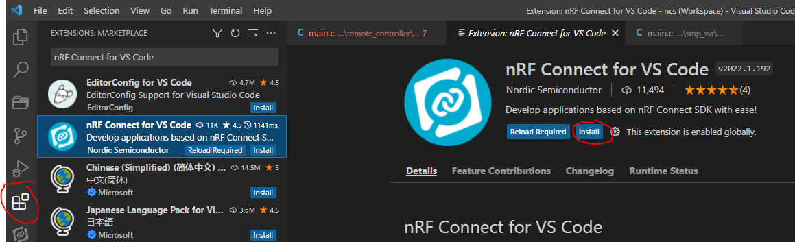
Todo:
In VS Code, install the extension:

Slide 5
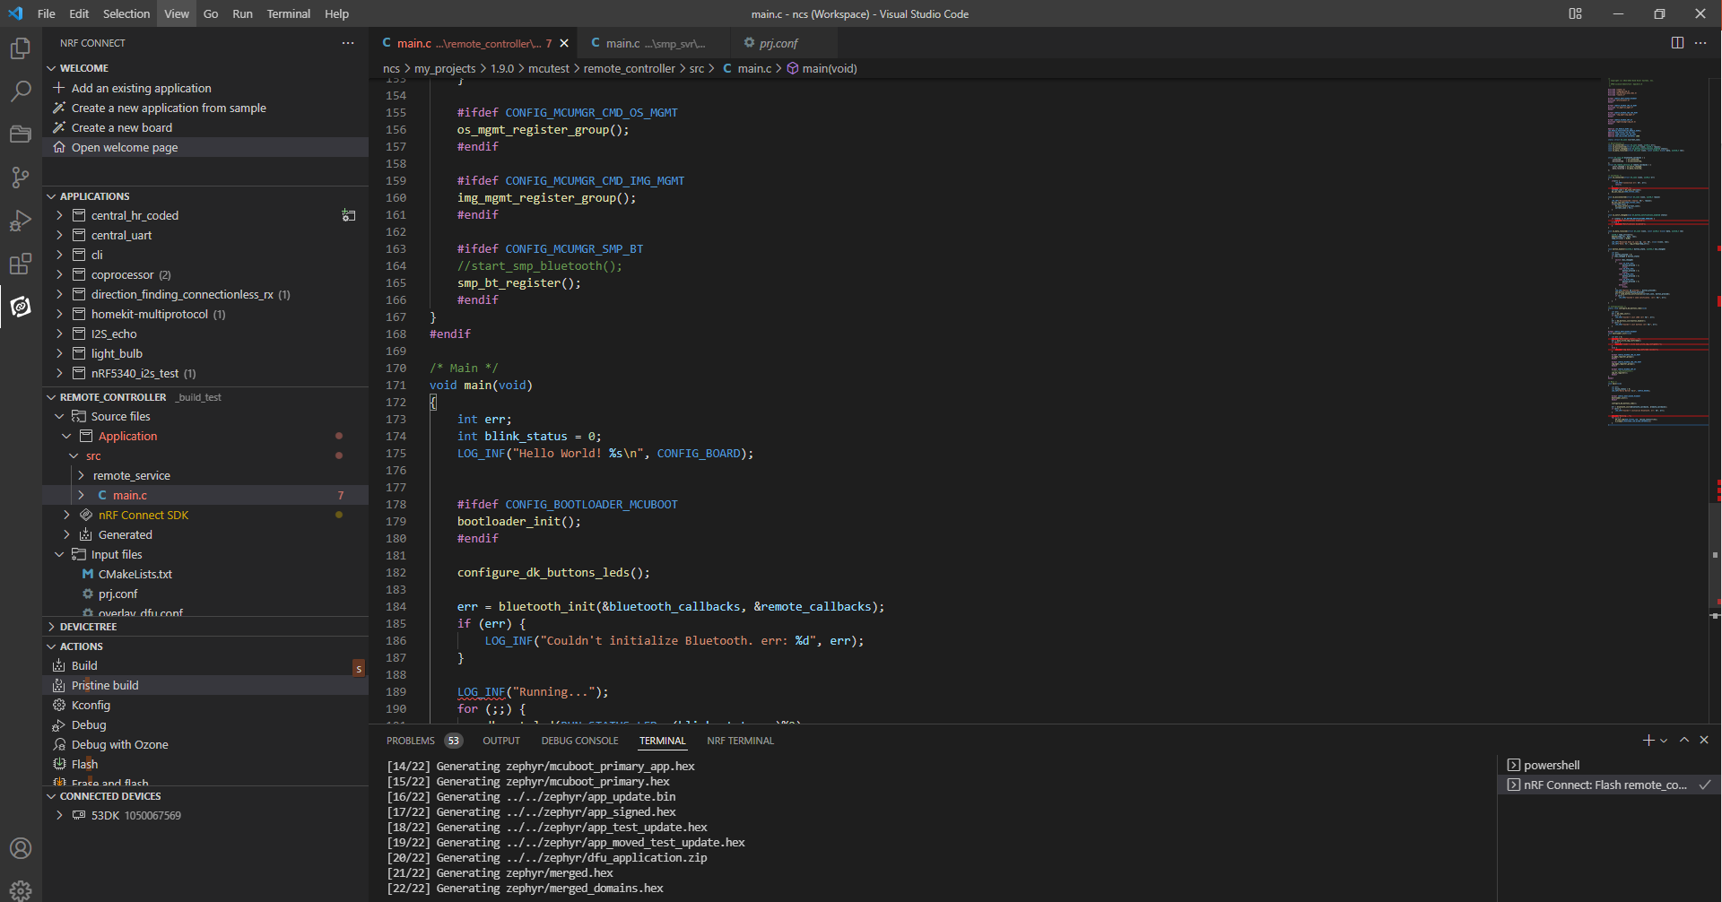
Show and tell

Slide 6
Show and tell

Slide 7
Segger Embedded Studio
Introduction to the nRF52 Development Kit and Segger Embedded Studio
Edvin Holmseth
Uni. Of Strathclyde
January 2020

