Slide 1


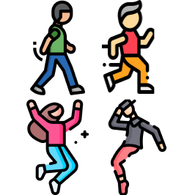
Activity
Level 1
Level 2
Level 3

Slide 3



Person
Level 1
Level 2
Level 3

Slide 4
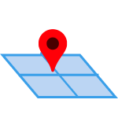


Range
Level 1
Level 2
Level 3

Slide 5


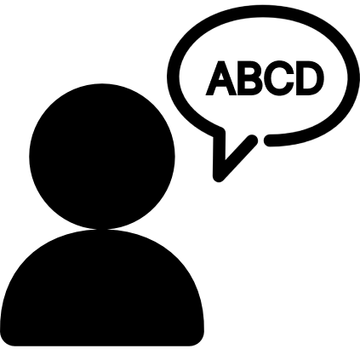
Range
Level 1
Level 2
Level 3

Slide 6
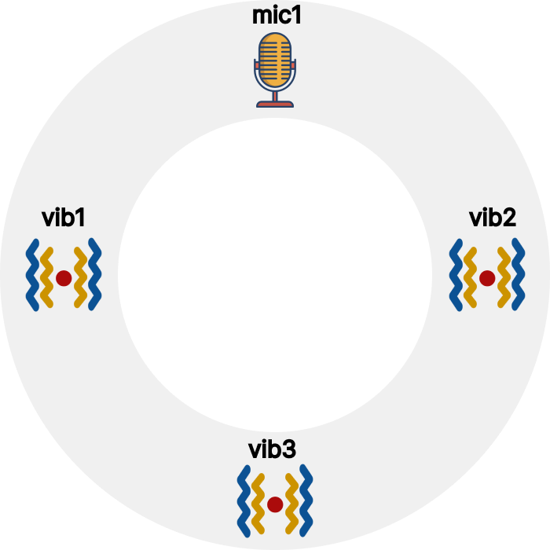
UI

Slide 7
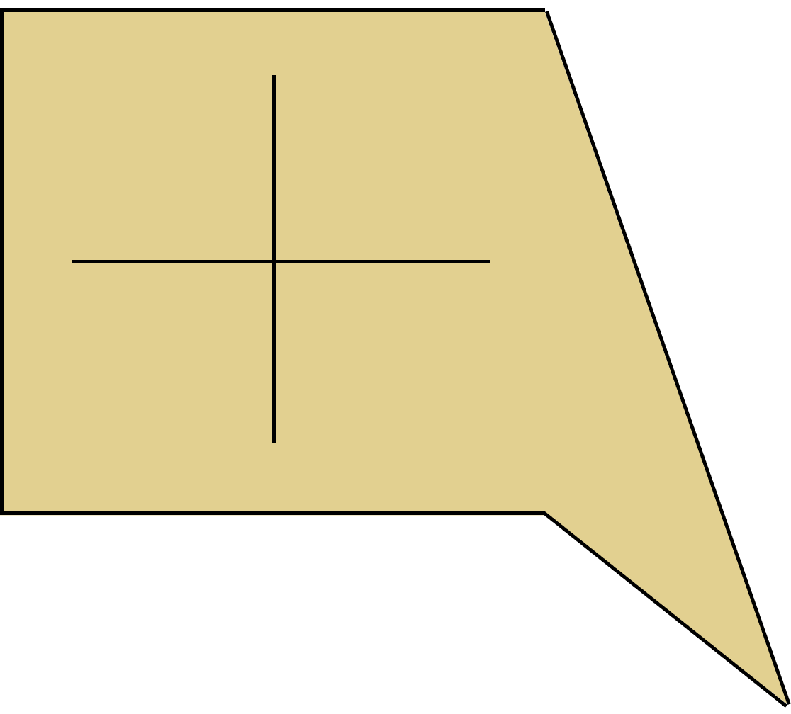
Property Tag

