Slide 1
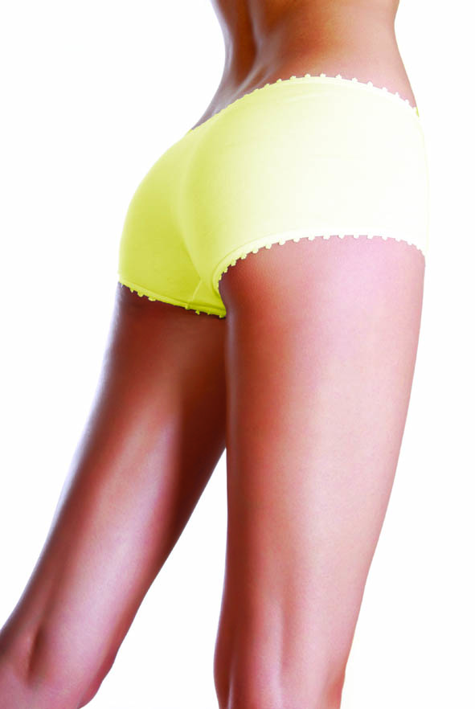
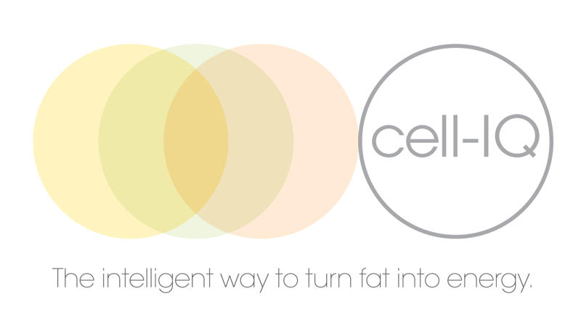
Welcome to cell-IQ

Slide 2
WHAT IS CELL IQ?
Cold Low Level Laser Treatment for Fat Reduction
Very Low Doses of Light
Pain Free, Non Invasive and Safe
Focuses on Trouble Spots and Stubborn Areas
Notes:
Focuses Adipose tissue – fat cells
Everyone has

Slide 3
HOW DOES IT WORK?
Low Level Laser Energy Disrupts the Fat Cell
Reduction of Adipose Cell Size (fat cells)
Removes Contents of Fat Cells
Stimulates Lymphatic System to Mobilise this Fat
Exercise Post Treatment ‘Burns Off’ this Fat

Slide 4
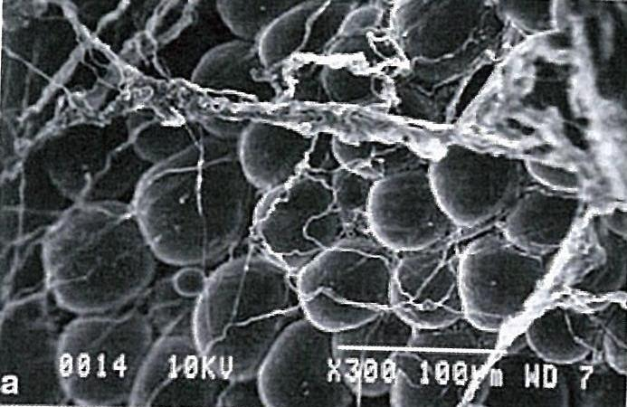
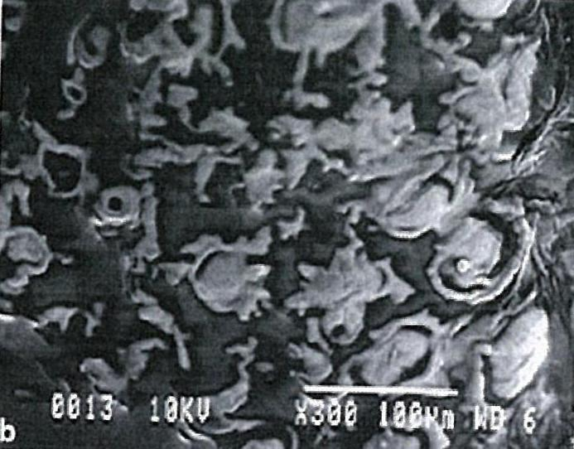
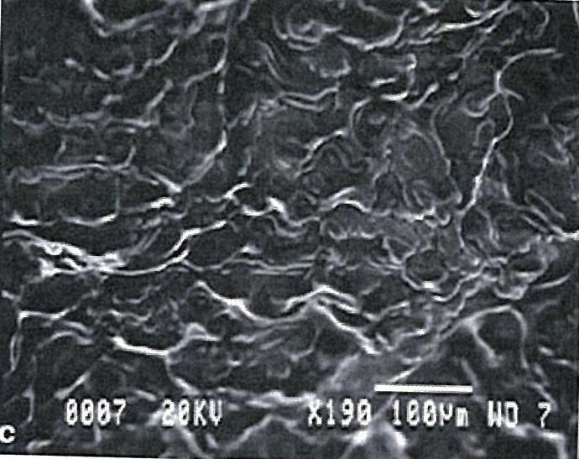
a) Round adipose cells with the surrounding connective tissue
b) At 4 minutes of laser exposure, 80% of the fat is seen coming out of the adipose cell through a disrupted membrane
c) At 6 minutes of laser exposure, the fat is almost completely 100% liquefied outside the cell

Slide 5
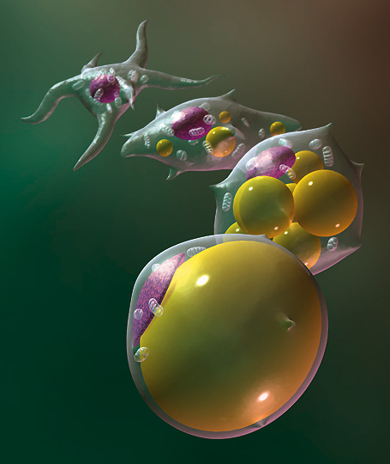
What is Adipose Tissue?
Adipose tissue = fat cells
Each individual has 20-40 billion fat cells
Average size 0.1mm
Can expand 4X

Slide 6
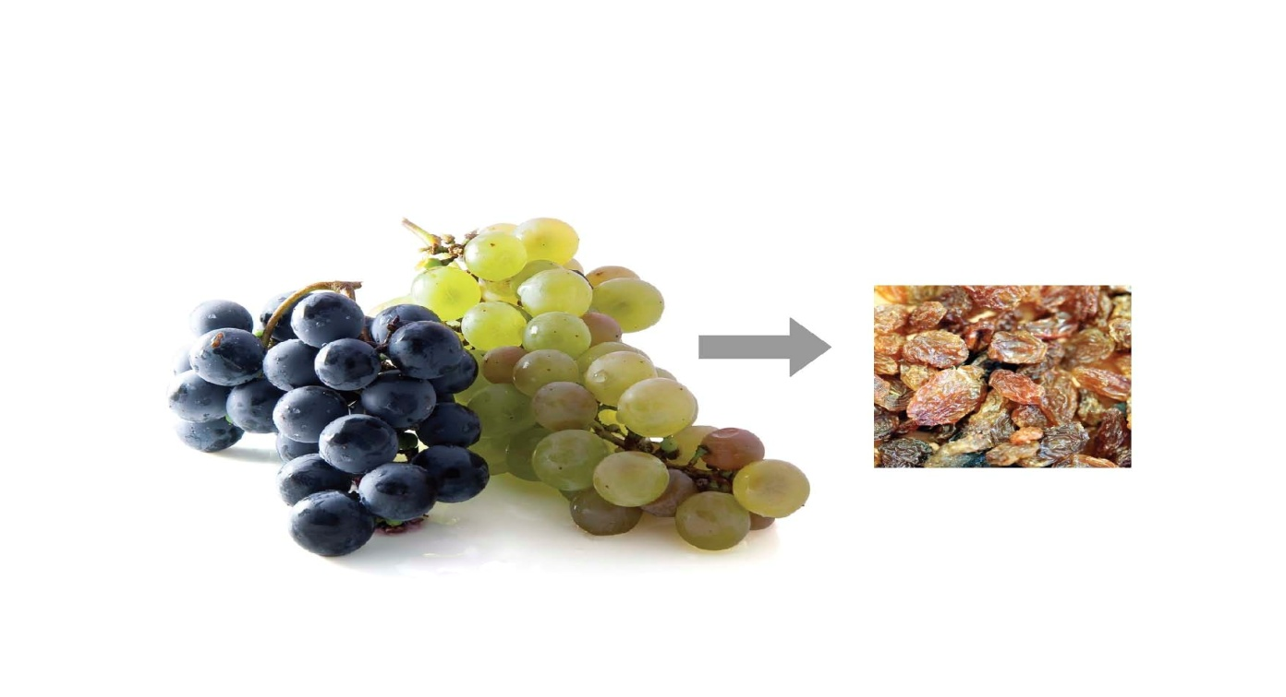
From Grapes
to Raisins
Imagine the fat cell as a plump grape, after 10 minutes of the laser energy penetrating the fat cell, the cell then loses it’s shape (shrinking to a raisin) releasing the fatty fluid into your system.
The empty cells are still there, just taking up less space.
In the future, they can be filled up again if the body has excess calories from food.

Slide 7
Benefits
Fast treatment time
Fast results.
Immediate results from one off session
Course of 8 sessions will provide continual centimetre loss.
Selective targeting of ‘problem areas’.
What can I expect?
Typical loss over a course of treatments is
5-10 cm(per measurement).
Very dependant on depth of fat layer, diet and lifestyle
Will I need future treatments?
Once fat is removed, it will only return if the calories in exceeds calories out.
Occasional or regular or one off treatments can be scheduled to counter – act diet blips
How long will my treatments last?
Simple maths, calories in = calories out
Once you buy a fat cell its yours to keep

Slide 8
The Perfect Client
Someone who has made decision to improve overall diet and exercise regime and wants help to reduce 1-2 dress sizes in an anatomical location
Someone who wants quick results
To provide motivation to carry on
One off special event
Specific targeting of ‘resistant’ areas despite regular gym usage

Slide 9
Treatment Schedule
Course of 8 sessions
Treatment twice weekly
Treatment time 30 minutes (2 X 15 minute irradiation )
Exercise/Cardio-vascular – must be performed as soon as possible after treatment
Only one treatment area at any one time
once one course finished, second zone can be started after 2 week rest period

Slide 10
What Sort Of Exercise?
Cardio-Vascular Exercise - first 20 minutes metabolises ‘quick’ energy stored as glycogen -After the metabolises other sources including that mobilised by cell-IQ
Needs to be a sustained work out at a ‘fat burning ‘ rate that speeds up metabolic rate and ‘uses up’ mobilised fat
Cardio exercise prevents the fat being re-stored

Slide 11
Pre-Treatment
AVOID
A heavy meal in the two hours before and after treatment as this will confuse the body as to which ‘fat’ to metabolise
Coffee, tea or carbonated drinks prior to a treatment as these may cause bloating. ( Good hydration provides a healthy lymphatic system)
Treatment around menstruation

Slide 12
After Treatment
cell-IQ treatment will achieve inch loss
cell-IQ does not remove fat cells or the ability to store fat
This is GOOD, since removing the ability to store fat here will make the body seek out other areas to store vital energy, such as the major organs or arteries.
Diet and Exercise are crucial to retain results in the future
Healthy Lymphatic System and cells increase results

Slide 13
Maximising Results
Avoid ‘normal’ meal just prior or after treatment
Exercise as soon as possible after treatment ideally within 2 hours of treatment
Drink plenty of water

Slide 14
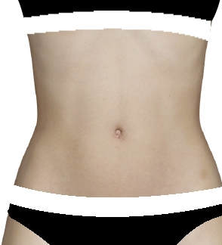
Measurements are taken in
3 places over the treatment area

Slide 15
STOMACH
Case 1 Case 2
Before After Before After
82cm 77cm 116cm 109.5cm
101cm 92cm 124cm 116cm
103cm 100cm 123cm 116cm
TOTAL 17cm TOTAL 21.5cm
Case 3 Case 4
(MINIMUM EXERCISE, (STEPPED UP EXERCISE INTENSITY)
SOMETIMES JUST LEFT GYM)
Before After Before After
80cm 77.5cm 100cm 92cm
92cm 88cm 101cm 93cm
94cm 89.5cm 101.5cm 93cm
TOTAL 11cm TOTAL 27.5cm

Slide 16
STOMACH (cont.)
Case 5 Case 6
(3 x PT A WEEK & CHANGED (2 x PT A WEEK, MORE
FOOD HABITS) WORKOUTS A WEEK, DIET)
Before After Before After
110cm 101cm 118cm 104cm
122cm 112cm 126cm 110cm
123cm 112cm 130cm 110cm
TOTAL 30cm TOTAL 50cm
LEGS
Case 7
LEFT LEG RIGHT LEG
Before After Before After
63cm 59cm 61cm 56cm
60cm 55cm 59cm 53cm
55cm 50cm 54cm 50cm
TOTAL 33cm both legs

Slide 17
LEGS (cont.)
Case 8
LEFT RIGHT
Before After Before After
63.5cm 57cm 66cm 58cm
62cm 55cm 62cm 54cm
55cm 53cm 56cm 49cm
LOST 47cm both legs
ARMS
Case 9
LEFT RIGHT
Before After Before After
26cm 23cm 28cm 25.5cm
24cm 22.5cm 23.5cm 21.5cm
22cm 19.5cm 22cm 21cm
LOST 12.5cm both arms
Case 10
Before After Before After
30cm 28cm 32cm 29cm
27cm 25.5cm 28cm 26cm
26cm 23cm 28cm 26.5cm
LOST 13cm both arms

Slide 18
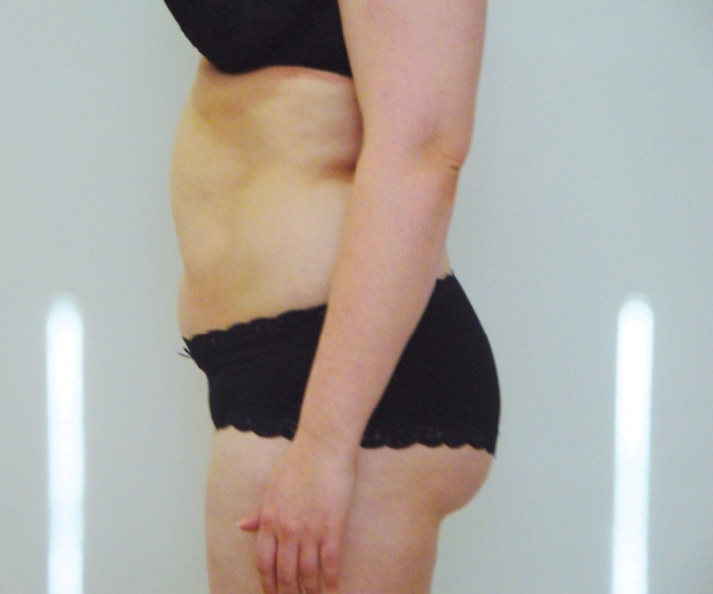
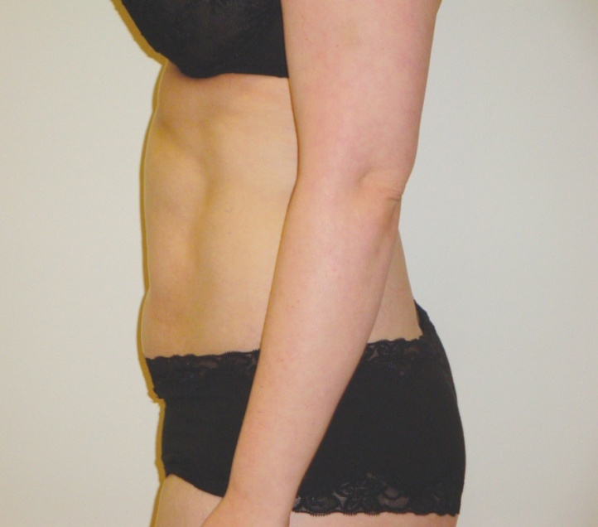
3 inch loss and down a dress size
Before
After

Slide 19
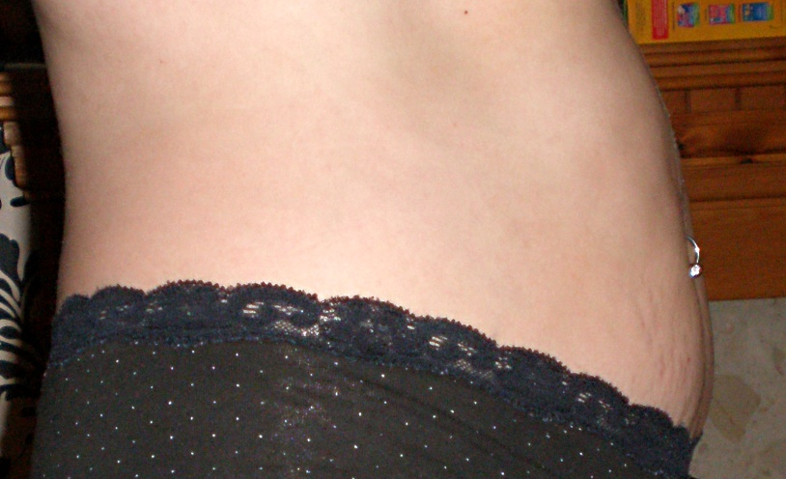
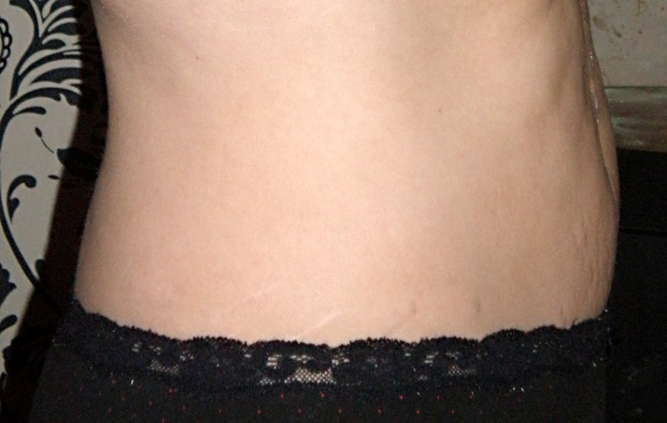
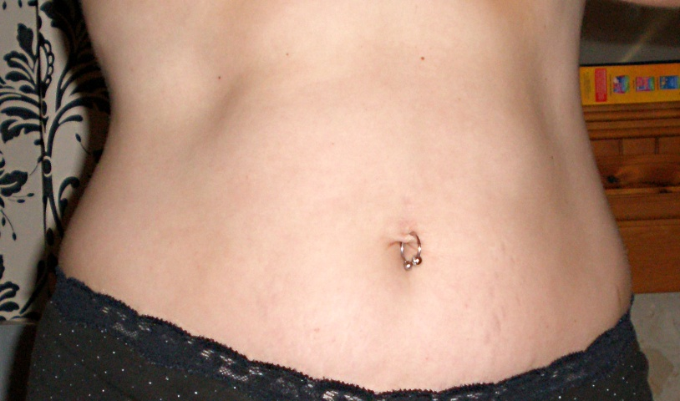
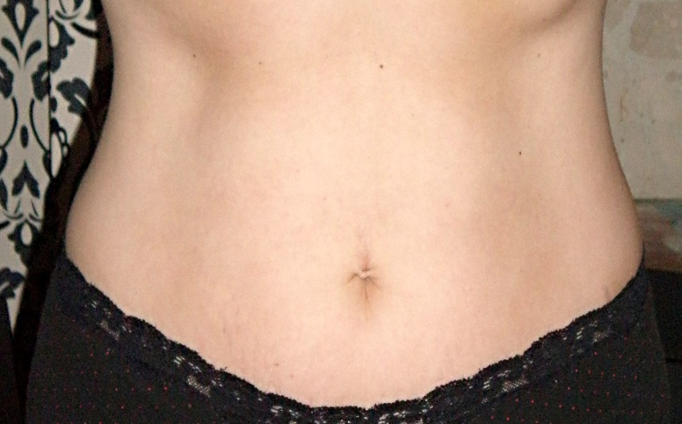
Clinical Results
Before
After

Slide 20
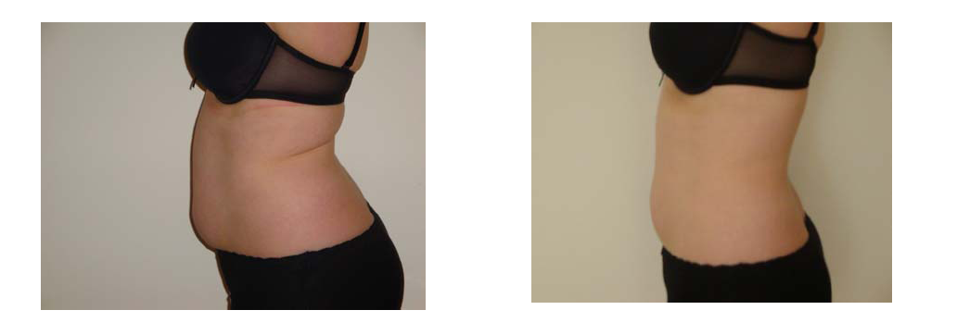
Clinical Results
Before and After 8 treatments
Total inch loss: 12.6 inches

Slide 21
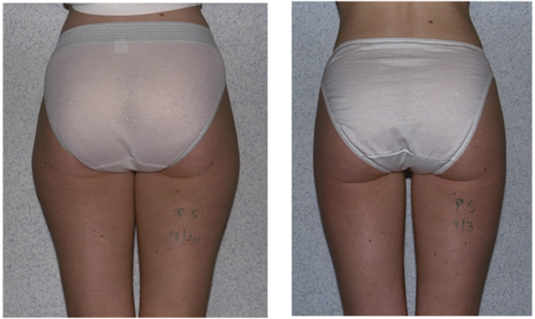
Clinical Results
Before
Thigh Size : 65 cm
After
Thigh Size : 58cm

Slide 22
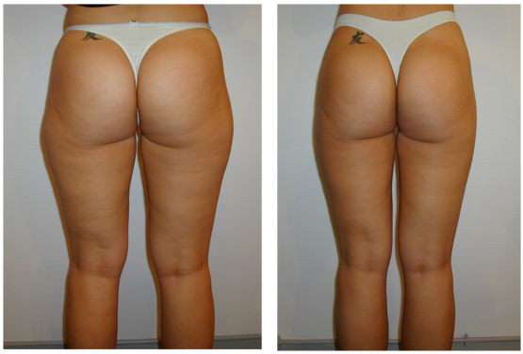
Clinical Results
Before
Thigh Size : 75 cm
After
Thigh Size : 63cm

Slide 23
Special Launch Offer
Member
8 x cell-IQ Sessions
4 x Food Coaching Sessions
4 x PT Sessions
Gift Pack
$1440
(value $2540 save $1100)
Non Member
8 x cell-IQ Sessions
4 x Food Coaching Sessions
4 x PT Sessions
6 x weeks Fernwood Club Membership
Gift Pack
$1840
(value $2690 save $850)
*AVAILABLE FOR FIRST 20 CLIENTS ONLY

Slide 24
QUESTIONS?

