Slide 1





Search . . .
CSM3114 - FRAMEWORK
STUDENT TASK LIST
NAME: MUHAMMD AMIER AL SIDDIQ
MATRIC NUMBER: S63650
Start Page

Slide 2

CSM3114- FRAMEWORK
Search . . .
PROJECT OVERVIEW
TaskList is a comprehensive student task management app designed to streamline the organization of assignments and enhance productivity for students.
FEATURES
Simple and user-friendly interface
Understandable and easy to navigate
Lottie Animation

Slide 3
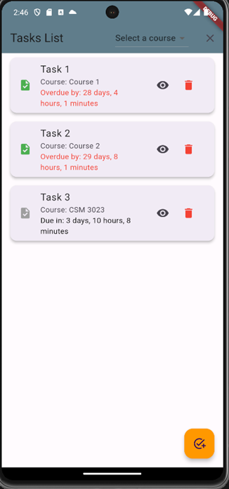
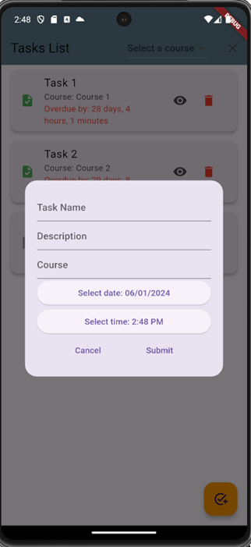
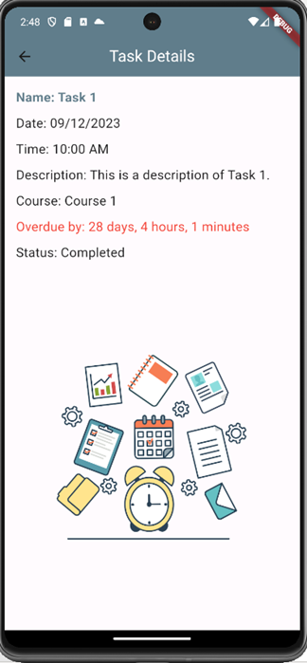

CSM3114 - FRAMEWORK
USER INTERFACE
Search . . .

Slide 4

CSM3114 - FRAMEWORK
Search . . .
REFERENCES
Biessek, A. (2019). Flutter for Beginners. Birmingham, United Kingdom: Packt Publishing Ltd
ChatGPT. (n.d.). https://chat.openai.com/
educations.com. (n.d.). Time management for students - How to manage your time effectively as a student. https://educations.com/articles-and-advice/time- management for-students-23537
Flutter - Dart API docs. (n.d.). https://api.flutter.dev/
True Coders. (2022, September 9). Display List in Flutter Using ListTile | Flutter Listtile Example | Listview | Circle avatar [Video]. YouTube. https://www.youtube.com/watch?v=_TNuEZSJVm8

