Slide 1





CSM3114 - FRAMEWORK
Search . . .
HAULIER TRACKING APP
NAME: MUHAMMD AMIER AL SIDDIQ
MATRIC NUMBER: S63650
Start Page

Slide 2

CSM3114- FRAMEWORK
Search . . .
PROJECT OVERVIEW
The "Haulier Tracking" project is a comprehensive solution designed to streamline the logistics and delivery management system for a fleet of trucks.
FEATURES
Truck Utilization Monitoring
Understandable and easy to navigate
Data Storage and Retrieval

Slide 3
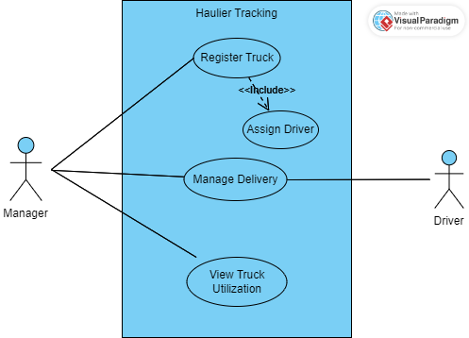

CSM3114 - FRAMEWORK
USE CASE
Search . . .

Slide 4
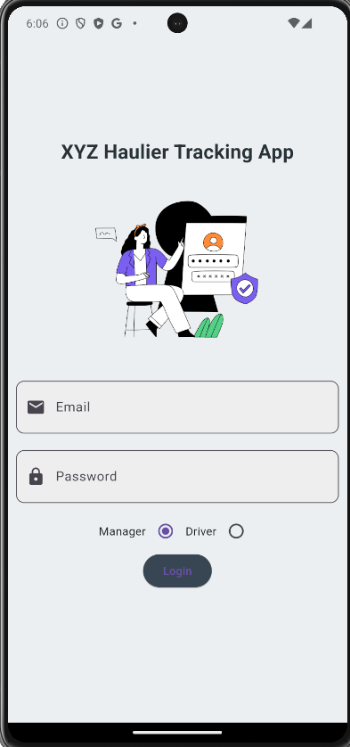
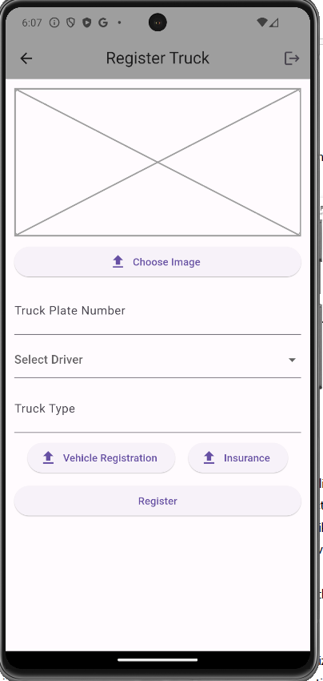
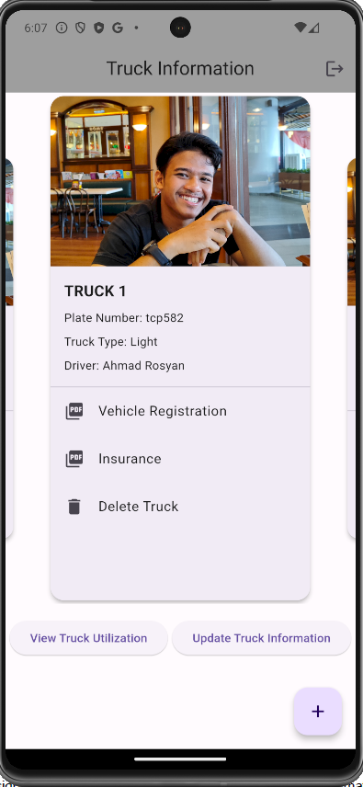
CSM3114 - FRAMEWORK
USER INTERFACE
Search . . .

Slide 5
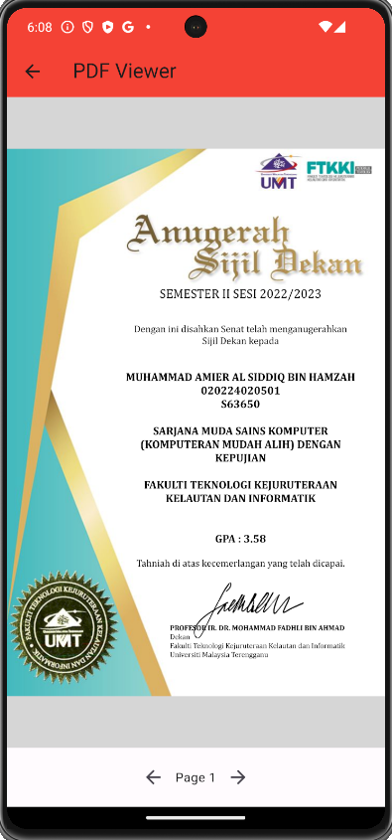
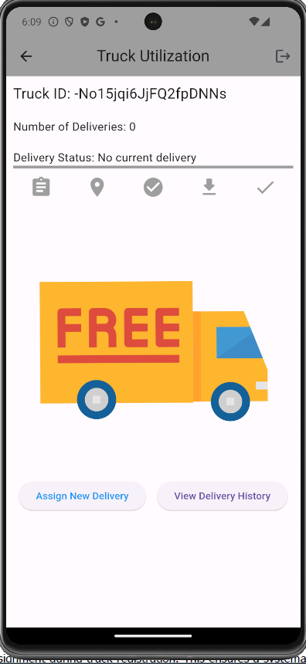
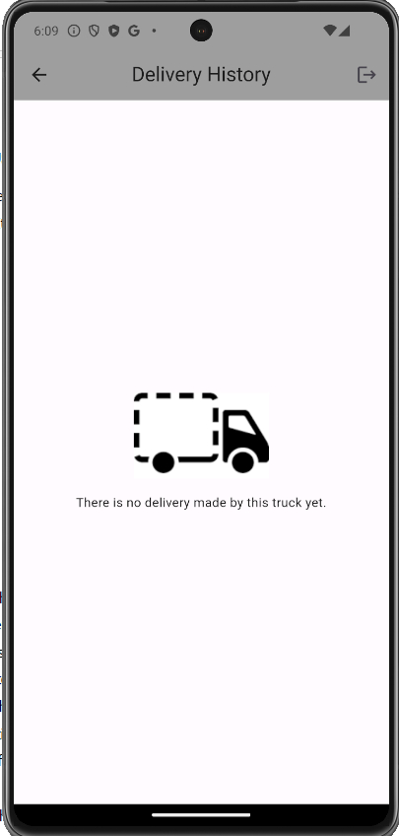
CSM3114 - FRAMEWORK
USER INTERFACE
Search . . .

Slide 6

CSM3114 - FRAMEWORK
Search . . .
REFERENCES
Ahmad, H. (2022, July 29). Firebase Realtime Database CRUD Operations for Flutter Project. CodingZest. https://codingzest.com/firebase-realtime-database-crud-operations-for-flutter-project/
ChatGPT. (n.d.). https://chat.openai.com/
Firebase. (2023, March 2). Add Firebase to your Flutter app: The fast way [Video]. YouTube. https://www.youtube.com/watch?v=FkFvQ0SaT1I
Flutter - Dart API docs. (n.d.). https://api.flutter.dev/
HeyFlutter․com. (2022, March 29). Flutter: Upload Files to Firebase Storage (Image, Video, PDF, etc.) [Video]. YouTube. https://www.youtube.com/watch?v=3x92z0oHbtY

