Slide 1
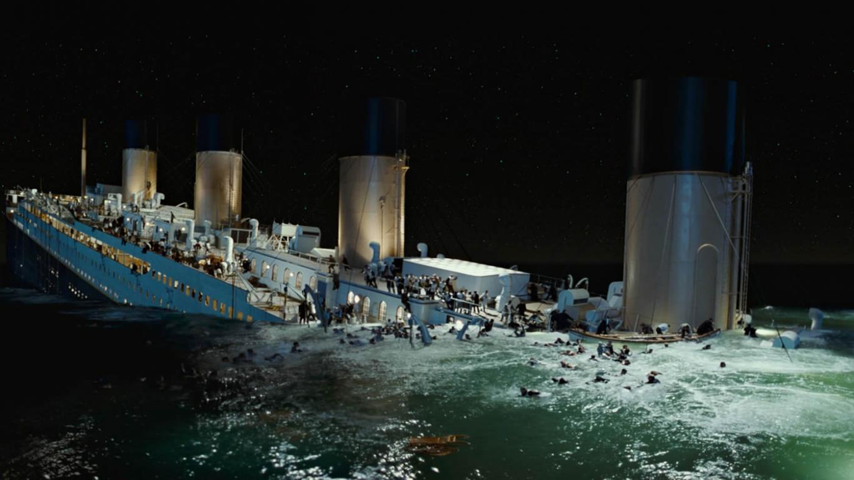
Surviving the Titanic
Miguel, Nicholas, Quinton

Slide 2
Introduction
The RMS Titanic sank on 15 April 1912, after colliding with an iceberg during its maiden voyage from Southampton to New York.
Out of 2224 passengers and crew, 1502 lost their lives.
We would like to identify more factors that improved the likelihood of survival. Furthermore, we will map these factors to an appropriate feature space.
We will implement and train a decision tree to analyze what sorts of people were likely to survive.
We will compare the accuracy of our decision tree to the accuracy of scikit-learn’s bagging meta-estimator with a decision tree classifier as a base estimator.
Notes:
Quinton

Slide 3
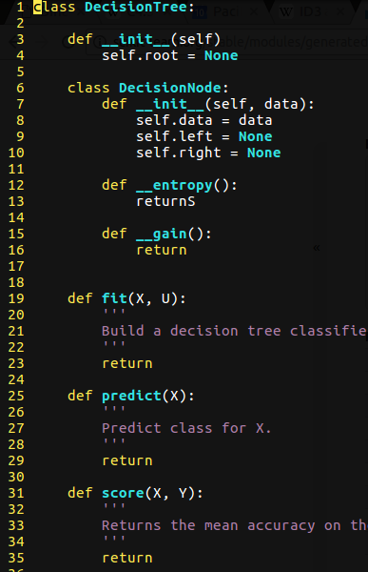
Model
Dataset
Loads .csv file
Cleans data
Feature Space
Uses a Dataset object to create a 2-dimensional array that represents a feature space
Decision Tree
C4.5 algorithm
Bagging Meta-Estimator
scikit-learn
Decision tree classifier as a base estimator.
Bagging is used to reduce the variance of a base estimator
Notes:
Quinton

Slide 4
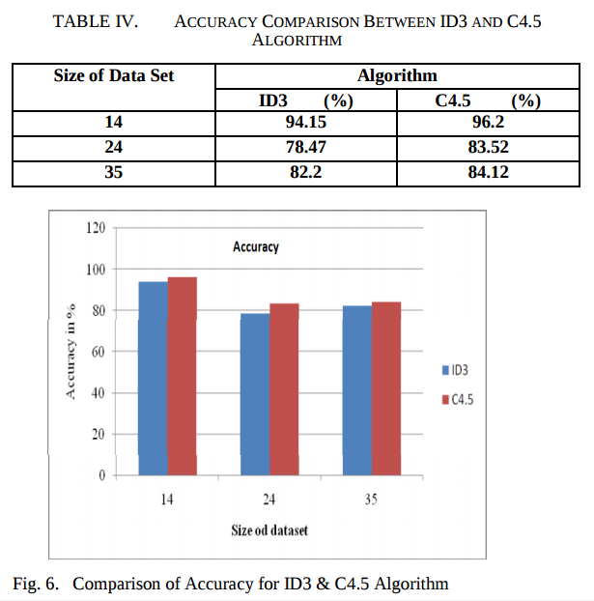
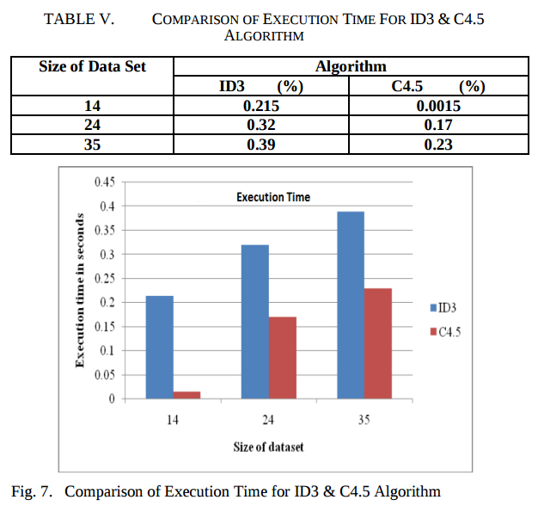
Why C4.5?
Images from http://saiconference.com/Downloads/SpecialIssueNo10/Paper_3-A_comparative_study_of_decision_tree_ID3_and_C4.5.pdf
Notes:
Quinton

Slide 5
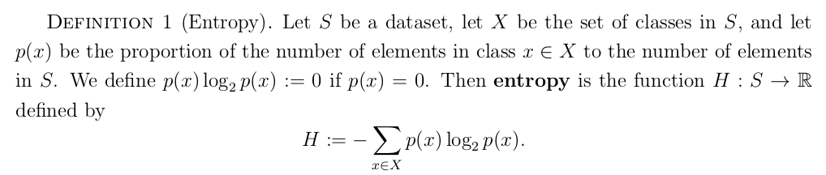
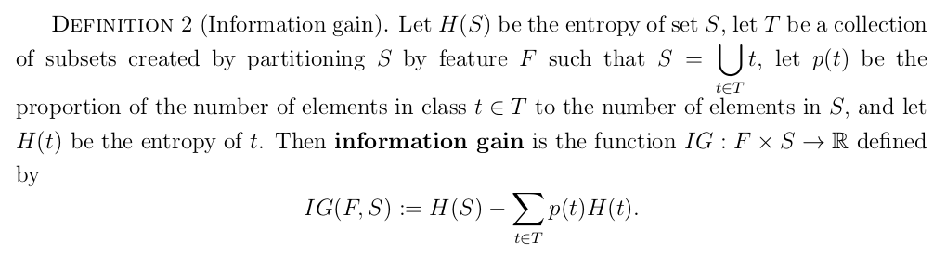
Information Gain Concept
Notes:
Miguel

Slide 6
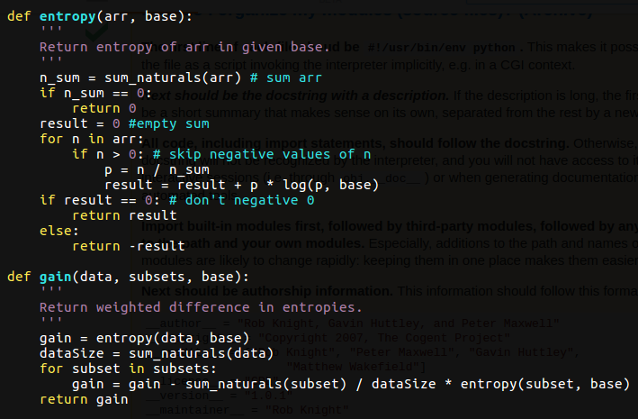
Notes:
Miguel

Slide 7
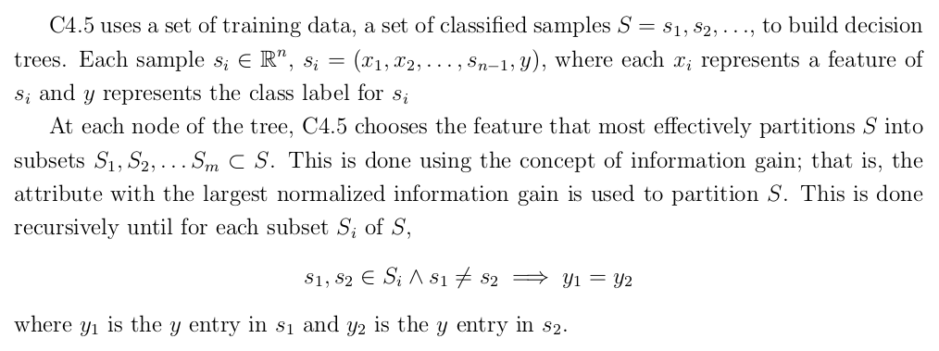
C4.5 Algorithm
Notes:
Miguel

Slide 8
C4.5 Pseudocode
Base Cases:
If all samples in list belong to same class, then create a leaf node saying to choose that class.
If none of the features provide any information gain or an instance of the previously-unseen class is encountered, create a decision node higher up the tree using expected value of the class.
Notes:
Miguel

Slide 9
C4.5 Pseudocode
Check for base cases.
For each feature x, compute the normalized information gain from splitting on x.
Let x_best be the feature with the highest normalized information gain.
Create a decision node that splits on x_best.
Recur on the subsets obtained by splitting on x_best, and add those nodes as children of node.
Notes:
Miguel

Slide 10
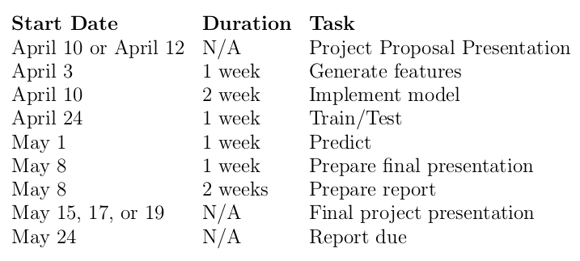
Timeline
Notes:
Quinton

Slide 11
Training Data
Contents
Variable Definition Key
passengerid Passenger ID
survival Survival 0=No, 1=Yes
pclass Ticket Class 1=1st, 2=2nd, 3=3rd
name Name (with Title)
sex Sex
age Age in Years
sibsp # of siblings / spouses aboard the Titanic
parch # of parents / children aboard the Titanic
ticket Ticket Number
fare Passenger Fare
cabin Cabin Number
embarked Port of Embarkation C=Cherbourg, Q=Queenstown, S=Southampton
Notes:
Nicholas

Slide 12
Variable Notes
pclass: A proxy for socio-economic status (SES)
1st=Upper
2nd=Middle
3rd=Lower
age: Age is fractional if it is less than 1, if age is estimated it’ll be in the form xx.5
sibsp: The dataset defines family relations in this way…
Sibling: brother, sister, step-sister, step-brother
Spouse: husband, wife (mistresses and fiancés were ignored)
parch: The dataset defines family relations in this way…
Parent: mother, father
Child: son, daughter, stepdaughter, stepson
(Some children traveled with nannies therefore parch=0 for them)
Notes:
Nicholas

Slide 13
Feature Space
From Dataset
Pclass
Sex
Age
Sibsp
Parch
Ticket
Fare
Cabin number
Embarked
Generated
Family size (parch + sibsp + 1)
Age Interval
1 if age < 10
0 if 10 <= age <= 60
-1 if age > 60
Title (Mr. , Mrs. , Ms. , Dr. , etc.)
Cabinmates
Notes:
Nicholas

Slide 14
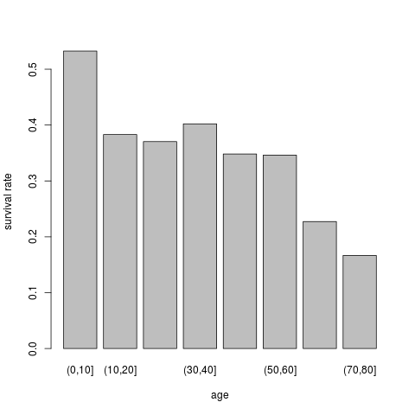
Example of Generated Feature
Age Interval
Survival rate decreases as age increases
People younger than 10 have the highest survival rate
10-60 relatively constant
People older than 60 have the lowest survival rate
Notes:
Nicholas

Slide 15
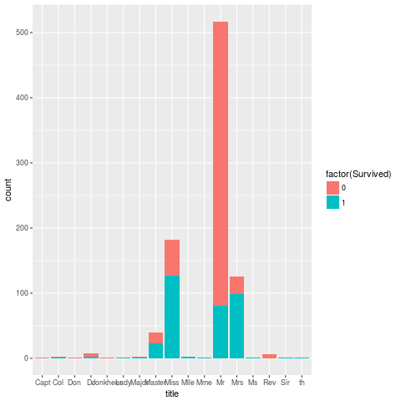
Example of Generated Feature
Title
Miss and Mrs close to average survival rate for females
Master higher than average for male group
Col, Rev, Dr, etc also influence survival
Notes:
Nicholas

Slide 16


Performance Evaluation
Let be the function defined by
,
where a is the number of correct predictions and b is the number of incorrect predictions.
Notes:
Miguel

Slide 17

Work Allocation
Model Component | Name
Dataset/Feature Space | Nicholas Glover
Decision Tree | Miguel Amezola
Bagging Meta-Estimator | Quinton Teas
Notes:
Quinton

Slide 18
Possible Setbacks
Scheduling
Efficiency
Memory
Notes:
Quinton

Slide 19
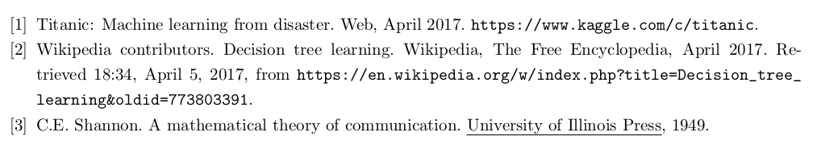
References

Slide 20
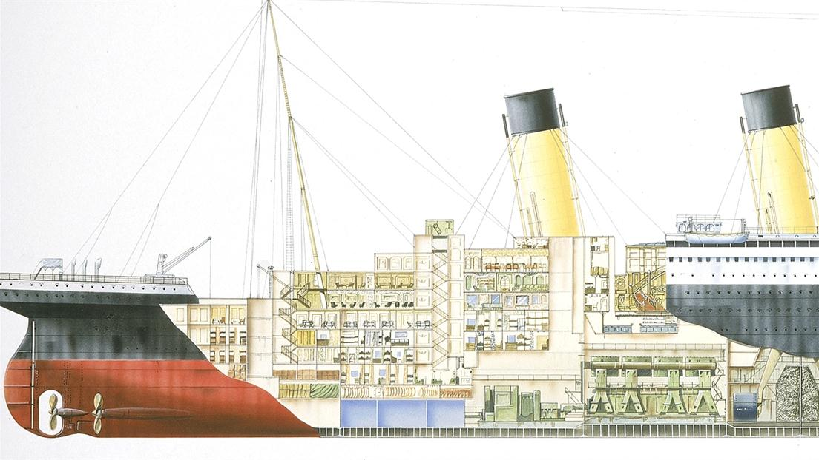
Questions

