Slide 1
The plots are a comparison of both NDI and INDI with noise added to the attitude rates (p, q, r)
Noise was added to the state vector going into the controller, using randn, as we discussed during our meeting
Noise density (variance) range: [0, 1e-5, 1e-4, 1e-3]
Plots included for both ‘Guidance’ and ‘Rate’ control loops
Both NDI and INDI seem to struggle when the noise level is at 1e-3 I haven’t looked into why this happens in detail yet

Slide 2
Rate Loop

Slide 3
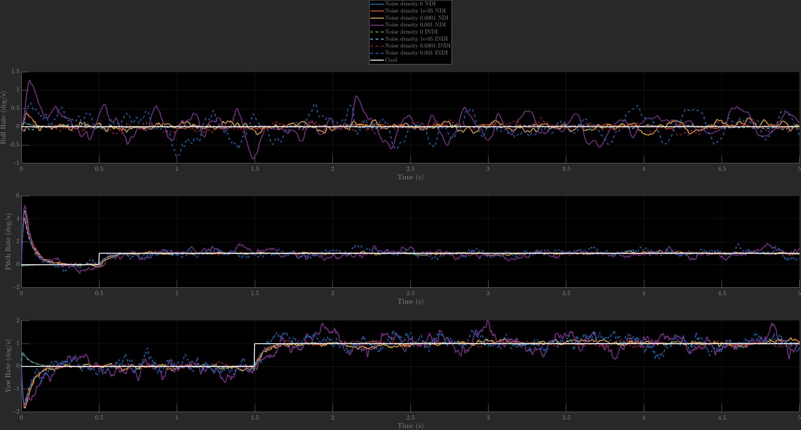
Angular Rates
Angular rate comparison shows that both NDI and INDI have a noticeable drop in performance when the noise level is 1e-3

Slide 4
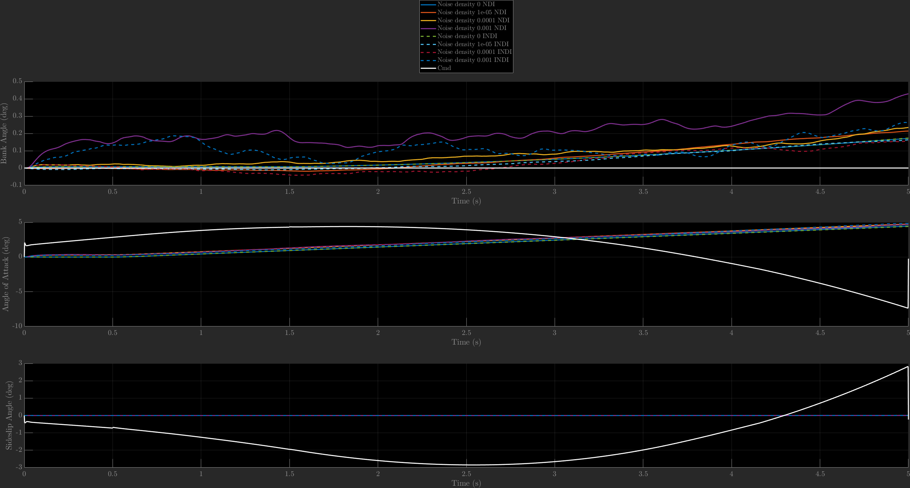
Angles
Only the bank channel seems to be strongly affected by noise

Slide 5
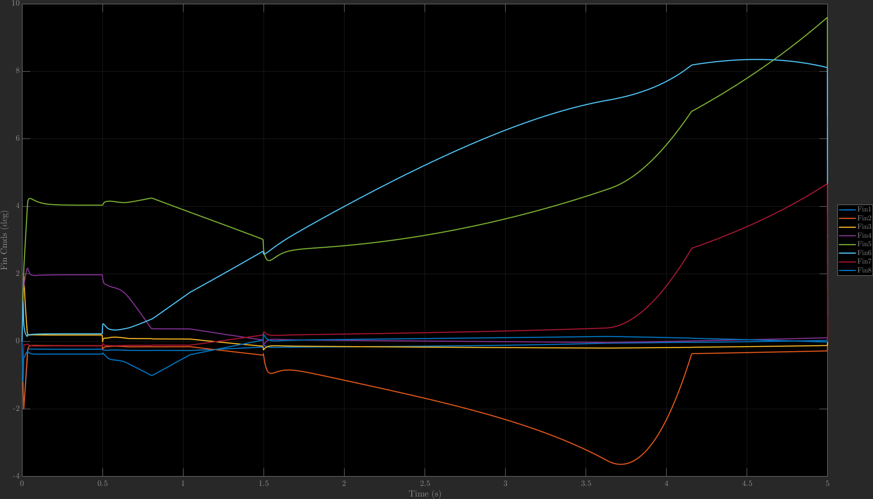
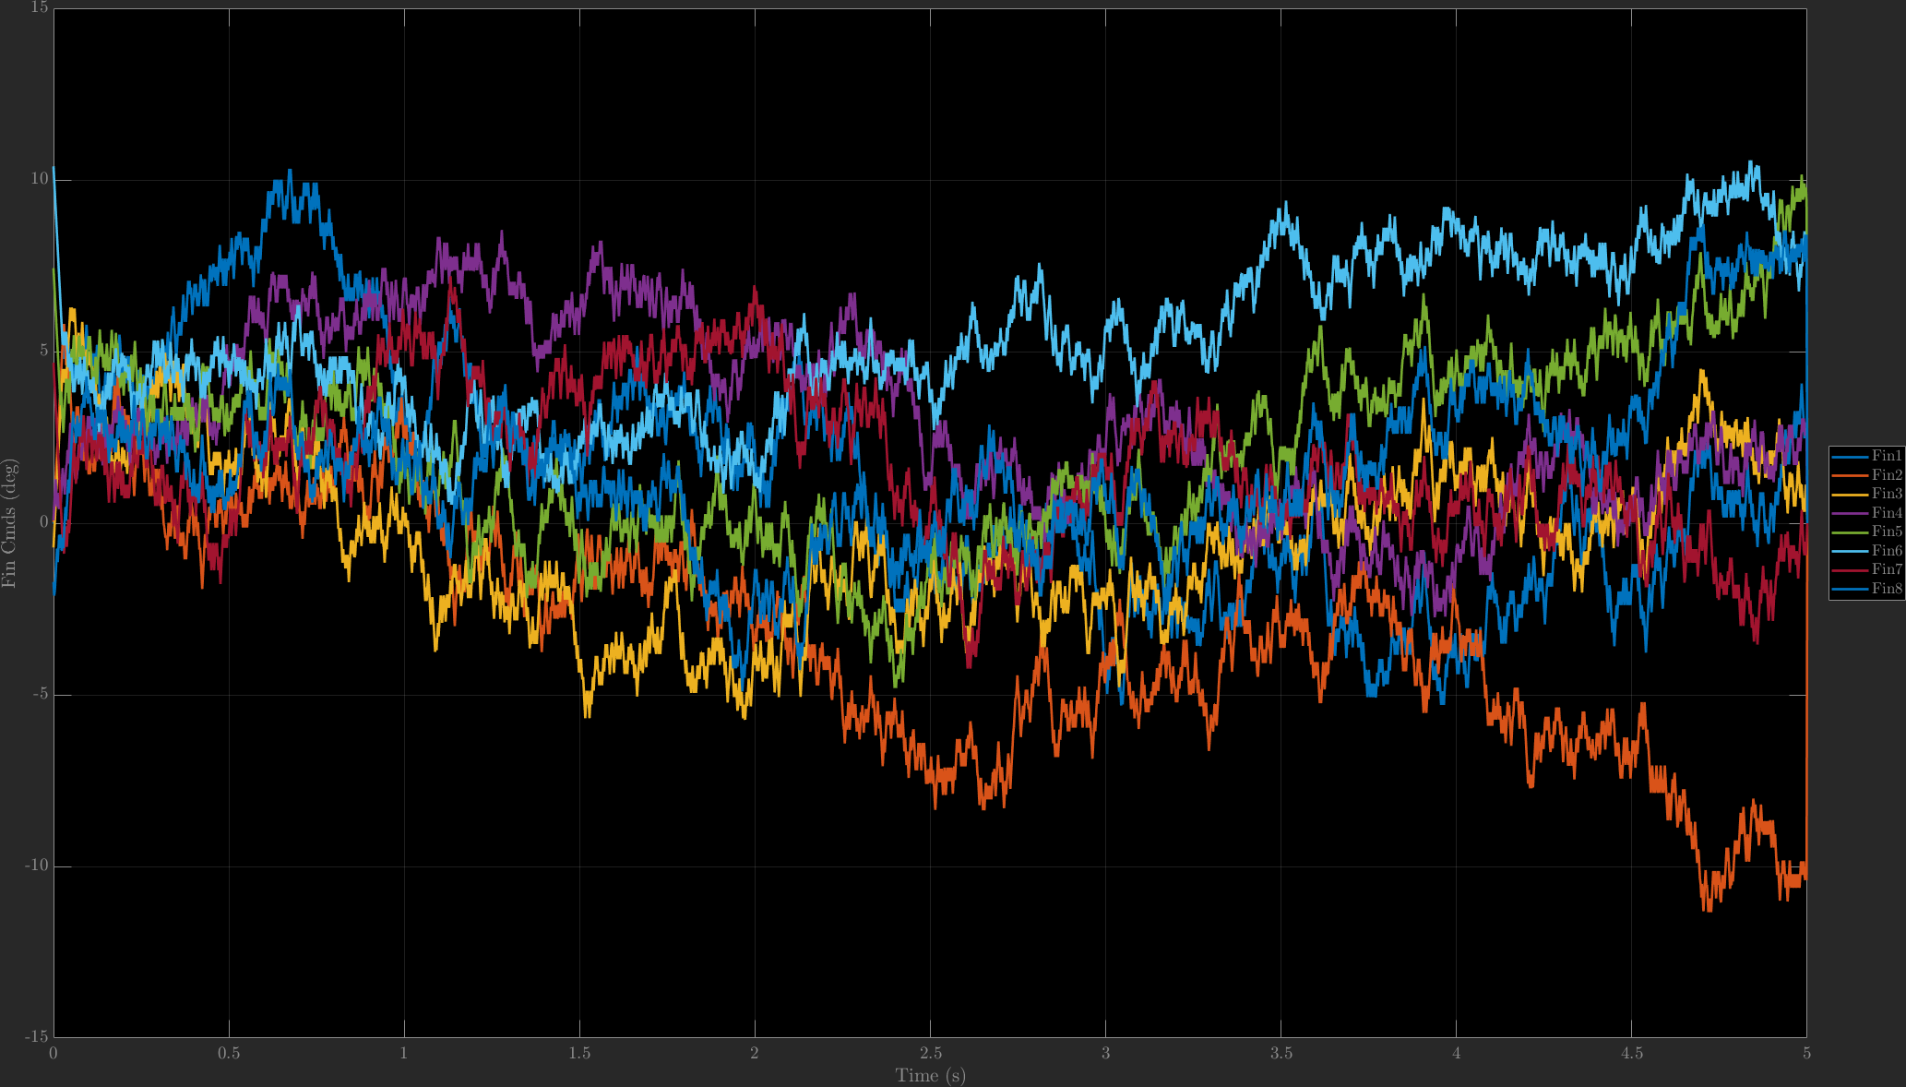
NDI Fin Commands
NDI fin commands, using rate loop, no noise (left) compared to 1e-3 noise. Note that the y-axis limits are different for each plot
Fin commands seem sporadic, and do not track the general shape of the no-noise case

Slide 6
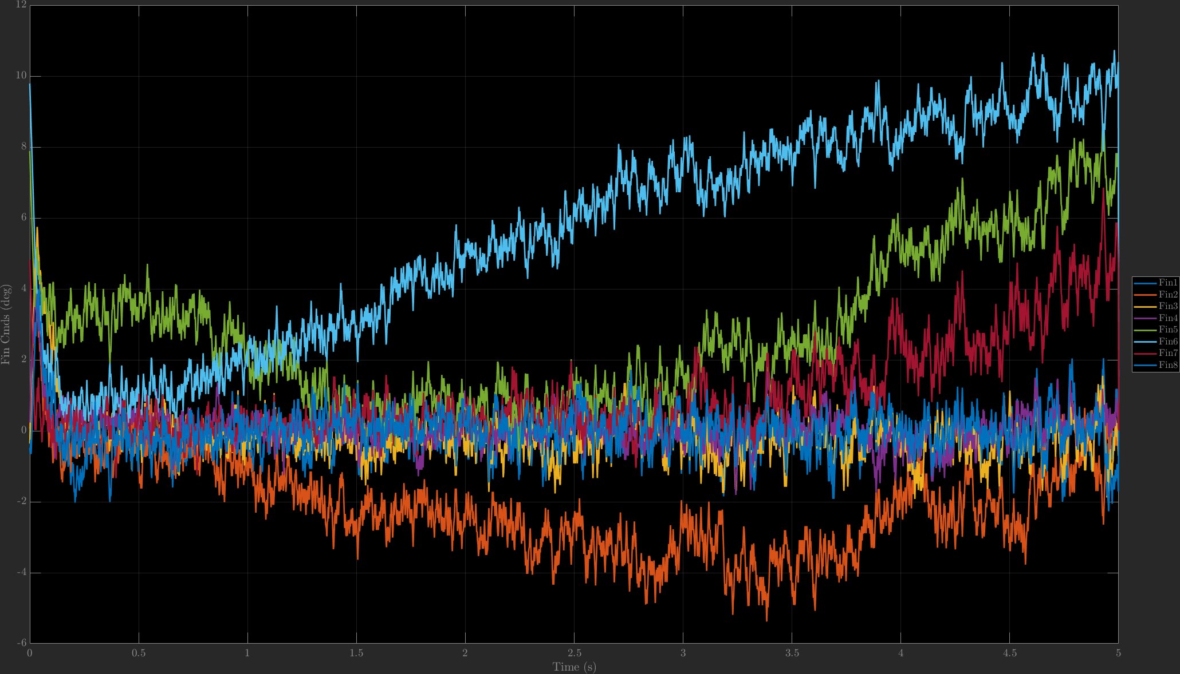
NDI Fin Commands
NDI fin commands, using rate loop, no noise (left) compared to 1e-4 noise. Note that the y-axis limits are different for each plot
Commands seem to track the general shape of the no-noise case when the noise level is reduced from 1e-3 to 1e-4

Slide 7
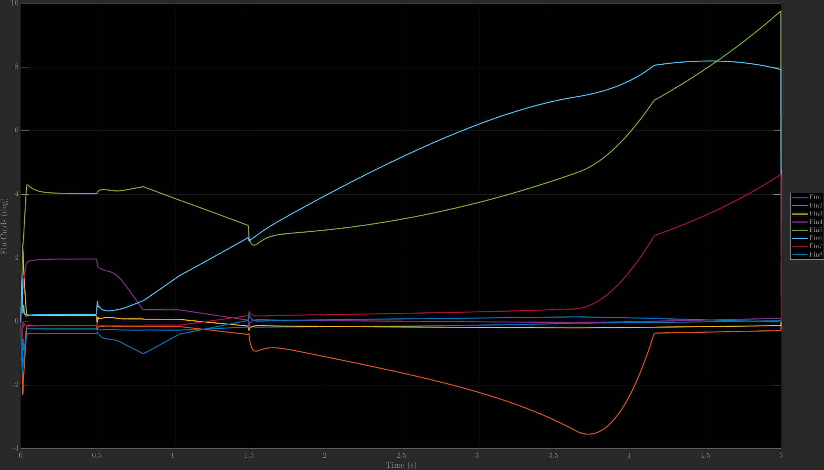
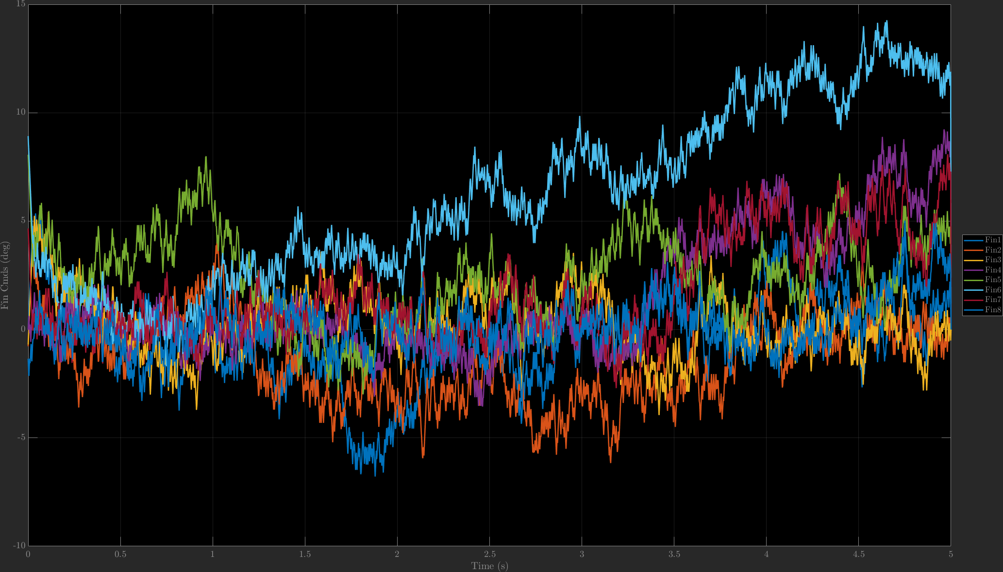
INDI Fin Commands
INDI fin commands, using rate loop, no noise (left) compared to 1e-3 noise. Note that the y-axis limits are different for each plot
Fin commands seem sporadic, and do not track the general shape of the no-noise case

Slide 8
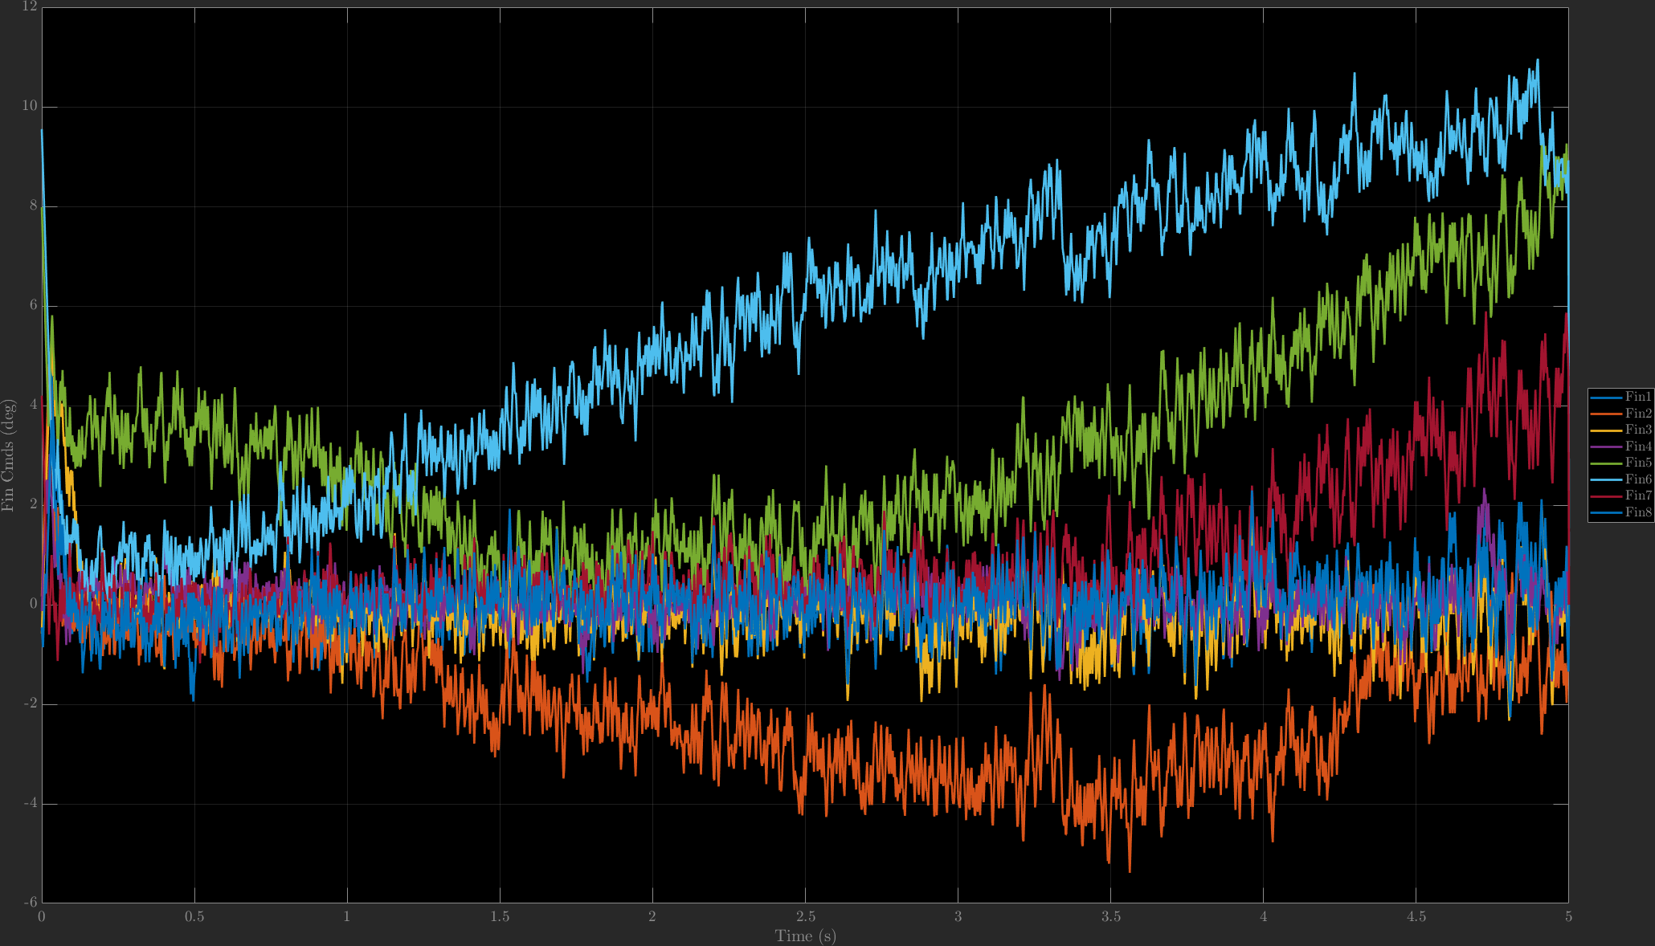
INDI Fin Commands
INDI Fin Commands
INDI fin commands, using rate loop, no noise (left) compared to 1e-4 noise. Note that the y-axis limits are different for each plot
Commands seem to track the general shape of the no-noise case when the noise level is reduced from 1e-3 to 1e-4

Slide 9
Guidance Loop

Slide 10
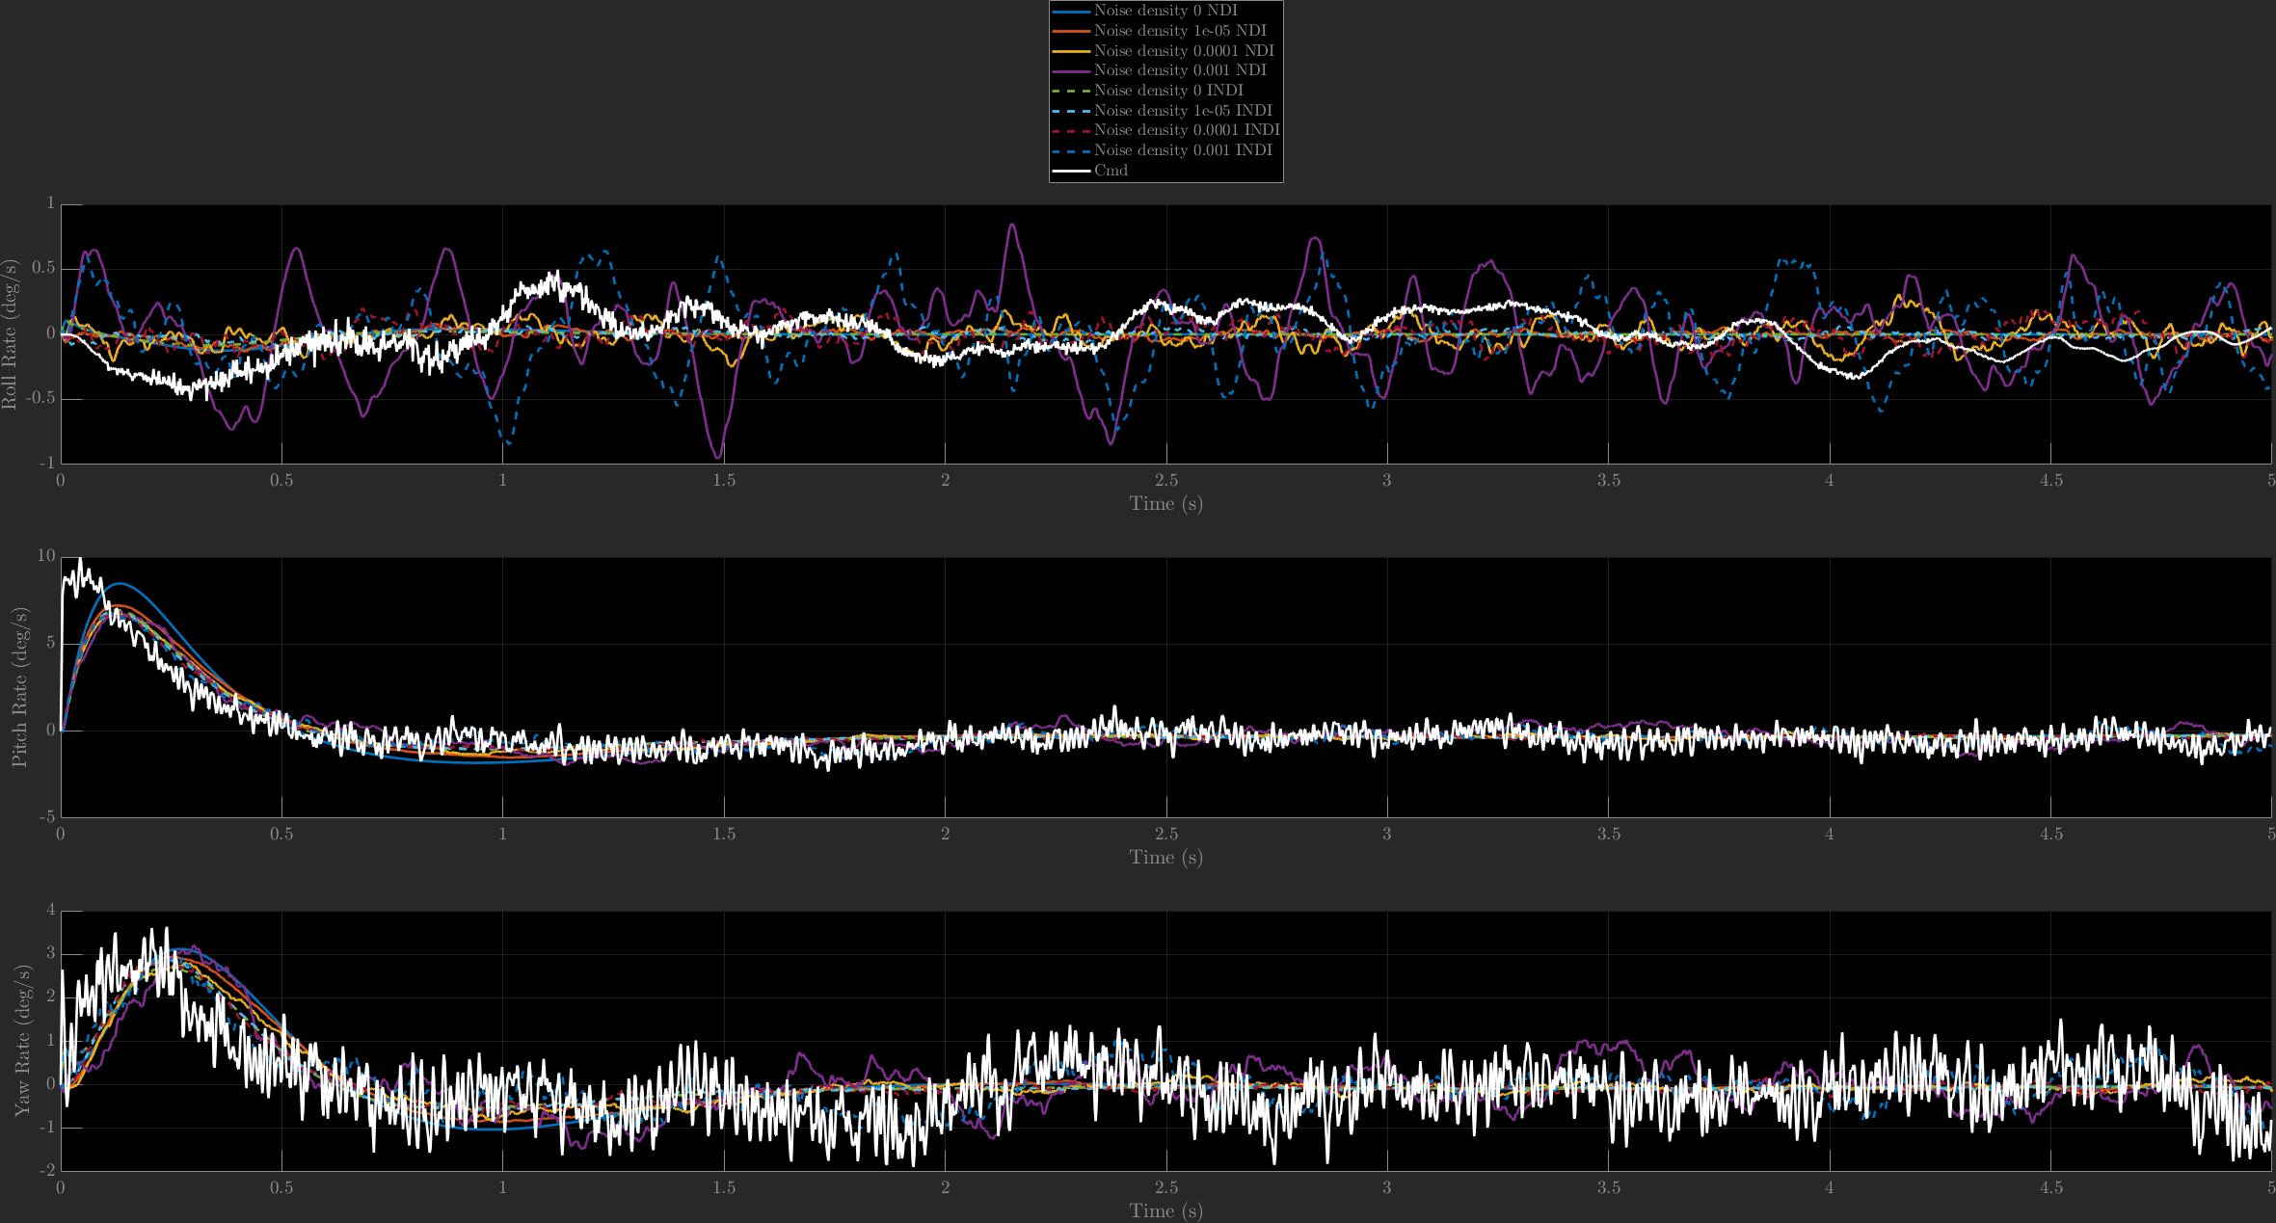
Angular Rates
Angular rate comparison shows that both NDI and INDI have a noticeable drop in performance when the noise level is 1e-3

Slide 11
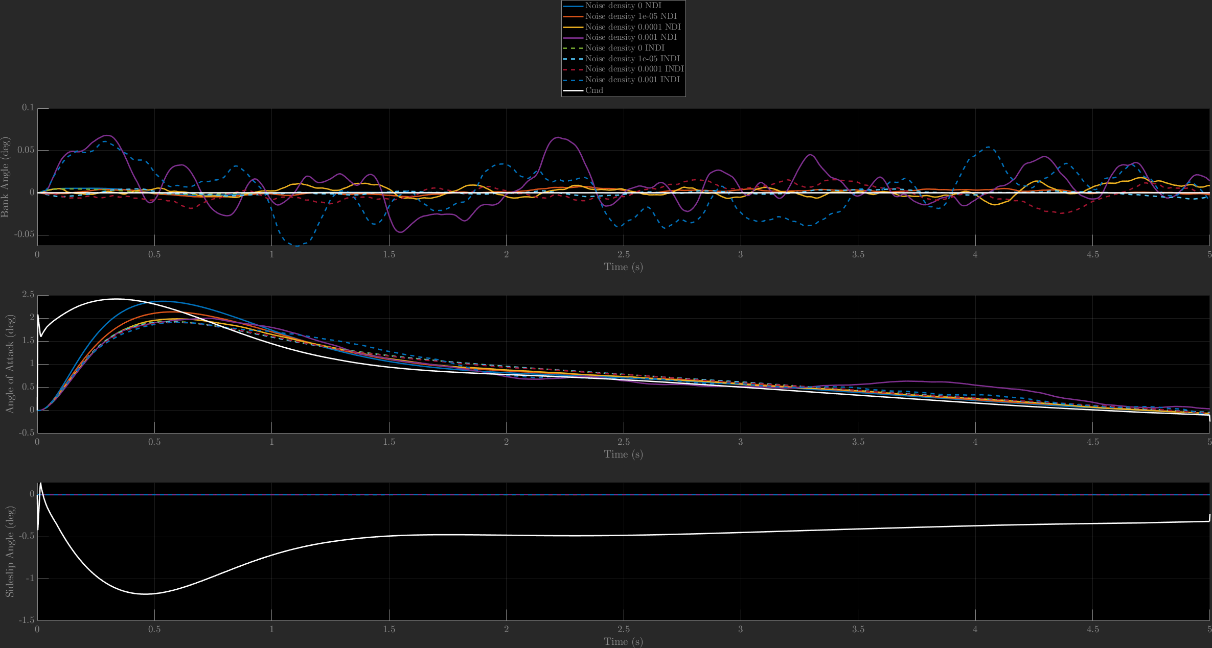
Angles
Angle errors are relatively small, even with the 1e-3 noise level
Increased noise degrades the AoA tracking performance

Slide 12
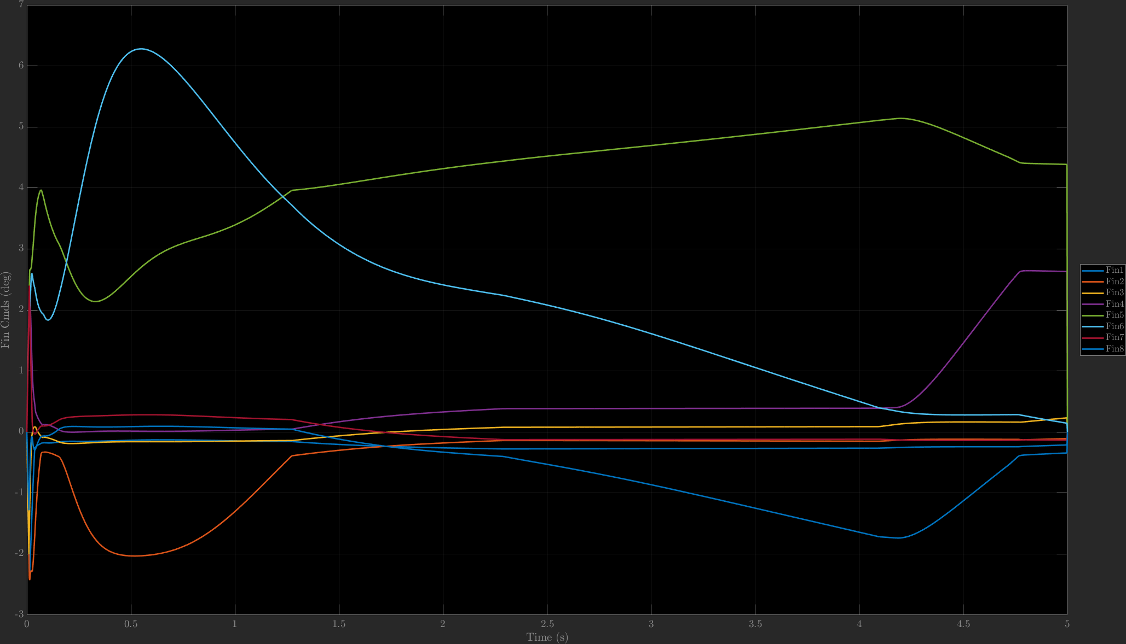
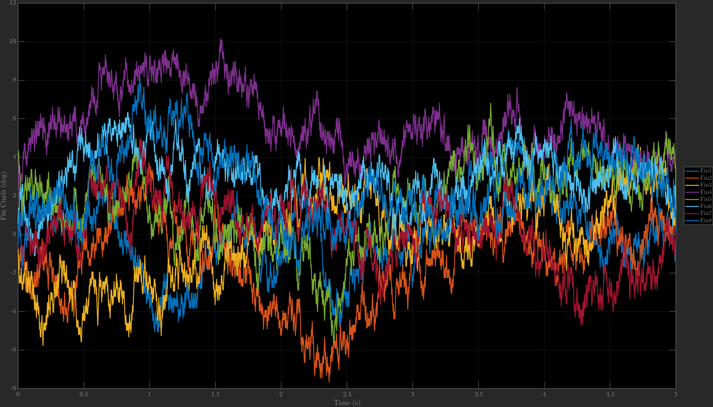
NDI Fin Commands
NDI fin commands, using rate loop, no noise (left) compared to 1e-3 noise. Note that the y-axis limits are different for each plot
Fin commands seem sporadic, and do not track the general shape of the no-noise case

Slide 13
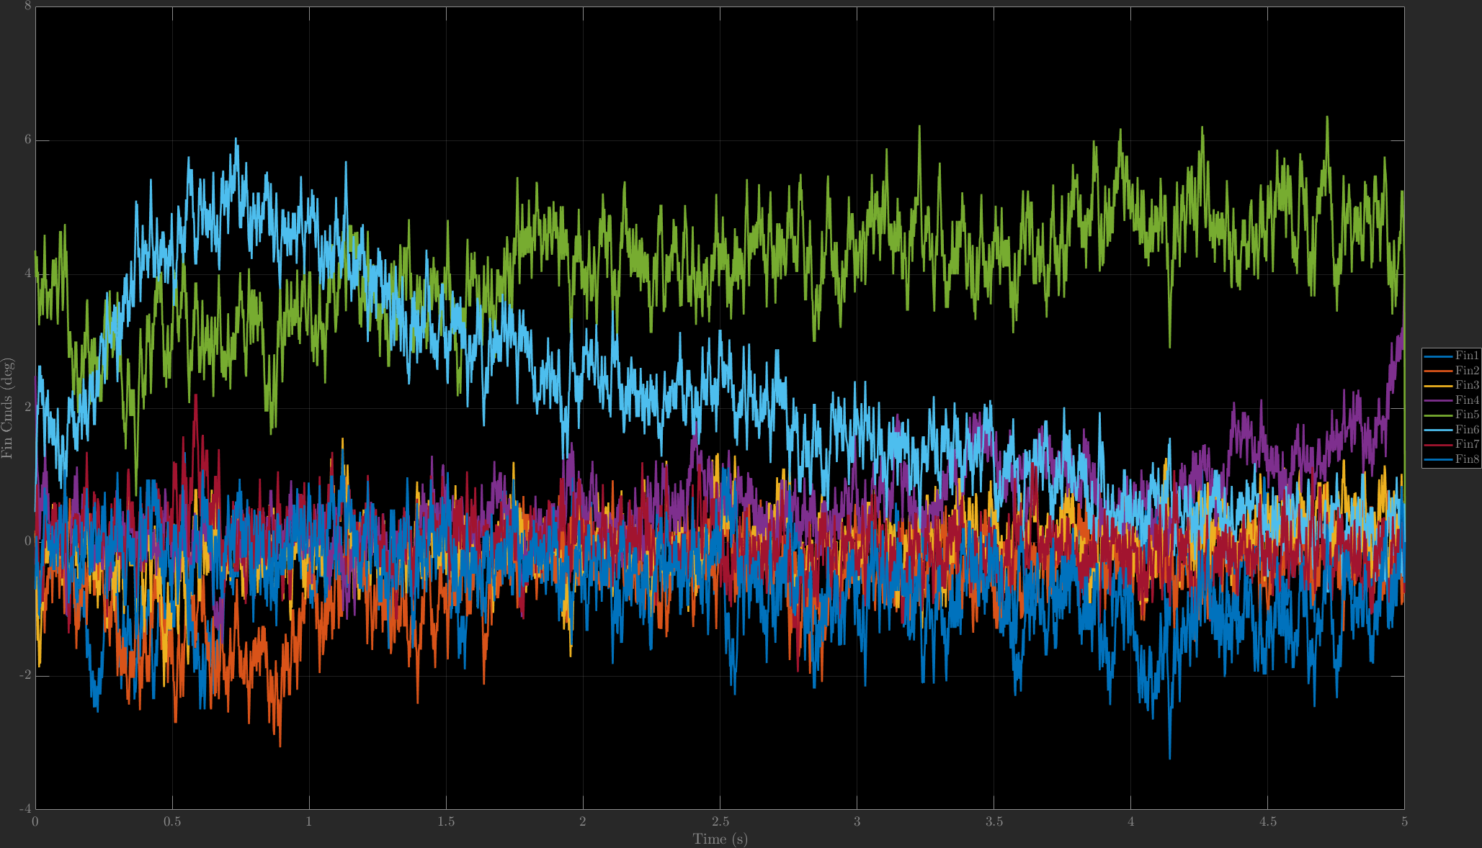
NDI Fin Commands
NDI fin commands, using rate loop, no noise (left) compared to 1e-4 noise. Note that the y-axis limits are different for each plot
Commands seem to track the general shape of the no-noise case when the noise level is reduced from 1e-3 to 1e-4
Fin command magnitude is much lower, albeit still very noisy

Slide 14
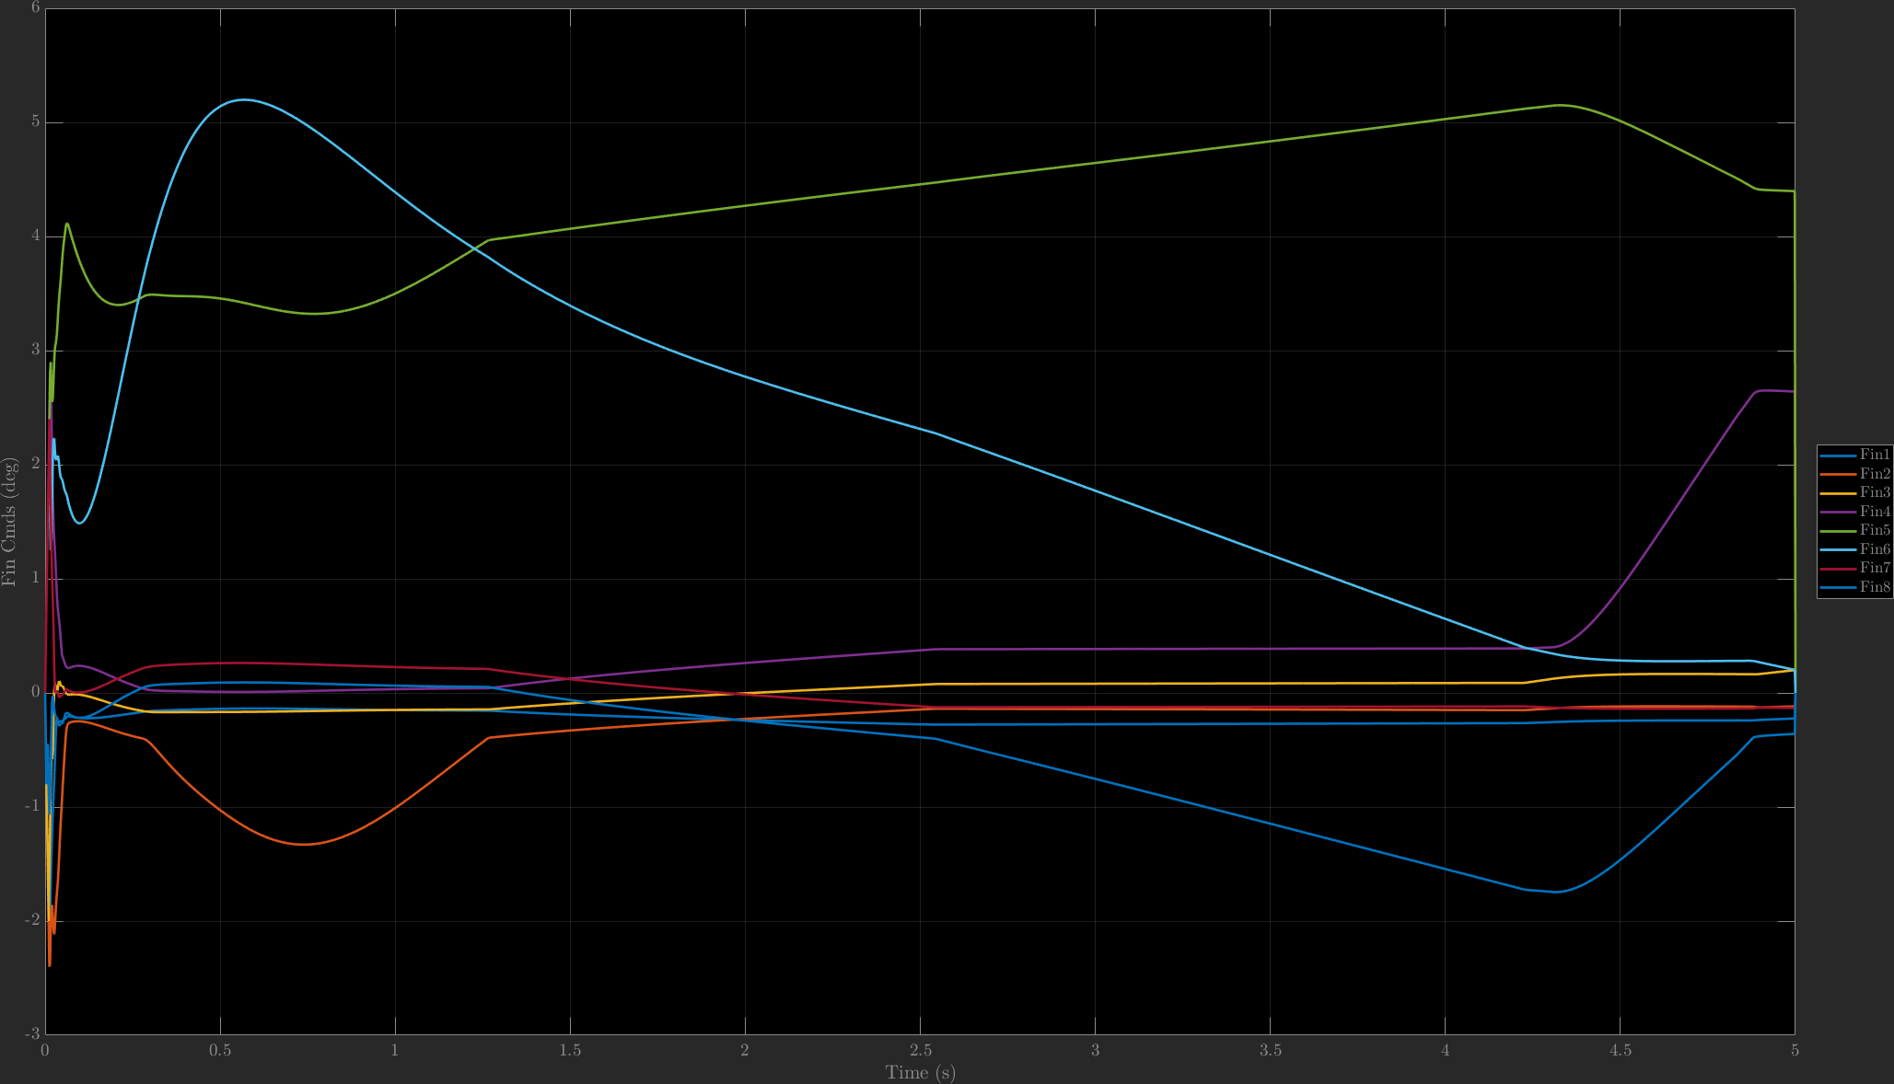
INDI Fin Commands
INDI fin commands, using rate loop, no noise (left) compared to 1e-3 noise. Note that the y-axis limits are different for each plot
Fin commands seem sporadic, and do not track the general shape of the no-noise case

Slide 15
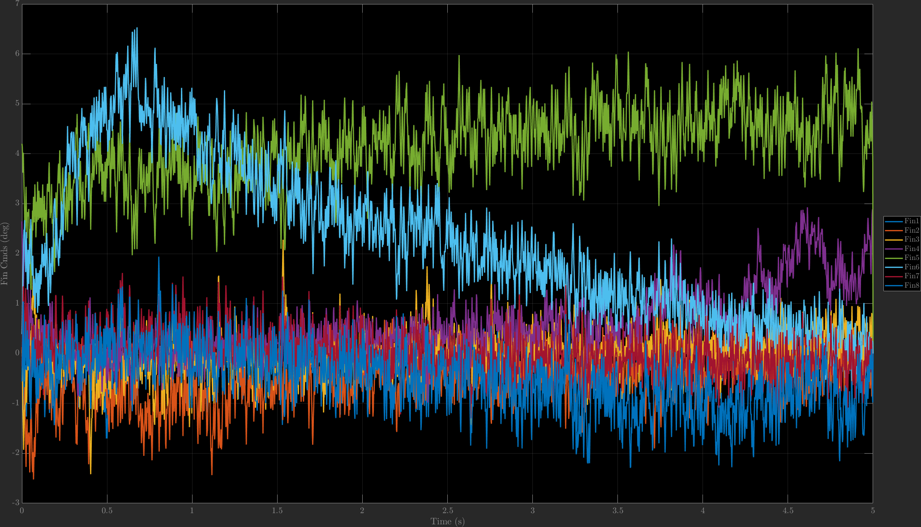
INDI Fin Commands
NDI fin commands, using rate loop, no noise (left) compared to 1e-4 noise. Note that the y-axis limits are different for each plot
Fin commands seem noisier compared to NDI

