Slide 1
Jigjiga City Traffic Management System
Final Project Presentation – System Design, Implementation & Testing
Group Members: Sakariye, Hamse, Kalid, Kader, Rahma, Anab, Fuad
Jigjiga University – Dept. of Computer Science
June 2025

Slide 2
Recap of Project Objectives
General Objective: Develop a web-based traffic management system for Jigjiga.
Target Users: Traffic police, transport administrators, drivers.
Problems Addressed:
- Manual record-keeping
- Inefficiency and data loss
- Poor accessibility

Slide 3
System Design Overview
Purpose: Solve problems identified in analysis.
Design Goals:
- Performance
- Maintainability
- Usability
- Security
- Reliability

Slide 4
System Architecture: 3-Tier
Presentation Tier: GUI for traffic police, admins, drivers.
Logic Tier: Handles all system operations.
Data Access Tier: Interfaces with MySQL database.
(Diagram to be inserted)

Slide 5
Deployment Diagram
Describes runtime configuration of components.
Includes: Web Server, Database, Admin, Police, Drivers.
(Insert Figure 30 from project)

Slide 6
Web Application Navigation
Modules include:
- Login
- Dashboard
- Driver Registration
- Offense Tracking
- Reporting
(Insert Navigation Tree - Figure 31)

Slide 7
Implementation Tools
Frontend: HTML, CSS, JavaScript
Backend: PHP, AJAX
Database: MySQL
Development Tools: PhpStorm, XAMPP

Slide 8
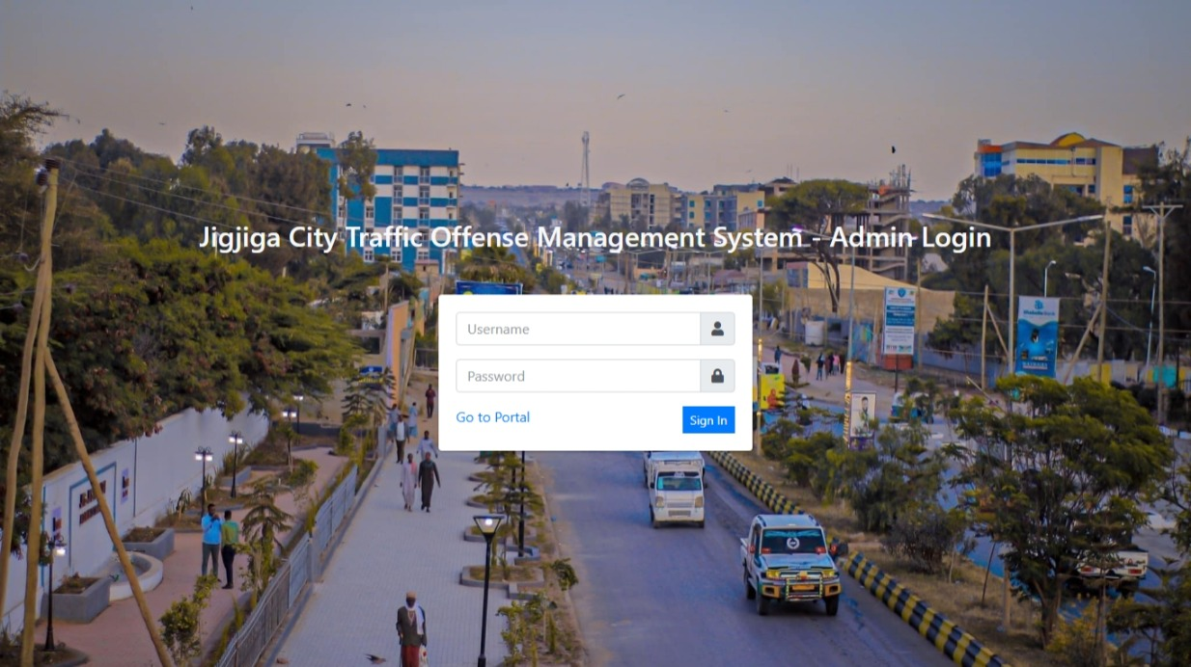
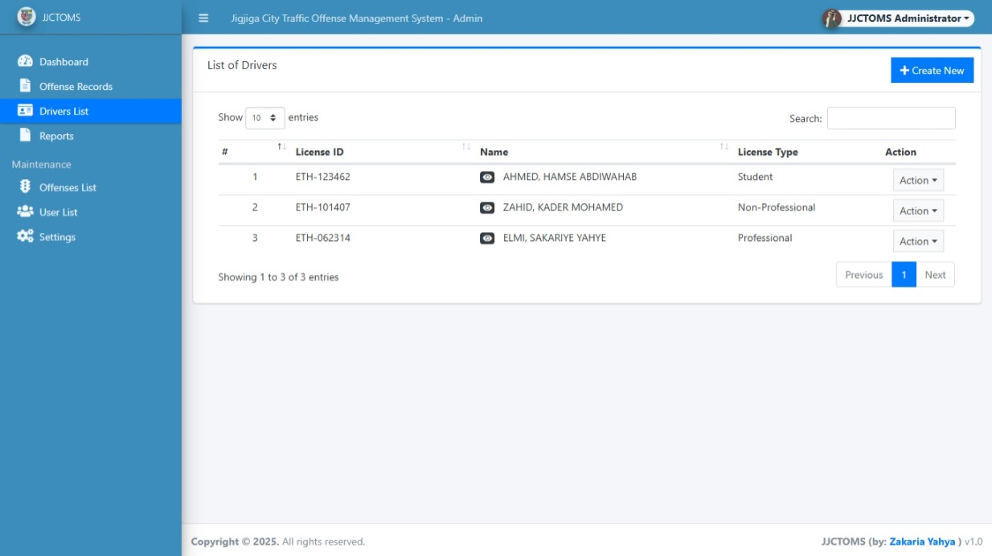
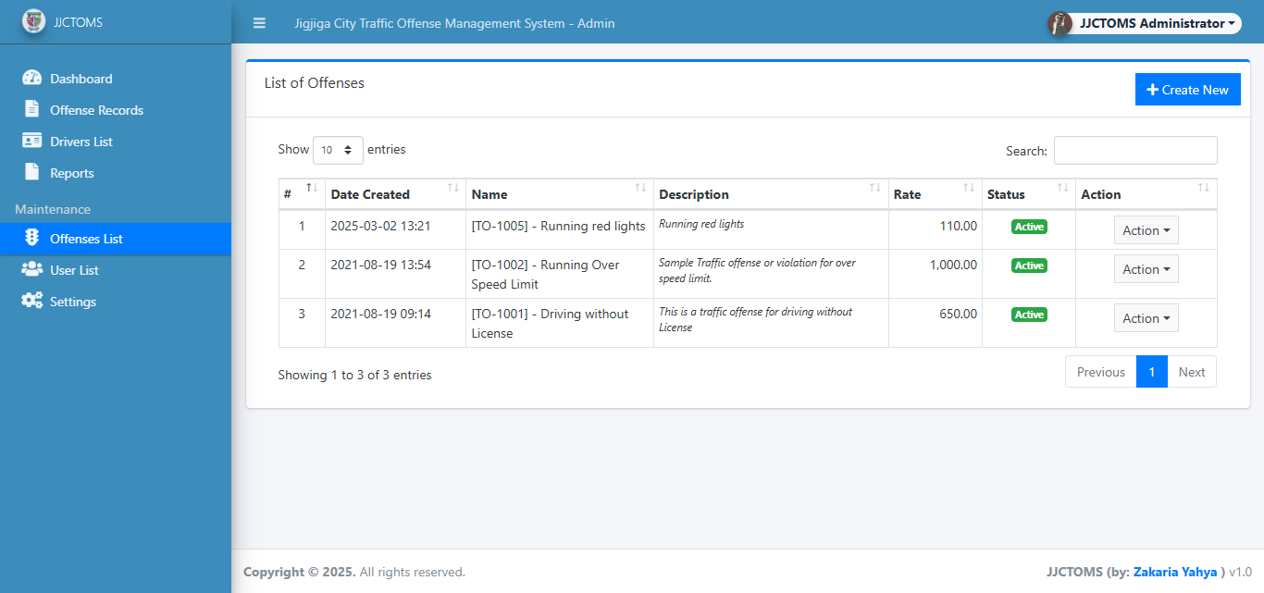
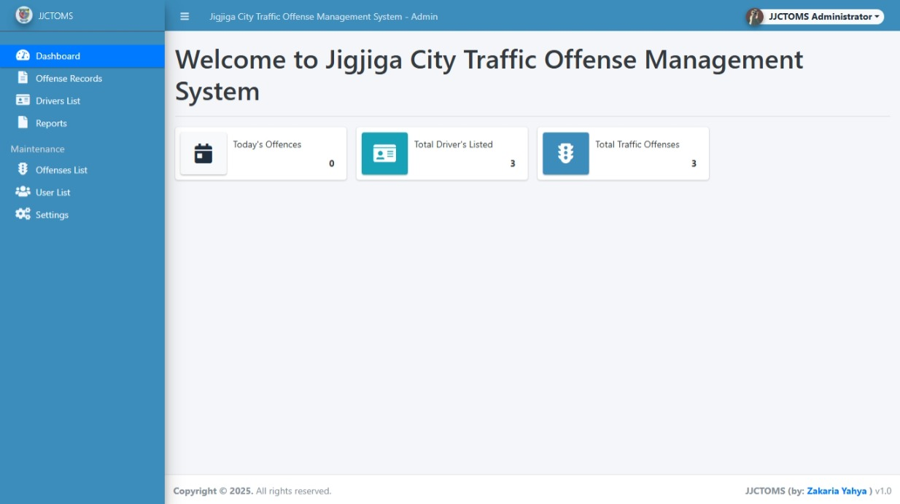
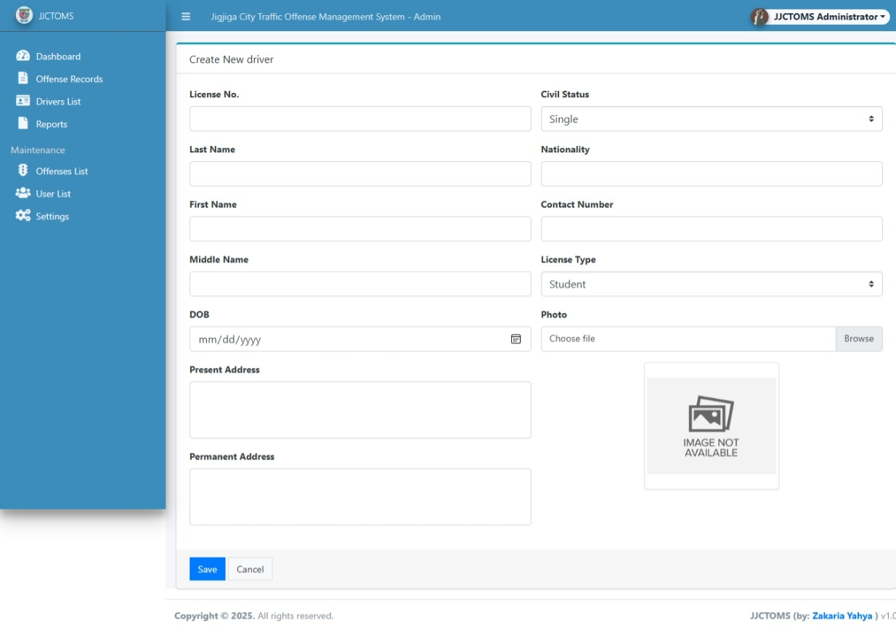
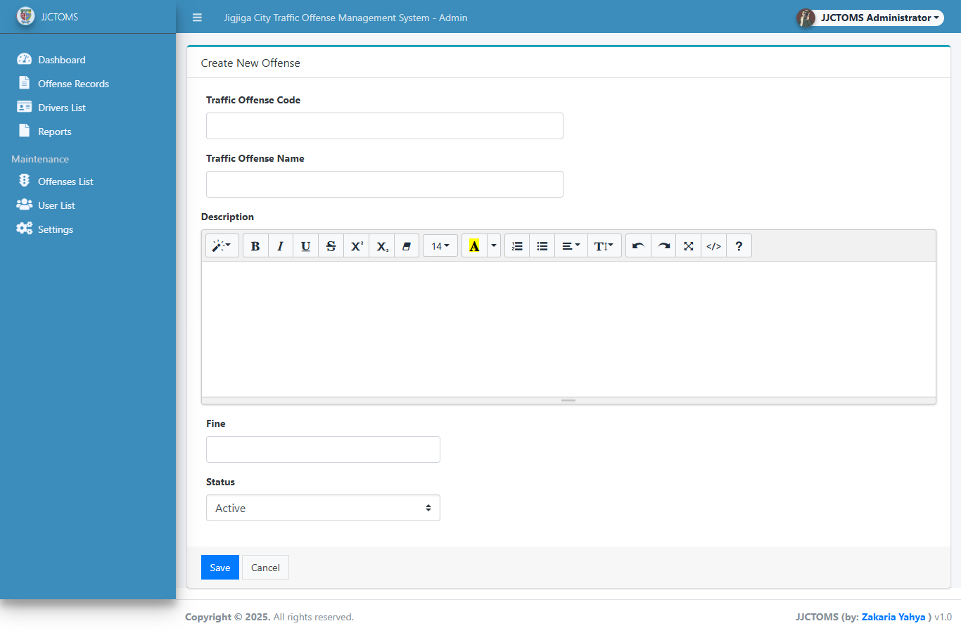
User Interface Snapshots
Login Page (Fig. 32)
Dashboard (Fig. 33)
Driver List & Registration (Fig. 34 & 35)
Offense Reporting (Fig. 36 & 37)

Slide 9
Implementation Highlights
Centralized authentication system.
Real-time offense reporting.
Role-based access control.
Data validation and error handling.

Slide 10
Testing Approach
Unit Testing: Individual functions tested independently.
Integration Testing: Modules interaction verified.
User Acceptance Testing: Validated with end-users.

Slide 11
Challenges Faced
Limited time for implementation.
Manual data source migration.
Network stability issues during testing.

Slide 12
Key Achievements
Functional system prototype delivered.
Intuitive user interface.
Fast and secure record search.
Improved information access and control.

Slide 13
Future Work & Recommendations
Expand system to other Ethiopian cities.
Develop mobile app version.
Integrate real-time traffic monitoring tools.

Slide 14
Conclusion
Provides scalable solution for Jigjiga traffic management.
Addresses key inefficiencies and data issues.
Promotes better coordination among stakeholders.

Slide 15
Q&A
Thank you for your attention!
We welcome your questions and feedback.

