Slide 1
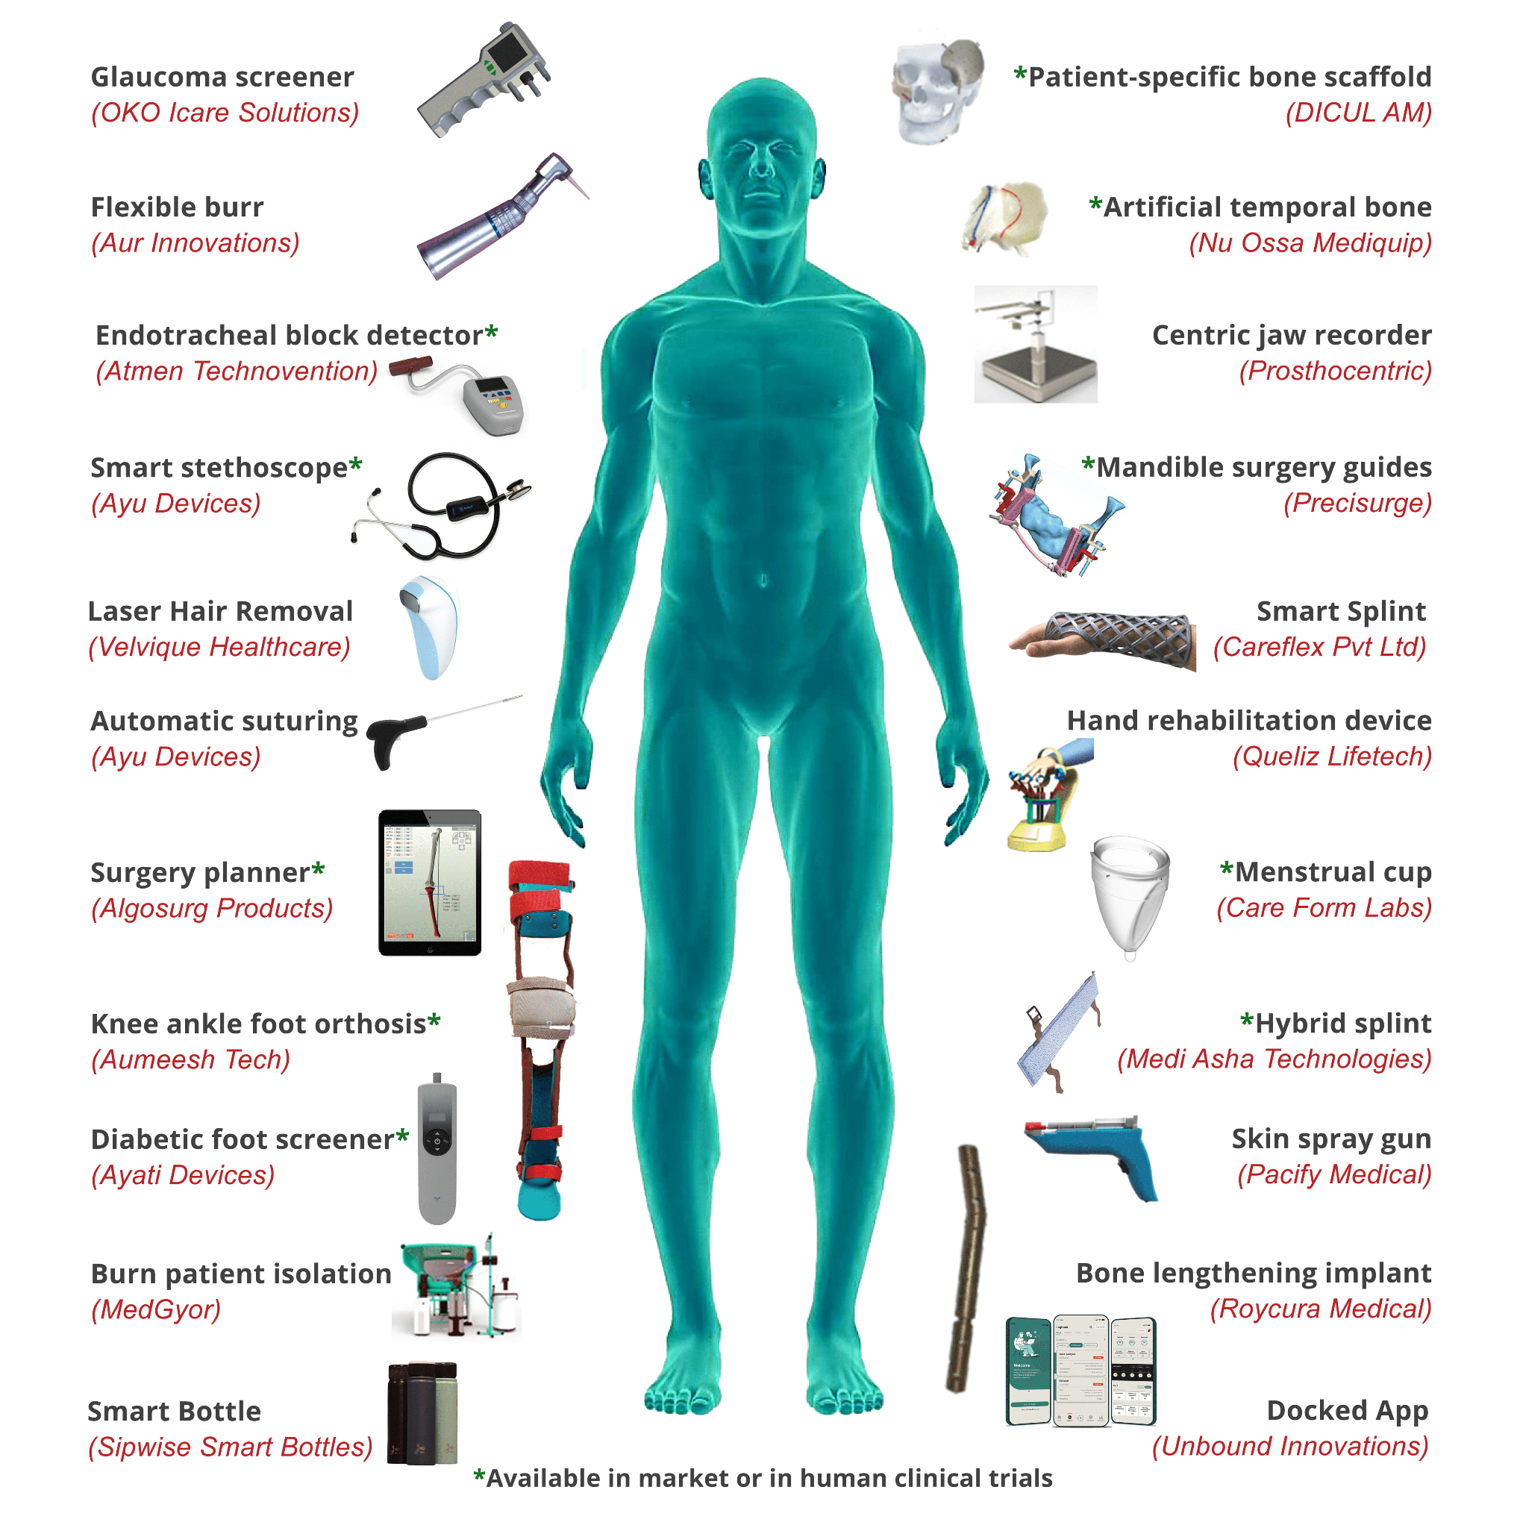
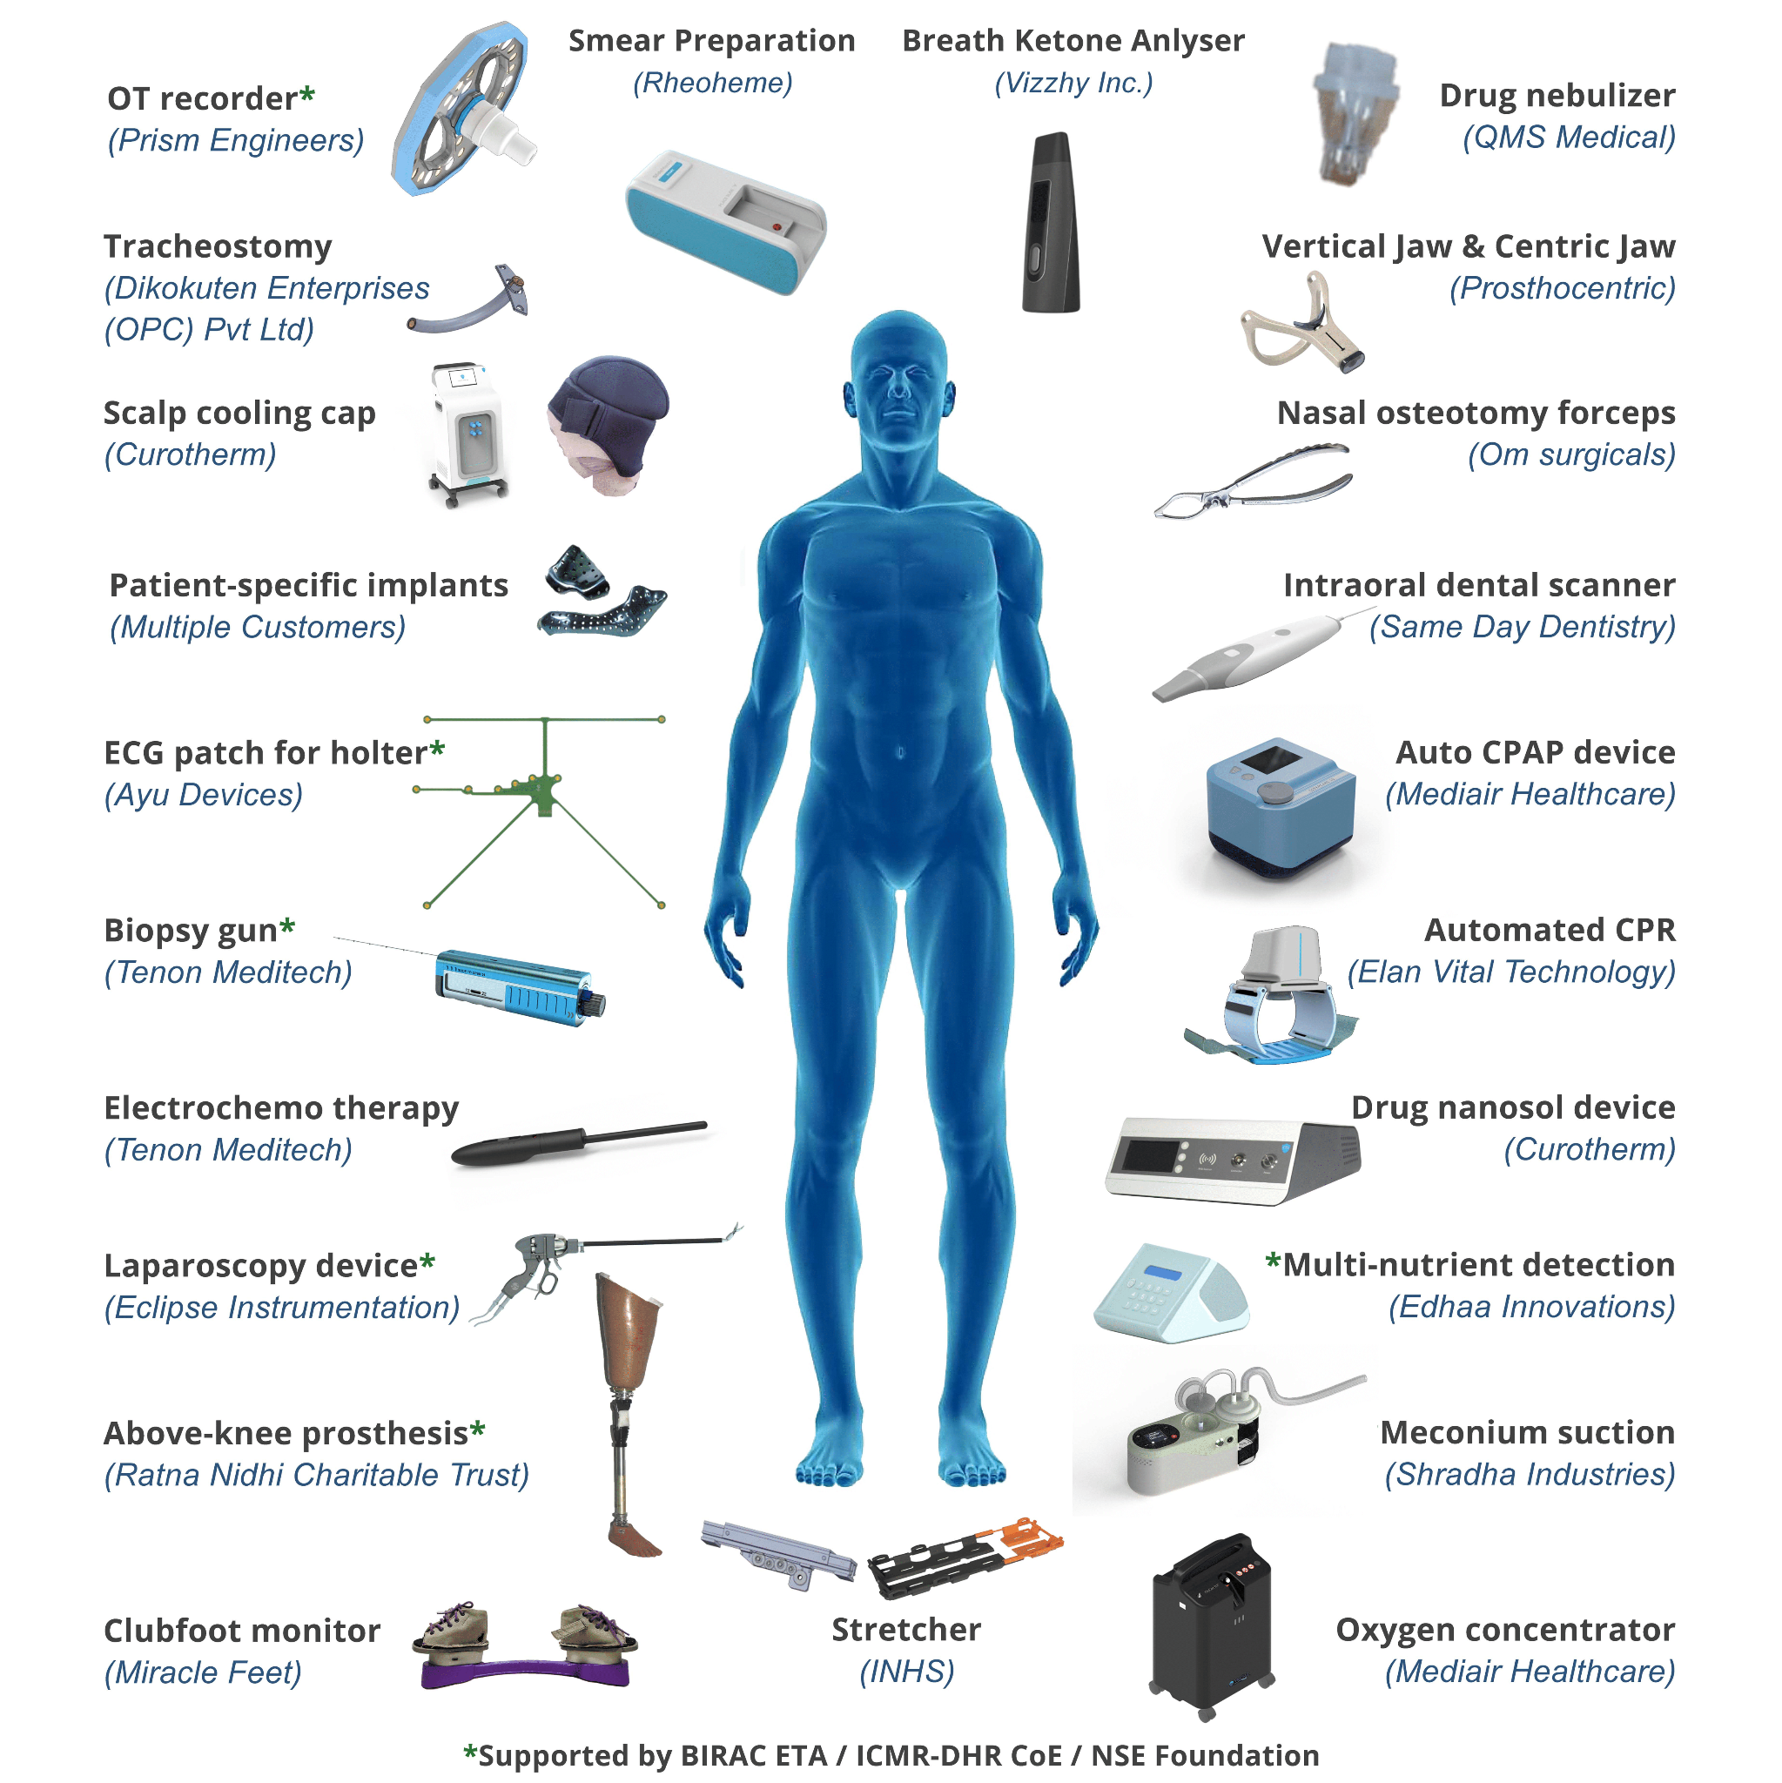

Total 50 Devices - 25 Startups and 25 Industry Projects

