Slide 1

BANK MANAGEMENT SYSTEM
Developed by:
ANSHU PanDEY
Section: A2
Roll No: 2218403
Date: 20/07/2024

Slide 2
INTRODUCTION
The “Bank Account Management System” project is a model Internet Banking Site. This site enables the customers to perform the basic banking transactions by sitting at their office or at homes through PC or laptop. The system provides the access to the customer to create an account, deposit/withdraw the cash from his account, also to view reports of all accounts present.
The customers can access the banks website for viewing their Account details and perform the transactions on account as per their requirements.

Slide 3
Components:
Admin Module: Admin login, Add/delete/update account, Withdrawal/deposit/statements, transaction , Account Information , User details list , View transaction histories.
User Module: User login, use PIN system, Creating/open new account registration, Funds transfer (local/international/domestic), View statements transaction,User account details , Change Password and PIN.

Slide 4
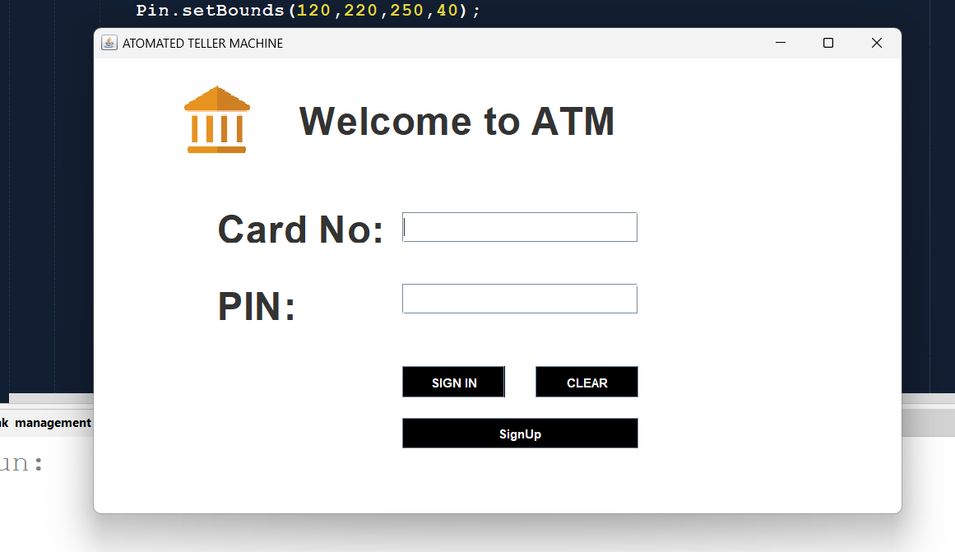
Practical working:
Technologies used : java(AWT & SWING) for application , MYSQL for database
Admin login page: checks user card number & PIN if a user is new he can create his/her new account by clicking the signup button otherwise click the sign-in button.

Slide 5
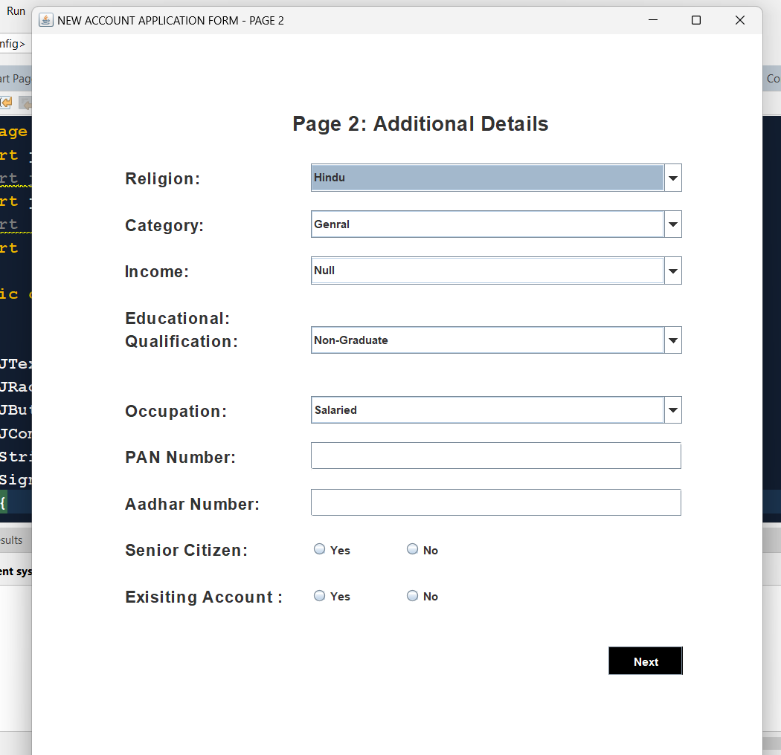
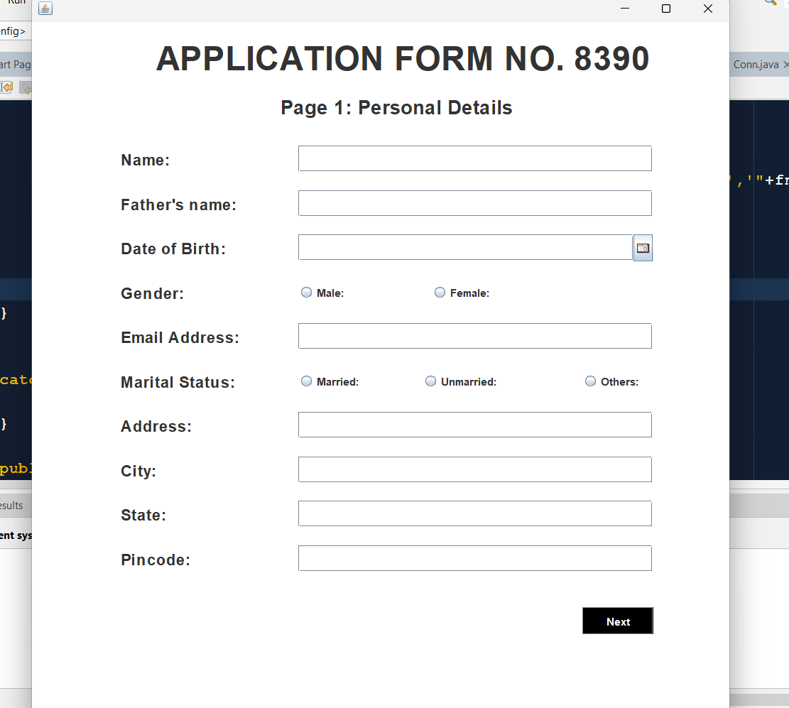
SIGN UP PAGE 1 and 2 page:
If a user is new first he/she fills their details on the signup page.

Slide 6
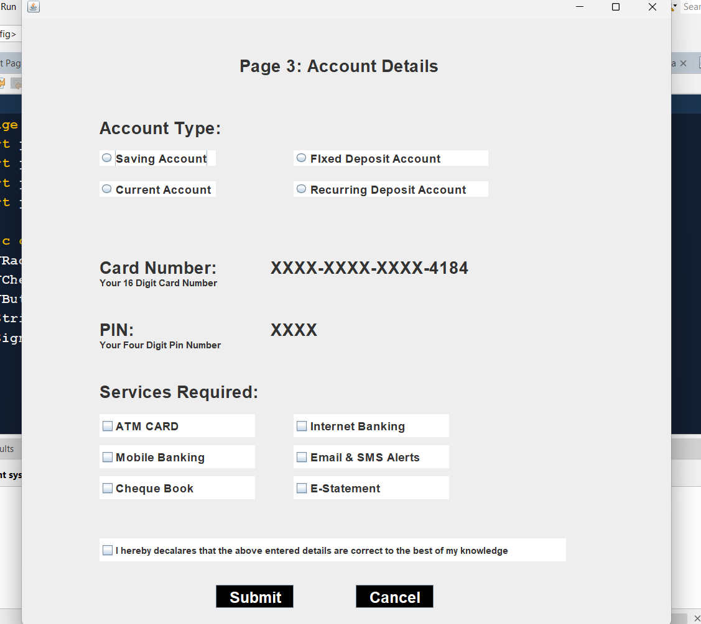
Sign up 3 page:
Here user has to filled their account type and services required then after that user get their card number number and PIN

Slide 7
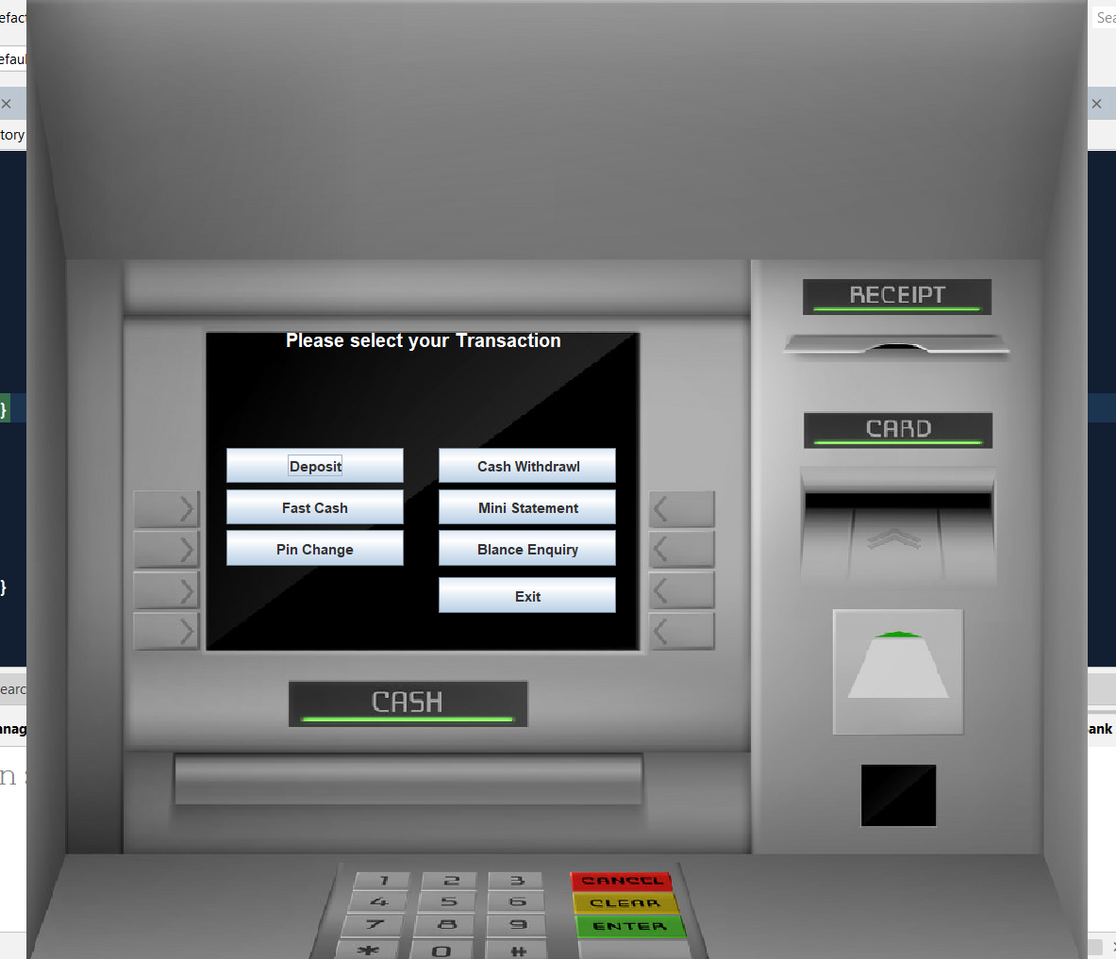
Transaction page:
After entering their PIN and card Number user can do their transaction

Slide 8

Benefits
You don't have to wait in line.
You don't have to plan your day around the bank's hours.
You can look at your balance whenever you want, not just when you get a statement.

Slide 9

Future look
More branches of the bank, maybe it will be international, that means more ATM machines outside.
Customer issues development based on their needs, so the help desk will be aware of their needs and easy to use.
Developing a mobile App for banking system that help users to do the obtained his operations without go to the bank only he needs to sign in using his A/C NO. And password and then use your own PIN. Finally the system will update automatically.

Slide 10
Conclusion
Banks are providing internet banking services also so that the customers can be attracted. By asking the bank employees we came to know that maximum number of Internet bank account holders are youth and businessmen.
Online banking is an innovative tool that is fast becoming a necessity. It is a successful strategic weapon for banks to remain profitable in a volatile and competitive marketplace of today.
If proper training should be given to customers by the bank employees to open an account, it will be beneficial secondly the website should be made friendlier from where the customers can directly make and access their accounts. Thus, the Bank Management System it is developed and executed successfully.

Slide 11

THANK YOU
BY: Anshu pandey

