Slide 1

SecureVault: A File Encryption and Decryption System
Team: The Mavericks
Anuj Pokhriyal (220113037)
Samrat Kumar (220111019)
Zoya Safdar (22152649)
Anshu Pandey (220113001)

Slide 2
ABSTRACT
The title of our project is “SecureVault: A File Encryption and Decryption System”. This project encrypts and decrypts the textual files by using EAS algorithm. Our aim is to develop the software named ENCRYPTION AND DECRYPTION that encrypts and decrypts the textual files by using EAS algorithm. Encryption and Decryption is a strong text and file encryption software for personal and professional security. It protects privacy of our email messages, documents and sensitive files by encrypting them using EAS algorithm to provide high protection against unauthorized data access.

Slide 3

OBJECTIVE
The main objective of our project is to encrypt/decrypt the textual files for personal and professional security. Encryption and Decryption protects privacy of our email messages, documents and sensitive files by encrypting them using encryption algorithm to provide high protection against unauthorized data access.
Sending sensitive messages over the Internet is very dangerous as all emails are transmitted in an unsecured form and anybody - ISP, your boss, etc. can read your emails

Slide 4
SCOPE
The scope of our project is presently specific. Both the sender and the receiver must have this software installed on their systems to encrypt/decrypt and compress/decompress the files transmitted between them. This includes all the users who want to interact electronically, whether it is through emails, e-commerce, etc. through internet in order to keep their private information confidential.
➔Each step is clearly stated and user will not face any ambiguity in using the software.
➔The software provides clarity in its functionality even to naïve users.
➔No complexity is involved.

Slide 5
System Design
Software design sits at the technical kernel of software engineering process and is applied regardless of the development paradigm and the area of application. Once the system requirements have been analysed and specified, system design is the first of the three technical activities- design, code and test that are required to build and verify s/w. emphasis is on translating the s/w requirements into design specification. It involves preparing I/P- O/P specifications, making security and control specification, and preparing a logical and physical design work through

Slide 6
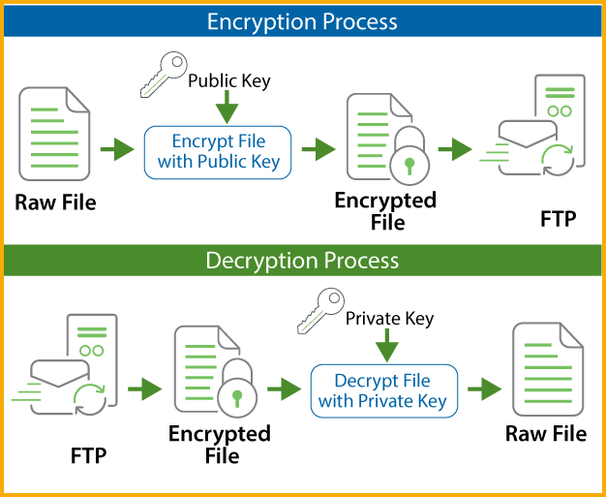
Data Flow Diagram

Slide 7
AES ALGORITHM
Advanced Encryption Standard (AES)?
Advanced Encryption Standard (AES) is a highly trusted encryption algorithm used to secure data by converting it into an unreadable format without the proper key. Developed by the National Institute of Standards and Technology (NIST), AES encryption uses various key lengths (128, 192, or 256 bits) to provide strong protection against unauthorized access. This data security measure is efficient and widely implemented in securing internet communication, protecting sensitive data, and encrypting files. AES, a cornerstone of modern cryptography, is recognized globally for its ability to keep information safe from cyber threats.

Slide 8
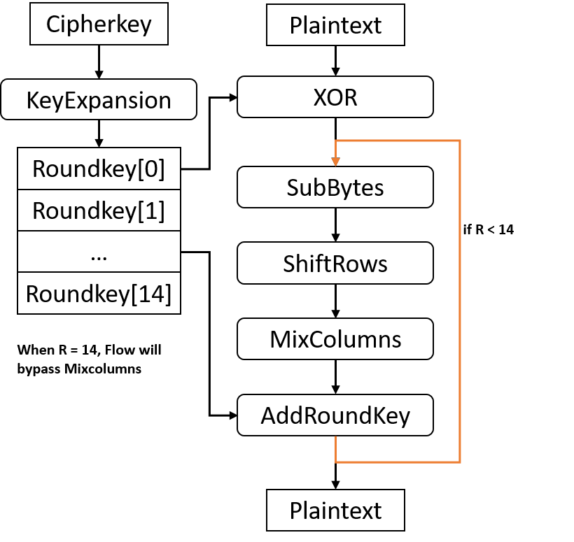

Slide 9
OPERATING SYSTEM INTEGRATION
Functionality | OS Involvement
File encryption/decryption | Uses file system APIs
Key/IV storage | Controlled by OS permissions
Random IV/key generation | Provided by OS entropy sources
Memory security | Protected by OS memory management
Process execution | Managed by OS scheduler
Library integration | OS links OpenSSL or cryptographic libs

Slide 10
void encrypt_file(const char *input_filename, const char *output_filename, const unsigned char *key, unsigned char *iv) {
FILE *infile = fopen(input_filename, "rb");
FILE *outfile = fopen(output_filename, "wb");
if (!infile || !outfile) handle_errors("File open error");
unsigned char inbuf[1024], outbuf[1024 + AES_BLOCK_SIZE];
int inlen;
AES_KEY enc_key;
AES_set_encrypt_key(key, 128, &enc_key);
while ((inlen = fread(inbuf, 1, sizeof(inbuf), infile)) > 0) {
AES_cbc_encrypt(inbuf, outbuf, inlen, &enc_key, iv, AES_ENCRYPT);
fwrite(outbuf, 1, inlen, outfile);
}
fclose(infile);
fclose(outfile);
}

Slide 11
void decrypt_file(const char *input_filename, const char *output_filename, const unsigned char *key, unsigned char *iv) {
FILE *infile = fopen(input_filename, "rb");
FILE *outfile = fopen(output_filename, "wb");
if (!infile || !outfile) handle_errors("File open error");
unsigned char inbuf[1024], outbuf[1024 + AES_BLOCK_SIZE];
int inlen;
AES_KEY dec_key;
AES_set_decrypt_key(key, 128, &dec_key);
while ((inlen = fread(inbuf, 1, sizeof(inbuf), infile)) > 0) {
AES_cbc_encrypt(inbuf, outbuf, inlen, &dec_key, iv, AES_DECRYPT);
fwrite(outbuf, 1, inlen, outfile);
}
fclose(infile);
fclose(outfile);
}

Slide 12

CONCLUSION
After implementing the system in the market its advantages were incomparable to the present contemporary systems available in the market. The most admirable feature founded was its simplicity in terms of application to the user but its highly beneficial outputs can’t be ignored. The users will be highly benefited after using the system. There is always a room for improvement in any software, however efficient the system may be. The system is flexible enough for future modifications. The system has been factored into different modules to make the system adapt to further changes. Every effort has been made to cover all the user requirements and make it user friendly. Appropriate messages and tool tips have been provided wherever necessary.

Slide 13

Goals achieved: Following are the goals achieved in designing and implementing the system.
➔ User Friendliness: The system is user friendly as any naïve user can use it and easily understand its functionality.
➔ Security: Security is enabled as certain features and functionalities are restricted to the registered users only and also at other levels security is implemented.
➔ Fast: The system aims to respond to the user as fast as possible.
➔ Future Plans: The system is adaptable to the future changes if any are deployed

Slide 14


