Slide 1
SCOTBANK
Group 7

Slide 2
The Development Cycle

Slide 3
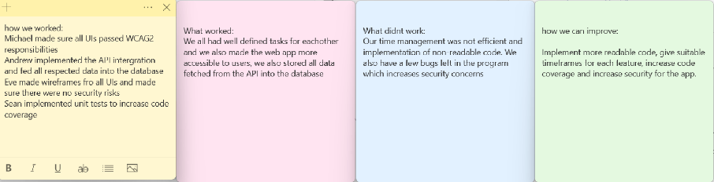
Retros:
We completed retros throughout our sprints, giving us ideas on how we can improve our development process and our web app. It also allowed us to improve our communication with eachother as we all knew exactly what to complete for that sprint, as well as what we had already completed.
Example:

Slide 4
Beginning of development
At the start of this project, we did not know each other and none of us knew how to use Mockito, Jooby and Maven. Throughout our development cycle we have improved relationships between each other as well as our own personal skills including project management, team collaboration and problem solving.
We now know how to build web applications within Java, as well as conducting conclusive testing and following the agile methodology.

Slide 5
GitLab
It was also an experience utilising gitlab properly for the first time, allowing us to learn about fixing pipelines; how to pull, push, commit, merge etc; Creating a project through version control. We also utilised branches within our project, allowing the programming cycle to be much easier
It also allowed us to collaborate with each other easier and allow for an easier development, especially with the use of the issue board.

Slide 6
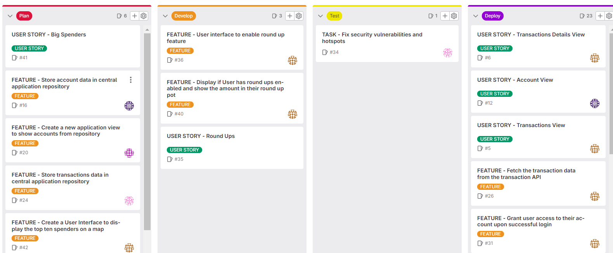
Issue Board
A first time experience for all of us, the utilisation of an Issue Board enhanced the development cycle for our project. It allowed us to see what User Stories and features to implement within our project, and to see who was tackling what problems.
Regular updates of the issue board occurred to allow for the development process to be smoother and easier.

Slide 7
The Project

Slide 8
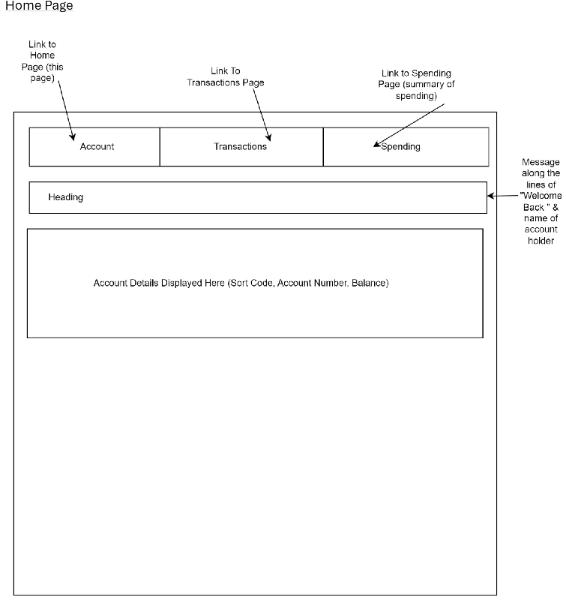
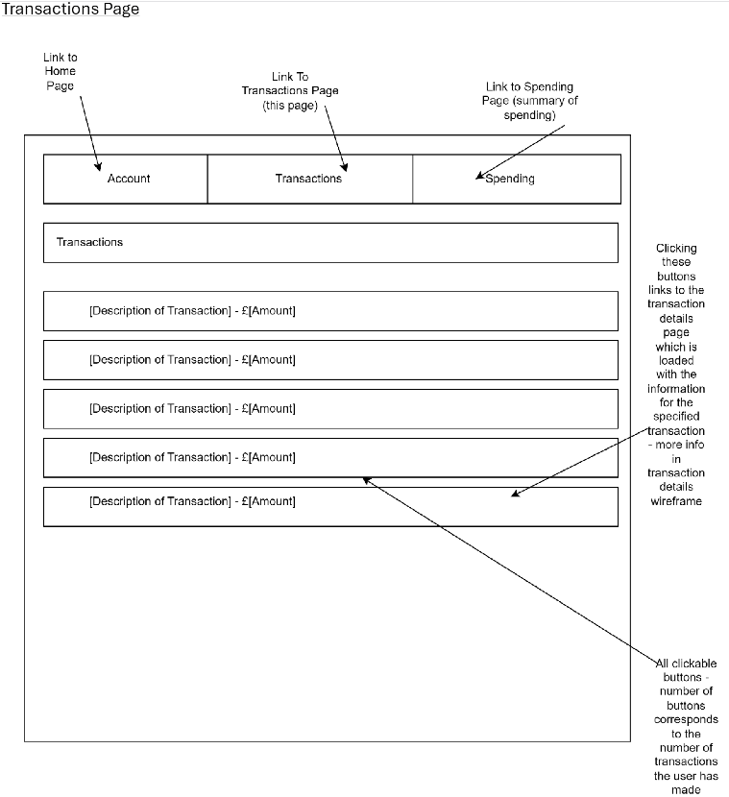
Wireframes
For our user interfaces, we developed wireframes to follow to allow for a more structured and accessible design of our UIs. Some of the designs changed due to new requirements. Some examples:

Slide 9
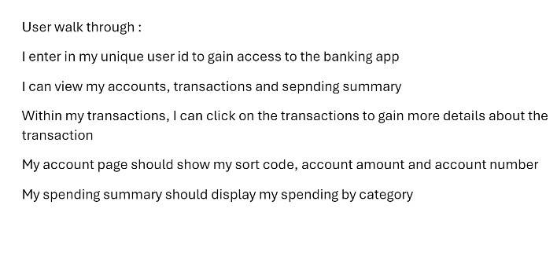
User Walkthroughs
We also developed some user walkthroughs throughout the development cycle to give us a better idea on how our consumers would utilise our app. This allowed us to design our app suited towards our customer's needs. Here is a version of our user walkthrough, aimed towards the consumer:

Slide 10
WCAG2 Compliancy
All of the webpages in our website are WCAG2 compliant, attempting to be as accessible to our users as possible. This includes our webpages ensuring they can be used with only a keyboard, sufficient colour contrast between text and background to improve readability and using ARIA roles.

Slide 11
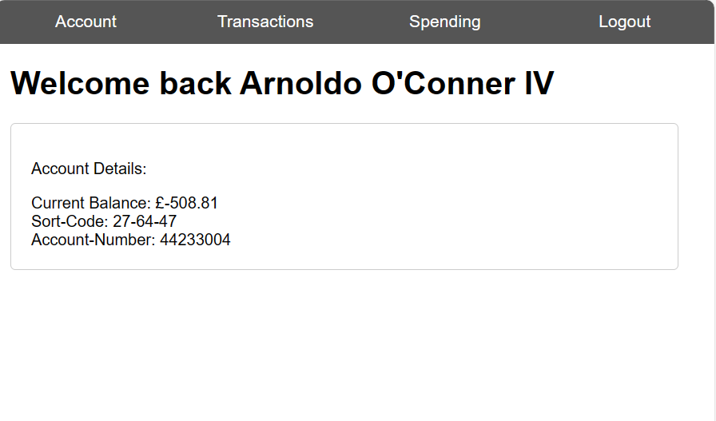
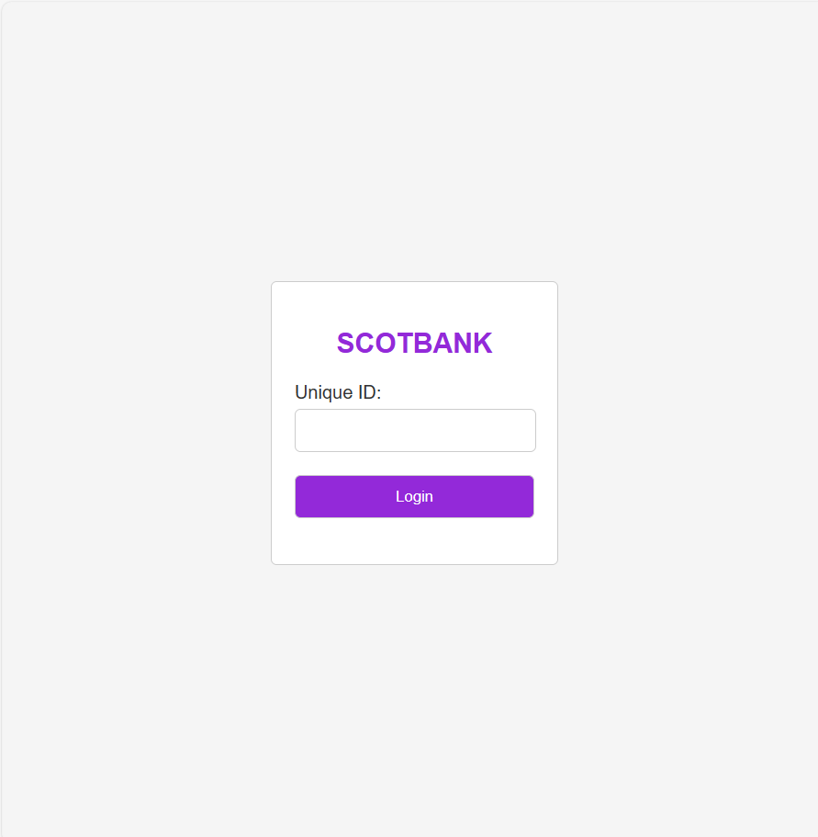
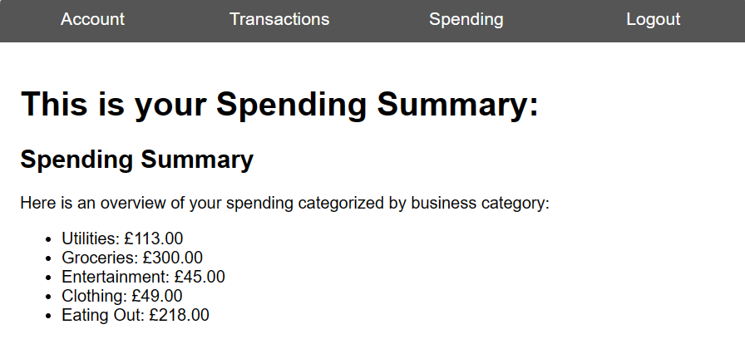
UI examples

Slide 12
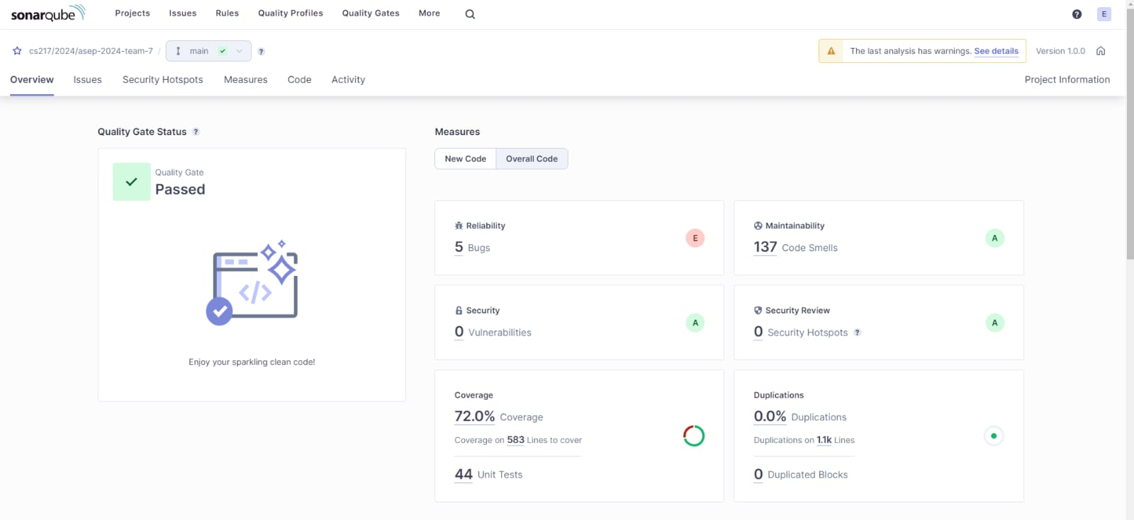
Sonarqube Code Coverage & Security Scanning
Our total code coverage within our program was 72% which increased over multiple sprints. We also met our security requirement of no security hotspots or vulnerabilities.

Slide 13
API and Database Usage
We read in from all APIs required: Transactions, Accounts and Businesses. We stored each of the API's data within array lists as well as in a database and passed all of this data through to our controller.

Slide 14
More on testing
Our code coverage for this project was 72%. We were able to complete this using libraries such as JUnit and Mockito.
Our team has used JUnit before in previous projects, but Mockito was a brand new idea. It allowed us to mock dependencies required for testing. This enabled us to increase coverage on the controller, as before we all learnt how to utilise it, our coverage was extremely poor.

Slide 15
Implemented Requirements
We were able to implement all MVP requirements, as well as other requirements. The only requirements we did not implement were:
Big Spenders
Round Ups
Round Ups Reclamation
This was due to time constraints on the project, and we felt as if developing the features would hinder our projects progress. We made the decision to further develop and prioritise other features that were already implemented to reach deadlines and improve our overall app. This included prioritising testing, usability and security.

Slide 16
Cloud Deployment Report
Available on GitLab project

Slide 17
We will now show off our program

