Slide 1

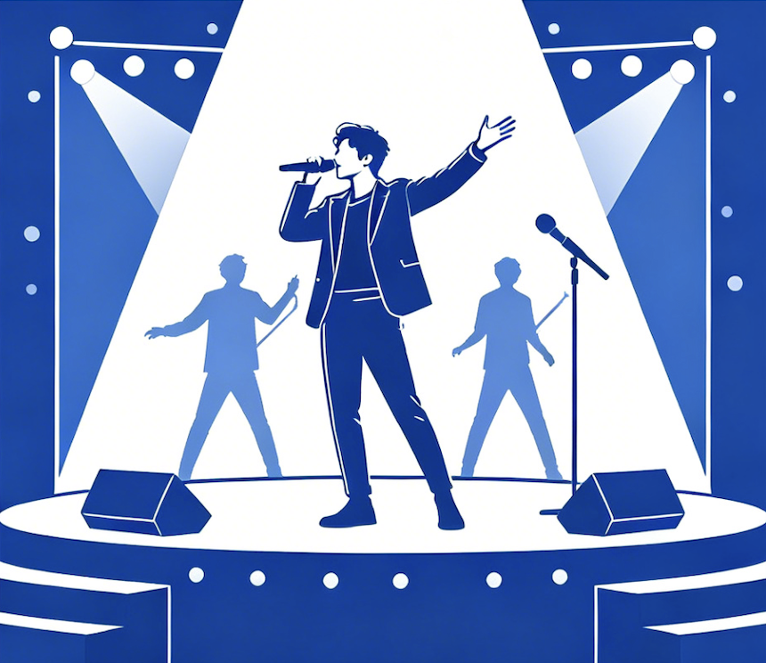
Psychological Motivations for Idol Worship and Their
Perceived Impact Among Chinese University Students
An Empirical Study Based on Survey Data from 193 University Students
1
Introduction
4
Findings: RQ1 - Psychological Motivations
7
Discussion
Fan culture has evolved from a niche subculture into a pervasive social force in China, with fan communities constituting a significant part of internet users and generating intense public debate. While the scale and visibility of idol worship among young people continue to grow, the psychological motivations behind these behaviors remain insufficiently understood.
This study addresses this gap by investigating three interconnected research questions:
RQ1: What are the dominant psychological motivations driving idol worship among Chinese university students?
RQ2: How do different motivations relate to students' perceived impact of idol worship on their personal lives?
RQ3: How do students perceive fan culture conflicts' effect on the online environment?
Cognitive-aspirational dominance and Maslow's hierarchy: The overwhelming prevalence of talent recognition (89.9%) and values identification (83.0%) supports the hypothesis that idol worship fulfills higher-order needs for esteem and self-actualization. Students admire idols as aspirational models — consistent with Maslow's framework and distinct from the pathological framing in existing literature.
The private-public paradox: The sharp disconnect between private experience and public evaluation suggests the problem lies not in 'liking an idol' itself, but in collective, organized dynamics — where emotional support transforms into time displacement, consumption pressure, and group hostility. This aligns with Mao et al.'s (2023) characterization of fan circles as quasi-organizational structures.
Connections to prior research: Our motivational categories complement Wei & Huang's (2024) six-profile taxonomy. The finding that personal well-being perceptions remain largely positive parallels Zhang et al.'s (2026) insight that only borderline-pathological worship bridges to reduced life satisfaction.
2
Literature Review
■ Cognitive-Aspirational ■ Aesthetic ■ Emotional ■ Social ■ External
Parasocial Interaction & Motivational Foundations: Horton & Wohl (1956) described the 'intimacy at a distance' audiences develop with media figures. McCutcheon et al. (2002) proposed the absorption-addiction model with three stages: entertainment-social, intense-personal, and borderline-pathological. Gong et al. (2025) found insecure attachment predicts higher initial celebrity worship among Chinese freshmen.
Impact on Well-Being: Maltby et al. (2004) linked intense-personal worship to poorer mental health. Wei & Huang (2024) identified six distinct fan profiles among 806 Chinese emerging adults. Zhang et al. (2026) used network analysis to identify borderline-pathological cognition as the key bridge to reduced life satisfaction.
Chinese Fan Culture Dynamics: Mao et al. (2023) characterized Chinese fan circles as quasi-organizational communities governed by emotional discipline and commercial logic. Zhang (2024) traced 30 years of China's online fandom evolution.
Research Gap: Motivation has been treated as an implicit variable rather than a central object of inquiry. Few studies examine how distinct psychological motivations differentially relate to perceived personal and social impact.
Cognitive-aspirational motivations — admiring talent, character, and growth narratives — dominate overwhelmingly. Emotional-attachment motives are moderate, while social-belonging and external influences are minor.
8
Conclusion
5
Findings: RQ2 - Perceived Personal Impact
1. Cognitive-aspirational motivations dominate idol worship among Chinese university students, with talent and character recognition far exceeding emotional dependence or social needs.
2. Perceived personal impact is largely positive or neutral, suggesting moderate idol worship can serve as an emotional and aspirational resource.
3. A significant private-public paradox exists: students view personal worship positively yet acknowledge collective fan behavior as damaging to the online environment.
4. Implications: Educational interventions should focus on cultivating media literacy and critical evaluation, not discouraging idol worship itself.
42.6%
48.1%
5.4%
Positive
No Impact
Negative
3
Methodology
!
Limitations
Design: Online cross-sectional survey distributed to Chinese university students.
Sample: 193 valid responses (45.6% male, 54.4% female). 29.0% actively worship idols, 37.8% have an idol but not worship-level, 33.2% no idol involvement.
Instrument: Demographic items, idol type (multiple choice), self-rated worship intensity (0-10), psychological motivations (multiple choice), fan circle participation, perceived personal impact (Likert 1-5), perceived online environment impact.
Analysis: Descriptive statistics. Motivations inductively categorized into four profiles: cognitive-aspirational, aesthetic attraction, emotional-attachment, and social-belonging.
Most students perceive idol worship as personally benign or positive, yet acknowledge that excessive worship can distort values (highest concern at 3.99/5).
Sample size (N=193), self-report measures susceptible to social desirability bias, cross-sectional design precluding causal inference, and descriptive statistics without inferential testing. Future research should employ longitudinal designs, validated scales, and larger samples.
R
References
6
Findings: RQ3 - Perceived Online Impact
[1] Brooks, S. K. (2021). FANatics: Systematic literature review. Current Psychology, 40, 864-886.
[2] Gong, X., et al. (2025). Attachment and celebrity worship trajectory. Personality and Individual Differences, 237, 113169.
[3] He, Y., & Liu, Q. (2024). Excessive celebrity worship behavior questionnaire. PLOS ONE, 19(5), e0303683.
[4] Horton, D., & Wohl, R. R. (1956). Mass communication and para-social interaction. Psychiatry, 19(3), 215-229.
[5] Jia, R., et al. (2023). Social anxiety and celebrity worship. BMC Psychology, 11, 364.
[6] Maltby, J., et al. (2004). Celebrity worship and mental health. British J. of Psychology, 95(4), 411-428.
[7] Mao, D., Wang, J., & Chen, J. (2023). Chinese fandom: Organizational characteristics. J. of Chinese Sociology, 10(1), 18.
[8] McCutcheon, L. E., et al. (2002). Conceptualization of celebrity worship. British J. of Psychology, 93(1), 67-87.
[9] Morgan, A. K., et al. (2024). Celebrity worship: Friend or foe? Int. J. of Adolescence and Youth, 29(1), 2371396.
[10] Qu, F., & Zhong, L. (2025). Idol worship: A chain mediation model. Acta Psychologica, 261, 105935.
[11] Wang, E. N., & Ge, L. (2023). Fan conflicts and state power in China. Asian Studies Review, 47(2), 355-373.
[12] Wei, D., & Huang, Y.-T. (2024). Celebrity worship among emerging adults in China. Humanities & Social Sciences Comms., 11, 1721.
[13] Zhang, K., et al. (2026). Celebrity worship and well-being via network analysis. Behavioral Sciences, 16(1), 28.
[14] Zhang, W. (2024). 30 years of China's online fandom. Communication and the Public, 9(4), 421-425.
Private Experience
42.6% positive
48.1% neutral
Only 5.4% negative
VS
Public Evaluation
70.5% negative
(46.5% severe +
24.0% moderate)

