Slide 1
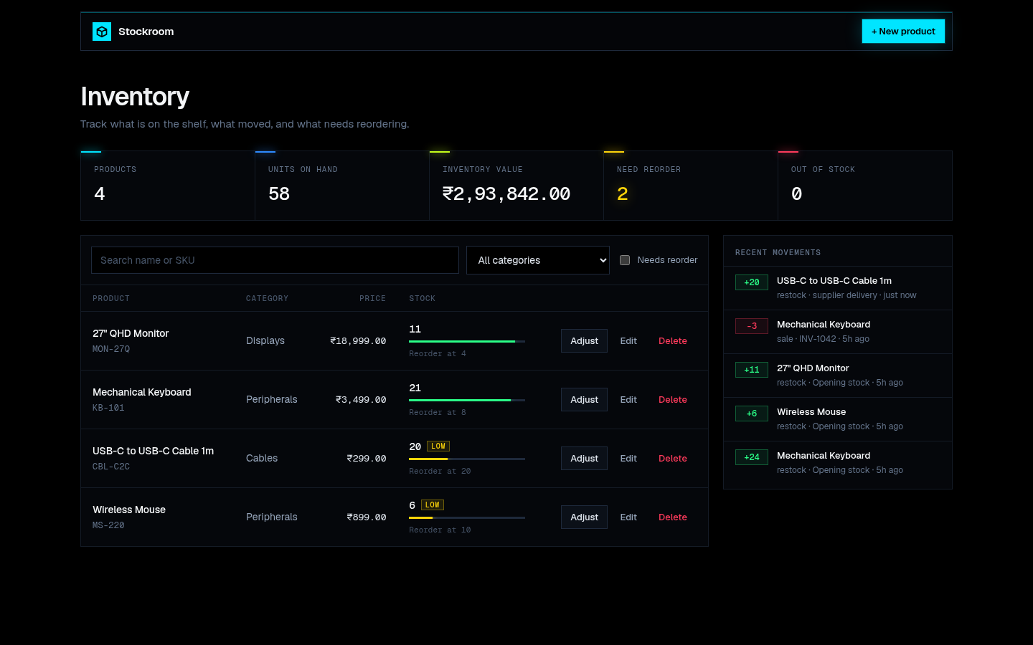
THE PROJECT
01 / 07
Stockroom
Inventory management
Products, stock levels and
movement history.
React / FastAPI / PostgreSQL
Parth Sankhla
STOCKROOM
Parth Sankhla / 2024BCS10229
github.com/aPassie/stockroom
Notes:
Hi, I'm Parth. This is Stockroom, an inventory app for a small shop or warehouse. I can add products, record sales and restocks, and see what needs reordering. Every stock change is recorded, and the app rejects changes that would make stock negative. Here's how I built and deployed it.

Slide 2
THE SETUP
02 / 07
How it runs
React + Nginx
FastAPI
PostgreSQL
The UI sends requests to the API.
Product and stock operations.
Application data and stock history.
$ docker compose up --build
Health checks control startup. Alembic runs database migrations.
Both application images run as non-root users.
STOCKROOM
Parth Sankhla / 2024BCS10229
github.com/aPassie/stockroom
Notes:
The frontend is React, the backend is FastAPI, and the database is PostgreSQL. Nginx routes API requests to the backend, and Alembic handles database changes. Locally, Docker Compose starts all three services. The containers wait for their dependencies to be healthy, and both application images run as non-root users.

Slide 3
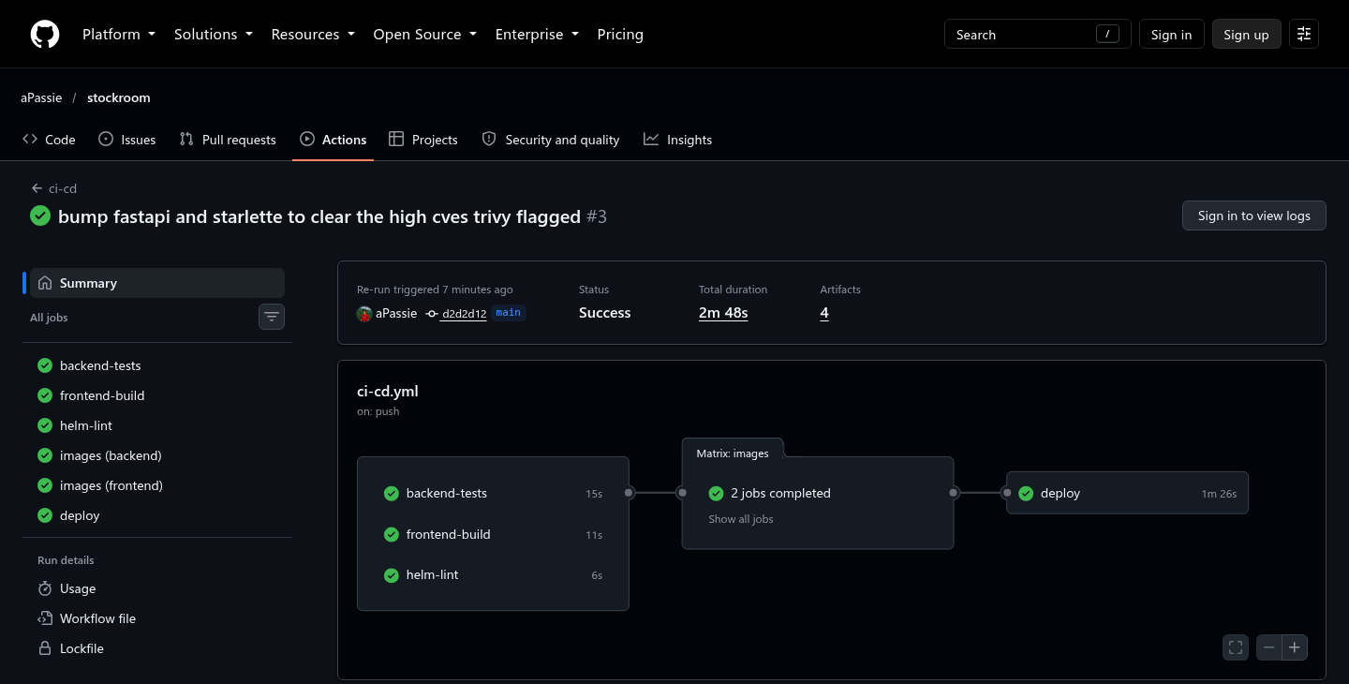
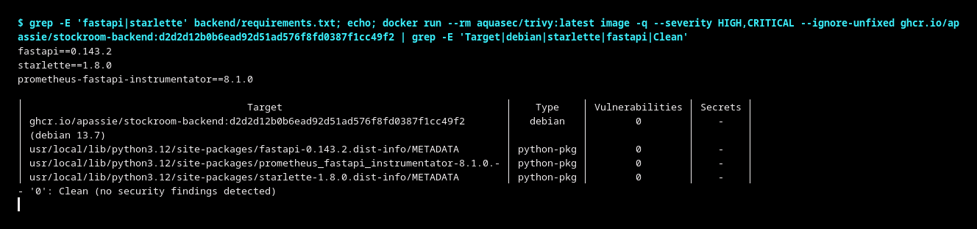
TESTS AND DELIVERY
03 / 07
What happens when I push code
01
22 passing tests
Product operations, validation and stock
changes.
02
GitHub Actions
Tests and builds run before publishing.
03
Trivy + GHCR
Scan the images, then publish with the
commit SHA.
Trivy scan after the dependency update
STOCKROOM
Parth Sankhla / 2024BCS10229
github.com/aPassie/stockroom
Notes:
A push starts GitHub Actions. It runs twenty-two backend tests, builds the frontend, and checks the Helm chart. Then it builds both Docker images and scans them with Trivy before publishing to GitHub Container Registry. The scan actually caught issues in Starlette. I upgraded the dependencies and checked again before deploying.

Slide 4
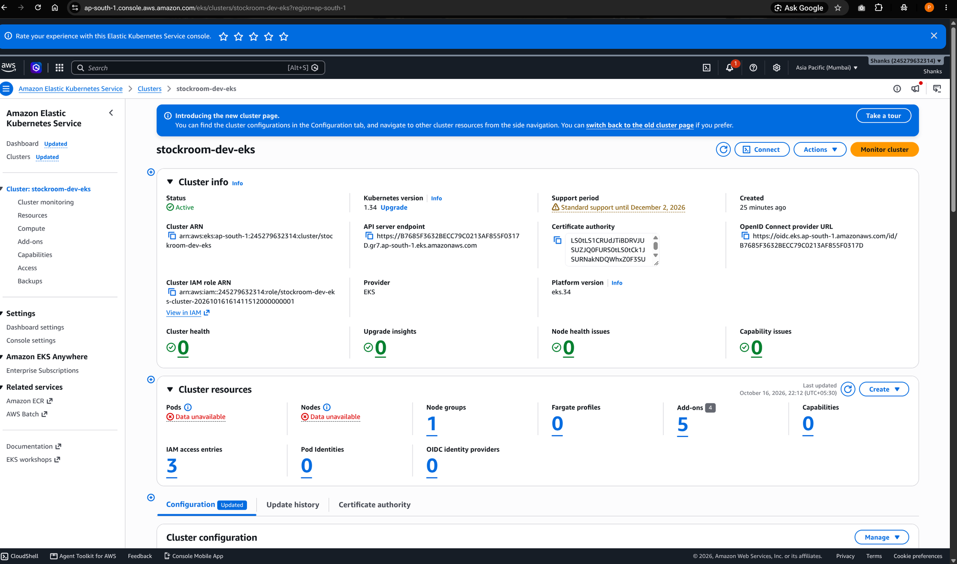
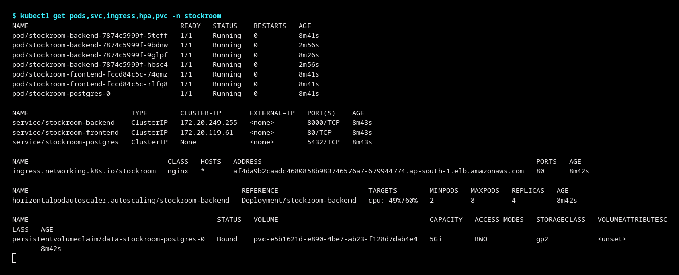
DEPLOYMENT
04 / 07
Running on AWS
01
Terraform
Creates the VPC, subnets and EKS cluster.
02
Helm
Deploys the frontend, backend and
database.
EKS deployment captured on 16 October 2026
03
Ingress
Routes browser requests to the right
service.
Application pods, services, ingress and storage
STOCKROOM
Parth Sankhla / 2024BCS10229
github.com/aPassie/stockroom
Notes:
I used Terraform to create the AWS network and EKS cluster, then Helm to deploy the app. Ingress sends browser requests to the frontend or API. PostgreSQL uses persistent storage, and readiness checks keep traffic away from a backend that cannot reach the database. These screenshots are from the completed AWS deployment.

Slide 5
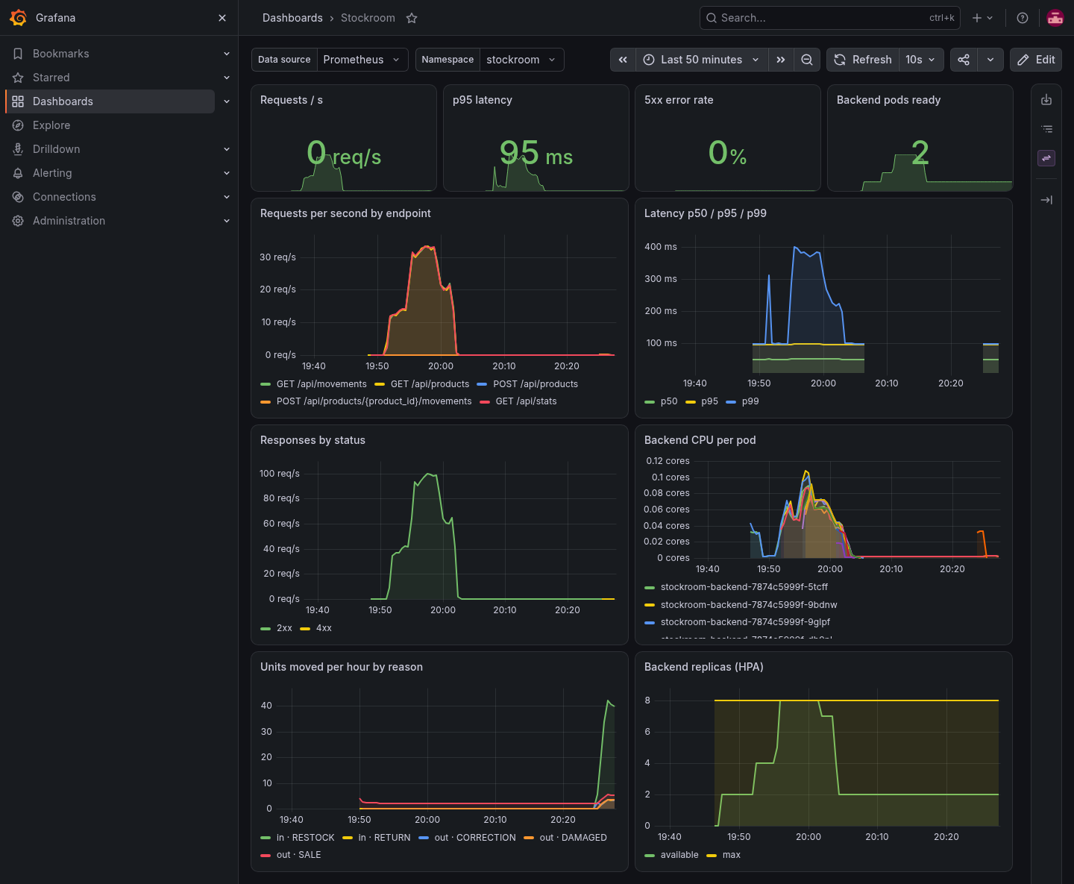
UNDER LOAD
05 / 07
Scaling and monitoring
01
2 to 8 pods
Backend replicas increased during the
load test.
02
60% CPU target
The autoscaler uses CPU metrics.
03
Prometheus + Grafana
Requests, latency, errors and replica
count.
STOCKROOM
Parth Sankhla / 2024BCS10229
github.com/aPassie/stockroom
Notes:
During the load test, the backend scaled from two pods to eight. Prometheus collected the metrics, and Grafana showed requests, latency, errors, and replica count. I also added a counter for stock movements. The alerts cover a backend going down, too many errors, and slow requests.

Slide 6
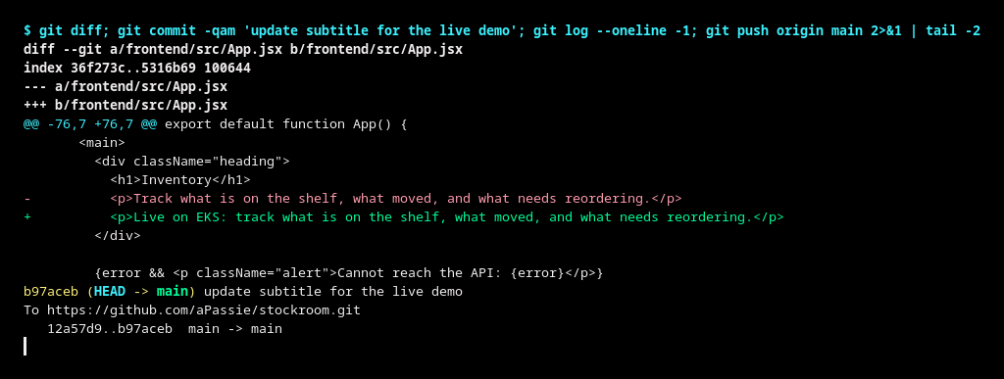
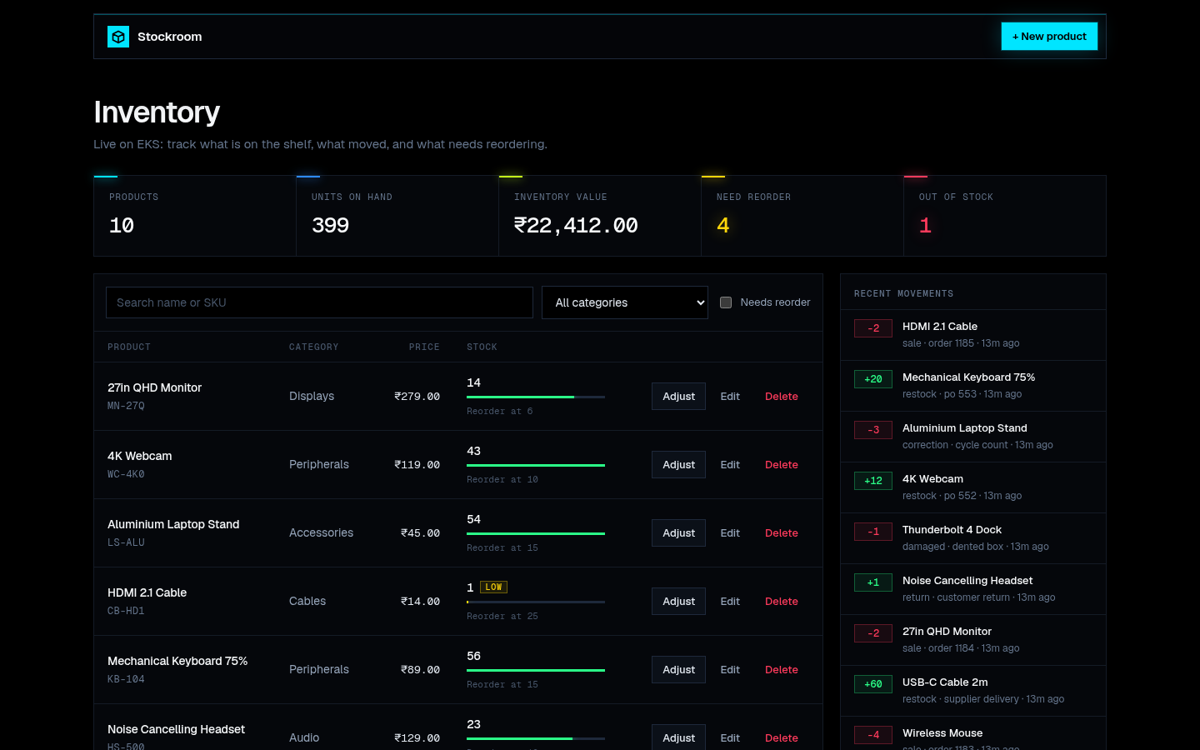
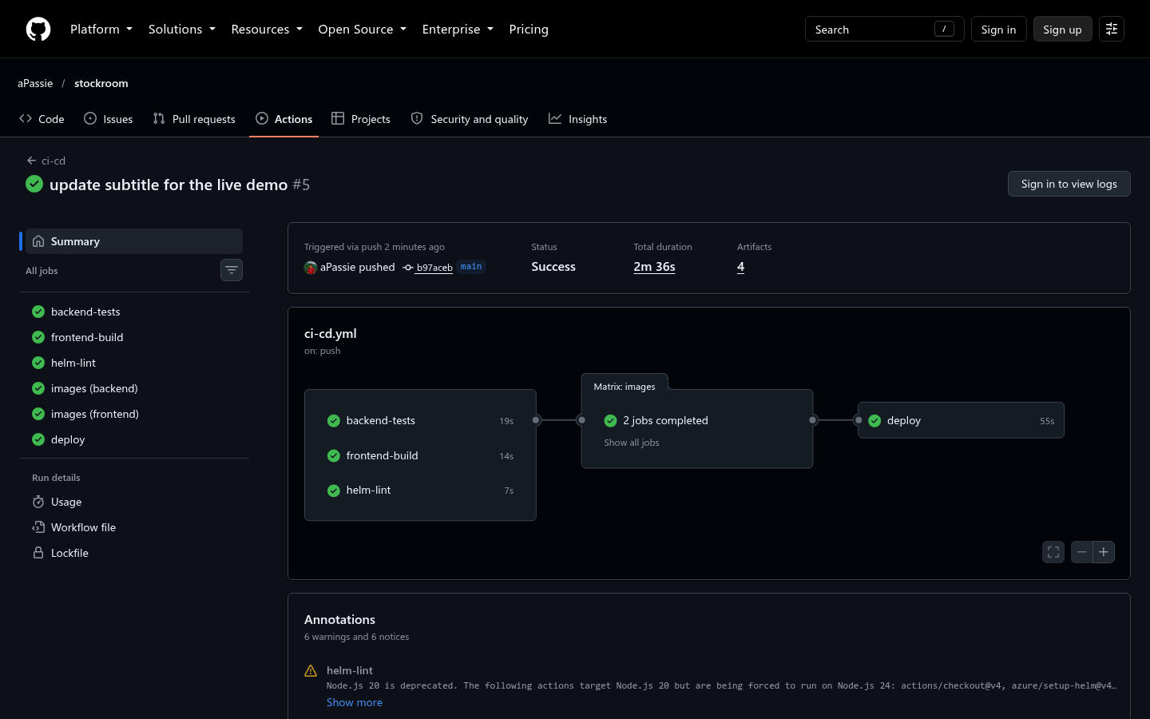
THE DEMO
06 / 07
A change going live
1. Change the subtitle, commit and push
2. The pipeline finishes successfully
3. The updated subtitle appears in the app
STOCKROOM
Parth Sankhla / 2024BCS10229
github.com/aPassie/stockroom
Notes:
For the deployment demo, I changed the page subtitle, committed it, and pushed. The pipeline passed, published the images, and upgraded the app through Helm. The new pods became ready before the old ones stopped. The updated subtitle then appeared in the browser. These captures show that change from commit to deployment.

Slide 7
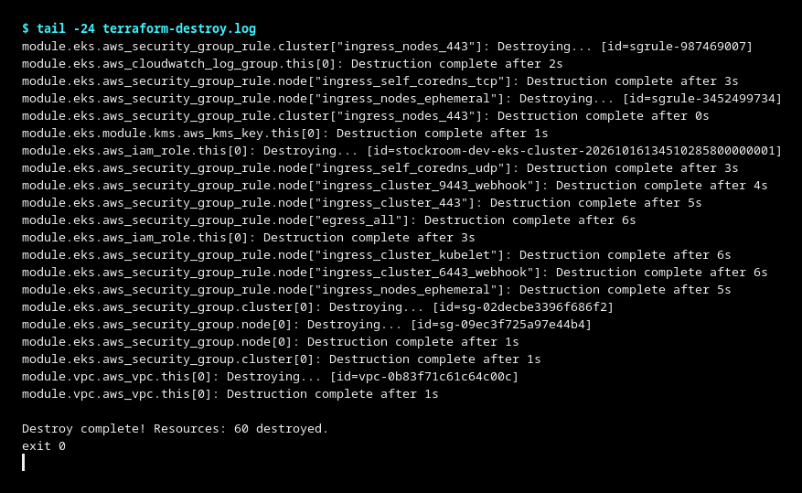
FIXES AND CLEANUP
07 / 07
What I fixed, and how I cleaned up
Bad image tag
Use an image that exists.
Service selector
Match the pod labels.
Database host
Read the URL from the Secret.
Memory limit
Raise the limit and verify the pod.
Saved teardown output: 60 resources destroyed
Deployment finished. Infrastructure removed.
STOCKROOM
Parth Sankhla / 2024BCS10229
github.com/aPassie/stockroom
Notes:
I also tested four failures: a bad image tag, a wrong Service selector, a wrong database host, and a low memory limit. I used pod events and logs to find and fix each issue. After the demo, I removed the deployment and ran Terraform destroy, which removed sixty resources. The code and demo files are in my GitHub repository. Thank you.

