Slide 1

Advanced Techniques
SoftUni Teams
Technical Trainers
Software University
https://softuni.bg

Slide 2
Table of Contents
Context
HOC
Reducers
Error Boundaries
Unit Testing with JEST

Slide 3
Have a Question?
sli.do #js-web

Slide 4

Context

Slide 5
Easier Context
export const Context = React.createContext();
export const ContextProvider = ({children}) => { const [state, setState] = React.useState({});
return ( <Context.Provider value={state}>
{children}
</Context.Provider> ) }

Slide 6

Context Demo

Slide 7


Higher-Order Components
Advanced Composition and Decoration

Slide 8
Higher-Order Components
A higher-order component (HOC) is an advanced technique in React for reusing component logic
HOCs are not part of the React API
HOC is a function that takes a component and returns a new component
8

Slide 9
Higher-Order Component
Components are the primary unit of code reuse
Some patterns aren't straightforward for traditional components
Whereas as component transforms props into UI
HOC component transform a component into another component
const EnhancedComponent = higherOrderComponent(WrappedComponent);

Slide 10
HOC Example
function hocFunc(WrappedComponent) {
return function Component(props) {
render() {
return <WrappedComponent {...props} />;
}
};
}

Slide 11

Advantages
Greater code reuse
Reduced boilerplate
Easily handle cross-cutting concerns
Commonly used for
Share logic between components
Binding component props to business logic
Automating repetitive tasks

Slide 12

UseReducer

Slide 13
More Hooks
useReducer
An alternative to useState
Accepts a reducer of type (state, action) => newState
Return the current state paired with a dispatch method
Preferable when you have complex state logic
const [state, dispatch] = useReducer(reducer, initialState);

Slide 14
More Hooks Demo

Slide 15

Error Boundaries

Slide 16
Error Boundaries
Error boundaries are React components
Catching, logging and displaying JS error anywhere in their child component tree
They catch errors during rendering
Do not catch errors for
Event handlers
Asynchronous code
Server-side rendering
16

Slide 17
Error Boundaries
A component becomes an error boundary if it defines
static getDerivedStateFromError
Render a fallback UI after an error has been thrown
componentDidCatch
Log error information
You can use it as a regular component
<ErrorBoundary>
<MyWidget />
</ErrorBoundary>

Slide 18
Error Boundaries
Error boundaries work like a JavaScript catch {} block for component
Only class component can be error boundaries
Declare an error boundary component once and use it throughout your application

Slide 19
Error Boundaries
You may wrap top-level route components to display some error message
Wrapping individual widgets in an error boundary
Protect them from crashing the rest of the app

Slide 20
Error Boundaries Demo

Slide 21

JEST
Unit Testing

Slide 22
What is JEST?
Jest is a JavaScript unit testing framework
Used by Facebook to test services and React applications
Jest acts as a test runner, assertion library and mocking library
Jest provides Snapshot testing
Create a rendered 'snapshot' and compare it to a previous
https://jestjs.io/

Slide 23
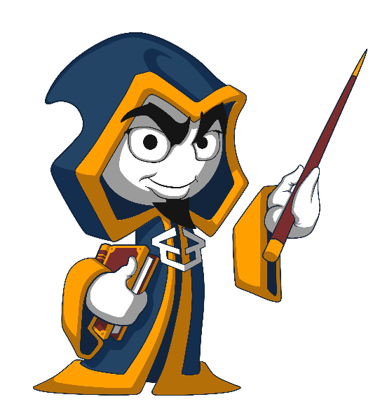
Summary
Context provides way to pass data through the component without passing the props manually
Context API
HOC
useReducer
Error Boundaries
Unit Testing
…
…
…

Slide 24
Questions?
Notes:
24

Slide 25












SoftUni Diamond Partners

Slide 26


Educational Partners

Slide 27
Trainings @ Software University (SoftUni)
Software University – High-Quality Education, Profession and Job for Software Developers
softuni.bg, about.softuni.bg
Software University Foundation
softuni.foundation
Software University @ Facebook
facebook.com/SoftwareUniversity
Software University Forums
forum.softuni.bg
27
Notes:
27

Slide 28

License
This course (slides, examples, demos, exercises, homework, documents, videos and other assets) is copyrighted content
Unauthorized copy, reproduction or use is illegal
© SoftUni – https://about.softuni.bg
© Software University – https://softuni.bg
Notes:
28

