Slide 1


UniRank
User-generated rankings:
an Android mobile application

Slide 2
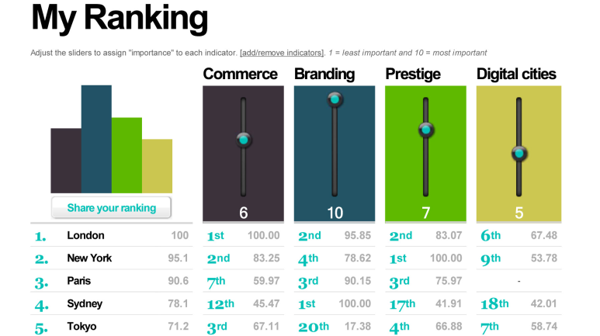
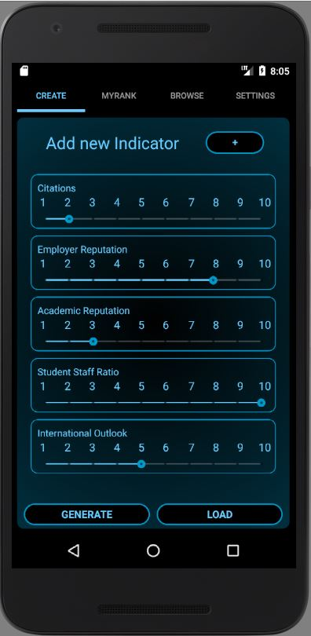
Abstract
Inspiration: CityRank (Flaxman, Huang, Stephenson, Comtesse, 2009)
Keywords
user-generated
personalization
indicators
rank aggregation
Goals
Alternative to static aggregations
Promote transparency and availability
Investigate visualization strategies
CityRank
UniRank
Implement CityRank concepts on another platform and topic

Slide 3


Motivations
Topic
Universities
Data readily available
Many static rankings
Topic of interest
Platform
Android Application
High reachability
New data visualization challenges
Personal interest
Target audience
High school students
University students
Parents
Choose best University
UniRank to gain sensibility
Eterogeneous needs
Not reflected by static rankings
Personalized rankings gain value

Slide 4




University data
Three sources
QS World University Rankings
Times Higher Educaton World University Rankings
Academic Ranking of World Universities
(Shanghai Ranking)
Small set of indicators
Academic Reputation
Employer Reputation
Student to Staff ratio
Research Influence (Citations)
International Outlook
Educational performance only
No external factors
Easy addition of new indicators

Slide 5

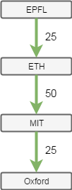
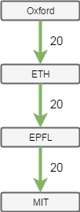
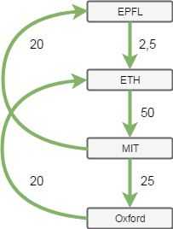
The algorithm
HodgeRank
Statistical ranking and combinatorial Hodge theory (Jiang et al., 2008)
Easy to switch in other algorithms
Intuition:
Build pairwise comparison graph for each indicator
Combine into aggregated graph ( cycles!)
Least squares minimization over space of pairwise comparison graphs

Slide 6
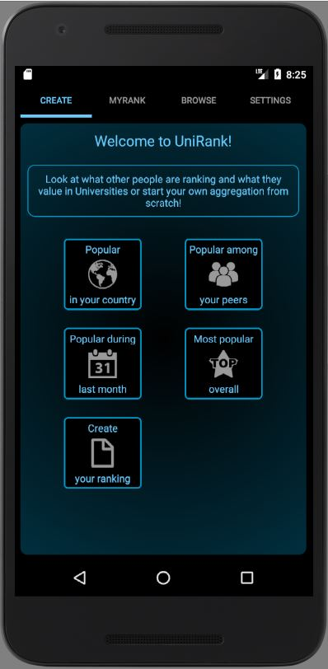
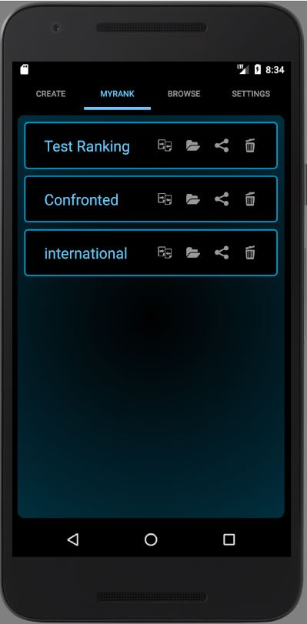

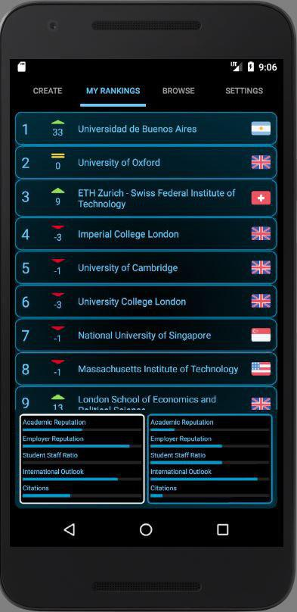
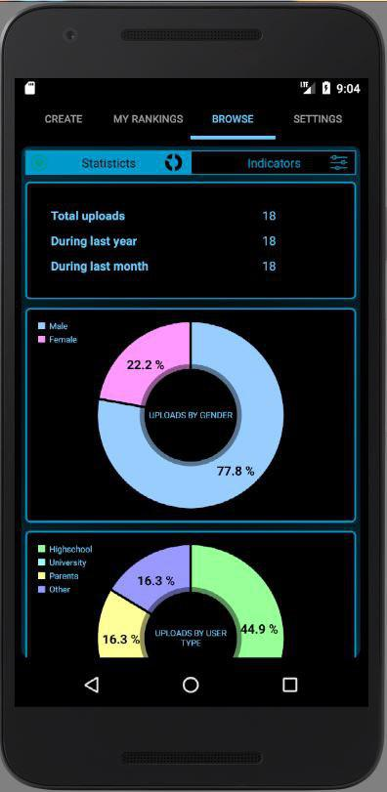
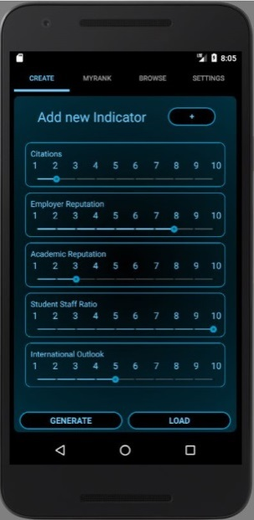
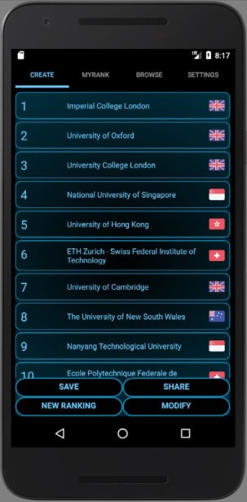
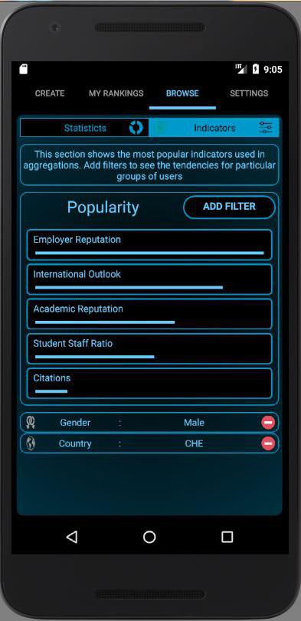

The application - Features
Rank aggregation procedure
Select indicators, assign weights, display result
Save system
Save work across app launches
Aggregation comparison
See differences between rank generations
Sharing system
Upload interesting aggregations
Access to remote shared pool
Analyze trends from other user’s data
Curation of pre-defined aggregations
Use shared data to suggest popular indicators

Slide 7
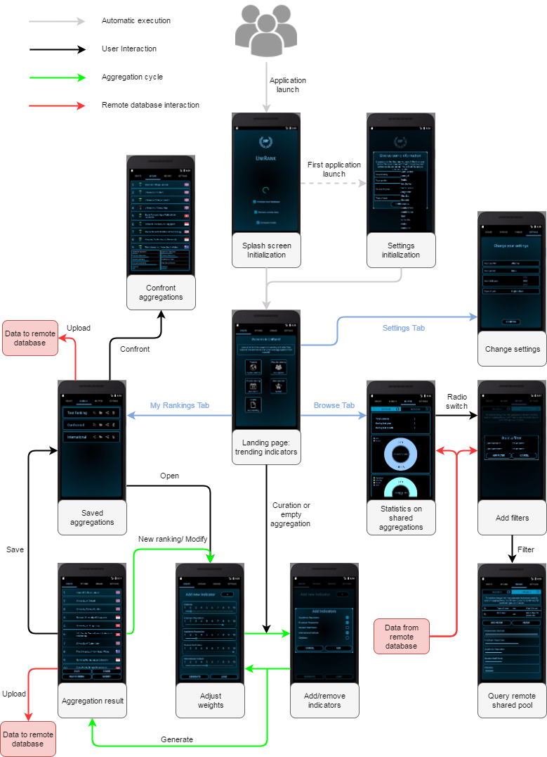
User flow
Rank aggregation cycle
Save and curated aggregations
= Entry points
Remote database interaction
= Research tool

Slide 8
Demo

Slide 9
Evaluation - Issues
Local university database had to be revisited
Initial choice: top 50 universities for each indicator = poor overlap
Final choice: first choose universities, then collect indicator data for all
Algorithm implementation is really slow:
Least square minimization is bottleneck
Poor library choices in Java
Inerhently complex optimization problem (> 120 variables)
Overall simple visualization strategies employed
Difficulty with dynamic/transparent elements
Limited time to invest in complex solutions

Slide 10
Evaluation - Achievements
Working rank aggregation application
Mimics some functionalities of CityRank
- Adds some new functionalities
Remote database
Repository of user data
Increasingly precise approximation of user needs
Integrated into application, not only for external uses
Extensible
Easy to change algorithm
Easy to extend dataset

