Slide 1
Use Logistic Regression to predict Heart Disease
(for DS)

Slide 2
Architectural Components
Development Environment: Watson Studio
Data Storage: Cloud Object Storage
Runtime Environment: Spark 2.1 with Python 3.5
Model creation: Jupyter Notebook

Slide 3
Data Source
Heart Disease UCI from Kaggle (https://www.kaggle.com/ronitf/heart-disease-uci)
Features available for the prediction: 13 from clinical data of each patient
Prediction target: 2 classes related to Heart Disease = Yes/No

Slide 4
DataLoading and Esploration
Data are loded in the Cloud Object Storage and the connection is made using a Spark Session
Data set has 303 raws and 14 columns
Data Types are string → need to cast to integer/double
No null values
There are some 0 values but they are ok for the prediction

Slide 5
Model Identification
The preferred model in this case is Logistic Regression
It has been created using 2 different methodologies:
Pyspark ML Calssification
A Keras Sequential model
Both models were trained and tested on the data.

Slide 6
Option 1: pyspark Classification model
Split Data Ser in train 80% and test 20%
Instantiate LogisticRegression model
Create a pipeline with:
Indexer
vectorAssembler
Normalizer
LR model
Train model
Evaluate against train set and data set
Accuracy:
55% against the Train Set
52% against the Test Set

Slide 7
Option 2: Simple Logistic Regression using Keras
Split Data Ser in train 80% and test 20%
Create a Keras Sequential Classifier with following layers:
Dense layer, activation: ’relu’, input dim=13
Dense layer, activation: ‘sigmoid’, output dim= 1
Configure the model for training:
Optimizer: ‘adam’, loss: ‘binary_crossentropy’, metrics=[‘accuracy’]
Fit the network to the training data set and extract predictions
Evaluate the model

Slide 8
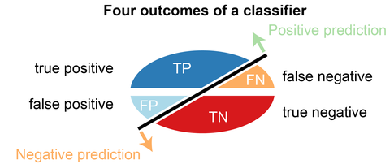
Keras Model Evaluation
Classifier.evaluate function returned an Accuracy around 83%
Confusion matrix returned following values:
Accuracy = 83%
Error rate: 17%
False Positive Rate: 21%
False Negative Rate: 18%
N=76 | Predicted: NO | Predicted: YES
Actual: NO | 26 | 7
Actual: YES | 6 | 37

Slide 9
Conclusions
Keras Classifier is the best option to predict Heart Disease based on the clinical data.
It allows to reach 83% Accuracy with a FN-FB <=20%
Those values can reasonably be increased tuning parameters of the network.
Thanks!

