Slide 1
Use Logistic Regression to predict Heart Disease
(for StakeHokders)

Slide 2
Data Source and Use Case
Heart Disease UCI from Kaggle (https://www.kaggle.com/ronitf/heart-disease-uci)
Prediction target: 2 classes related to Heart Disease = Yes/No
Features available for the prediction: 13 from clinical data of each patient

Slide 3
Model Identification
The preferred model in this case is Logistic Regression
It has been created using 2 different methodologies:
Pyspark ML Calssification
A Keras Sequential model
Both models were trained and tested on the data.

Slide 4
Model Evaluation
Data were splitted in training set and test set
Training set = 75% of the full data set
Test set = 25% of the full data set
The Keras DL Model has an higher Accuracy compared to the ML model
ML | Keras
50% on the test set | 83% of the test set

Slide 5
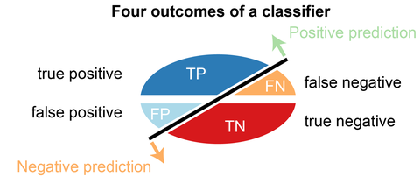
Model Evaluation
We decided to go with the Keras DL model and run more evaluation tests like the Confusion matrix on the test dataset
Accuracy = 83%
Error rate: 17%
False Positive Rate: 21%
False Negative Rate: 18%
N=76 | Predicted: NO | Predicted: YES
Actual: NO | 26 | 7
Actual: YES | 6 | 37

Slide 6
Conclusions
Keras Classifier is the best option to predict Heart Disease based on the clinical data.
It allows to reach 83% Accuracy with a FN-FB <=20%
Those values can reasonably be increased tuning parameters of the network.
Thanks!

