Slide 1
Swapz
Dolwin Fernandes
Hugo Ng
Alex Wan
Notes:
Dolwin authication, Hugo Styling, Alex Database

Slide 2
What is Swapz?
Exchange app for everyone
Non - currency item barter system
Why Pay... when you can Swapz!
Notes:
can trade anything, no need for money

Slide 3
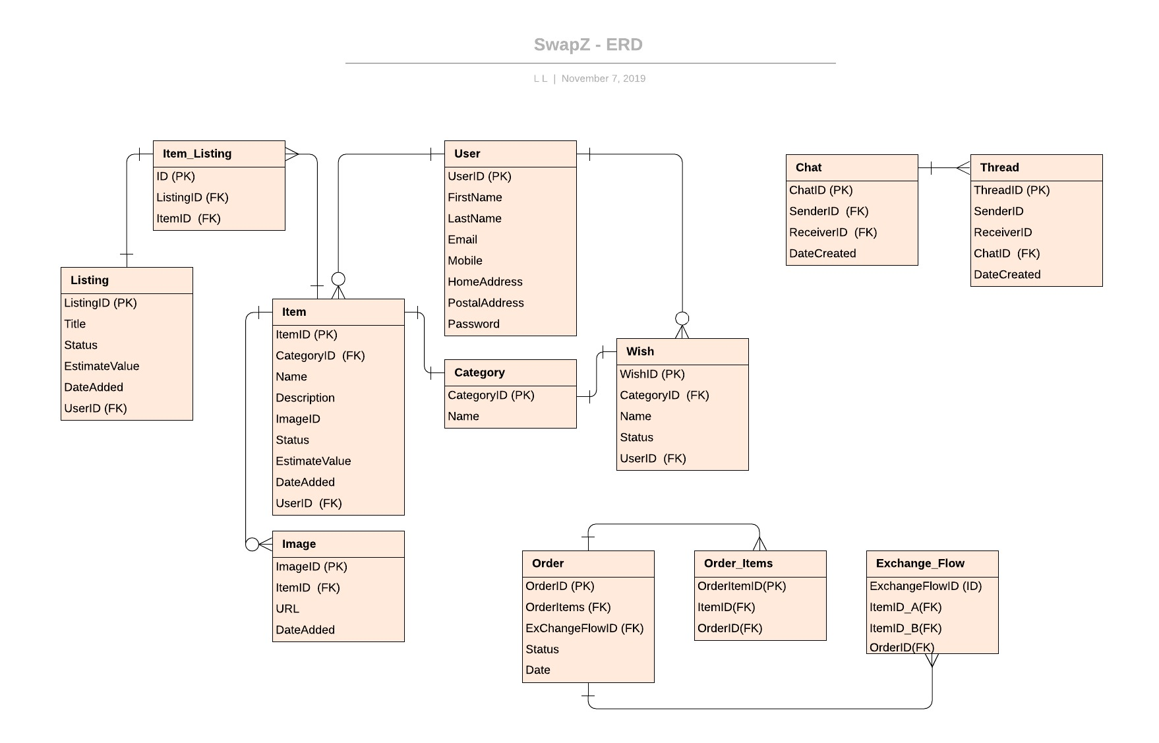
App Flow
Notes:
What we wanted

Slide 4
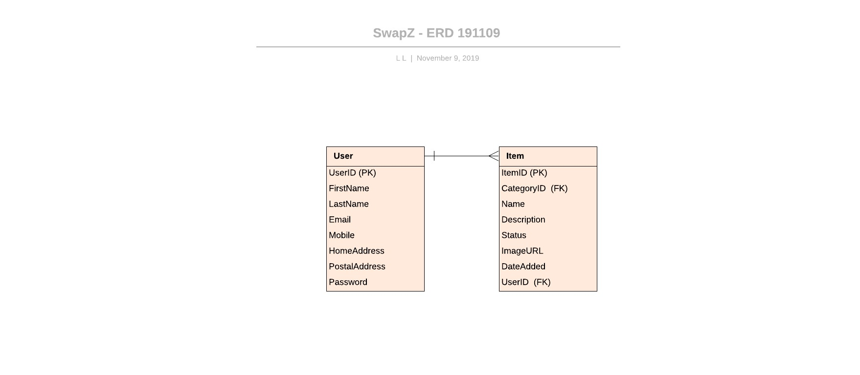
Simplified Flow
Notes:
what we ended up with

Slide 5
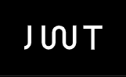
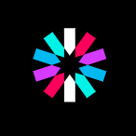
Login-in
Security authentication
JSONweb tokens
Database storage
Notes:
How long did this take?

Slide 6
Features
Add / delete your items
Edit your profile
view details of other owners
Notes:
what it does

Slide 7
Presentation

Slide 8
Improvements
Messaging
Multi - trade
Wish - list
Notes:
what we want to add

