Slide 1

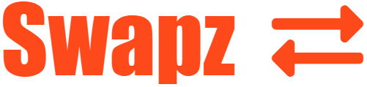
Dolwin Fernandes
Hugo Ng
Alex Wan

Slide 2
What is Swapz?
EXCHANGE
Login / Register, just need name and E-mail
FOR EVERYONE
NON-CURRENCY
Your item for their item
BARTER SYSTEM
WHY PAY... WHEN YOU CAN SWAPZ

Slide 3
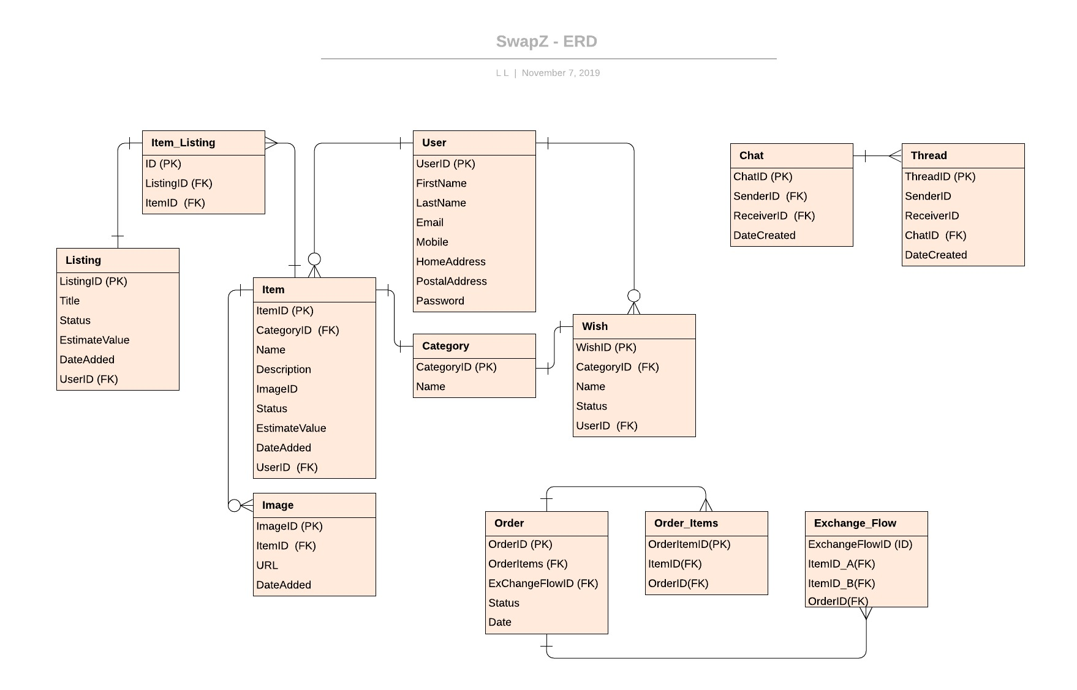


APP FLOW

Slide 4
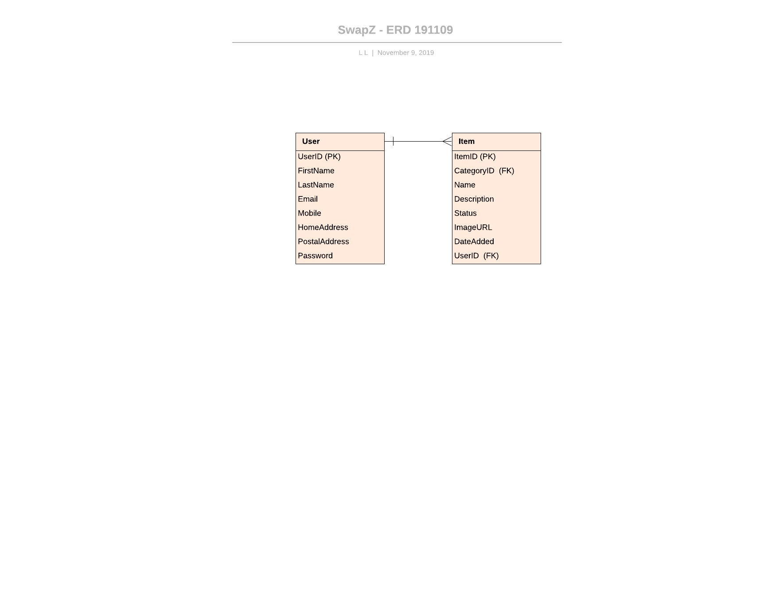
SIMPLIFIED FLOW

Slide 5

HOW IT WORKS
Add / view items
Swap agreed items
REGISTER
E-MAIL
Thanks!
ITEMS
EXCHANGE
Login / Register
Contact item user
Easy!

Slide 6
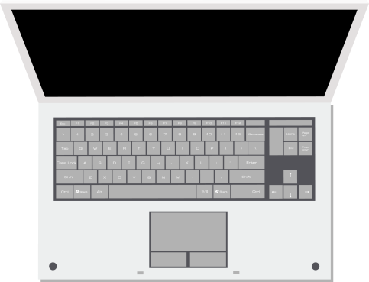
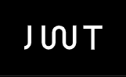
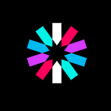


FEATURES
1
SAFE AUTHENTICATION
JSON web token
No.
2
DATABASE STORAGE
MySQL
No.
3
EDIT PROFILE
Automatically filled form with current database details
No.
4
ADD / DELETE ITEMS
User can only add and delete items they own
No.
5
VIEW OTHER USER DETAILS
Displays the owners details for the item
No.

Slide 7

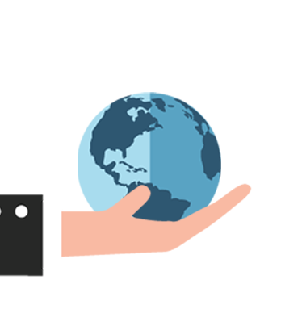

PRESENTING

Slide 8
REFLECTION
IMPROVEMENTS
Messaging component
Multi-user trades
Smart Trades - Wishlists and notifications
Time spent on authentication
Over complicated starting goal
SETBACKS

Slide 9
Questions?
Questions?
THANK YOU

