Slide 1

第13节 SET 运算符
讲师：宋红康
新浪微博：尚硅谷-宋红康

Slide 2
目 标
通过本章学习，您将可以:
描述 SET 操作符
将多个查询用 SET 操作符连接组成一个新的查询
UNION/UNION ALL
INTERSECT 取交集
MINUS 减
排序:ORDER BY
Notes:
Lesson Aim
In this lesson, you learn how to write queries by using SET operators.

Slide 3
SET 操作符
A
B
A
B
UNION(取并集) / UNION ALL(取全部)
A
B
INTERSECT 取交集
A
B
MINUS 取差集A-B 把A中所有B的元素全去掉
Notes:
The SET Operators
The SET operators combine the results of two or more component queries into one result. Queries containing SET operators are called compound queries.
All SET operators have equal precedence. If a SQL statement contains multiple SET operators, the Oracle server evaluates them from left (top) to right (bottom) if no parentheses explicitly specify another order. You should use parentheses to specify the order of evaluation explicitly in queries that use the INTERSECT operator with other SET operators.
Note: In the slide, the light color (gray) in the diagram represents the query result.
Instructor Note
The INTERSECT and MINUS operators are not ANSI SQL-99 compliant. They are Oracle-specific.

Slide 4
UNION 操作符
A
B
UNION 操作符返回两个查询的结果集的并集
Notes:
The UNION Operator
The UNION operator returns all rows selected by either query. Use the UNION operator to return all rows from multiple tables and eliminate any duplicate rows.
Guidelines
The number of columns and the datatypes of the columns being selected must be identical in all the SELECT statements used in the query. The names of the columns need not be identical.
UNION operates over all of the columns being selected.
NULL values are not ignored during duplicate checking.
The IN operator has a higher precedence than the UNION operator.
By default, the output is sorted in ascending order of the first column of the SELECT clause.
Instructor Note
To illustrate the UNION SET operator, run the script demo\15_union1.sql.
Point out that the output is sorted in ascending order of the first column of the SELECT clause.

Slide 5

UNION 操作符举例
SELECT employee_id, job_id
FROM employees
UNION
SELECT employee_id, job_id
FROM job_history;
…
…
进行union操作，需要选取的列数一样、数据类型对应的也要一致
Notes:
Using the UNION SET Operator
The UNION operator eliminates any duplicate records. If there are records that occur both in the EMPLOYEES and the JOB_HISTORY tables and are identical, the records will be displayed only once. Observe in the output shown on the slide that the record for the employee with the EMPLOYEE_ID 200 appears twice as the JOB_ID is different in each row.
Consider the following example:
SELECT employee_id, job_id, department_id
FROM employees
UNION
SELECT employee_id, job_id, department_id
FROM job_history;
…
…

Slide 6
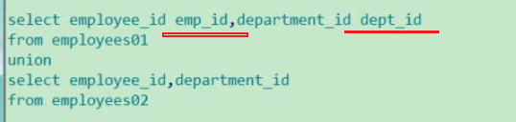
union操作可以进行重命名，会保留上面查询部分的名称，且下面的重命名无效
结果集会默认以第一列进行排序

Slide 7
UNION ALL 操作符
A
B
UNION ALL 操作符返回两个查询的结果集的并集。对于两个结果集的重复部分，不去重。
Notes:
The UNION ALL Operator
Use the UNION ALL operator to return all rows from multiple queries.
Guidelines
Unlike UNION, duplicate rows are not eliminated and the output is not sorted by default.
The DISTINCT keyword cannot be used.
Note: With the exception of the above, the guidelines for UNION and UNION ALL are the same.

Slide 8

UNION ALL 操作符举例
SELECT employee_id, job_id, department_id
FROM employees
UNION ALL
SELECT employee_id, job_id, department_id
FROM job_history
ORDER BY employee_id;
…
…
Notes:
The UNION ALL Operator (continued)
In the example, 30 rows are selected. The combination of the two tables totals to 30 rows. The UNION ALL operator does not eliminate duplicate rows. The duplicate rows are highlighted in the output shown in the slide. UNION returns all distinct rows selected by either query. UNION ALL returns all rows selected by either query, including all duplicates. Consider the query on the slide, now written with the UNION clause:
SELECT employee_id, job_id,department_id FROM employees UNION SELECT employee_id, job_id,department_id FROM job_history ORDER BY employee_id;
The preceding query returns 29 rows. This is because it eliminates the following row (as it is a duplicate):
Instructor Note
Note that this is the example from page 15-8.

Slide 9
INTERSECT 操作符
A
B
INTERSECT 操作符返回两个结果集的交集
Notes:
The INTERSECT Operator
Use the INTERSECT operator to return all rows common to multiple queries.
Guidelines
The number of columns and the datatypes of the columns being selected by the SELECT statements in the queries must be identical in all the SELECT statements used in the query. The names of the columns need not be identical.
Reversing the order of the intersected tables does not alter the result.
INTERSECT does not ignore NULL values.
Instructor Note
To illustrate the INTERSECT SET operator, run the script demo\15_inters.sql.

Slide 10

INTERSECT 操作符举例
SELECT employee_id, job_id
FROM employees
INTERSECT
SELECT employee_id, job_id
FROM job_history;
Notes:
The INTERSECT Operator (continued)
In the example in this slide, the query returns only the records that have the same values in the selected columns in both tables.
What will be the results if you add the DEPARTMENT_ID column to the SELECT statement from the EMPLOYEES table and add the DEPARTMENT_ID column to the SELECT statement from the JOB_HISTORY table and run this query? The results may be different because of the introduction of another column whose values may or may not be duplicates.
Example
SELECT employee_id, job_id, department_id
FROM employees
INTERSECT
SELECT employee_id, job_id, department_id
FROM job_history;
Employee 200 is no longer part of the results because the EMPLOYEES.DEPARTMENT_ID value is different from the JOB_HISTORY.DEPARTMENT_ID value.

Slide 11
MINUS 操作符
A
B
MINUS操作符：返回两个结果集的差集
Notes:
The MINUS Operator
Use the MINUS operator to return rows returned by the first query that are not present in the second query (the first SELECT statement MINUS the second SELECT statement).
Guidelines
The number of columns and the datatypes of the columns being selected by the SELECT statements in the queries must be identical in all the SELECT statements used in the query. The names of the columns need not be identical.
All of the columns in the WHERE clause must be in the SELECT clause for the MINUS operator to work.
Instructor Note
To illustrate the MINUS operator, run the script demo\15_minus.sql.

Slide 12
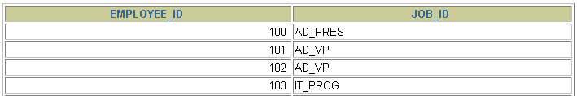

MINUS 操作符举例
SELECT employee_id,job_id
FROM employees
MINUS
SELECT employee_id,job_id
FROM job_history;
…
Notes:
The MINUS Operator (continued)
In the example in the slide, the employee IDs and Job IDs in the JOB_HISTORY table are subtracted from those in the EMPLOYEES table. The results set displays the employees remaining after the subtraction; they are represented by rows that exist in the EMPLOYEES table but do not exist in the JOB_HISTORY table. These are the records of the employees who have not changed their jobs even once.

Slide 13
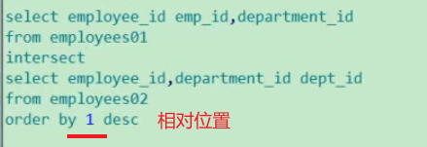

Slide 14
使用 SET 操作符注意事项
在SELECT 列表中的列名和表达式在数量和数据类型上要相对应
括号可以改变执行的顺序
ORDER BY 子句:
只能在语句的最后出现
可以使用第一个查询中的列名, 别名或相对位置(列的相对位置，1 2 3......)
Notes:
SET Operator Guidelines
The expressions in the select lists of the queries must match in number and datatype. Queries that use UNION, UNION ALL, INTERSECT, and MINUS SET operators in their WHERE clause must have the same number and type of columns in their SELECT list. For example:
SELECT employee_id, department_id
FROM employees
WHERE (employee_id, department_id)
IN (SELECT employee_id, department_id
FROM employees
UNION
SELECT employee_id, department_id
FROM job_history);
The ORDER BY clause:
Can appear only at the very end of the statement
Will accept the column name, an alias, or the positional notation
The column name or alias, if used in an ORDER BY clause, must be from the first SELECT list.
SET operators can be used in subqueries.
Instructor Note
You might want to mention that the ORDER BY clause accepts the column name only if the column has the same name from both queries.

Slide 15
SET 操作符
除 UNION ALL之外，系统会自动将重复的记录删除
系统将第一个查询的列名显示在输出中
除 UNION ALL之外，系统自动按照第一个查询中的第一个列的升序排列
Notes:
The Oracle Server and SET Operators
When a query uses SET operators, the Oracle Server eliminates duplicate rows automatically except in the case of the UNION ALL operator. The column names in the output are decided by the column list in the first SELECT statement. By default, the output is sorted in ascending order of the first column of the SELECT clause.
The corresponding expressions in the select lists of the component queries of a compound query must match in number and datatype. If component queries select character data, the datatype of the return values are determined as follows:
If both queries select values of datatype CHAR, the returned values have datatype CHAR.
If either or both of the queries select values of datatype VARCHAR2, the returned values have datatype VARCHAR2.
Instructor Note
You might want to mention that the output is sorted in ascending order of the first column, then the second column, and so on, of the SELECT clause.

Slide 16
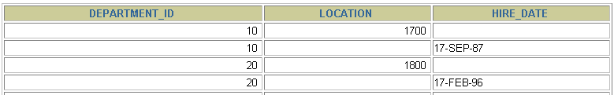

匹配各SELECT 语句举例
SELECT department_id, TO_NUMBER(null)
location, hire_date
FROM employees
UNION
SELECT department_id, location_id, TO_DATE(null)
FROM departments;
…
varchar2 补充使用to_char(null)
Notes:
Matching the SELECT Statements
As the expressions in the select lists of the queries must match in number, you can use dummy columns and the datatype conversion functions to comply with this rule. In the slide, the name location is given as the dummy column heading. The TO_NUMBER function is used in the first query to match the NUMBER datatype of the LOCATION_ID column retrieved by the second query. Similarly, the TO_DATE function in the second query is used to match the DATE datatype of the HIRE_DATE column retrieved by the first query.
Instructor Note
Demonstration: demo\15_union3.sql, demo\15_dummy.sql
Purpose: The demonstration 15_union3.sql illustrates using conversion functions while matching columns in the two select lists. The demonstration 15_dummy.sql uses dummy columns in order to match the select lists. For the 15_dummy.sql, run the script, then uncomment the REMARKS, add ORDER BY 2, and rerun.
You might want to mention that the conversion functions in the code shown on the slide are not mandatory. The code will work fine even without the conversion functions, but it is recommended to explicitly convert values for performance benefits.

Slide 17

匹配各SELECT 语句举例
SELECT employee_id, job_id,salary
FROM employees
UNION
SELECT employee_id, job_id,0
FROM job_history;
…
Notes:
Matching the SELECT Statement: Example
The EMPLOYEES and JOB_HISTORY tables have several columns in common; for example, EMPLOYEE_ID, JOB_ID and DEPARTMENT_ID. But what if you want the query to display the EMPLOYEE_ID, JOB_ID, and SALARY using the UNION operator, knowing that the salary exists only in the, EMPLOYEES table?
The code example in the slide matches the EMPLOYEE_ID and the JOB_ID columns in the EMPLOYEES and in the JOB_HISTORY tables. A literal value of 0 is added to the JOB_HISTORY SELECT statement to match the numeric SALARY column in the EMPLOYEES SELECT statement.
In the preceding results, each row in the output that corresponds to a record from the JOB_HISTORY table contains a 0 in the SALARY column.

Slide 18

使用相对位置排序举例
COLUMN a_dummy NOPRINT
SELECT 'sing' AS "My dream", 3 a_dummy
FROM dual
UNION
SELECT 'I`d like to teach', 1
FROM dual
UNION
SELECT 'the world to', 2
FROM dual
ORDER BY 2;
Notes:
Controlling the Order of Rows
By default, the output is sorted in ascending order on the first column. You can use the ORDER BY clause to change this.
Using ORDER BY to Order Rows
The ORDER BY clause can be used only once in a compound query. If used, the ORDER BY clause must be placed at the end of the query. The ORDER BY clause accepts the column name, an alias, or the positional notation. Without the ORDER BY clause, the code example in the slide produces the following output in the alphabetical order of the first column:
Note: Consider a compound query where the UNION SET operator is used more than once. In this case, the ORDER BY clause can use only positions rather than explicit expressions.
Instructor Note
To illustrate the ordering of rows with a SET operator, run the script demo\ 15_setord.sql. Briefly explain the COLUMN command with the NOPRINT option. Highlight the usage of the single quotes in the 'I''d like to teach' literal, in the second SELECT statement. You might want to mention that one can only use ORDER BY with a column, alias, or position of the column of the first query.

Slide 19
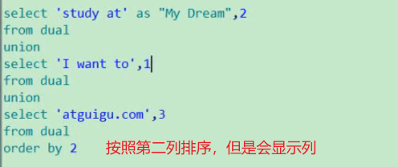
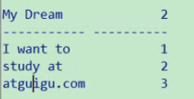
输出 I WANT TO STUDY AT WWW.ATGUIGU,com,并且排序
不打印某列的命令：
然后给第二列取别名就可以了

Slide 20
总 结
通过本章学习,您已经可以:
使用 UNION 操作符
使用 UNION ALL 操作符
使用 INTERSECT 操作符
使用 MINUS操作符
使用 ORDER BY 对结果集排序
Notes:
Summary
The UNION operator returns all rows selected by either query. Use the UNION operator to return all rows from multiple tables and eliminate any duplicate rows.
Use the UNION ALL operator to return all rows from multiple queries. Unlike with the UNION operator, duplicate rows are not eliminated and the output is not sorted by default.
Use the INTERSECT operator to return all rows common to multiple queries.
Use the MINUS operator to return rows returned by the first query that are not present in the second query.
Remember to use the ORDER BY clause only at the very end of the compound statement.
Make sure that the corresponding expressions in the SELECT lists match in number and datatype.

Slide 21


