Slide 1
Detecting Software Vulnerabilities Using Neural Networks

Slide 2


Introduction
Software vulnerabilities is a severe threat to network and information security.
For decades, many studies have been contributed to detecting vulnerabilities
At the source code level
Code Similarity Detection or Pattern Matching
Cons: Code similarity detection is still not well-suited for detecting vulnerabilities.
Pattern matching requires human experts to define patterns that represent vulnerabilities.
Accuracy and F1 scores are less than 70%

Slide 3

Research Problem Statement
To address the limitations of current approaches, the neural networks can be utilized to detect vulnerabilities.
provide higher accuracy in prediction
slightly rely on human experts in feature extraction
eliminate influence of human bias
Objective
Our main goal is to develop an application using neural networks for detecting the vulnerability of C/C++ programs automatically
Detect the vulnerability more accurately and efficiently
At Source codes level
Low level programming → Machine codes (binary programs)

Slide 4
Project 1
Detecting Vulnerability from
C/C++ Source codes

Slide 5
Dataset
15K + C/C++ programs
Collected from National Vulnerability Database (NVD) & Software Assurance Reference Dataset (SARD)
Transformed to 420,627 slices called semantic vulnerability candidates:
13.5% vulnerable slices
86.5% non-vulnerable slices
Divided into 4 main types using vulnerability syntax analysis from Checkmarx
1. Library/API Function Call → 811 C/C++ library/API function calls
2. Array Usage → improper use in array element access, array & arithmetic
3. Pointer Usage → improper use in pointer arithmetic, reference
Arithmetic Expression → improper arithmetic expressions (e.g. integer overflow)
Independent Variable: Set of vectors extracted from program slices
Dependent Variable (Binary): Class 0: Non-vulnerable slice
Class 1: Vulnerable slice

Slide 6
Methodology
Source codes → Syntax VC → Semantic VC → Program Slices
Tokens → Vectors → Train/Validation/Test Sets
Adjusted Input Length → DL Models
→ Prediction/Evaluation

Slide 7
I. Generating Program Slices
The program slices are generated in a two-phase process:
Syntax-based Vulnerability Candidates
Extracted from Program Dependency Graph for each function of the C/C++ programs.
Each candidate embodies syntax characteristics of a vulnerability.
II. Semantics-based Vulnerability Candidates
Produced from Syntax candidates
Each Semantic candidate extends a Syntax candidate with data dependency and control dependency information.
C/C++
Source Codes
Syntax
VC
Semantic
VC
Slices
Fig 1: Process of Generating Program Slices from Source Codes

Slide 8
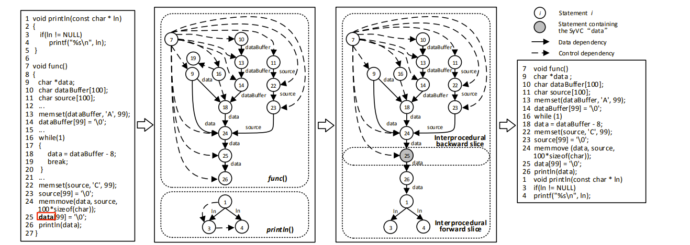
I. Generating Program Slices
C/C++
Source Codes
Syntax
VC
Semantic
VC
Slices
Fig 1: Process of Generating Program Slices from Source Codes

Slide 9
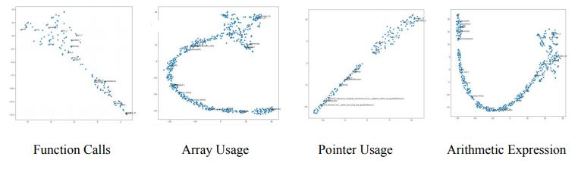
II. Transforming Program Slices into Vectors
Preprocess each slice: Tokenization, removing punctuations, stop words (void, return,…), etc.
Converted to vectors using Word2Vec model based on “cosine similarity distance”
Fig2: Visualized words from W2V model for each vulnerability type
Different program slice types convey different characteristics of vulnerabilities

Slide 10
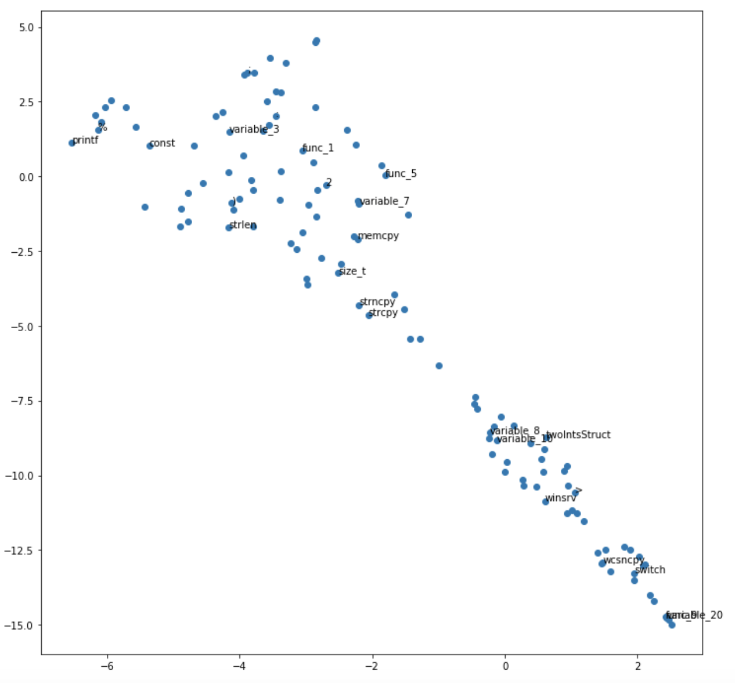
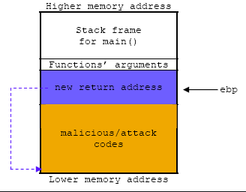
II. Transforming Program Slices into Vectors
C Library function
“Strncpy” → Copy characters from string
“Strcpy” → Copy string from src to des
Both functions are UNSAFE!
causes vulnerability
segmentation fault
Don’t limit input length
Can overwrite the buffer
Attacker sends data to a program

Slide 11
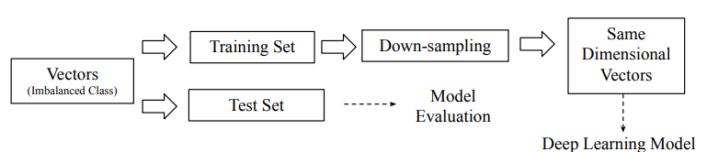
III. Model Optimization
1. 2.
1. Balancing Dataset
Imbalanced dataset
Class 1: 15.6% of total program slices
Class 0: 84.4% of total program slices
The model has considerably more ability to predict class 0
(bias toward class 0).
Down-sampling method
Randomly extract samples from a majority class (label 0) from a training set.
The new sample set has a balanced class label
2. Adjusting Vector Lengths
Array of vectors extracted from each slice has different dimension
Neural networks required all vector input to have a same dimension
Use Mean vector length as a threshold
embed the shorter length of array with 0
truncated the longer length of array to a mean length
Fig 3: Down-sampling and vector adjustments

Slide 12
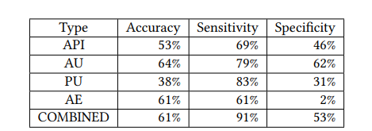
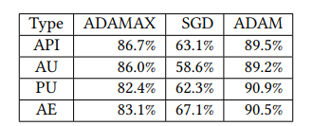
3. Combining Program Slice Types
In previous work, different models are built using different program slice types.
Our study performs a preliminary study using 1,000 randomly sampled data points
The model fitted with the combined data types outperform all models fitted with individual datasets
Fig 4: Model Performance of Combined Slice Types VS Individual Types Dataset
4. Optimizer Tuning
ADAMAX, SGD, and ADAM
ADAM optimizer performs the best
a combination of RMSprop and SGD with momentum
an adaptive learning rate method, computationally efficient
ADAM achieves an average accuracy rate of 90.0%.
This is approximately 5% more than the accuracy
rate of ADAMAX, which is used in previous work
Fig 5: Accuracy Rates of Models fitted with various optimizer

Slide 13
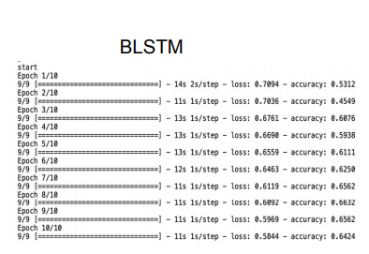
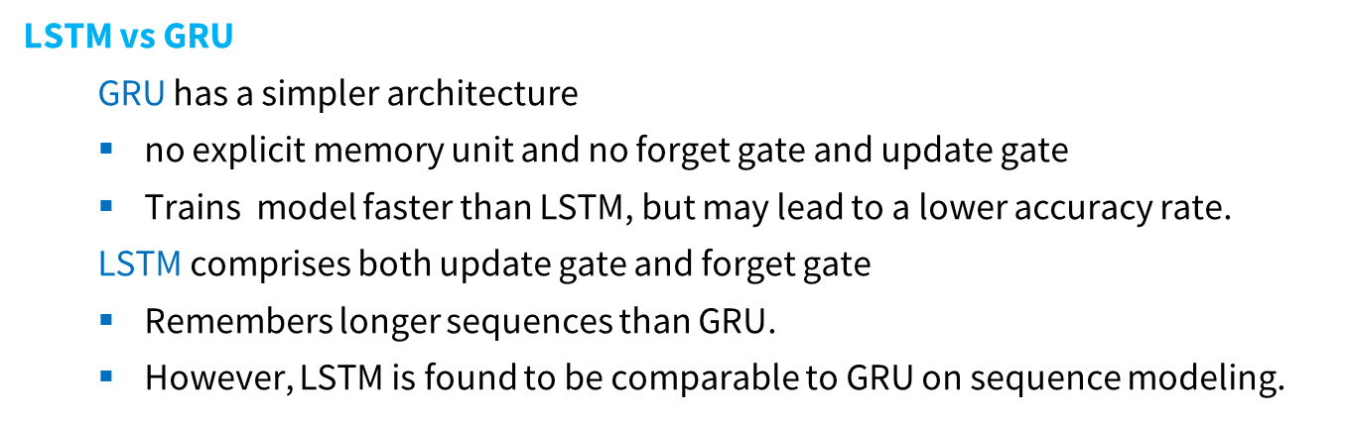
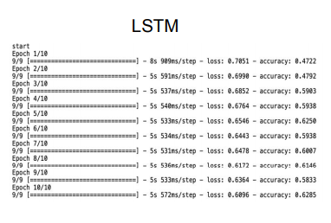
IV. Neural Network Evaluation
Bidirectional RNN vs Regular RNN
Bi-RNNs provides the original input sequence to the first layer and a reversed copy of the input sequence to the second layer
Have access to the past as well as the future information
more effective and have a better prediction than regular RNNs which preserves only information of the past.
The Bidirectional RNN model outperform all regular RNN models
Lower Loss rate and Higher accuracy rate
Fig 6: Loss and Accuracy Rates of LSTM and BLSTM

Slide 14
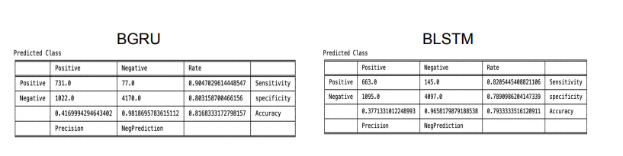
IV. Neural Network Evaluation
Bidirectional LSTM vs Bidirectional GRU
For a larger dataset of 30,000 and 100,000 slices, the BGRU also outperforms BLSTM
for all metrics
BGRU has 90% of sensitivity which is 8% higher than that of BLSTM
The BGRU model can explain the vulnerability class better than the BLSTM
The BGRU network typically train, converge, and learn faster.
Fig 7: Confusion Matrix for BGRU and BLSTM (fitted with 30,000 samples)

Slide 15
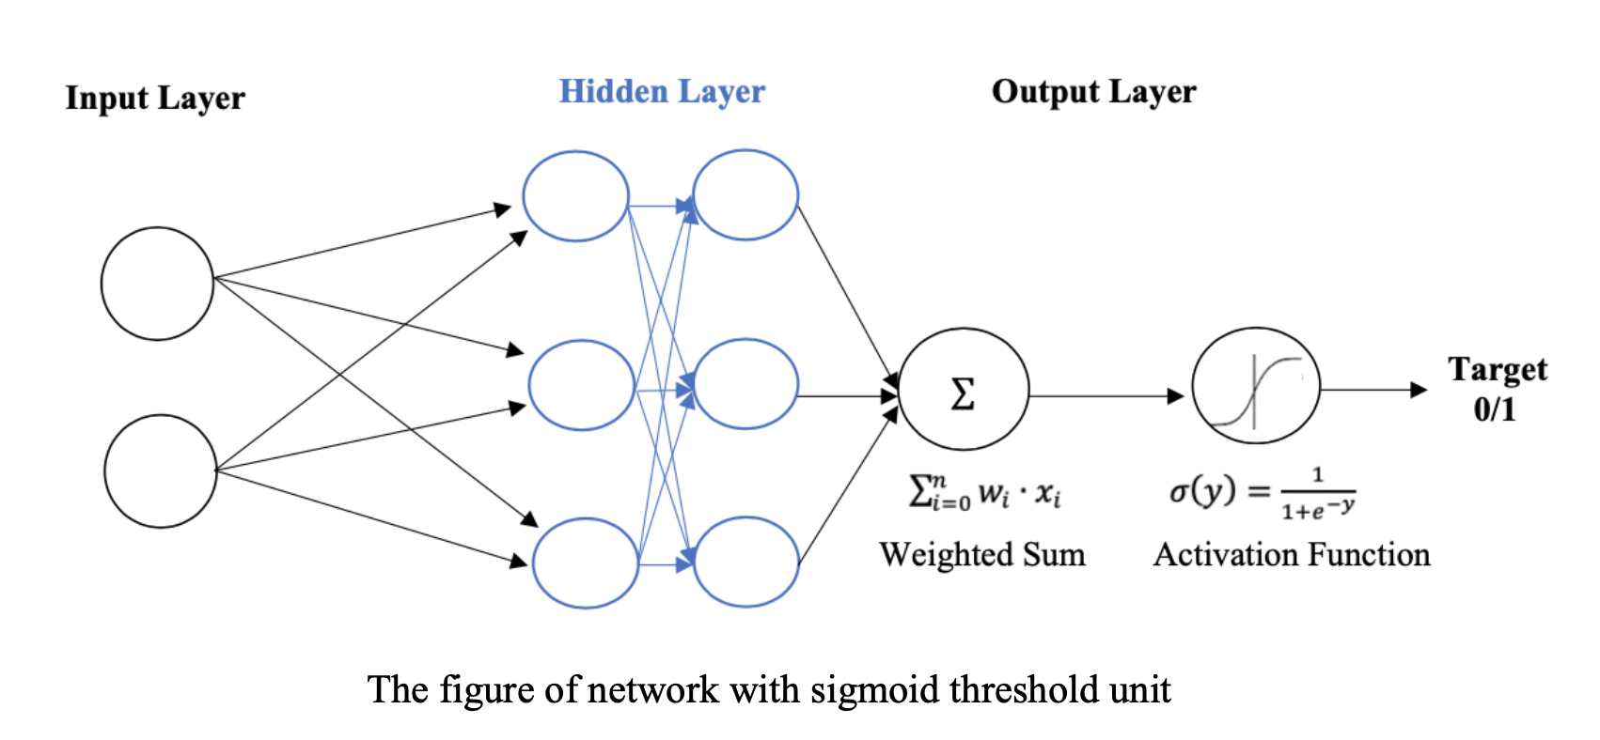
V. Final Model
Trained with over 400K program slices
Bidirectional gated recurrent unit (Bi-GRU) of 256 neuron units with 2 hidden layers.
ADAM optimizer with cross-entropy loss
Tanh function applied to produce the outputs of
2 hidden layers
Sigmoid function was applied to compute activation outputs in the last layer.
The learning rate is 0.1
The network outputs are decimal numbers range between 0 and 1
so, we applied a Threshold of 0.5 for class prediction
> 0.5 Vulnerable Slice < = 0.5 Non-vulnerable slice
Accuracy of 94.89% Specificity of 91% F1-score 85.9%

Slide 16
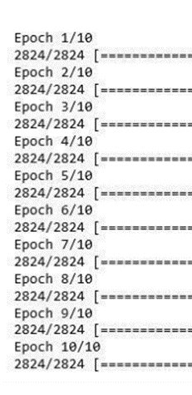

VI. Model Fitting
The learning process is faster in the beginning as the loss rates from cross entropy decreases.
The loss is significantly decrease in epoch 1 to 3.
The accuracy rates increase for as the training process goes from epoch 1 to 10
The model has the highest accuracy rate of 94.89% in epoch 9
The accuracy rate starts to decrease in epoch 10 as the error rate has no longer minimized.
Fig 8: Model Fitting with a Training Set
- +
0.13 94%

Slide 17
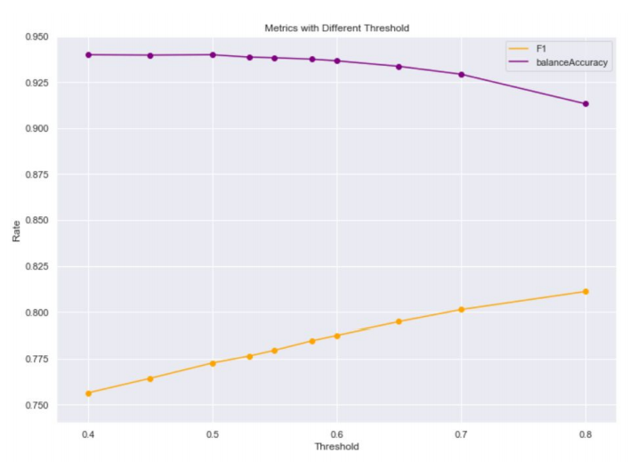
VII. Model Evaluation
Performance on Different Output Threshold
Output Threshold (for class prediction) ranges from 0.4 to 0.8
F1 scores increase while balanced accuracy decreases
However, F1 is utilized to blend precision and specificity,
so it is biased with the increasing threshold
Balanced accuracy is more accurate for model evaluation
The optimal threshold is 0.5 at peak of balanced accuracy curve
Fig 9: F1 vs Accuracy Rate for Different Thresholds

Slide 18
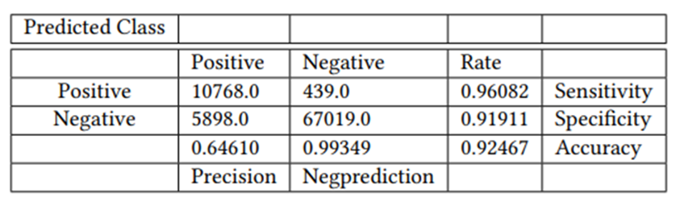
VII. Model Evaluation
Confusion Matrix on Test Set
performs well with a high balanced accuracy rate of 93%.
The high sensitivity and specificity (over 90%) imply a good ability
in explaining both vulnerability and non-vulnerability classes.
The model performs better in predicting non-vulnerability class 99% in negative prediction
However, the predictive power for vulnerability class is still moderately strong F1 ranges between 75% to 80% across different thresholds.
Fig 10: Confusion Matrix for Test Set

Slide 19
VIII. Conclusion
We present a study on using neural networks for detecting software vulnerabilities at source code level.
The Neural Networks are trained with over 400K program slices extracted from the source code of 14,000 C/C++ programs.
We compare different types of training data and different types of neural networks.
Our result shows that the model built with combining different types characteristics of source code surpasses models based on individual type of characteristics of source code.
The model was optimized by hyperparameter tuning and using a balanced number of vulnerable data points and non-vulnerable data points ensures a balanced accuracy in predicting both vulnerable code and non-vulnerable code.
Bidirectional GRU performs best among other neural networks.
An accuracy rate of 94.89%
A high sensitivity rate of 96%
A specificity rate of 91%.

Slide 20
Project 2
Detecting Vulnerability from
Machine codes

Slide 21
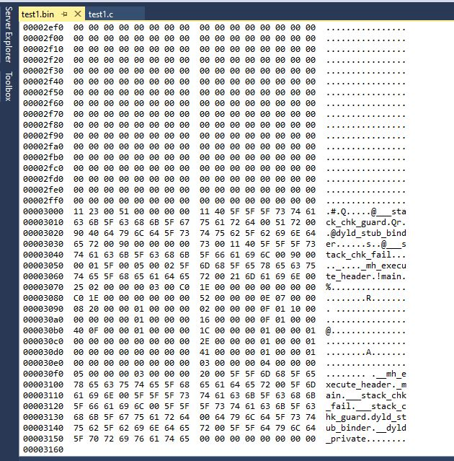
Dataset
The binary programs retrieved by complying the original 13,443 programs
written in C/C++ languages
collected from Software Assurance Reference Dataset (SARD).
compiled with GCC on Linux x86-64
The binary programs comprise 44k binary functions
• 69.69 % non-vulnerable functions
30.31% vulnerable functions
Dependent Variable
0 is vulnerable function
1 is non-vulnerable function
Independent Variables:
105 features of machine instructions and operands
extracted from basic blocks in all functions using CountVectorizer

Slide 22
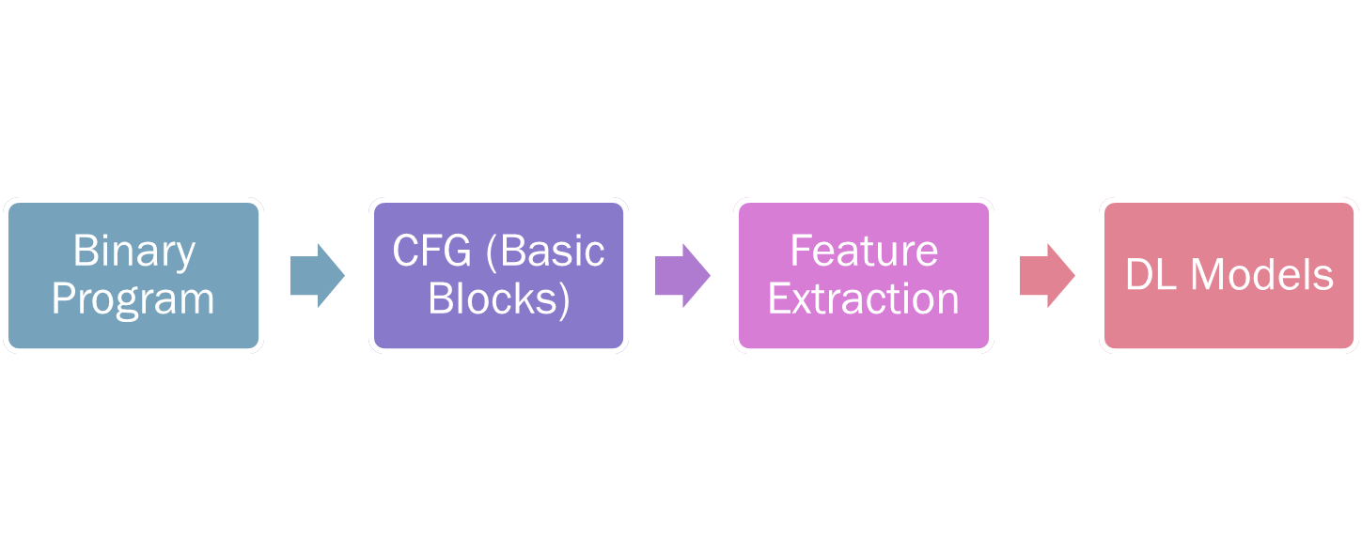
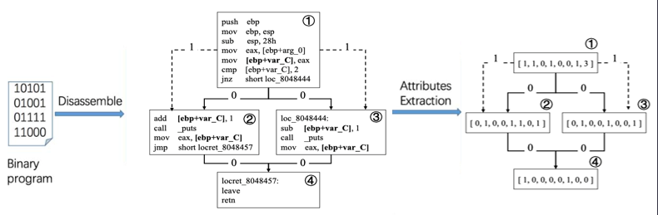
Methodology

Slide 23
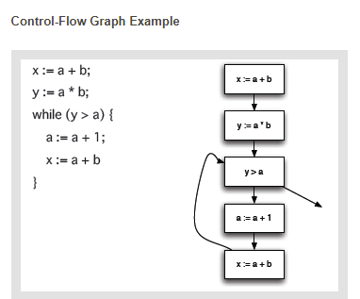
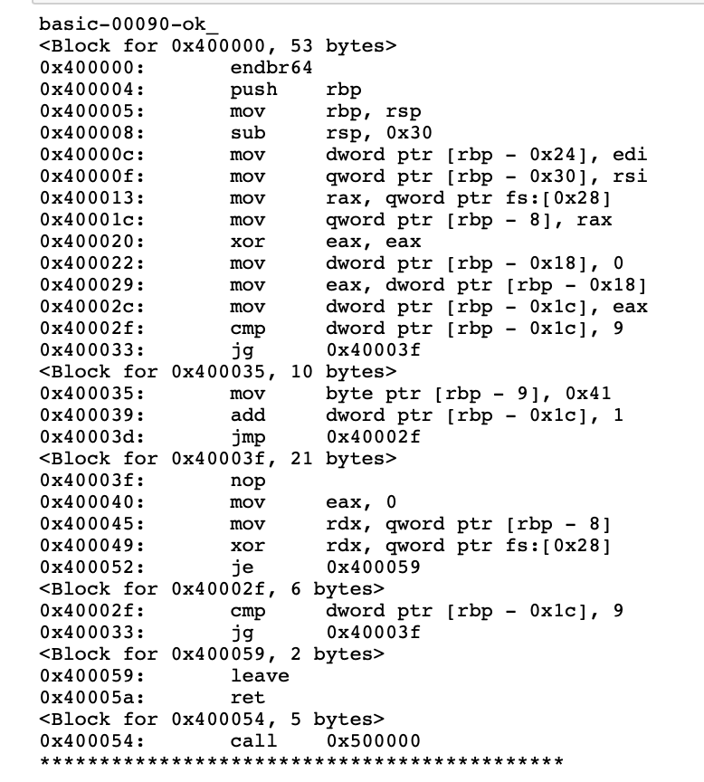
Construct Control Flow Graph (CFG)
CFG of
Source Codes
The flow of control between the basic blocks in a program
CFG of Source codes look simpler than machine codes
Extracted CFG from binary programs
Binary analysis framework
IDA Pro
Angr
CFG of
Machine Codes

Slide 24
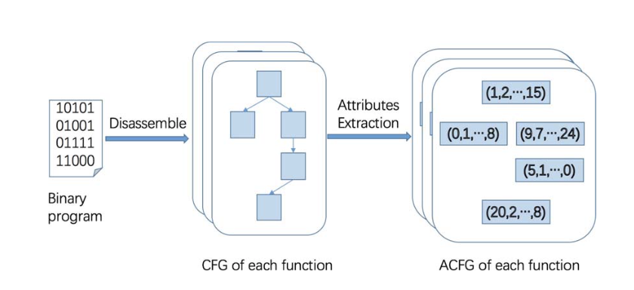
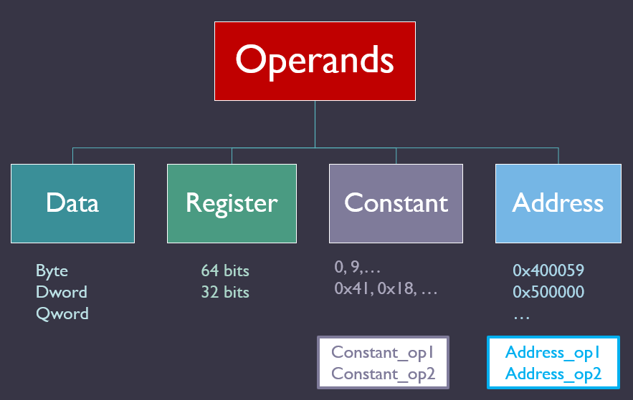
Construct Control Flow Graph (CFG)
1 Basic Block
Instructions
Operands

Slide 25
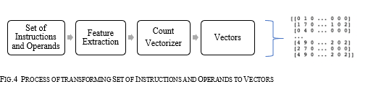
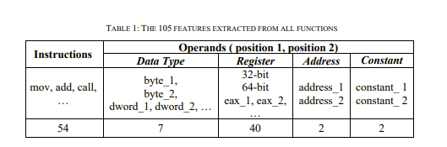
Preprocess the sets of instructions and operands of each block
Tokenization
removing punctuations & stop words (ret, endbr64,…)
Extract Features
105 unique features
The sets of instructions and operands
Use Count Vectorizer
Count the feature in set of instructions and operands from each function

Slide 26
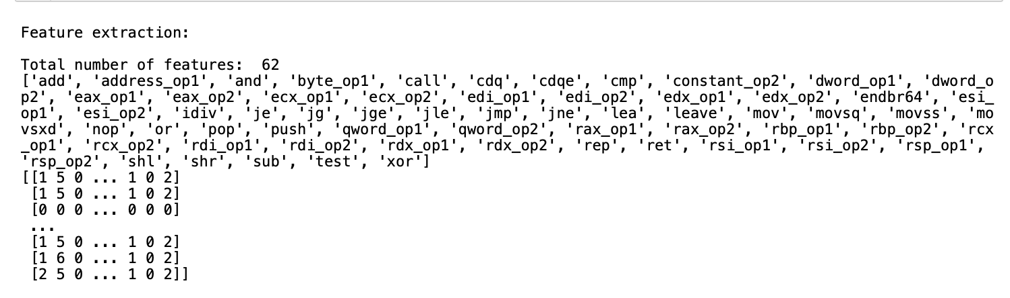
Count Vectorizer

Slide 27
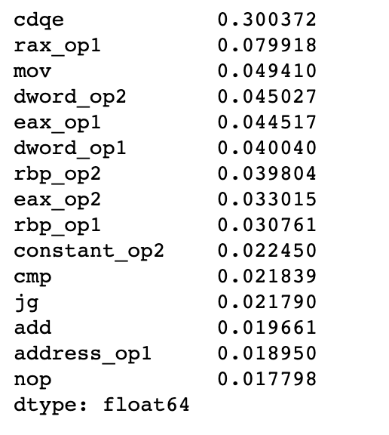
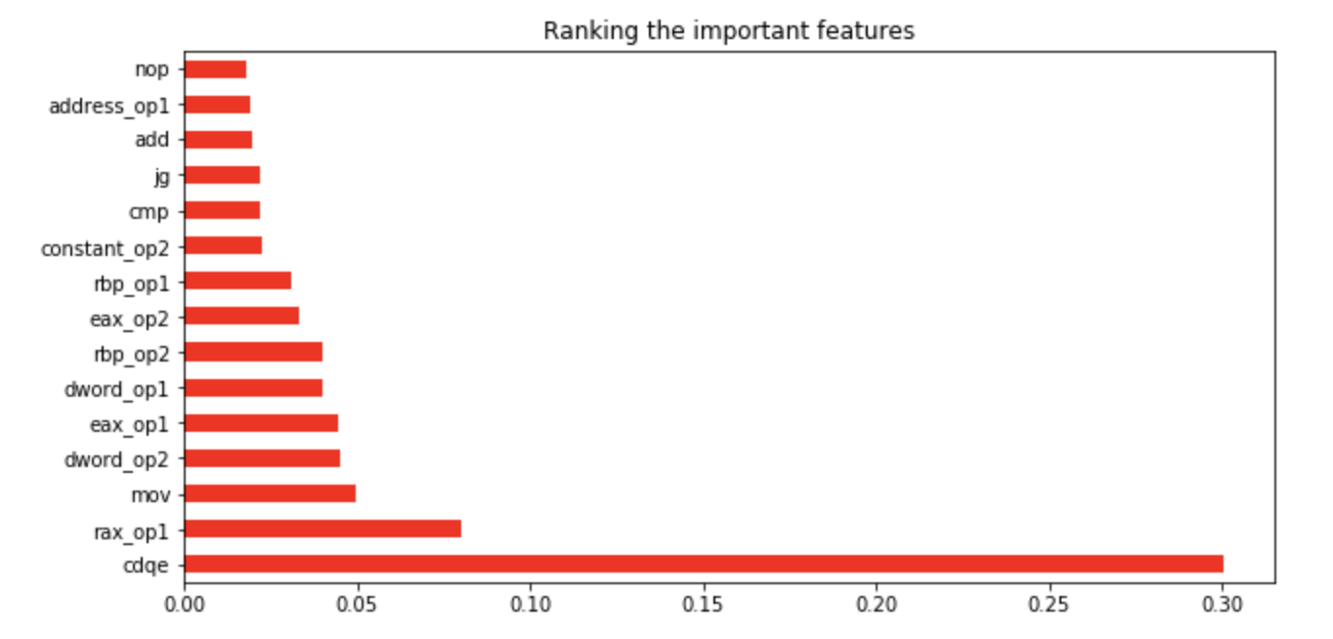
Feature importance (TOP 15)
Op_2
Op_1
Instruction
“CDQE , MOV” are the most important instructions
Operands are important in classification (0/1)

Slide 28
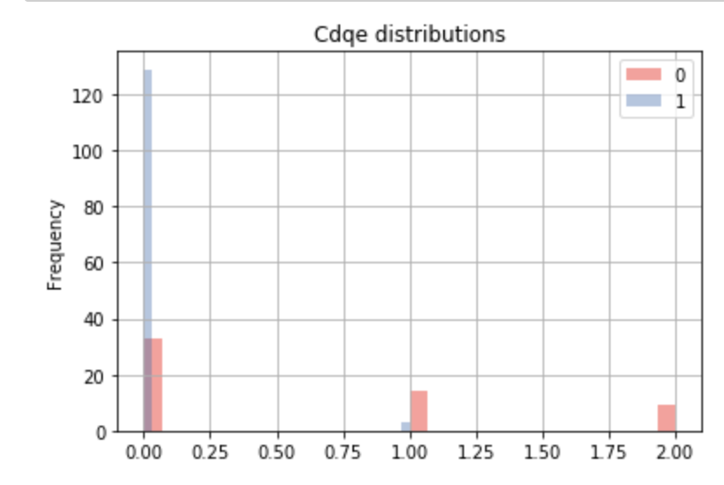
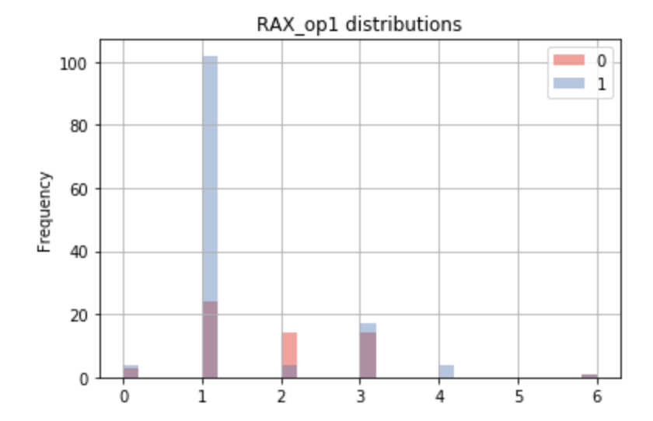
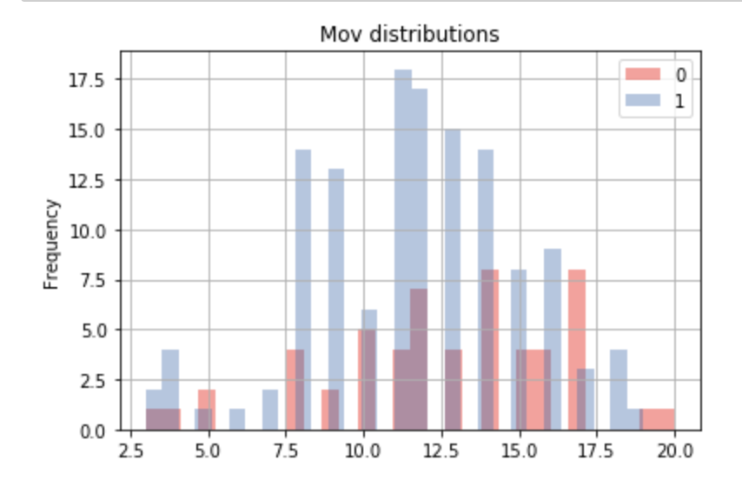
Different patterns Top 3 features
cdeq
0 = non-vulnerable 1 = vulnerable
Non-overlapping value counts between classes for each feature
Better performance on classifying classes (0/1)

Slide 29
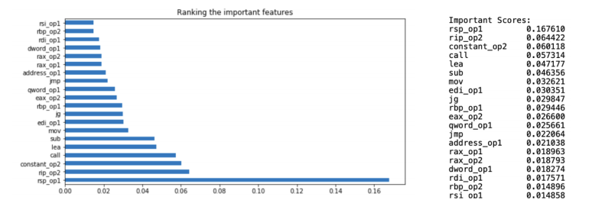
Model Fitting & Feature Importance
Decision Trees, Random Forest, SVM
Final Model from ML is SVM
Accuracy of 92% Specificity of 93% F1-score 83%
Deep Learning Models: Bi-LSTM, Bi-GRU ( finalizing models in progress )

Slide 30
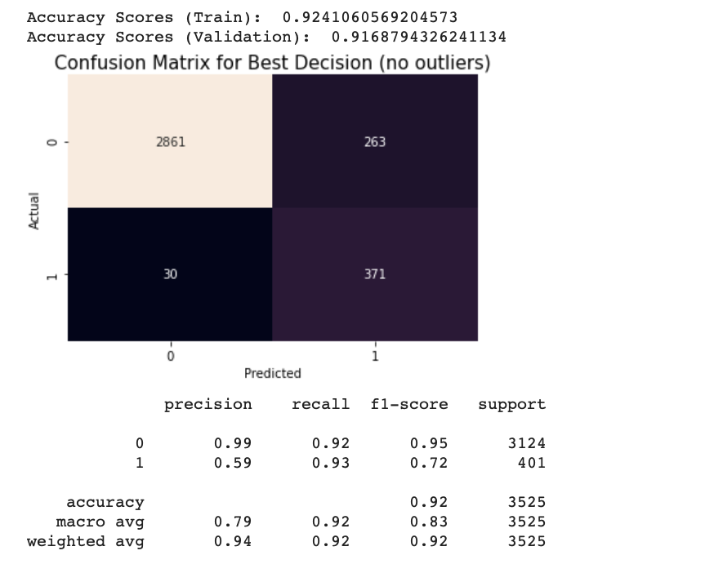
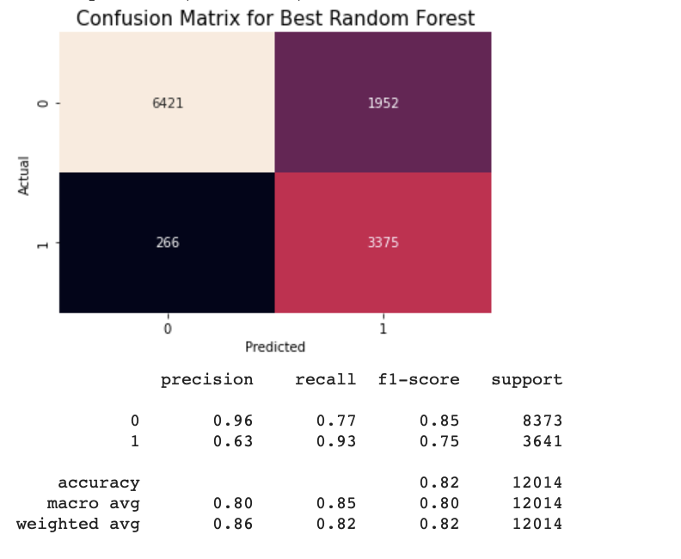
Decision Tree
New (no outliers)
+ 10% accuracy, +15 specificity
Great improvement + no overfitting (1% gap)

Slide 31
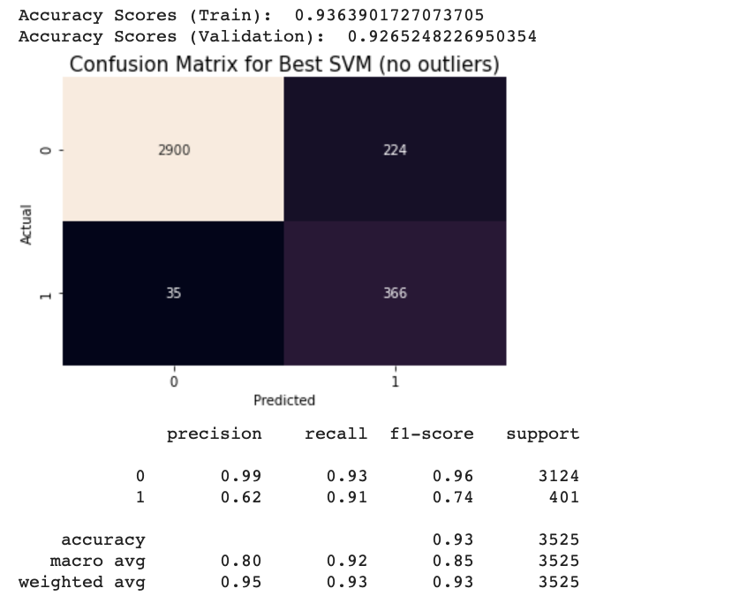
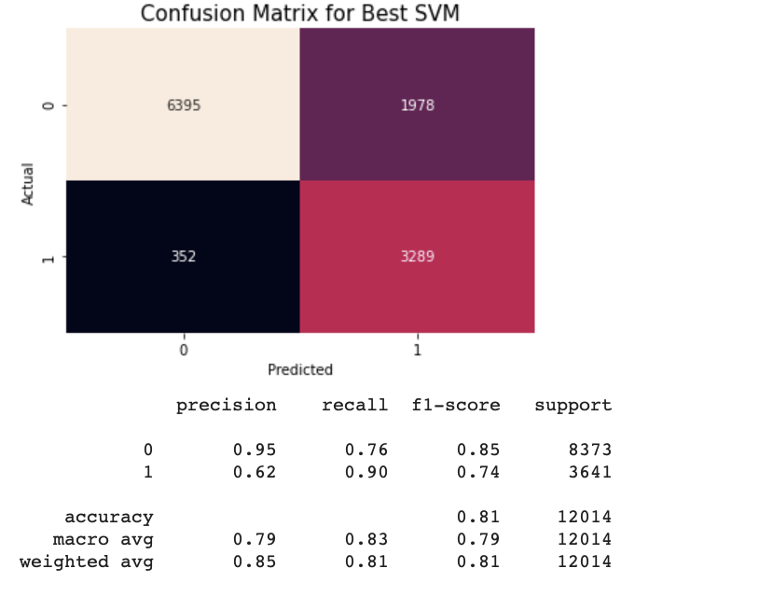
SVM (Best)
New (no outliers)
+ 12% accuracy, +17% specificity +1% recall
Great improvement + no overfitting (1% gap)

