Slide 1
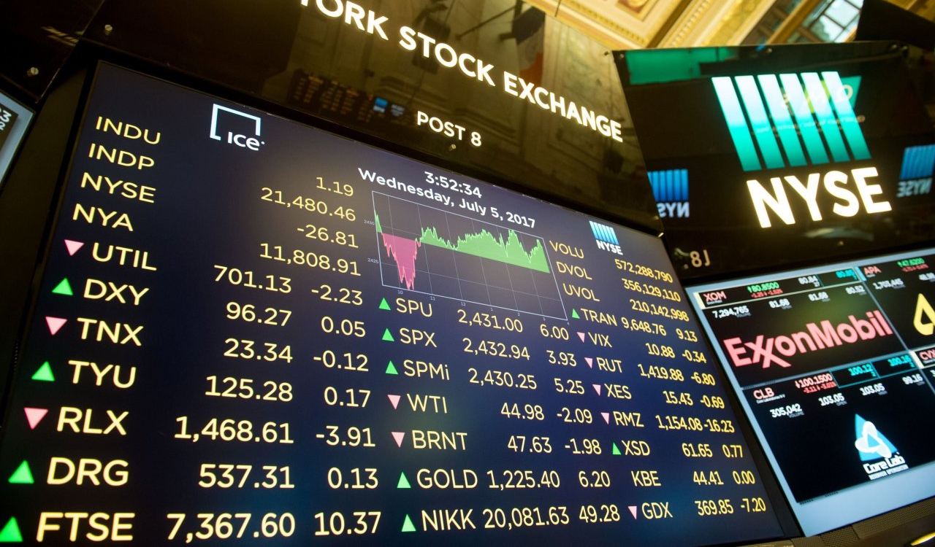
Chasing the Whale Portfolio Optimization Analysis using Whalewisdom Index
Team Members:
Connor Gross
Julas Hollie
Marcus Kim
Aaron Packard

Slide 2
Presentation Agenda
Introduction and Goal
Data Sources and Analysis
Results
Summary

Slide 3
Introduction and Goal
Introduction of Team 1 Members:
Connor Gross
Julas Hollie
Marcus Kim
Aaron Packard
Project goal:
Use SEC 13F filings and whalescores to build a model based on fund performance and investor sector weightings that will outperform the S&P 500 in annual return

Slide 4
Data Sources and Analysis
Baseline data:
Whalewisdom.com
Berkshire Hathaway – the holding company produced 15.5% return in 2019
Comparisons:
Gilder, Gagnon, Howe (GGHC)
Soros Fund Management
Tiger Global
Synyder Capital
Cypress
Valueact
Goodnow
Rice, James Hill
Breakdown of funds by the 11 investment sector weightings:
Materials - XLB
Industrials - XLI
Financials - XLF
Energy - XLE
Consumer discretionary - XLY
Information technology - XLK
Communication services - XLC
Real estate - XLRE
Health care - XLV
Consumer staples - XLP
Utilities - XLU

Slide 5
About Whalewisdom
Whalewisdon attempts to identify market managers that outperform the market on a consistent basis.
The group assigns, whalescores, to managers. Whalescores take into consideration risk measurements and returns to identify managers most likely to outperform the market.
There are minimum criteria required to be included:
No banks, trusts, insurance companies
Must manage a portfolio greater than $100 million
Holdings must be between 5 and 750

Slide 6
Part 1: Finding the optimized weightings
Two methods used:
Whalescores per quarter from Q2 2018 to Q2 2020
Average weightings per investor sectors
Notes:
Percentage (cumulative) chart by city – line chart
Top 5
Bottom 5

Slide 7
Part 2: Compare the results - Optimized
Comparing the exchanged-traded funds (ETFs)
Comparisons
Market vs Portfolio
Market vs Portfolio vs Other Individual Funds
Sharpe Ratio
Notes:
Line chart by property type + interest rates

Slide 8
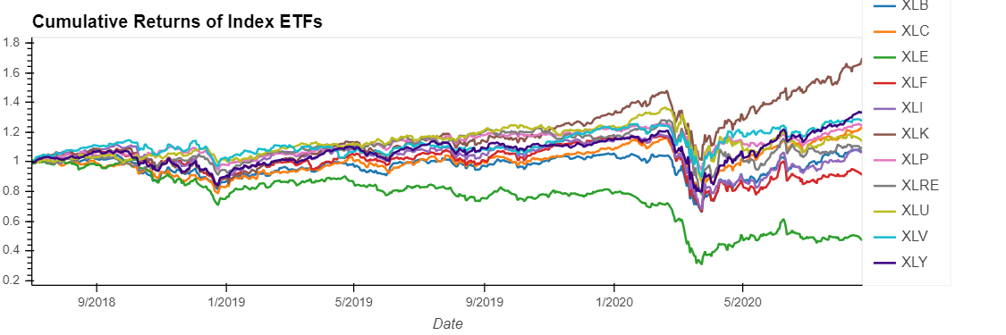
Part 2: Compare the Results Create a portfolio with index ETFs

Slide 9
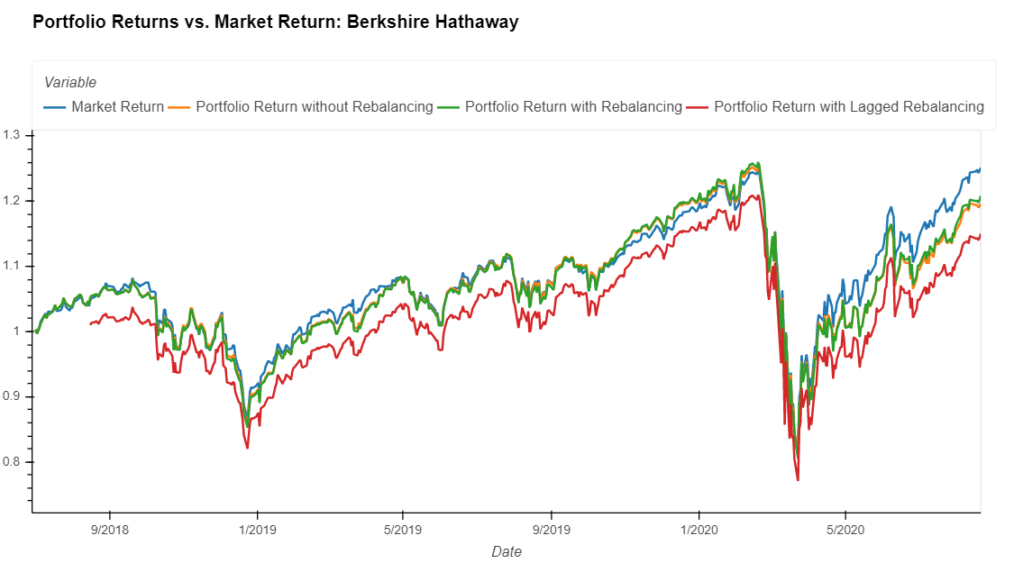
Part 2: Compare the Results
Berkshire
Notes:
Line chart by property type + interest rates

Slide 10
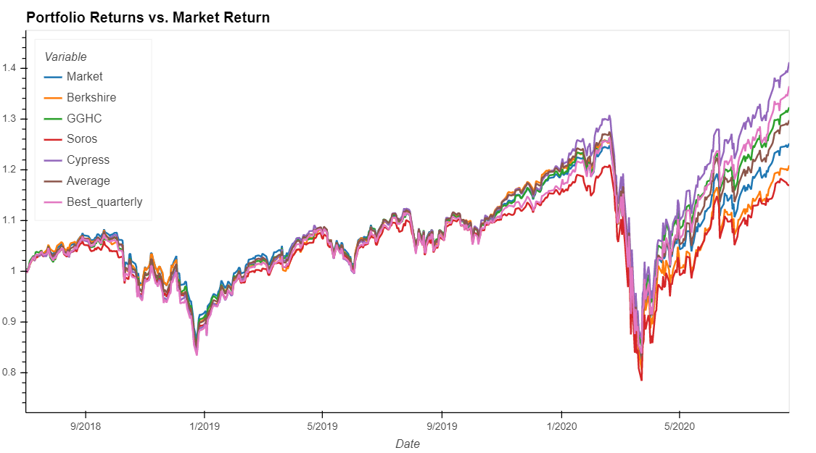
Part 2: Compare the Results Performance Comparison - 1

Slide 11
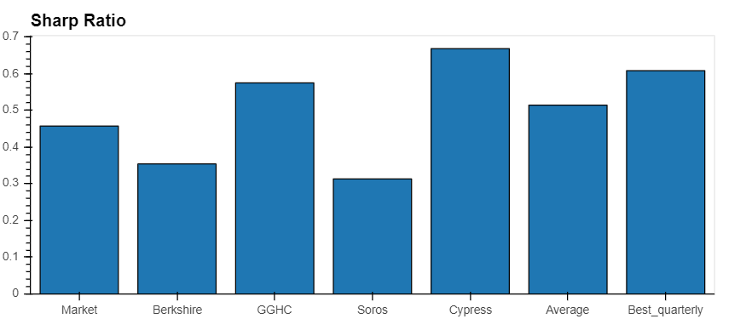
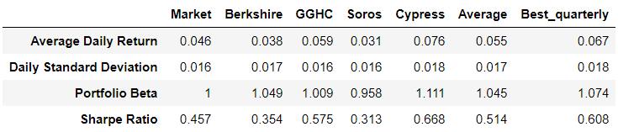
Part 2: Compare the Results Performance Comparison - 2

Slide 12
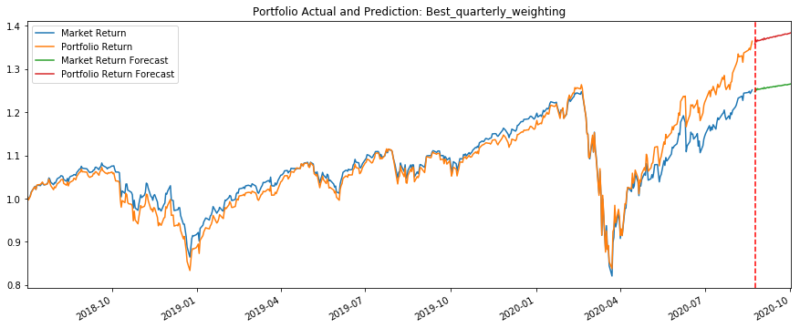
Machine Learning Prediction – ARIMA Model

Slide 13
Summary
Hypothesis
Conclusion
Identify top performing funds
Identify investment sector weightings for top performing funds
Create model to predict sector weightings for maximum annual return
Using sector ETFs combined using suggested sector weightings, compare quarterly and annual returns versus S&P 500
Creating a portfolio based upon best performing portfolio quarterly returns, we were able to beat market returns in most cases.
To build an optimized machine-learning model, more signal data is required.
Optimal investment can be made through replicating the sector weightings
Notes:
Property Feature
Affordable, luxury, etc.
Bubble chart real time walkthrough (switch to jupyter)

Slide 14
Questions
Notes:
Property Feature
Affordable, luxury, etc.
Bubble chart real time walkthrough (switch to jupyter)

