Slide 1


Candidate Name: Aryan
Email: aryan.2023y@gmail.com
Phone No. : +91 8102048291
Problem Statement: E-Commerce

Slide 2

Understanding of the problem statement
The dataset that has been provided is a dataset of E-commerce sales.
We are going to find the key metrics and visualize the dataset in order to gain a more comprehensive understanding of the dataset by identifying the key metrics.
By performing this task as a business manager, you provide insight into sales to the company, which can be used to make better decisions.

Slide 3
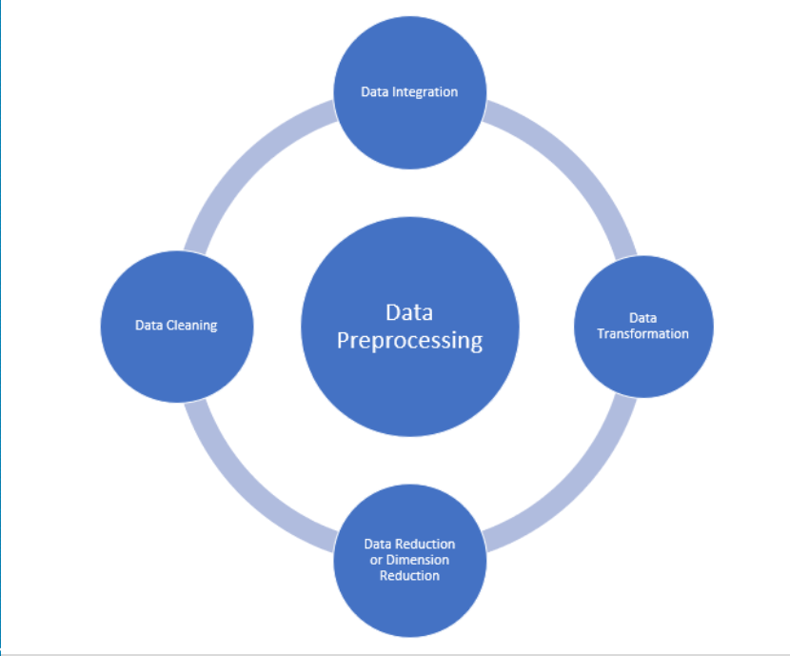
Approach
The first step is to understand the dataset.
Data pre-processing is the next step before the ingestion of data.
The next step is to analyse and visualize data and get valuable insights.
Visualizing and Analysing the data for finding profit based on States, Category, Monthly, Customer and other parameters.
Visualizing using different types of graphs to get insights into data, will lead to better decisions.
Use of clustering algorithms like K-means and Mean-Shift to detect different customer groups.

Slide 4


Flow of Steps
Exporting the data from Excel to CSV.
Cleaning of Data
Check the Shape of the Data
Check for NAs
Check Data Info
Check for Duplicate Data
Check for Outliers
Joining tables with common columns, the primary key is OrderID.
Finding profit and order count based on states and cities.
Quantity vs Category/Sub-Category.
Customer and Sales target Analysis.
Amount vs Quantity Clustering.
Correlation matrix of Amount, Profit, Quantity.

Slide 5
Final Solution
The approach used is in Colab notebook, having link-only access, i.e. anyone with the link can access the notebook for viewing.
https://colab.research.google.com/drive/1MJJEclQlrNTv2pNVJxIosmKXTCgSpbmf?usp=sharing

