Slide 1


Solution By: rux21
PSID: INTL-DA-07
Team Leader Name: Aryan

Slide 2

Idea Introduction
IDEA TITLE- BASELINE
Tech Stack
1. Java
2. Python(pandas and NumPy)
Resources Used:
112 emergency number historical dataset
Any Third Party API/Services used
Not yet
IDEA-OUTCOME – HEADLINE-
Nation wide geographical mapping to predict the crime/accidents prone regions accurately on the basis of verified historical data. This solution will be automated as it will keep getting updated based on future distress calls or reported incidents thus assisting the police with their jobs..

Slide 3
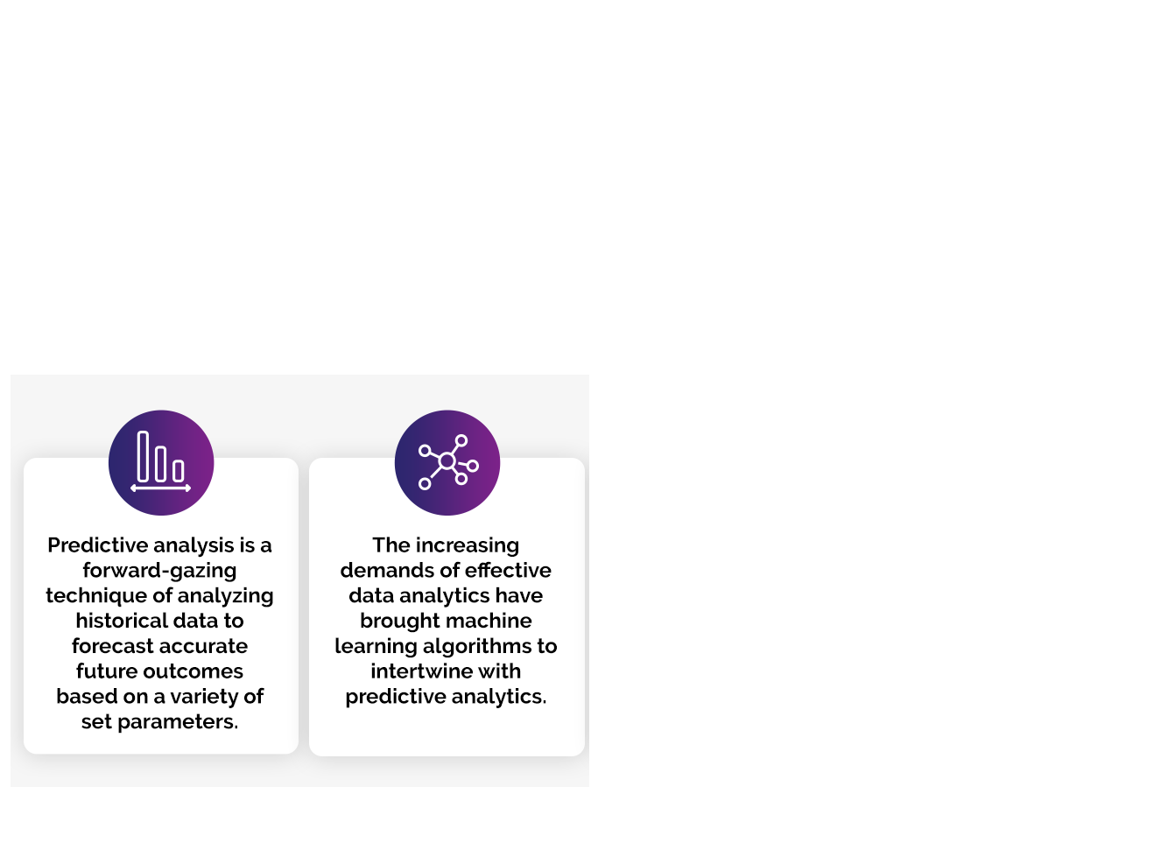


Your Approach Towards Idea
Approach in brief:
Calculate percentage of each crime annually and compare it to the average
of the same crime for the rest of the years; If it is significantly higher we
can predict it will happen again next year and accordingly rate them on
their likelihood of happening again based on severity of crime/event.
How you targeted the problem?
Using a statistical approach to compare percentages throughout the years
What Innovation or feature you added ?
Identifying patterns from the historical data to improve the model using ml techniques
Any functional requirement in further development? Complete and continuous data flow from the 112 emergency number database
Notes:
Use any image of your proposed solution here instead of this macbook image

Slide 4

Team Slide
Aryan
Team lead
Aditya Raj
Data cleaning and analysis
D Sree Harsha
Data mapping and analysis
G Tushar Vishnu Skandan Reddy
Improving Data collection and Data analysis
Dr V Keerthika
Team mentor

Slide 5
Development Pipeline
Any Third party API used, if yes please specify
Documents To be prepared for installation and evaluation
1. jdk(v1.8+)
2. Pandas library
3. Spreadsheet
4. NumPy library
Proposed Development Plan in pointers
1 Dataset cleaned.
2. Sorting crimes on the basis of frequency.
3. Parameters-Crime Severity & Monthly basis data.
Proposed UI and functional flow in pointers
1. Authenticate access
2. Enter city name
3. Display projected upcoming crime/event
4. Lists the steps for being prepared for projected event
Not Yet
Repository Link or Any references link of folders
Manthan2021 repo link (https://github.com/aa-ryan/manthan2021)
Step A
Step B
Step C
Step D
Step E

Slide 6
Vision of Innovation/Idea/Solution
Explain How you developed Idea
We analysed the sample dataset manually and identified the parameters for comparing the crime/event with the historical data and patterns on the small dataset; This gives us the confidence to replicate the same for a larger dataset.
How you idea is different and innovative form other ideas- a default comparison
We are mapping the patterns to the geographical location and will be taking continuous inputs from the 112 database to keep improving the model.
Any early stage innovation detected while developing the solution ?
Some of the data in 112 database is redundant/ it poisons the integrity of the rest of the data. Hence we cleaned it up accordingly. This includes non verifiable calls/event types & call for assistance in case of medical emergencies that cannot work as a parameter for data analysis.
How much time it will take in conversion as a final product ?
Once the model is proven, it can be scaled easily as the result will be monitored on a city to city basis.
The estimated time for development and testing is 12-18 months.

