Slide 1
Customer Churn Prediction Using Machine Learning
CSCE 5215 MACHINE LEARNING
DR. TYMOSHCHUK
GROUP 2
AMRIT ADHIKARI
SON DANG
BOB JACK
CRISTA KINGSLY

Slide 2
What is churn? Why does it matter?
When a customer cancels or stops using a service
“It costs 5 - 25x more to get a new customer than to retain an existing one” (Gallo, 2014)
Churn can be voluntary (switching providers) or involuntary (non-payment, inactivity)
Early prediction allows proactive retention

Slide 3
Project Goals
Predict which customers are likely to churn using machine learning
Understand which features most influence customer churn behavior
Compare multiple classification models for performance and reliability
Evaluate models using real-world metrics like recall, F₁ score, and ROC-AUC
Provide insights that telecom companies can use to reduce churn and retain customers

Slide 4
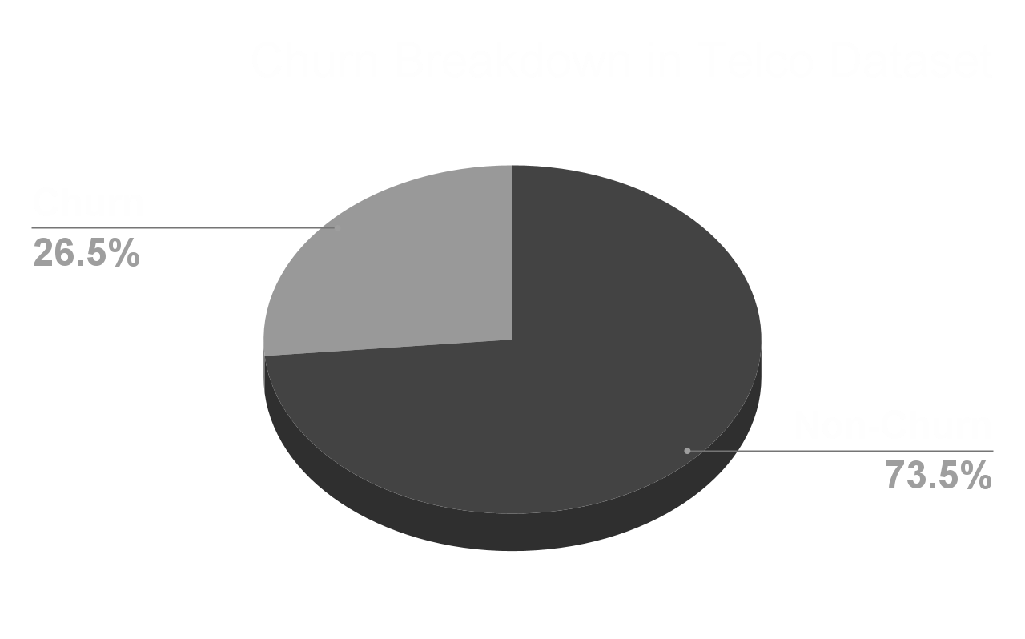
Dataset Overview
Source: Telco Churn Dataset (Kaggle)
~7,000 customers, 21 features
Binary target: Churn (Yes/No)

Slide 5
Data Preprocessing
Dropped customerID, converted TotalCharges to numeric
Label encoding for categoricals
Scaled numeric features, mean = 0 | std = 1
Class imbalance handled with class_weight = ‘balanced’

Slide 6
Exploratory Data Analysis (EDA)
Tenure and Contract highly linked to churn
Month-to-month leads to more churn
High charges means slight churn trend

Slide 7
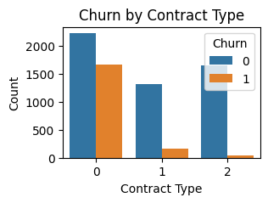
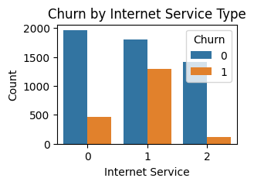
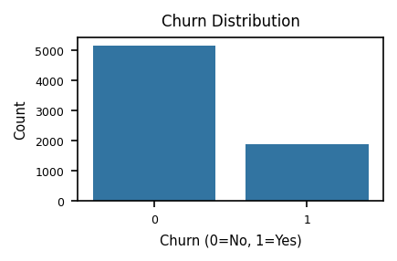
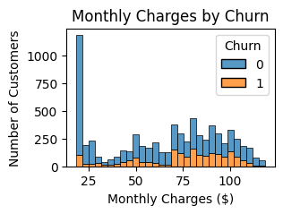
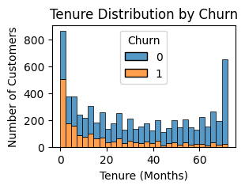
Exploratory Data Analysis (EDA)

Slide 8
Modeling Approach
Four models:
Advanced Models
Logistic Regression
Decision Tree
Split 80/20
Used Stratified K-Fold Cross-Validation
Random Forest
XGBoost
Baseline Models
Train-Test Design

Slide 9
Evaluation Metrics
Accuracy, Precision, Recall, F₁ Score, and ROC-AUC
More importance with Recall and F₁ Score due to imbalance
Class imbalance (73.5% non-churn, 26.5% churn) makes accuracy look good even if churners are missed
High Recall and strong F₁ score mean better real-world performance

Slide 10
Evaluation Results
Model | Accuracy | Precision | Recall | F₁ Score
Logistic Regression (Churn) | 0.79 | 0.63 | 0.48 | 0.55
Logistic Regression (Non-Churn) |  | 0.83 | 0.90 | 0.86
Decision Tree (Churn) | 0.78 | 0.58 | 0.54 | 0.56
Decision Tree (Non-Churn) |  | 0.84 | 0.86 | 0.85
Random Forest (Churn) | 0.73 | 0.49 | 0.78 | 0.60
Random Forest (Non-Churn) |  | 0.90 | 0.71 | 0.80
XGBoost (Churn) | 0.77 | 0.54 | 0.70 | 0.61
XGBoost (Non-Churn) |  | 0.88 | 0.79 | 0.83

Slide 11
Confusion Matrix Results
Model | True Pos. | True Neg. | False Pos. | False Neg.
Logistic Regression | 178 | 106 | 935 | 190
Decision Tree | 200 | 146 | 895 | 168
Random Forest | 287 | 297 | 744 | 81
XGBoost | 257 | 216 | 825 | 111

Slide 12
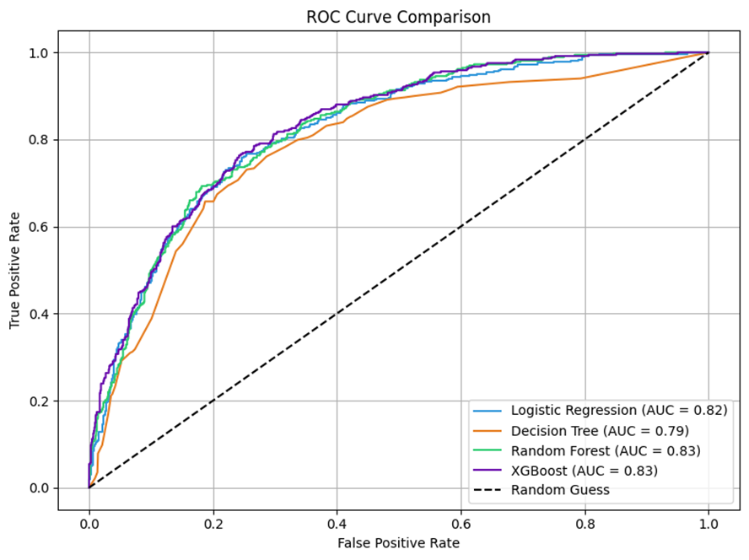
ROC Curve Comparison
ROC curves show each model’s ability to separate churners from non-churners
AUC (Area Under Curve) closer to 1.0 = better model performance
XGBoost and Random Forest had the highest AUC scores (~0.83)
Both significantly outperformed baseline models (Logistic & Decision Tree)
Indicates strong predictive power even with class imbalance

Slide 13
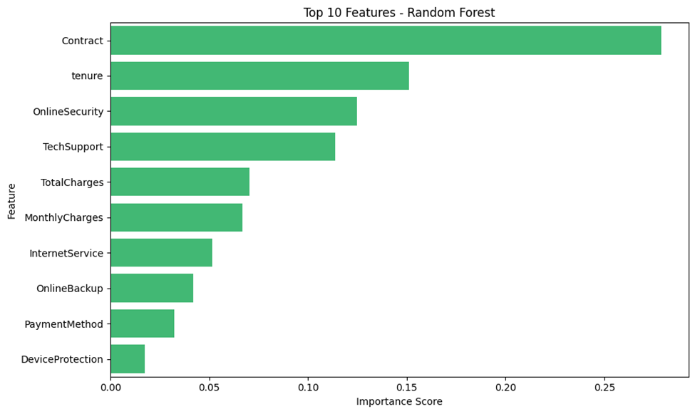
Feature Importance
Contract type was the top predictor of churn risk
Tenure showed that short-term customers were more likely to leave
OnlineSecurity and TechSupport ranked high. It suggests support quality impacts retention
Monthly charges and Total charges played a role, but less critical than service-related features

Slide 14
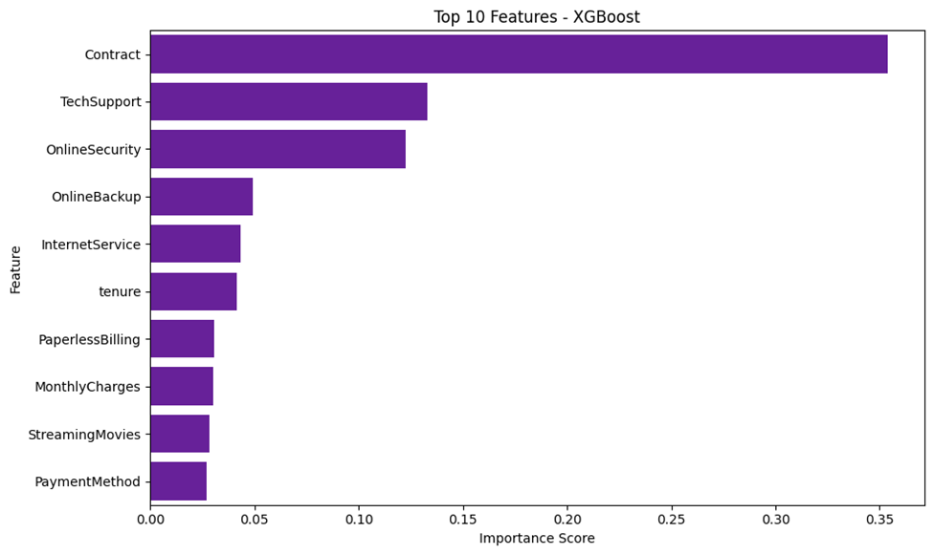
Feature Importance
Contract type was the top predictor of churn risk
Tenure showed that short-term customers were more likely to leave
OnlineSecurity and TechSupport ranked high. It suggests support quality impacts retention
Monthly charges and Total charges played a role, but less critical than service-related features

Slide 15
References
Gallo, A. (2014, October 29). The value of keeping the right customers. Harvard Business Review. https://hbr.org/2014/10/the-value-of-keeping-the-right-customers

Slide 16
Thank You!
Group 2
QUESTIONS?

